Slide 1
SENSEI Hacking
Burlen Loring
Lawrence Berkeley National Lab

Slide 2
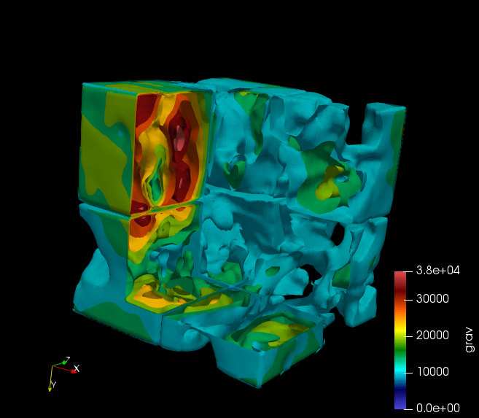
SENSEI Nyx
Tested SENSEI+Nyx. Added Makefile code to Nyx
Fixed build bug in AMReX
Fixed VTK, Python, & Catalyst SENSEI installs on cori (Libsim will be fixed soon)
Did parallel run on cori
Started Particle adaptor
Dug into block interface bug

Slide 3
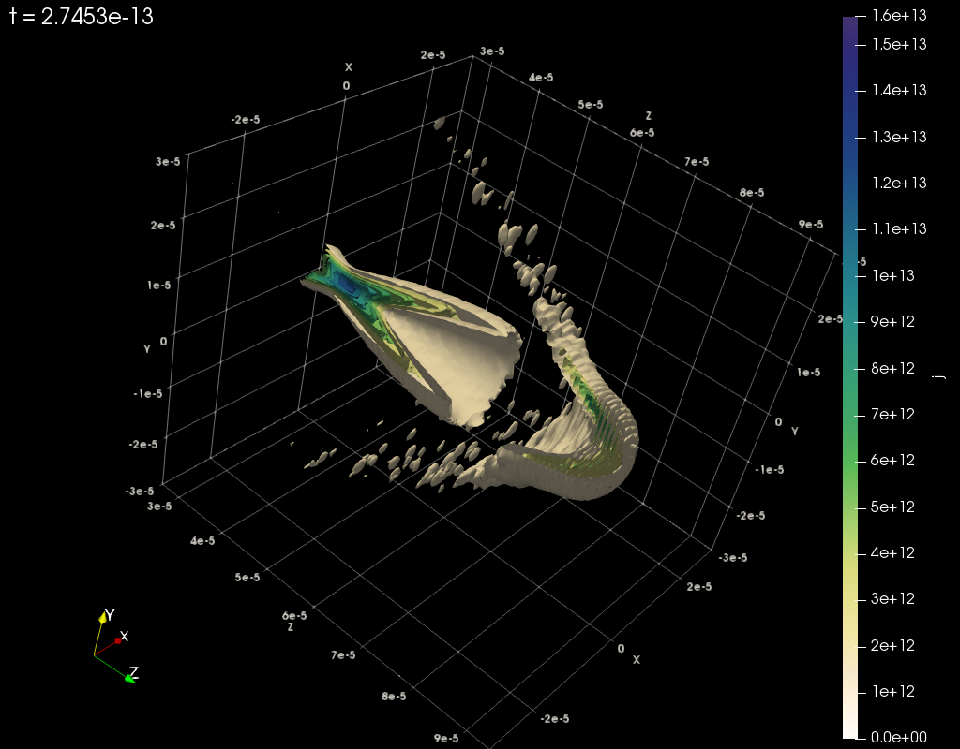
SENSEI WarpX
Work with Lixin on config and builds
Made runs on cori with updated installs

Slide 4
SENSEI In transit
Installed sensei 3 in transit branch w/ Estelle
Tested w/ her use case (1 sender many receiver)
Reported 2 bugs. MPI Comm not passed to Catalyst, Flex path mpi rank to block ratio

Slide 5
SENSEI + Sight
Got SENSEI compiled & running with Catalyst + EGL (Thanks Dave D)

