Slide 1
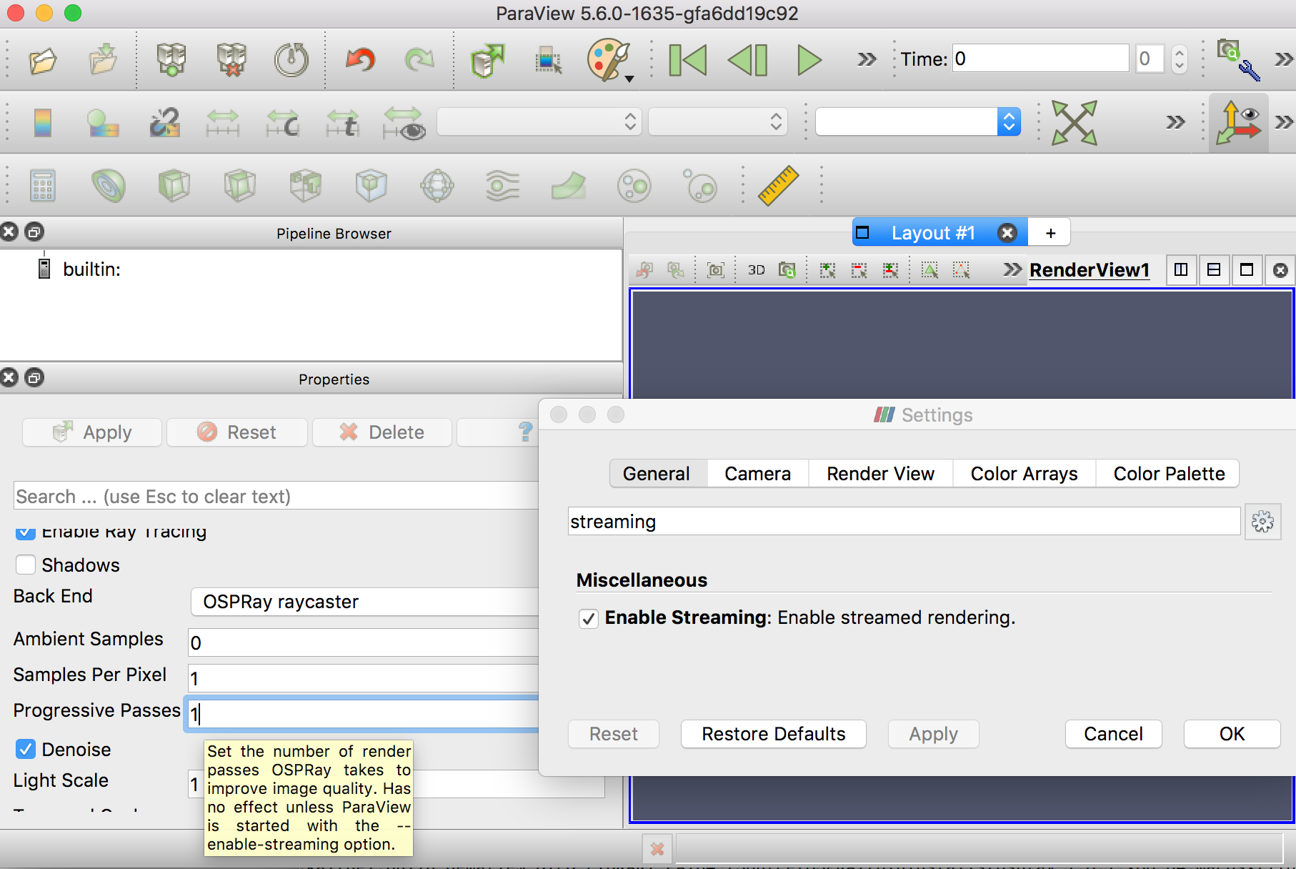
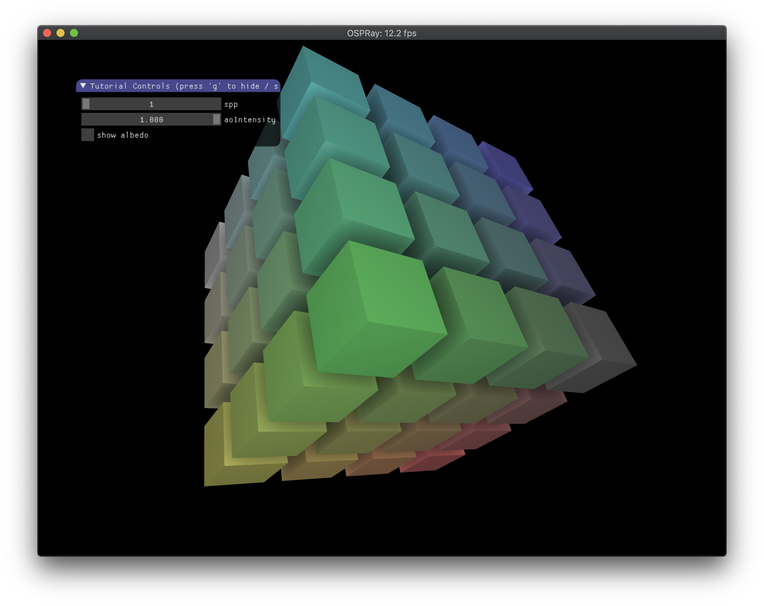
ParaView OSPRay GUI revamp
Carson Brownlee, Dave Demarle, Jeff Amstutz
Plan for next gen (OSP 2.0) PV 6.0 GUI
Designed simplified user controls renderer settings
  MR for runtime streaming switching
  OSPRay level Prototype for basic shading modes (AO no lights) in OSPRay 2.0
  Early prototype preset modes in PV GUI
Discussed missing feature support
Discussed new path traced volume rendering controls
Debugged mac linking issues with 1.8.5

