Slide 1
MPM Particle Sim + Galaxy
Krisha Kumar, University of Texas at Austin
Dave Semeraro, TACC
Greg Abram, TACC

Slide 2
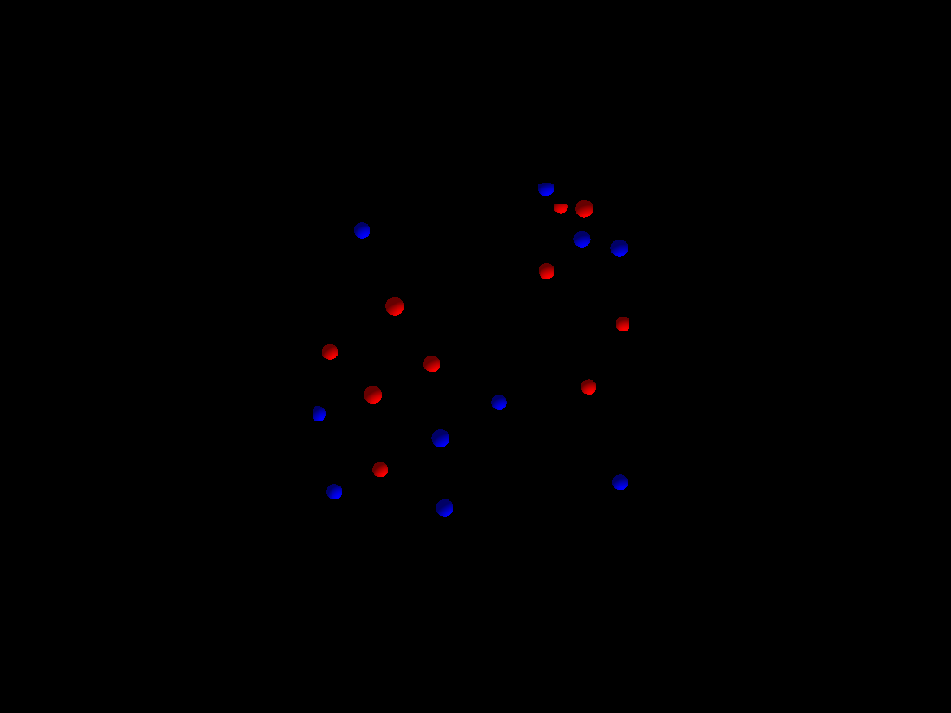
MPM Particle Code
Use Galaxy to render particles in parallel.
Create randomly placed particles and render in parallel using Galaxy
Call Galaxy functions from MPM code.

Slide 3
Issues
MPM’s partitioning of the computational space is unstructured. Galaxy assumes structured partitioning. Extend Galaxy to support limited unstructured partitioning.
  Galaxy’s reliance on structured partitioning is easily extended
  Volume rendering in unstructured spaces supported at OSPRay level
Plans for MPM envision re-partitioning for load balancing. Galaxy assumes fixed partitioning. Extend Galaxy to support changing partitioning.
MPM particle distribution is independent of partitioning. Particle contribution to computational grid requires communication. Galaxy assumes all geometry for a partition is co-located. Modify NPM to co-locate particles in partitions; add periodic re-partitioning based on movement of particles through computational space

Slide 4


