Slide 1
Cinema
Results from In-Situ Hackathon
David Rogers – Los Alamos National Laboratory

Slide 2
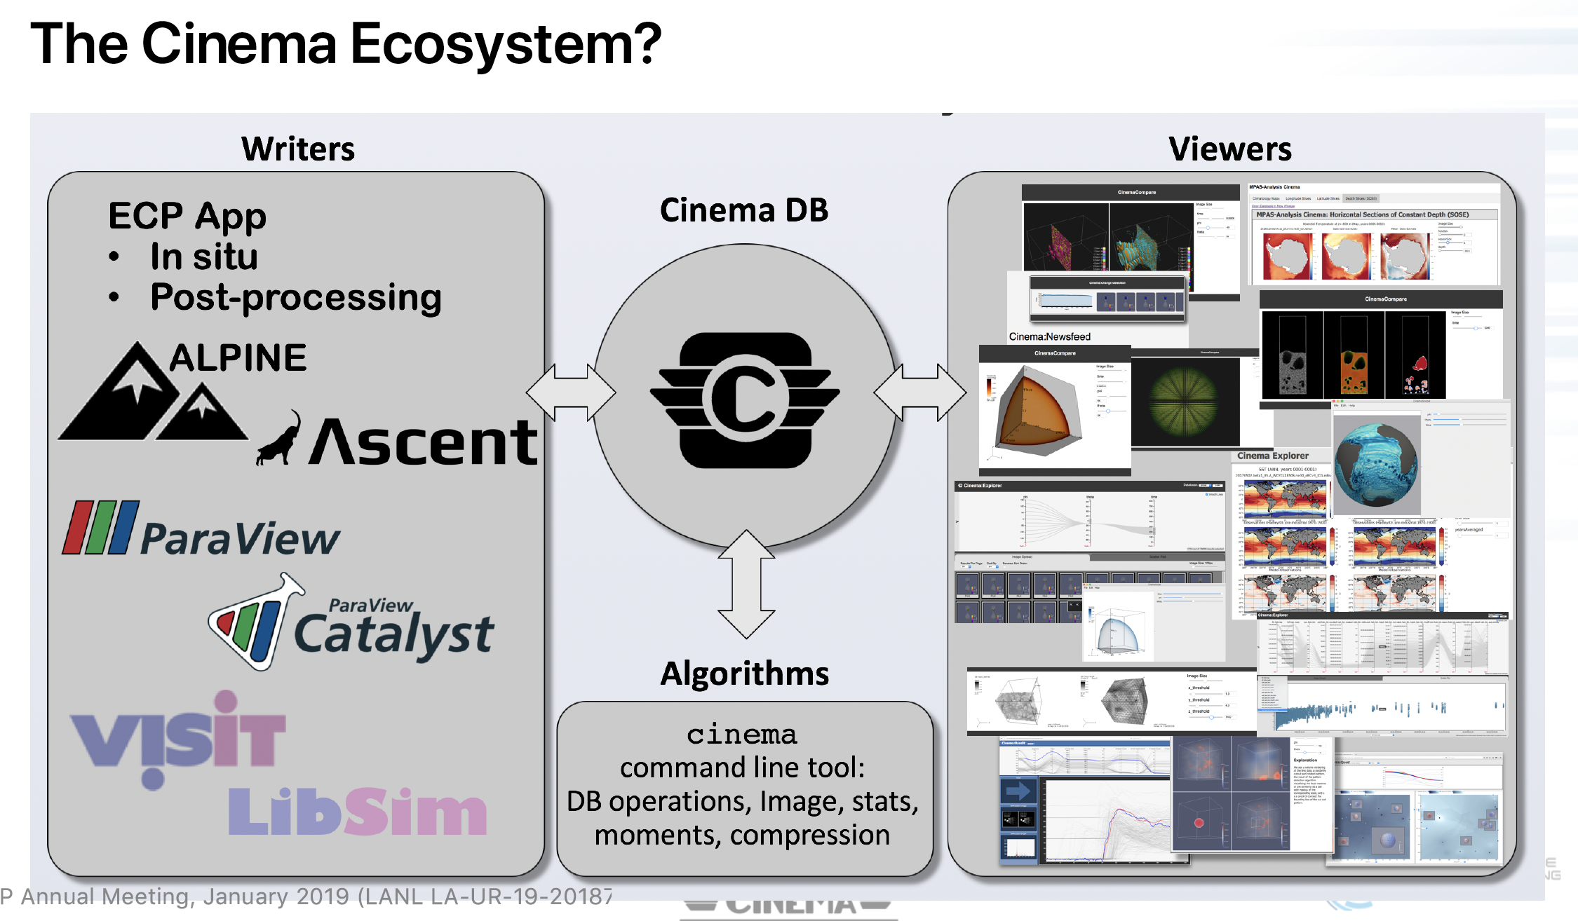

Slide 3
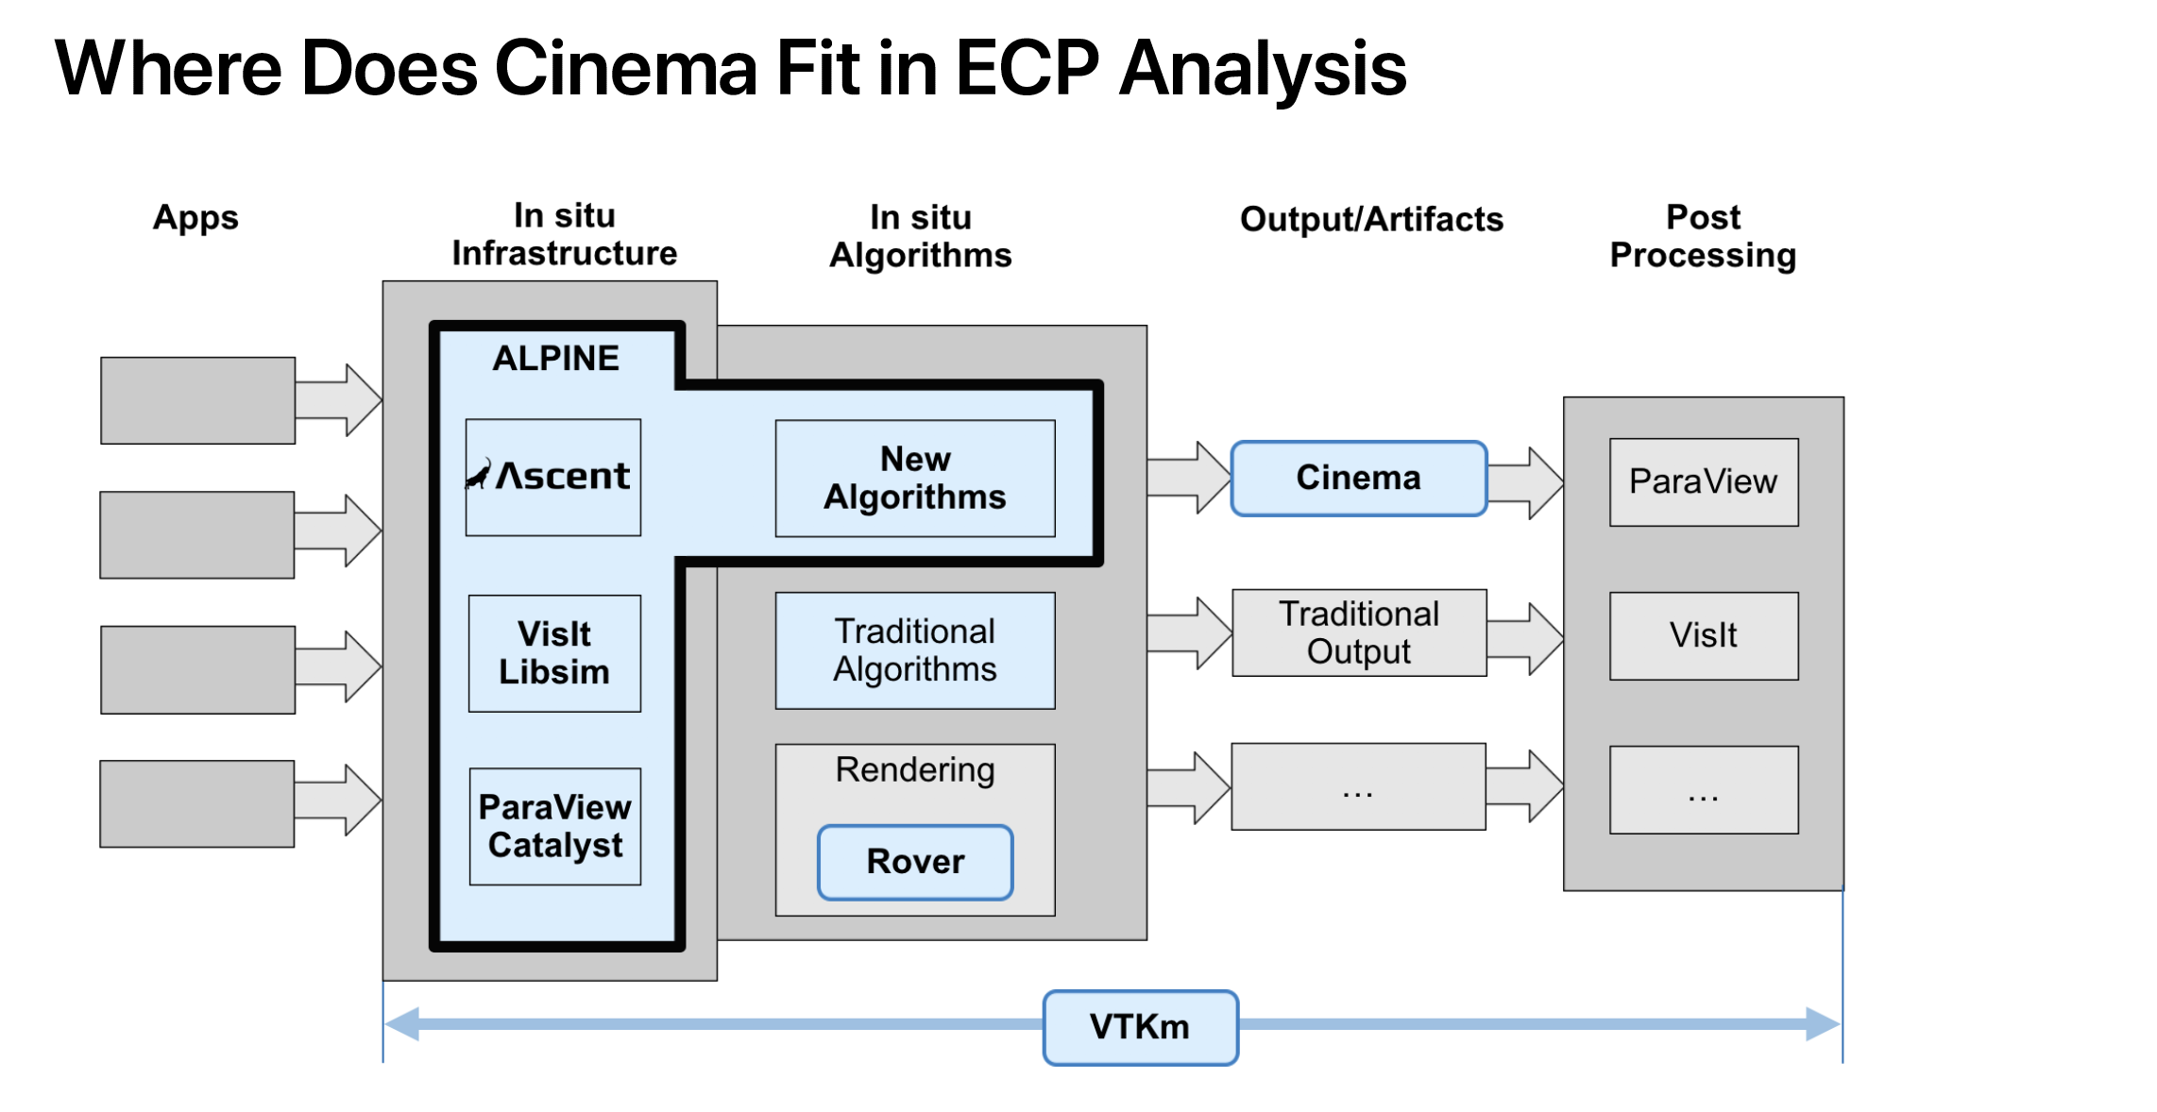

Slide 4
This week:
Answering questions about cinema database and viewers
  Github.com/cinemascience
  Cinemascience.com
Begin discussion about how we can help with ASCENT’s Cinema capabilities
Exercising new export capabilities in upcoming ParaView release (5.7)
Standardizing on image types exported from ParaView and VisIt
  Standard image types
  OpenEXR for Cinema-specific data products

