Slide 1
Enabling Multi-level Network Modeling in Structural Simulation Toolkit (SST) for Next-Generation HPC Network Design Space Exploration
Sai Chenna, Nalini Kumar, Leonardo Borges, Michael Steyer, Philippe Thierry, Maria Garzaran
HPC AI Software Solutions Engineer Intel Corporation
Notes:
1. Hello everyone, I’m Sai Chenna

Slide 2
Outline
Introduction
Structural Simulation Toolkit (SST)
Infrastructure for Network Modeling
Modeling Multi-level Networks in SST
Building the topology
Routing
Simulation Results
Experimental Setup
Motifs
Analysis
Conclusions and Future Work

Slide 3
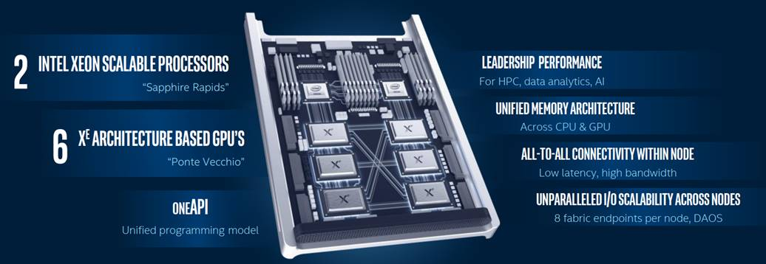
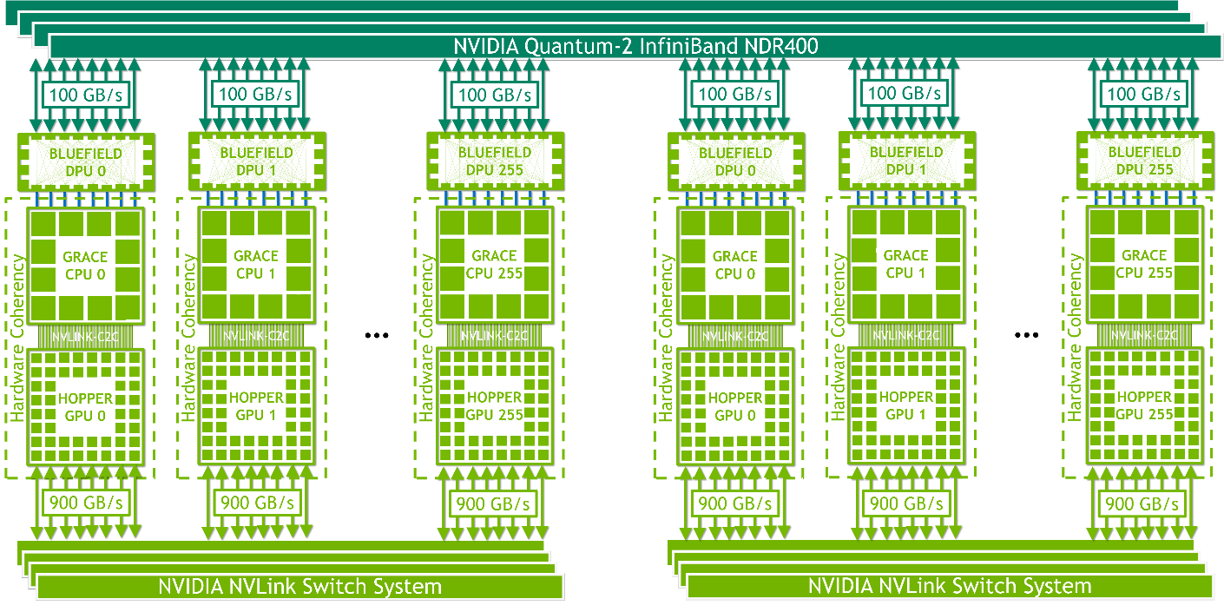
Introduction
Increasing complexity of nodes & systems – leading to hierarchical networks
E.g., Aurora, Grace-Hopper
Current modeling tools do not support multi-level network modeling
Crucial for system co-design
Contribution:
Adding support for multi-level network modeling in SST – parallel DES simulator
Evaluation of our modeling approach on a two-level network system
Aurora Compute Node
Image courtesy: https://www.hpcwire.com/2020/11/17/intel-xe-hp-gpu-aurora-exascale-development/
Nvidia HGX Grace Hopper with NVLink Switch
Image courtesy: https://resources.nvidia.com/en-us-grace-cpu/nvidia-grace-hopper

Slide 4
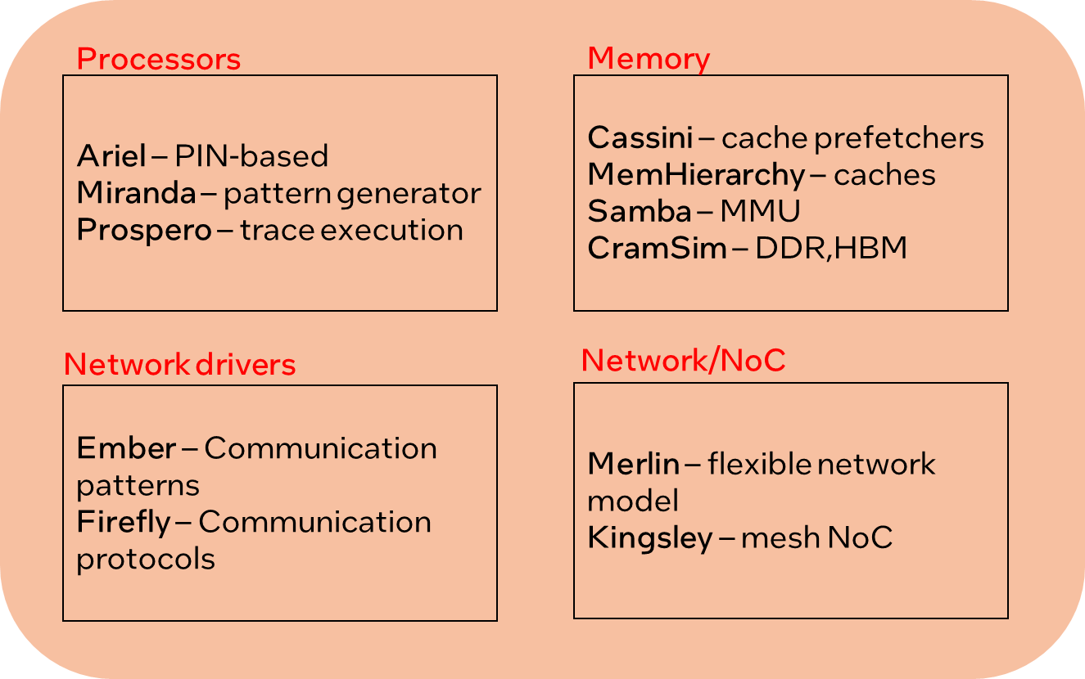
Structural Simulation Toolkit (SST)
Component
Component
Component
Component
Scalable, parallel DES* aimed to simulate large-scale systems
Developed by Sandia National Laboratories (http://sst-simulator.org/ )
Key Features
Scalability
Uses MPI for graph partitioning to enable million + component simulation
Multi-scale
Provides both simple and detailed (~ cycle) models for memory, compute and network components
Inter-operability
Provides support to integrate third-party component models
E.g., gem5, GPGPUSim etc..
Open-source, modular and easily extendable
Key Components
SST-Core: Simulation Backend
Takes care of simulation startup, component partitioning, event passing etc..
SST-Elements: Library containing detailed component models
E.g.: Merlin (router), DRAMSim2 (memory), Ariel (CPU)
Integration Services
SST Core
MPI and C++ Threads
Image courtesy: Sandia National Laboratories
(http://sst-simulator.org/SSTPages/SSTTopDocTutorial/)
* Discrete Event Simulator

Slide 5
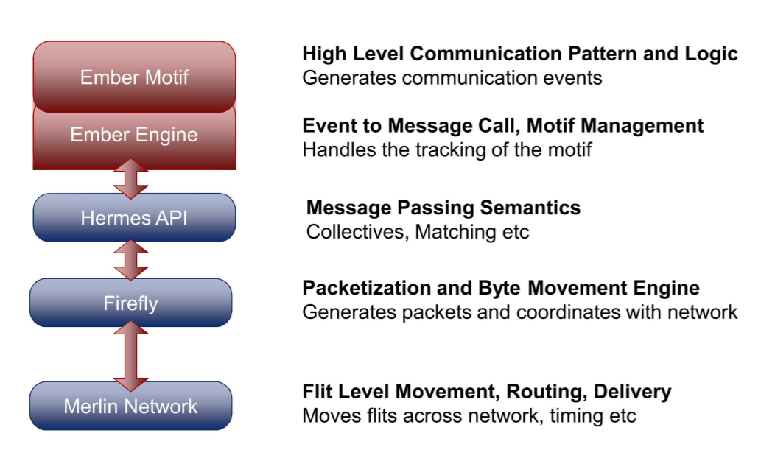
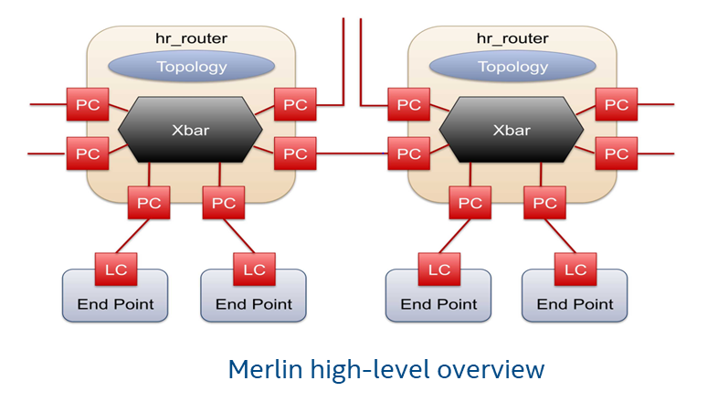
SST: Infrastructure of Network Modeling
Ember
Network traffic generator based on application communication patterns
Packages HPC comm patterns as motifs
Provides a collection of diverse HPC comm patterns
Firefly
Interface b/w network driver (Ember) and the router models (Merlin)
Provides packetization and byte movement engine
Implementation of communication protocols
Merlin
Provides low-level, flexible networking components to simulate high-speed networks
Models flit-level movement, physical routing and delivery of packets
Supported topologies – Fat-tree, Dragonfly, N-dimension Torus
SST Network modeling stack
Image courtesy: Sandia National Laboratories (https://www.osti.gov/servlets/purl/1513506)
Image courtesy: Sandia National Laboratories (https://www.osti.gov/servlets/purl/1513506)

Slide 6
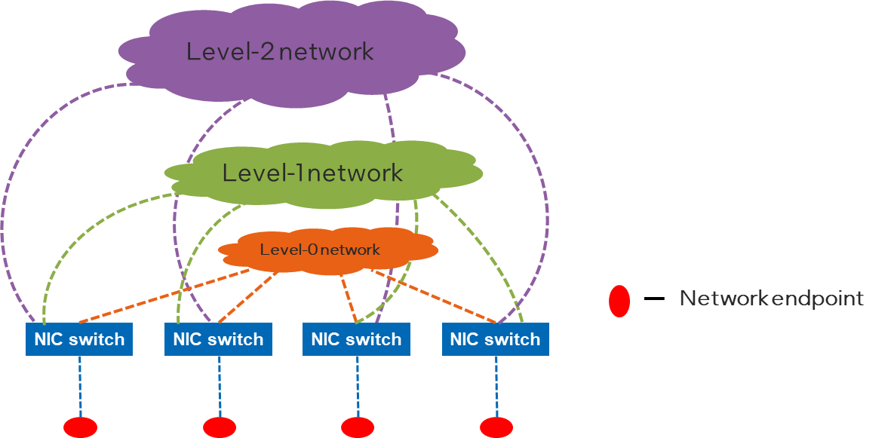
SST: Modeling Multi-level Networks
Multi-level networks(MLNs) provide higher path diversity in addition to low latency high BW communication
Modeling MLNs in SST requires two steps:
Building the topology – instantiating router models and establishing SST links b/w routers and endpoints
Routing – instantiate the topology sub-component class which determines the routing policy(ies)
Each network endpoint is connected to multiple network levels through a NIC module (switch)
Modular design:
Each network level contains multiple network topologies
Plug-n-play design to facilitate network DSE
Current implementation supports a three-level network
Level – 0 (intra-node) network
Level – 1 (inter-node) network
Level – 2 (inter-cluster/inter-pod) network
Multi-level Network System

Slide 7
Experimental Setup
Level 0 (intra-node) Topology
Topology | Fully connected (single switch)
Node size | 2,4,8,16,32
Link Bandwidth | 256 GB/s
Link Latency | 1 ns
Level 1 (inter-node) Topology
Topology | 2-D HyperX
Shape | (2,2),(2,4),(2,8),(2,16),(2,32),(4,2),(4,4),(4,8),(4,16),(8,2),(8,4),(8,8),(16,2),(16,4),(32,2)
Width | 1X1
Routing | Dimension Order Routing (DOR)
Link Bandwidth | 128 GB/s
Link Latency | 11 ns
Communication Pattern
Motifs | Halo2D, Halo3D, Sweep3D
Collective | Allgather, Allreduce, Alltoall
Iterations | 10
Message size | 1kB,2kB,4kB,16kB*,64kB
Performance metric | Performance metric
Simulated time = $time spent in MPI communication$
Inter-node traffic = $\frac{\# of packets entering inter−node network}{total \# of packets}$ | Inter-node traffic = $\frac{\# of packets entering inter−node network}{total \# of packets}$
* Simulation results have been shown for 16kB message sizes

Slide 8
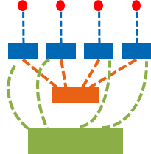
Modeling Multi-level Networks: Two-level Network
Intra-node: Fully connected
Inter-node: 2-D HyperX (8,4)
Node-size: 4
Node-count: 32
endpoint
endpoint NIC
intra-node switch
inter-node switch
Two-level network with 128 endpoints

Slide 9
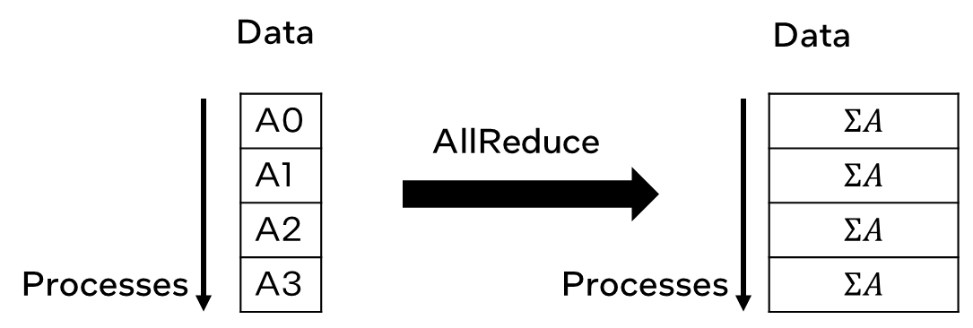
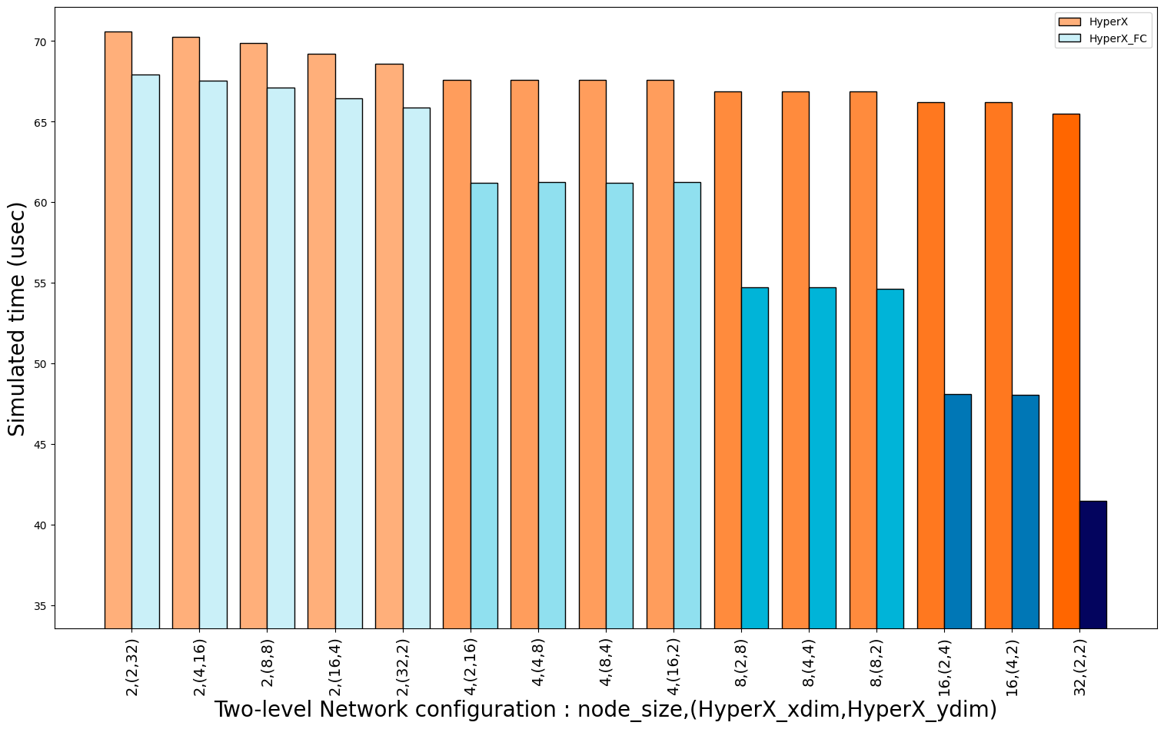
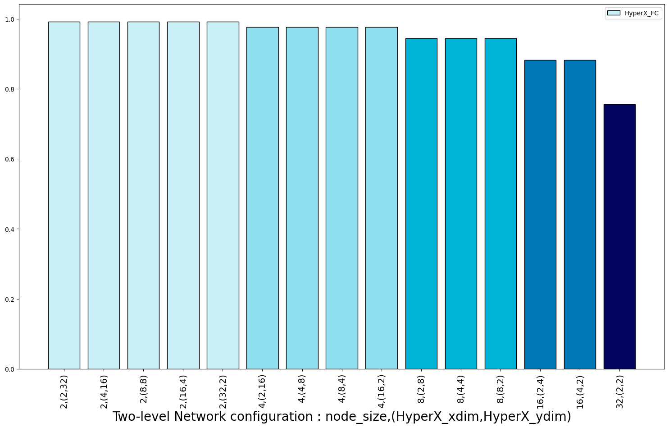
Simulation results: Allreduce
Tree-based algorithm
2LogP communication stages
Observation – Improved performance in two-level network
Performance gain significant in case of denser nodes – more endpoints per node
Collectives involve each process communicating with a group of processes – less spatial locality
Not a significant reduction in inter-node traffic
Allreduce
Allreduce
Allreduce
Inter-node traffic
Results have been estimated or simulated

Slide 10
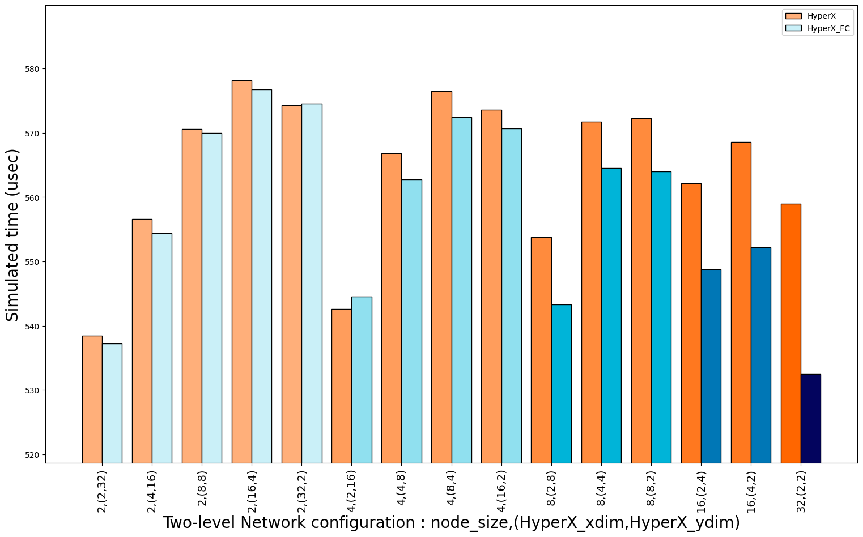
Simulation results: Alltoall
P-1 communication stages
Observation – Improved performance in two-level network
Performance gain significant in case of denser nodes – more endpoints per node
Collectives involve each process communicating with a group of processes – less spatial locality
Not a significant reduction in inter-node traffic
Alltoall
Alltoall
Alltoall
Inter-node traffic
Results have been estimated or simulated

Slide 11
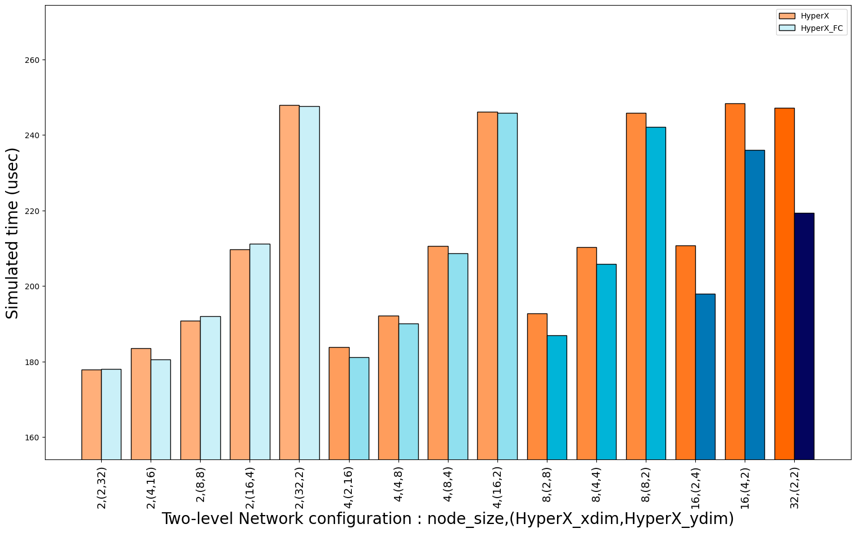
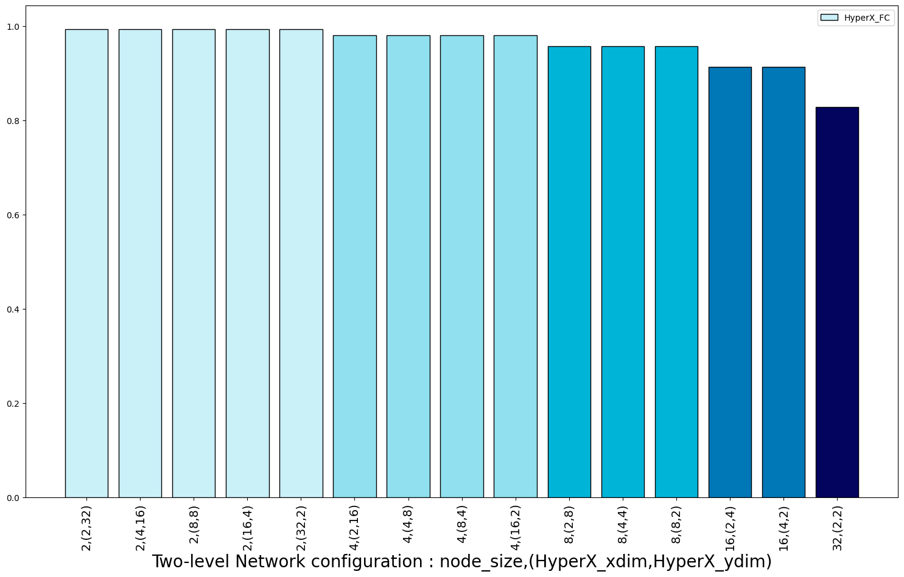
Simulation results: Allgather
LogP communication stages
Observation – Improved performance in two-level network
Performance gain significant in case of denser nodes – more endpoints per node
Collectives involve each process communicating with a group of processes – less spatial locality
Not a significant reduction in inter-node traffic
Allgather
Allgather
Allgather
Inter-node traffic
Results have been estimated or simulated

Slide 12
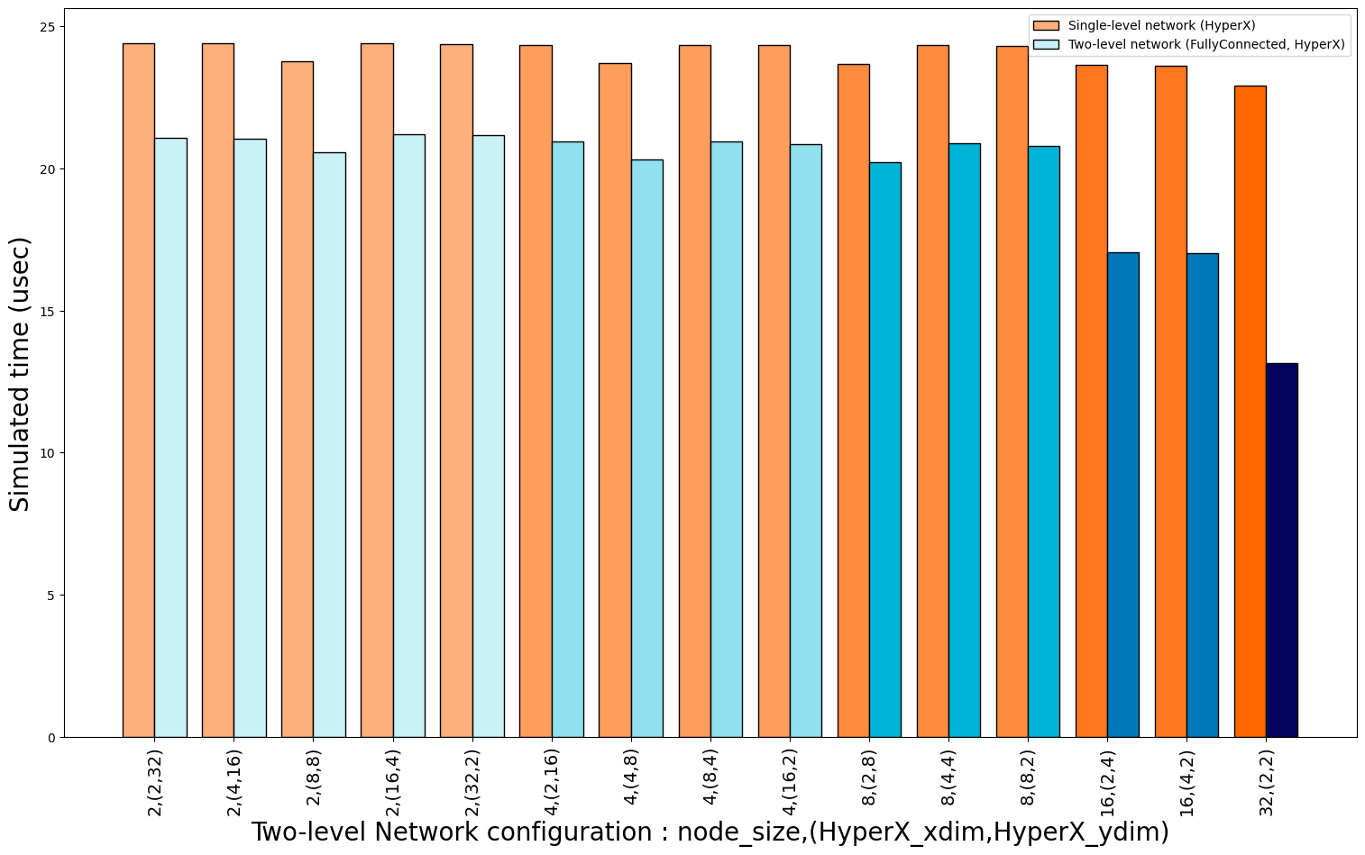
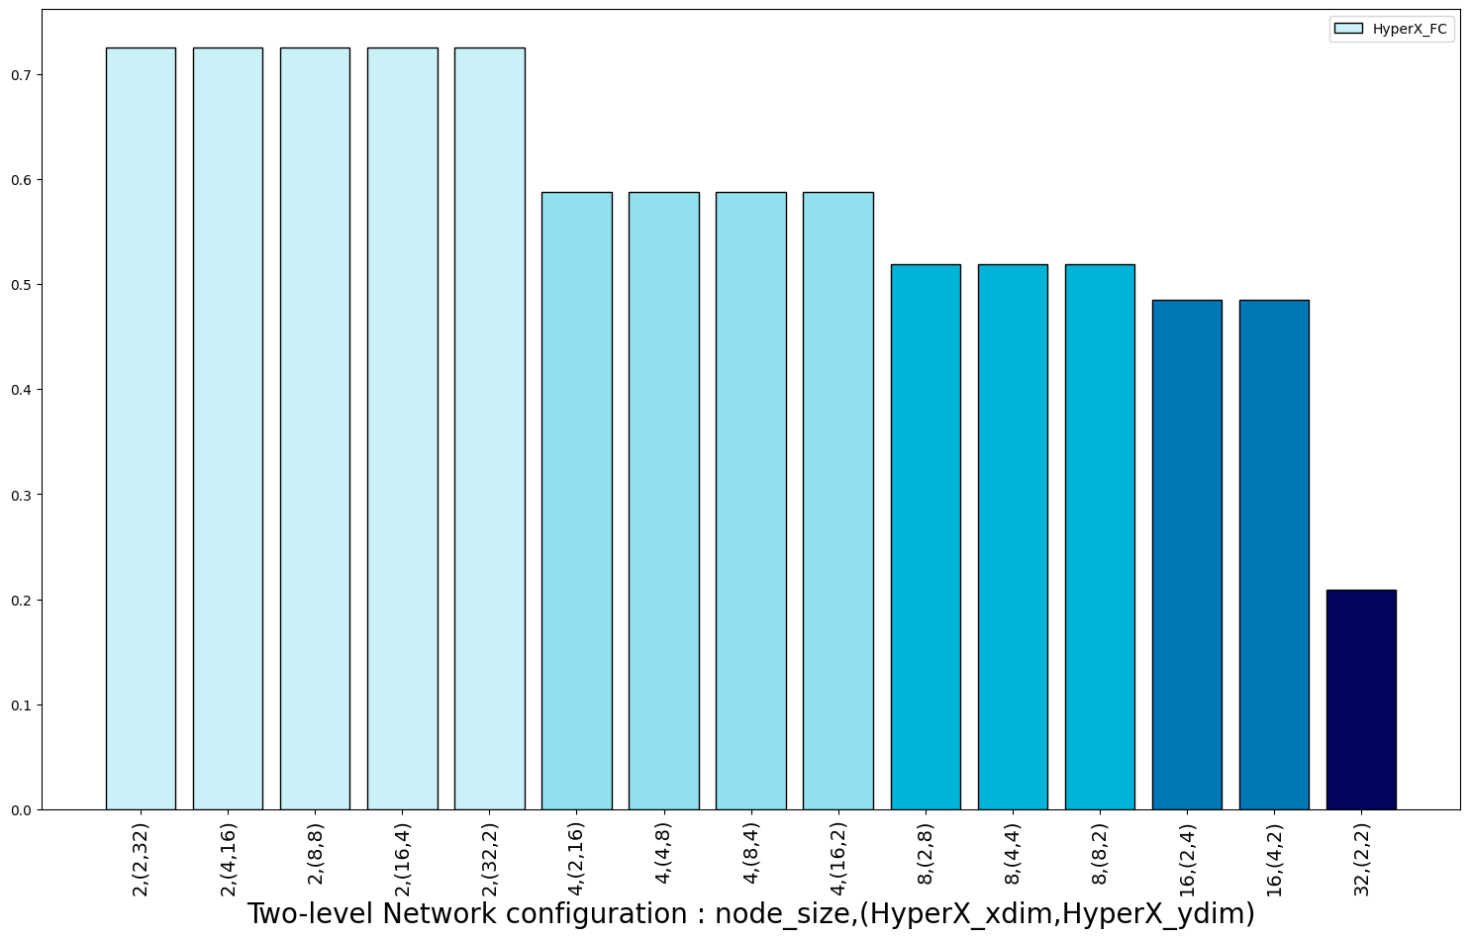
Simulation results: Halo2D
0
1
2
3
Models a 2D Halo exchange
Near neighbor communication
Uses Blocking Send/Recv pair
Observation – Improved performance in two-level network
Performance gain significant in case of denser nodes – more endpoints per node
Inter-node traffic accounts only for 20% in case of 32 endpoint-node
4
5
6
7
8
9
10
11
12
13
14
15
Halo2D communication
Halo2D
Halo2D
Inter-node traffic
Results have been estimated or simulated

Slide 13
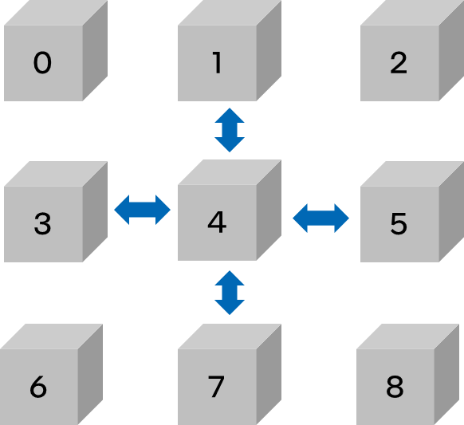
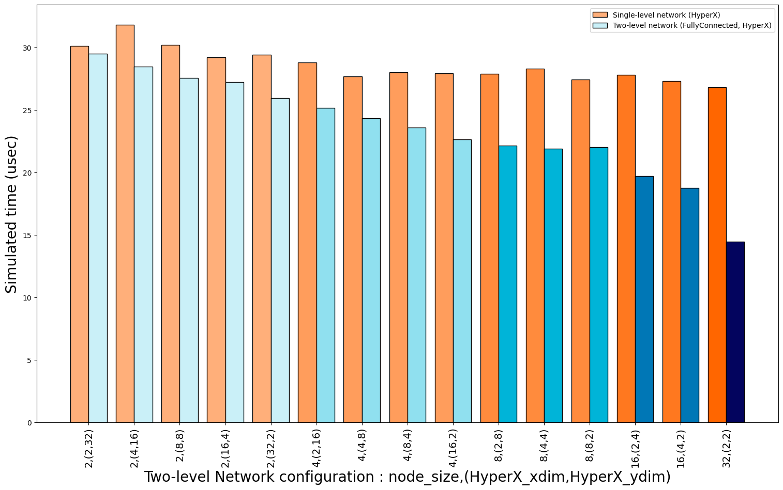
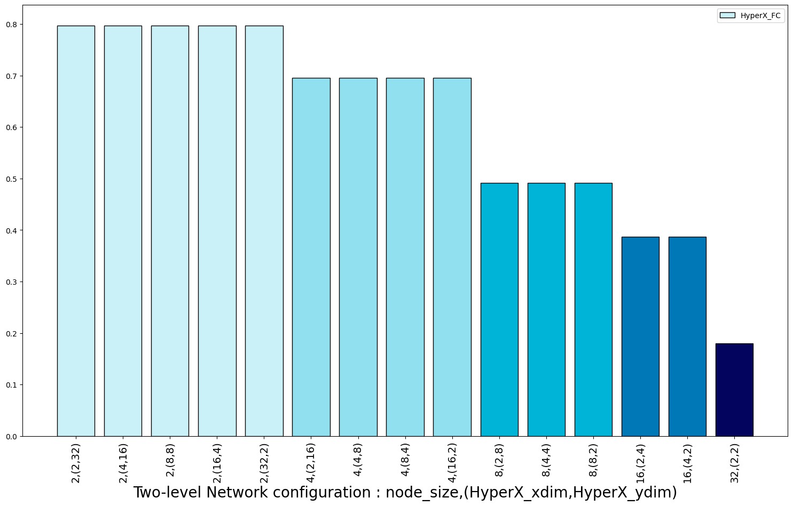
Simulation results: Halo3D
Models a 3D blocking Halo exchange
Near neighbor communication
Uses Irecv/Send pair
Observation – Improved performance in two-level network
Performance gain significant in case of denser nodes – more endpoints per node
Inter-node traffic accounts only for 20% in case of 32 endpoint-node
Halo3D communication
Halo3D
Halo3D
Inter-node traffic
Results have been estimated or simulated

Slide 14
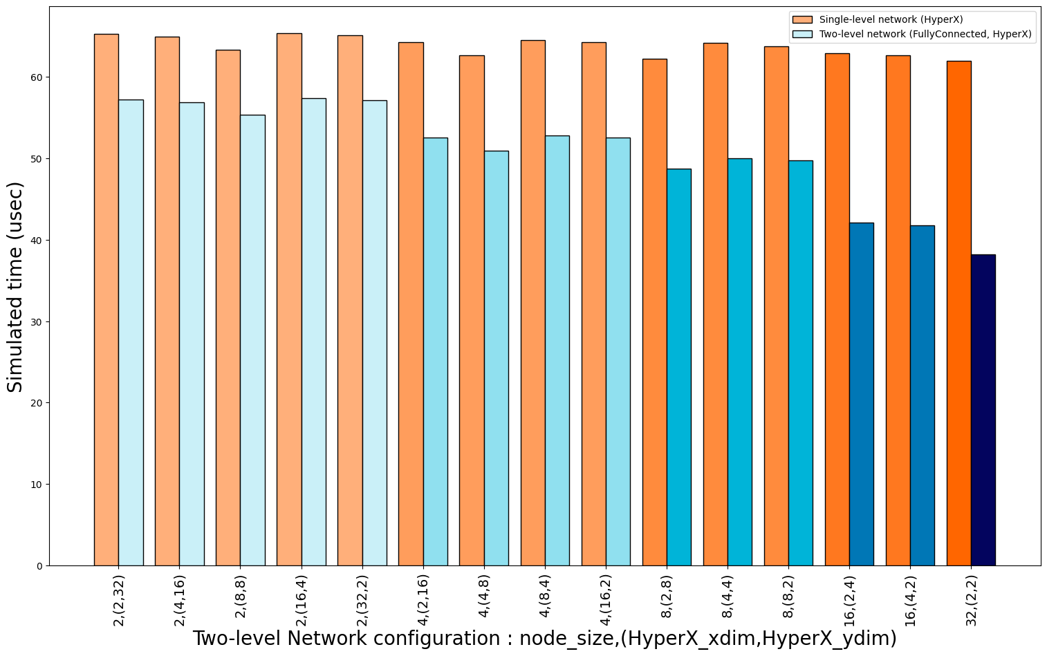
Simulation results: Sweep3D
0
1
2
3
Models a 3D sweep communication from all 8 vertices
Each processor sends a slice of stencil data to its immediate neighbors – creating a wavefront type of communication
Stresses the network latency
Majority of processors have to wait a long time to receive the stencil data
Near neighbor communication
Blocking Send/Recv pair
Observation – Improved performance in two-level network
Performance gain significant in case of denser nodes – more endpoints per node
Inter-node traffic accounts only for 20% in case of 32 endpoint-node
4
5
6
7
8
9
10
11
12
13
14
15
Sweep3D communication
Sweep3D
Inter-node traffic
Sweep3D
Results have been estimated or simulated

Slide 15
Conclusions and Future Work
Current and Future systems are becoming increasingly complex – leading to hierarchical networks
Modeling is crucial to study the network co-design
We included support for modeling multi-level networks in SST – a PDES large-scale system simulator
We evaluated our modeling framework on a
Two-level network system containing 128 network endpoints
3 HPC motifs – Halo2D/3D and Sweep3D ; 3 Collectives: Allreduce, Allgather, Alltoall.
We quantified the performance impact of the node size, topology and comm patterns on both the intra-node and inter-node traffic.
Using a fully connected network at an intra-node level resulted in a drop of :
80% in inter-node traffic for near-neighbor comm patterns (Halo2D/3D, Sweep3D)
20% in inter-node traffic for MPI Collectives (Allgather, Allreduce, Alltoall)
Going forward, we would like to include:
Support for multiple topologies
Adaptive routing policies
Trace-driven simulations.

Slide 16
Legal Notices and Disclaimers
Intel technologies may require enabled hardware, software or service activation.
No product or component can be absolutely secure.
Your costs and results may vary.
Configurations:
Structural Simulation Toolkit version: 12.0.1 (http://sst-simulator.org/SSTPages/SSTBuildAndInstall_older_downloads/ ); modified to include support for multi-level networks. The modified simulator code is not yet publicly available.
© Intel Corporation. Intel, the Intel logo, and other Intel marks are trademarks of Intel Corporation or its subsidiaries. Other names and brands may be claimed as the property of others.

Slide 17
Thank You!

