Slide 1
Performance Portability for
Next-Generation Heterogeneous Systems
Dr Tom Deakin

Slide 2
Rank | System | Accelerator
1 | Frontier | ✅
2 | Supercomputer Fugaku | ❌
3 | LUMI | ✅
4 | Leonardo | ✅
5 | Summit | ✅
6 | Sierra | ✅
7 | Sunway TaihuLight | ❌
8 | Perlmutter | ✅
9 | Selene | ✅
10 | Tianhe-2A | ✅
Rank | System | Accelerator
1 | Frontier | ✅
2 | Supercomputer Fugaku | ❌
3 | LUMI | ✅
4 | Leonardo | ✅
5 | Summit | ✅
6 | Sierra | ✅
7 | Sunway TaihuLight | ❌
8 | Perlmutter | ✅
9 | Selene | ✅
10 | Tianhe-2A | ✅
Source: TOP500 November 2022
Notes:
TOP500 systems
8/10 use an accelerator (GPU)
Why GPUs?
Best FLOPs - build with GPUs
Also come with best memory bandwidth
Technology trickles down over time

Slide 3
Latency Throughput
“Complex” cores
Instruction Level Parallelism
Deep cache hierarchy
NUMA
Wide SIMD
More “simple” cores
Very wide SIMD
Fast context switching
Programable memory hierarchy
Latest memory technology
Notes:
Processor design spectrum
Throughput optimized vs latency optimized
Left: CPUs latency optimized
Complex cores with built-in accelerators (e.g., SIMD, crypto)
Out-of-order cores, lots of execution units
Caches hide memory access latency by bringing data close
NUMA more memory at expense of performance
512-bit vectors
Right: GPUs throughput optimized
NVIDIA H100 132 SMs
Warp is SIMD at 32 threads
Oversubscription of blocks with fast switching uses bandwidth to hide latency
High bandwidth memory
Cross-pollination of technologies as CPUs adopt many-core, HBM, …
But GPUs have “offload” model via the programming model
Heterogeneity growing as processors become system on chip: Grace-Hopper, APU, etc.
Programing models developing to allow heterogeneous programming, not just offload

Slide 4
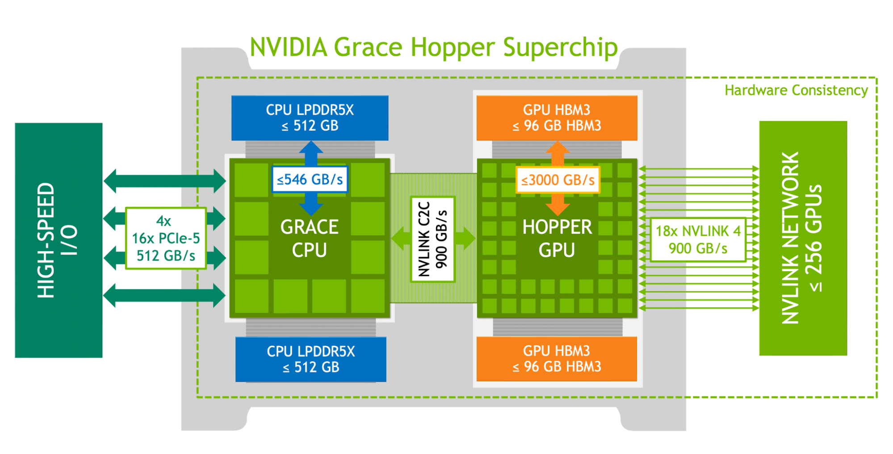
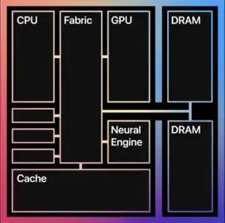
NVIDIA Grace-Hopper
Apple M1
Images belong to their respective owners
Notes:
The role of accelerators
Turn a common operation into hardware, offload, then incorporate
e.g., SIMD, Tensor cores, Ray tracing
Extreme heterogeneity is here is mobile.
Chiplets and packaging technology enabling a heterogeneous zoo
Apple M1 processor: CPU (two types), GPU, Neural Engine, Video encoder
AMD MI300: El Capitan. Chiplets of CPU, GPU, Cache, and HBM
NVIDIA Grace-Hopper superchip: highly integrated CPU and GPU, fast and wide coherent interconnect
Intel (2022 plans) for Falcon Shores
Heterogeneous programming: writing programs that use the whole system (the whole chip), not just part of it
Programming models need to work to make this simple
Images:
Grace-Hopper: https://developer.nvidia.com/blog/nvidia-grace-hopper-superchip-architecture-in-depth/\
Apple M1: https://en.wikichip.org/wiki/File:apple-m1-logical-schematic.png

Slide 5
Data: TOP500 June 2022
Graph: doi.org/10.1109/P3HPC56579.2022.00006
Notes:
Homogeneous Majority
But, two-thirds of systems have no accelerator.
Titan (ORNL) entered no 1 in November 2012 (a decade). Top 10 GPU tech taking more than a decade
CPU-only systems still workhorse for many
New procurements still including large CPU-only partition

Slide 6
Tension between migrating to next system (which may be GPUs), and keeping running on current system
Notes:
The need for Performance Portability
Competitive landscape of diverse processor technology
Embrace diversity
Vendor competition – Intel, AMD, NVIDIA, Arm,
Cloud rolling own silicon
National/international Exascale landscape: Tier-0, Tier-1, Tier-2
Mandate/expectation to be portable across systems (e.g., in DoE)

Slide 7
Performance, Portability, and Productivity
Notes:
The Three Ps
Applications must be:
Portable between different systems
Portable between different architectures
Performant on each system they need to run on
Productive: close to single source
Productive: easy to maintain, move between systems

Slide 8
“A code is performance portable if it can achieve a similar fraction of peak hardware performance on a range of different target architectures”.
Notes:
Performance Portability Definition
Caveats
Needs to be a good fraction of best achievable (i.e., hand optimised).
Range of architectures depends on your goal, but important to allow for future developments.
Most interested in consistency of distribution of performance across systems

Slide 9
Problem
Application
Platform
Efficiency
More details in doi.org/10.1109/P3HPC51967.2020.00007
Notes:
Taxonomy for discussing Performance Portability
Discussing PP can be contentious
Problem: Input to application, confirm correct answers and observe performance
Application: Software running problems on one/more platforms
Platform: Hardware + software where application runs problems
Efficiency: measure of relative performance on the platform
Architectural efficiency: % peak FLOPs, BW
Application efficiency: % performance of best (non-portable) version; world-record
E.g.,
Determine if bound by on- or off-core (Voysey, Met Office); e.g., my paper in Journal of Computational and Theoretical Transport
Sustained useful Memory Bandwidth
Sustained useful FLOPs
Roofline – measurement, might not be optimal

Slide 10
From Pennycook, Sewall and Lee: doi.org/10.1016/j.future.2017.08.007
Notes:
Measuring performance portability
PP metric
Harmonic mean of efficiencies

Slide 11
From doi.org/10.1109/P3HPC51967.2020.00006
Notes:
Comparing performance portability
2020 study
15 processors in different systems
6 programming models
Multiple compilers
A rigorous study like this is approx. 18 months 1.0 FTE
Team effort
X = impossible; E = compile/runtime error
Kokkos Rome – problem size 800MB, close to L3 cache of 512 MB
Distribution along the column that matters
More consistent, more performance portable

Slide 12
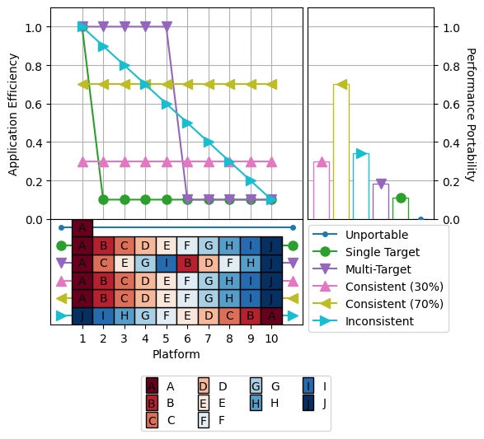
From https://intel.github.io/p3-analysis-library
Based on doi.org/10.1109/MCSE.2021.3097276
Notes:
Cascade plots
Synthetic data for characteristic behaviour
P3 Analysis Library with Intel

Slide 13
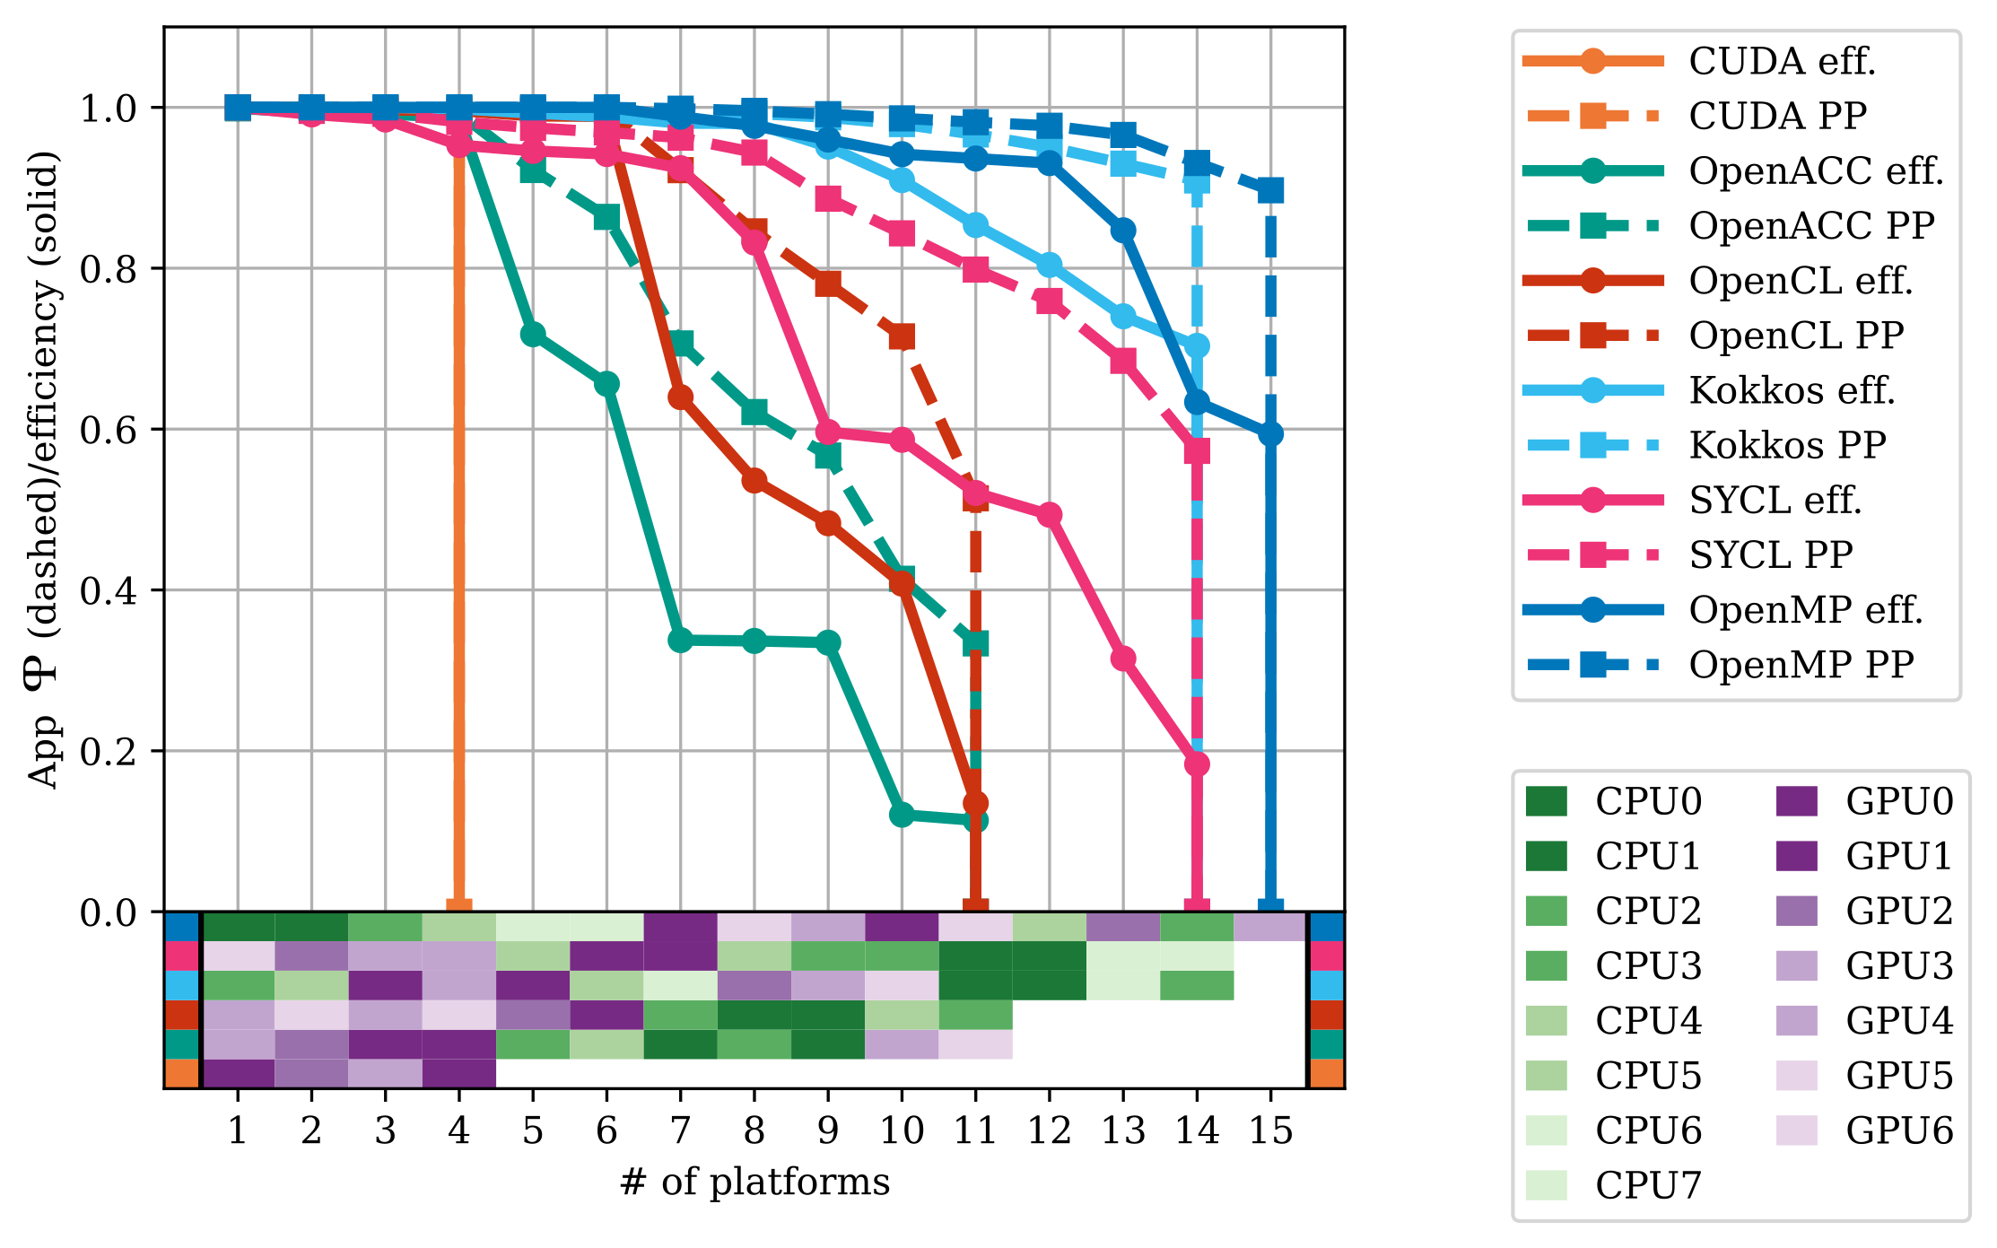
From doi.org/10.1109/MCSE.2021.3097276
Notes:
BabelStream
Similar data to the heatmap, now Application efficiency (% best in any model)
Figure with models showing but anonymised processors

Slide 14
BabelStream
From doi.org/10.1109/P3HPC56579.2022.00006
The University of Bristol is an Intel oneAPI Center of Excellence helped support this work.
This work was supported by the Engineering and Physical Sciences Research Council ASiMoV project [EP/S005072/1].
Notes:
SYCL on CPU
2022 study on heterogeneous models on CPUs
OpenMP target targeting CPUs
Heterogeneous first
Highlighting compiler dimension
Memory bandwidth bound: at least one compiler gets good performance in all models
Starting to see performance portability possible in multiple models

Slide 15




This work was supported by the Engineering and Physical Sciences Research Council as part of ExCALIBUR Hardware & Enabling Software [EP/X031829/1]
Logos belong to their respective owners
Notes:
Benchmarking Project
Lots of benchmarking, and need help.
Make all this easy!
Framework to build, run, and visualise Perf. Port. data
Reproducible, repeatable and comparable
Spack+ReFrame+P3 Analysis Library
Long term-goal: Continuous Integration
CI pipeline to track PP over time across different systems

Slide 16

https://github.com/uob-hpc/babelstream
Notes:
BabelStream
Collection of ExCALIBUR benchmarks, including BabelStream
BabelStream now in Spack.
Fortran version too.
John McCalpin’s STREAM in multiple programming models

Slide 17
Device discovery and control
Data location and movement in discrete memory spaces
Expressing concurrent and parallel work
Notes:
Heterogeneous Programming
Abstraction that defines concepts as on slide
Concurrency vs Parallelism
Different types of parallelism: data-parallel loop, nd-range loop, hierarchical parallelism, tasks, …
Also common parallel patterns: reductions

Slide 18

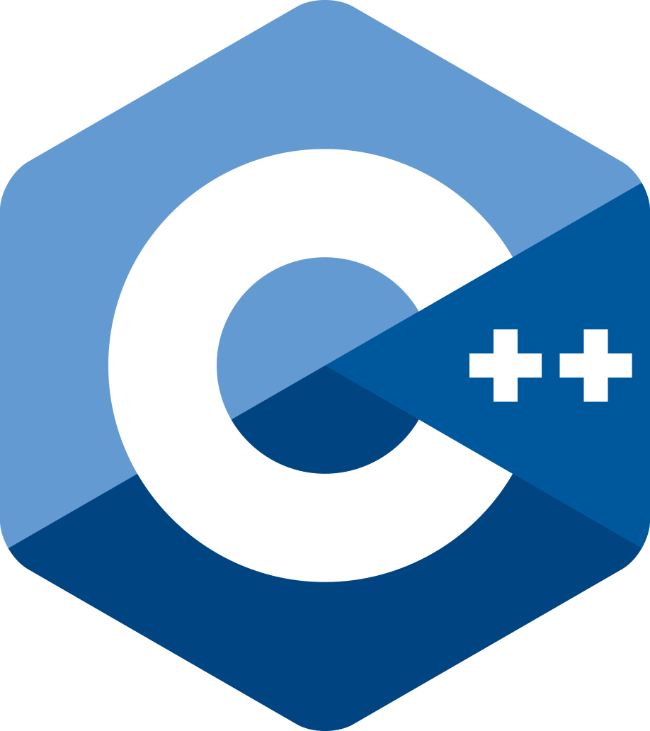



Logos belong to their respective owners
Notes:
The role of programming models
Need a language to program
Base languages: Fortran, C++
Exposing more abstractions for concurrency and parallelism
Open Standard models give more control and cross-vendor portability
DSL/Kokkos: roll your own abstraction, $$$

Slide 19
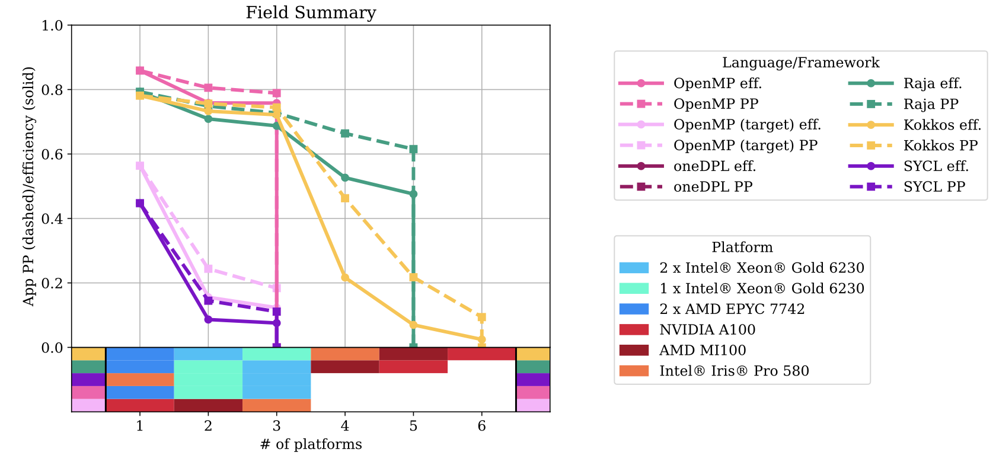
This work was supported by the Engineering and Physical Sciences Research Council ASiMoV project [EP/S005072/1].
Notes:
Abstraction of common patterns
Study exploring differences in how reductions are exposed in different models
Field Summary from CloverLeaf:
summation of five FP64 variables over 2D grid
Variables are computed, not just read from grid
transform_reduce()
Different guarantees of number of intermediate variables
Reduction result normally ends up with copy to host, not required?
Implementations not always doing a good job

Slide 20
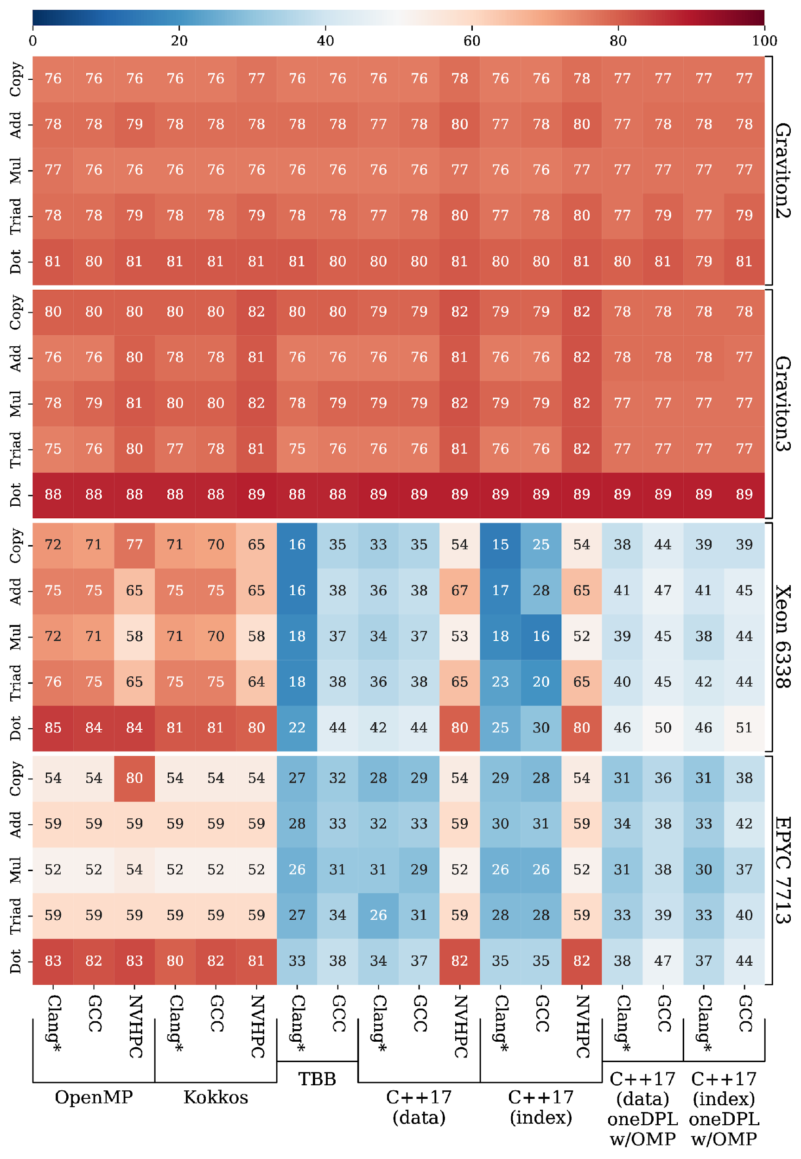
Architectural efficiency
x86 CPU
From doi.org/10.1109/PMBS56514.2022.00009
The University of Bristol is an Intel oneAPI Center of Excellence helped support this work.
Notes:
ISO C++
% theoretical peak memory bandwidth for BabelStream kernels
ISO C++ data-parallel and index-parallel
Can get comparable performance.
Also true on Arm (everything was good)
And on GPUs (next slide)

Slide 21
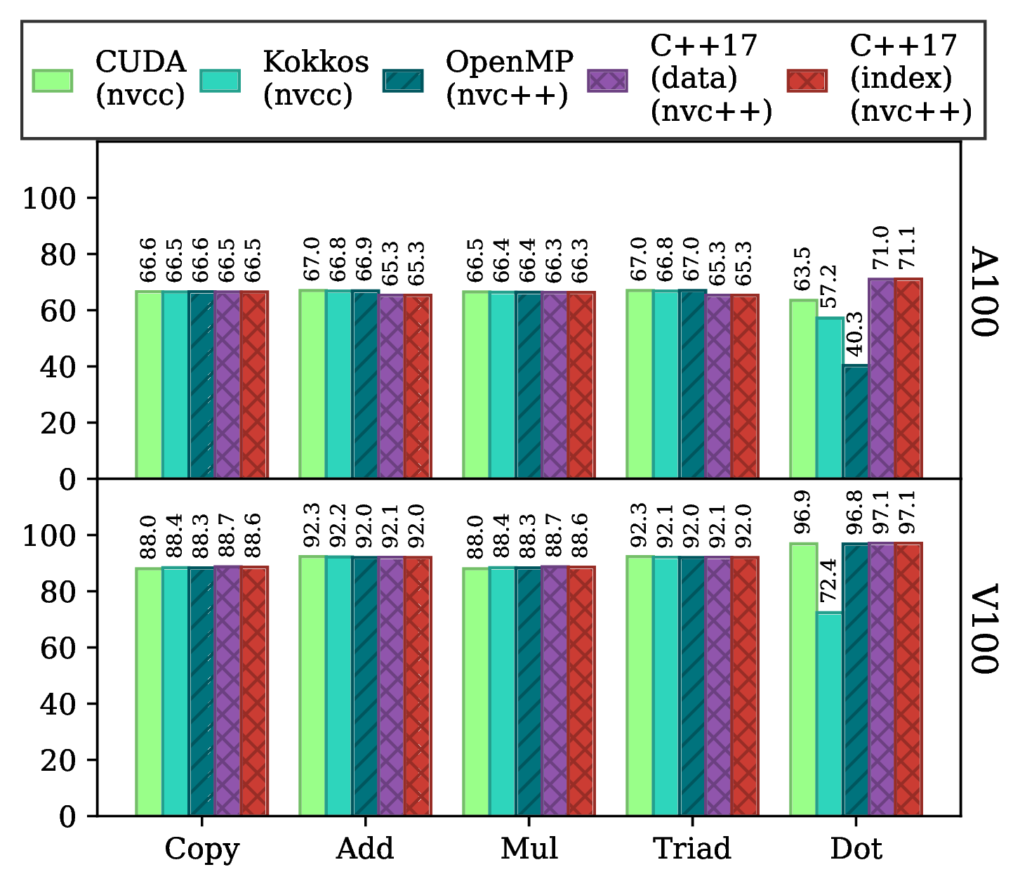
NVIDIA GPUs
Architectural efficiency
From doi.org/10.1109/PMBS56514.2022.00009
The University of Bristol is an Intel oneAPI Center of Excellence helped support this work.
Notes:
ISO C++ on GPUs
No source code changes needed
Excited by P2300 std::execution senders/receivers expressing scheduling graph of work on compute resources

Slide 22
ARCHER2: March-August 2022
From doi.org/10.1109/PMBS56514.2022.00013
Notes:
Fortran on ARCHER2
Aggregate all codes that >0.1% of the machine
Fortran consumes >80% node hours

Slide 23
Architectural efficiency
From doi.org/10.1109/PMBS56514.2022.00013
Notes:
ISO Fortran
DO CONCURRENT specifies restrictions to ensure no data dependencies between iteration
Restrictions: variable localization, no return, exit, calls to pure procedures
Implies that iterations can be re-ordered – concurrent
Sometimes can be parallel (and/or vectorized):
Compiler analysis to determine if safe, helped by Fortran 2018 locality statements
REDUCTION statement in Fortran Next
BabelStream All kernels at PMBS’22.
Grey boxes = unimplemented

Slide 24
Specialisation?
Notes:
The elephant in the room: specalisation
System specific optimisations and tuning
Use of vendor-specific features
Productivity angle

Slide 25
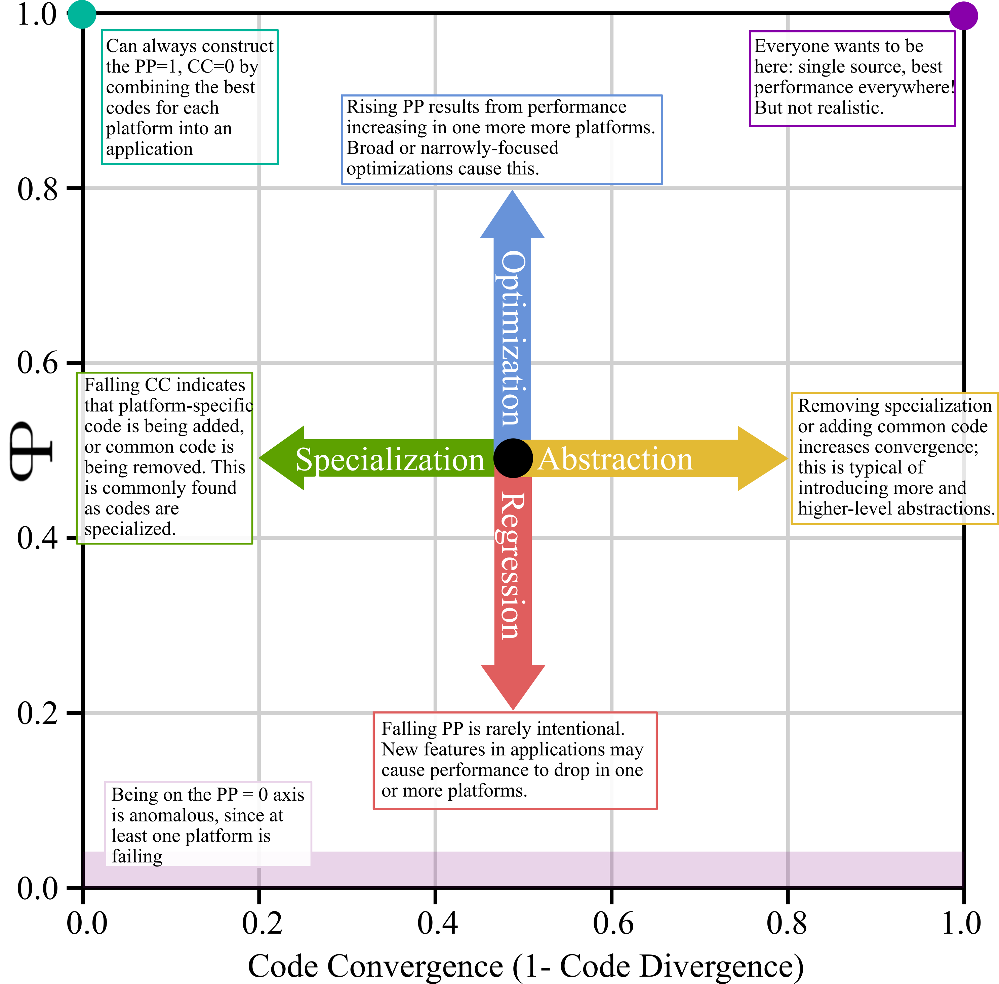
From doi.org/10.1109/P3HPC56579.2022.00006
Notes:
Briefly, productivity
Compass points
Intel Code Base Investigator

Slide 26
Which performance portable programming model should I use?
http://uob-hpc.github.io/2020/05/05/choosing-models.html
Notes:
My future of programming models
Path to specalisation from standard languages is smooth
Think about programming the whole system
Asynchrony and flexible parallelism is key
In an idea world, this doesn’t matter
Project proposals under review to make this come true
But for now (next slide)

Slide 27
Use open standard parallel programming models
Express all concurrent work asynchronously
Build in tuning parameters
Test all compilers & runtimes, on all systems
Tell your vendor
Notes:
Performance portability now
Describe all parallel work:
Allow/guide programming model in mapping it to hardware
Tuning parameters:
Tile size, domain decomposition size, batch sizes, etc
Test everywhere:
Portability first, across PrgEnv, systems and architectures
Report performance bugs as you would functional bugs
Demand the expected performance

Slide 28

Programming Your GPU with OpenMP
Performance Portability for GPUs
By Tom Deakin and Timothy G. Mattson
📚
November 7, 2023
Preorder via MIT Press website
Notes:
Programming Your GPU with OpenMP
OpenMP viable choice, esp. Fortran, for programming heterogeneous systems
Covers all OpenMP 5.2, introducing a common core for GPU, loop, interop, asynchronous offload, hierarchical parallelism,

Slide 29


https://hpc.tomdeakin.com
@tjdeakin
tom.deakin@bristol.ac.uk
Notes:
Contact me

