Slide 1
Cornelis Omni-Path Express
Performance Evaluation
John Swinburne
Principal Solution Architect (EMEA)
John.Swinburne@CornelisNetworks.com
James Erwin
Senior Benchmarking Engineer
James.Erwin@CornelisNetworks.com

Slide 2


Omni-Path Express Software Overview
Optimised for high-performance converged infrastructures
  Host architecture based on Open Fabrics Interfaces
  Standardised and Portable API
  Access to broad selection of industry standard frameworks
  Compatible with all existing Omni-Path deployments
  Foundational for next-generations of Omni-Path fabric
Opensource, Upstream First development model
  All current and future HFI drivers will remain in-tree in Linux
  In-distro availability with RHEL (& derivatives), SLES and Ubuntu
  No conflicts, No installation, No friction
  Driver/client software just works out of the box

Slide 3

OPX Host Software Stack
I/O
ULPs
IPoIB,
SRP,
iSER,
uDAPL
PyTorch
TensorFlow
File Systems
Intel MPI
Sandia SHMEM
DMABuf
OpenMPI
MPICH
MVAPICH2
GASNet
Charm++
Chapel
DAOS
MVAPICH2
GPUDirect RDMA
GPUDirect RDMA
rsockets
OpenMPI
NCCL
NCCL
/RCCL
/OneCCL
Fabric Manager
Verbs Provider
PSM2
OFI Libfabric
uMAD API
Omni-Path Express Native OFI Provider
Kernel User
Kernel User
OFA Verbs
Omni-Path HFI Driver (hfi1)
Omni-Path Adapter

Slide 4
Improved Code Implementation
recv.gnu.dynamic.opx_user:main | 9
recv.gnu.dynamic.opx_user:MPI_Recv@plt | 1
recv.gnu.dynamic.opx_user | 10
libmpi.so.12:PMPI_Recv | 32
libmpi.so.12:pthread_self@plt | 1
libmpi.so.12 | 33
libpthread.so.0:pthread_self | 3
libpthread.so.0 | 3
libmpi.so.12:PMPI_Recv | 7
libmpi.so.12:pthread_mutex_lock@plt | 1
libmpi.so.12 | 8
libpthread.so.0:__pthread_mutex_lock | 30
libpthread.so.0 | 30
libmpi.so.12:PMPI_Recv | 180
libmpi.so.12:MPIDI_GPU_request_create_hook | 2
libmpi.so.12:PMPI_Recv | 120
libmpi.so.12 | 302
libfabric.so.1:fi_opx_trecv_0_FI_AV_MAP_0x0018000000000000ull_OFI_RELIABILITY_KIND_ONLOAD | 121
libfabric.so.1 | 121
libmpi.so.12:PMPI_Recv | 33
libmpi.so.12:MPIR_Wait_impl | 9
libmpi.so.12:MPID_Progress_start | 1
libmpi.so.12:MPIR_Wait_impl | 7
libmpi.so.12:MPID_Progress_wait | 13
libmpi.so.12:MPID_Progress_completion_count_get | 6
libmpi.so.12:MPID_Progress_wait | 3
libmpi.so.12:MPID_Progress_idle_timer_start | 3
libmpi.so.12:MPID_Progress_wait | 11
libmpi.so.12:MPIDI_Progress_test | 63
libmpi.so.12:MPIDI_OFI_progress | 16
libmpi.so.12:MPIDI_OFI_get_buffered | 13
libmpi.so.12:MPIDI_OFI_progress | 13
libmpi.so.12 | 191
libfabric.so.1:fi_opx_cq_read_FI_CQ_FORMAT_TAGGED_0_OFI_RELIABILITY_KIND_ONLOAD_FI_OPX_HDRQ_MASK_2048_0x0018000000000000ull_FI_PROGRESS_MANUAL | 80
libfabric.so.1:fi_opx_hfi1_rx_reliability_ack | 76
libfabric.so.1:fi_opx_cq_read_FI_CQ_FORMAT_TAGGED_0_OFI_RELIABILITY_KIND_ONLOAD_FI_OPX_HDRQ_MASK_2048_0x0018000000000000ull_FI_PROGRESS_MANUAL | 37
libfabric.so.1:clock_gettime@plt | 1
libfabric.so.1 | 194
libc.so.6:__clock_gettime | 12
libc.so.6 | 12
[vdso]:clock_gettime | 26
[vdso]:.text | 11
[vdso]:clock_gettime | 30
[vdso] | 67
libc.so.6:__clock_gettime | 6
libc.so.6 | 6
libfabric.so.1:fi_opx_cq_read_FI_CQ_FORMAT_TAGGED_0_OFI_RELIABILITY_KIND_ONLOAD_FI_OPX_HDRQ_MASK_2048_0x0018000000000000ull_FI_PROGRESS_MANUAL | 15
libfabric.so.1:fi_opx_hfi_rx_reliablity_process_requests | 20
libfabric.so.1:fi_opx_cq_read_FI_CQ_FORMAT_TAGGED_0_OFI_RELIABILITY_KIND_ONLOAD_FI_OPX_HDRQ_MASK_2048_0x0018000000000000ull_FI_PROGRESS_MANUAL | 3
libfabric.so.1:fi_reliability_service_ping_remote | 15
libfabric.so.1:rbtBegin | 12
libfabric.so.1:fi_reliability_service_ping_remote | 14
libfabric.so.1:rbtNext | 10
libfabric.so.1:fi_reliability_service_ping_remote | 15
libfabric.so.1:fi_opx_cq_read_FI_CQ_FORMAT_TAGGED_0_OFI_RELIABILITY_KIND_ONLOAD_FI_OPX_HDRQ_MASK_2048_0x0018000000000000ull_FI_PROGRESS_MANUAL | 5
libfabric.so.1:clock_gettime@plt | 1
libfabric.so.1 | 110
libc.so.6:__clock_gettime | 12
libc.so.6 | 12
[vdso]:clock_gettime | 26
[vdso]:.text | 11
[vdso]:clock_gettime | 30
[vdso] | 67
libc.so.6:__clock_gettime | 6
libc.so.6 | 6
libfabric.so.1:fi_opx_cq_read_FI_CQ_FORMAT_TAGGED_0_OFI_RELIABILITY_KIND_ONLOAD_FI_OPX_HDRQ_MASK_2048_0x0018000000000000ull_FI_PROGRESS_MANUAL | 70
libfabric.so.1 | 70
libmpi.so.12:MPIDI_OFI_progress | 5
libmpi.so.12:MPIDI_OFI_handle_cq_entries | 9
libmpi.so.12:MPID_Progress_completion_count_incr | 6
libmpi.so.12:MPIDI_OFI_handle_cq_entries | 12
libmpi.so.12:MPIDI_OFI_dispatch_function | 21
libmpi.so.12:MPIDI_OFI_get_huge_event | 84
libmpi.so.12:MPIDI_GPU_request_complete | 14
libmpi.so.12:MPIDI_OFI_get_huge_event | 8
libmpi.so.12:MPIDI_GPU_request_free | 13
libmpi.so.12:MPIDI_OFI_get_huge_event | 15
libmpi.so.12:MPIDI_OFI_dispatch_function | 11
libmpi.so.12:MPIDI_OFI_handle_cq_entries | 14
libmpi.so.12:MPIDI_OFI_progress | 12
libmpi.so.12:MPIDI_Progress_test | 14
libmpi.so.12:pthread_self@plt | 1
libmpi.so.12 | 239
libpthread.so.0:pthread_self | 3
libpthread.so.0 | 3
libmpi.so.12:MPIDI_Progress_test | 10
libmpi.so.12:pthread_mutex_unlock@plt | 1
libmpi.so.12 | 11
libpthread.so.0:__pthread_mutex_unlock | 3
libpthread.so.0:__pthread_mutex_unlock_usercnt | 22
libpthread.so.0 | 25
libmpi.so.12:MPIDI_Progress_test | 4
libmpi.so.12:pthread_mutex_lock@plt | 1
libmpi.so.12 | 5
libpthread.so.0:__pthread_mutex_lock | 30
libpthread.so.0 | 30
libmpi.so.12:MPIDI_Progress_test | 12
libmpi.so.12:MPID_Progress_wait | 3
libmpi.so.12:MPID_Progress_completion_count_get | 6
libmpi.so.12:MPID_Progress_wait | 4
libmpi.so.12:MPID_Progress_idle_timer_stop | 3
libmpi.so.12:MPID_Progress_wait | 9
libmpi.so.12:MPIR_Wait_impl | 12
libmpi.so.12:MPID_Progress_end | 1
libmpi.so.12:MPIR_Wait_impl | 5
libmpi.so.12:PMPI_Recv | 15
libmpi.so.12:MPIDI_GPU_request_free | 13
libmpi.so.12:PMPI_Recv | 52
libmpi.so.12:pthread_mutex_unlock@plt | 1
libmpi.so.12 | 136
libpthread.so.0:__pthread_mutex_unlock | 3
libpthread.so.0:__pthread_mutex_unlock_usercnt | 22
libpthread.so.0 | 25
libmpi.so.12:PMPI_Recv | 15
libmpi.so.12 | 15
recv.gnu.dynamic.opx_user:main | 1
recv.gnu.dynamic.opx_user | 1
Totals | ]++++++
1732
recv.gnu.dynamic.impi_psm:main | 9
recv.gnu.dynamic.impi_psm:MPI_Recv@plt | 1
recv.gnu.dynamic.impi_psm | 10
libmpi.so.12:PMPI_Recv | 32
libmpi.so.12:pthread_self@plt | 1
libmpi.so.12 | 33
libpthread.so.0:pthread_self | 3
libpthread.so.0 | 3
libmpi.so.12:PMPI_Recv | 7
libmpi.so.12:pthread_mutex_lock@plt | 1
libmpi.so.12 | 8
libpthread.so.0:__pthread_mutex_lock | 30
libpthread.so.0 | 30
libmpi.so.12:PMPI_Recv | 180
libmpi.so.12:MPIDI_GPU_request_create_hook | 2
libmpi.so.12:PMPI_Recv | 107
libmpi.so.12 | 289
libpsmx2-fi.so:psmx2_tagged_recv_no_flag_directed_av_map | 35
libpsmx2-fi.so:psm2_mq_irecv2@plt | 1
libpsmx2-fi.so | 36
libpsm2.so.2:psm2_mq_irecv2 | 32
libpsm2.so.2:psm2_mq_init | 52
libpsm2.so.2:psm2_mq_irecv2 | 55
libpsm2.so.2 | 139
libpsmx2-fi.so:psmx2_tagged_recv_no_flag_directed_av_map | 8
libpsmx2-fi.so | 8
libmpi.so.12:PMPI_Recv | 33
libmpi.so.12:MPIR_Wait_impl | 9
libmpi.so.12:MPID_Progress_start | 1
libmpi.so.12:MPIR_Wait_impl | 7
libmpi.so.12:MPID_Progress_wait | 13
libmpi.so.12:MPID_Progress_completion_count_get | 6
libmpi.so.12:MPID_Progress_wait | 3
libmpi.so.12:MPID_Progress_idle_timer_start | 3
libmpi.so.12:MPID_Progress_wait | 11
libmpi.so.12:MPIDI_Progress_test | 63
libmpi.so.12:MPIDI_OFI_progress | 16
libmpi.so.12:MPIDI_OFI_get_buffered | 13
libmpi.so.12:MPIDI_OFI_progress | 13
libmpi.so.12 | 191
libpsmx2-fi.so:psmx2_cq_read | 2
libpsmx2-fi.so:psmx2_cq_readfrom | 26
libpsmx2-fi.so:psmx2_cq_poll_mq | 31
libpsmx2-fi.so:psmx2_trylock | 5
libpsmx2-fi.so:psmx2_cq_poll_mq | 6
libpsmx2-fi.so:psm2_mq_ipeek@plt | 1
libpsmx2-fi.so | 71
libpsm2.so.2:psm2_mq_ipeek | 18
libpsm2.so.2:psm2_poll | 17
libpsm2.so.2:.text | 19
libpsm2.so.2:psm2_poll | 7
libpsm2.so.2:psm2_uuid_generate | 232
libpsm2.so.2:psm2_mq_init | 172
libpsm2.so.2:psm2_uuid_generate | 131
libpsm2.so.2:psm2_error_defer | 17
libpsm2.so.2:psm2_uuid_generate | 262
libpsm2.so.2:psm2_mq_init | 90
libpsm2.so.2:psm2_uuid_generate | 51
libpsm2.so.2:psm2_poll | 15
libpsm2.so.2:psm2_mq_ipeek | 13
libpsm2.so.2 | 1044
libpsmx2-fi.so:psmx2_cq_poll_mq | 5
libpsmx2-fi.so:psm2_mq_test2@plt | 1
libpsmx2-fi.so | 6
libpsm2.so.2:psm2_mq_test2 | 45
libpsm2.so.2:psm2_mq_init | 13
libpsm2.so.2:psm2_mq_test2 | 8
libpsm2.so.2 | 66
libpsmx2-fi.so:psmx2_cq_poll_mq | 4
libpsmx2-fi.so:psmx2_unlock | 4
libpsmx2-fi.so:psmx2_cq_poll_mq | 48
libpsmx2-fi.so:psmx2_cq_rx_complete | 75
libpsmx2-fi.so:psmx2_cq_poll_mq | 12
libpsmx2-fi.so:psmx2_trylock | 5
libpsmx2-fi.so:psmx2_cq_poll_mq | 6
libpsmx2-fi.so:psm2_mq_ipeek@plt | 1
libpsmx2-fi.so | 155
libpsm2.so.2:psm2_mq_ipeek | 18
libpsm2.so.2:psm2_poll | 17
libpsm2.so.2:.text | 19
libpsm2.so.2:psm2_poll | 7
libpsm2.so.2:psm2_uuid_generate | 232
libpsm2.so.2:psm2_mq_init | 190
libpsm2.so.2:psm2_uuid_generate | 160
libpsm2.so.2:psm2_error_defer | 30
libpsm2.so.2:psm2_uuid_generate | 13
libpsm2.so.2:.text | 44
libpsm2.so.2:psm2_uuid_generate | 36
libpsm2.so.2:psm2_error_defer | 12
libpsm2.so.2:psm2_uuid_generate | 9
libpsm2.so.2:psm2_error_defer | 21
libpsm2.so.2:psm2_uuid_generate | 6
libpsm2.so.2:psm2_poll | 15
libpsm2.so.2:psm2_mq_ipeek | 9
libpsm2.so.2 | 838
libpsmx2-fi.so:psmx2_cq_poll_mq | 7
libpsmx2-fi.so:psmx2_unlock | 4
libpsmx2-fi.so:psmx2_cq_poll_mq | 11
libpsmx2-fi.so:psmx2_cq_readfrom | 13
libpsmx2-fi.so | 35
libmpi.so.12:MPIDI_OFI_progress | 5
libmpi.so.12:MPIDI_OFI_handle_cq_entries | 9
libmpi.so.12:MPID_Progress_completion_count_incr | 6
libmpi.so.12:MPIDI_OFI_handle_cq_entries | 12
libmpi.so.12:MPIDI_OFI_dispatch_function | 21
libmpi.so.12:MPIDI_OFI_get_huge_event | 81
libmpi.so.12:MPIDI_GPU_request_complete | 14
libmpi.so.12:MPIDI_OFI_get_huge_event | 8
libmpi.so.12:MPIDI_GPU_request_free | 13
libmpi.so.12:MPIDI_OFI_get_huge_event | 15
libmpi.so.12:MPIDI_OFI_dispatch_function | 11
libmpi.so.12:MPIDI_OFI_handle_cq_entries | 14
libmpi.so.12:MPIDI_OFI_progress | 12
libmpi.so.12:MPIDI_Progress_test | 14
libmpi.so.12:pthread_self@plt | 1
libmpi.so.12 | 236
libpthread.so.0:pthread_self | 3
libpthread.so.0 | 3
libmpi.so.12:MPIDI_Progress_test | 10
libmpi.so.12:pthread_mutex_unlock@plt | 1
libmpi.so.12 | 11
libpthread.so.0:__pthread_mutex_unlock | 3
libpthread.so.0:__pthread_mutex_unlock_usercnt | 22
libpthread.so.0 | 25
libmpi.so.12:MPIDI_Progress_test | 4
libmpi.so.12:pthread_mutex_lock@plt | 1
libmpi.so.12 | 5
libpthread.so.0:__pthread_mutex_lock | 30
libpthread.so.0 | 30
libmpi.so.12:MPIDI_Progress_test | 12
libmpi.so.12:MPID_Progress_wait | 3
libmpi.so.12:MPID_Progress_completion_count_get | 6
libmpi.so.12:MPID_Progress_wait | 4
libmpi.so.12:MPID_Progress_idle_timer_stop | 3
libmpi.so.12:MPID_Progress_wait | 9
libmpi.so.12:MPIR_Wait_impl | 12
libmpi.so.12:MPID_Progress_end | 1
libmpi.so.12:MPIR_Wait_impl | 5
libmpi.so.12:PMPI_Recv | 15
libmpi.so.12:MPIDI_GPU_request_free | 13
libmpi.so.12:PMPI_Recv | 52
libmpi.so.12:pthread_mutex_unlock@plt | 1
libmpi.so.12 | 136
libpthread.so.0:__pthread_mutex_unlock | 3
libpthread.so.0:__pthread_mutex_unlock_usercnt | 22
libpthread.so.0 | 25
libmpi.so.12:PMPI_Recv | 15
libmpi.so.12 | 15
recv.gnu.dynamic.impi_psm:main | 1
recv.gnu.dynamic.impi_psm | 1
Totals | ]++++++
3449
4-byte MPI_Recv
OPX removed 34 function calls and a lock
50% reduced instruction count
32% reduced cache line accesses
PSM2: 3449 instructions
OPX: 1732 instructions!

Slide 5
OPX Runtime Tuneables
FI_OPX_RELIABILITY_SERVICE_USEC_MAX - Controls how frequently a sending rank will issue reliability ping requests to solicit ACK/NACK status of sent packets. Reducing this value may improve performance at the expense of increased traffic on the OPX fabric. Default setting is 500.
FI_OPX_RELIABILITY_SERVICE_PRE_ACK_RATE - Controls how frequently a receiving rank will send ACKs for packets it has received without being prompted through a ping request. A non-zero value N tells the receiving rank to send an ACK for the last N packets every Nth packet. Used in conjunction with an increased value for FI_OPX_RELIABILITY_SERVICE_USEC_MAX may improve performance. Valid values are 0 (disabled) and powers of 2 in the range of 1-32768, inclusive. Default setting is 64
FI_OPX_RELIABILITY_
SERVICE_USEC_MAX
Ping frequency for ACK response
Sender
Receiver
Rate of (unsolicited) ACK responses
FI_OPX_RELIABILITY_
SERVICE_PRE_ACK_RATE

Slide 6
OPX Runtime Tuneables
FI_OPX_DELIVERY_COMPLETION_THRESHOLD - Controls the message size (in bytes) at which SDMA transitions from using an internal bounce buffer; in order to release the send buffer and complete the transaction on the send-side, to holding the send buffer and waiting for an ACK to confirm successful delivery completion from the receive side.
Increasing the threshold may improve performance by allowing the middleware to modify send buffers sooner at the expense of performing an additional, internal memory copy as part of the transaction. Valid values are in the range 16385-2147483646 Default setting is 16385 (>16KB)
All 3 of these runtime tuneables have the potential to drive a higher transaction rate from the send side by retiring send transactions/freeing up buffers more frequently resulting in higher throughput and/or lower latency.

Slide 7
Using the Omni-Path Libfabric OPX Provider
OPX Provider specified at execution time:
OpenMPI
$ mpirun –np ${PROCS} –host ${HOSTS} <ompi parameters> \
--mca mtl ofi -x FI_PROVIDER=opx \
-x LD_LIBRARY_PATH=${OPX_LIBFABRIC_PATH}:${LD_LIBRARY_PATH} \
<mpi application>
Intel MPI
$ mpirun –ppn ${PPN} –np ${PROCS} –hosts ${HOSTS} <impi parameters> \
-genv I_MPI_FABRICS=shm:ofi -genv FI_PROVIDER=opx
-genv LD_LIBRARY_PATH=${OPX_LIBFABRIC_PATH}:${LD_LIBRARY_PATH} \
<mpi application>

Slide 8
OPX Microbenchmark Performance
5% - 28% latency advantage at small –medium message sizes
Notes:
At larger messages sizes the test becomes more of a bandwidth test and therefore no longer serves as a valid latency comparison between fabrics with differing link speeds….

Slide 9
OPX Microbenchmark Performance
Tuning DCT delays transition to copyless/blocking transactions and demonstrates that use of bounce buffer can reduce send side blocking and improve point to point latency

Slide 10
OPX Microbenchmark Performance
Cornelis Omni-Path Dual Rail Adapter Limit
Cornelis Omni-Path HFI Adapter Limit

Slide 11
OPX AllReduce Collective Performance
OPX delivers ~12-39% performance improvement over PSM2 up to 8KB message size
Setting FI_OPX_RELIABILITY_
SERVICE_PRE_ACK_RATE=2 provides additional minor performance improvements

Slide 12
OPX AllReduce Collective Performance
OPX generally delivers improved performance (up to 80%) across range of Intel MPI AllReduce Algorithms
Convergence observed at larger message sizes where bandwidth becomes dominant
With the caveat…
Despite relative improvement, not all algorithms deliver optimal performance

Slide 13
OpenRadioss – Taurus 20m (2ms) Performance
3rd Generation Intel® Xeon® Scalable 8358
32 PPN/OMP=2
OpenMPI 4.1.4 & Libfabric 1.18.0
Selection of OPX provider at runtime delivers improved performance scaling for Taurus 20m workload.
28% scaling improvement at 16 nodes
MPI profiling shows dominant collectives are 4b and 80b AllReduce – inside the message size range where OPX delivers improved performance over PSM2

Slide 14
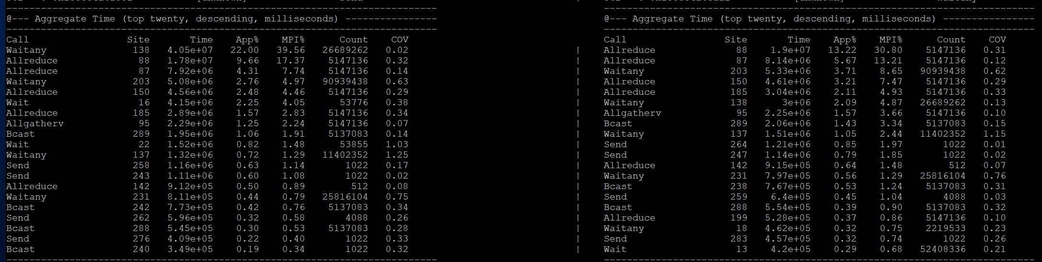
OpenRadioss – Taurus 20m (2ms) Performance
3rd Generation Intel® Xeon® Scalable 8358
32 PPN/OMP=2
OpenMPI 4.1.4 & Libfabric 1.18.0
application profiled with mpiP
https://github.com/LLNL/mpiP/tree/3.5
PSM2
OPX
4 bytes
80 bytes
Notes:
openradioss-taurus2ms-16nodes-32ppn-icx_opa_1rail_ompi_psm2_omp2_32ppn-run14126-job73585-20230516-074403
openradioss-taurus2ms-16nodes-32ppn-icx_opa_1rail_ompi_opx_omp2_32ppn-run14125-job73584-20230516-073811
Hypothesis: MPI rank imbalance with PSM2 causing periods of stall and becomes a performance bottleneck
Higher OPX raw performance leads to faster completion and reduces the effect of MPI rank imbalance

Slide 15
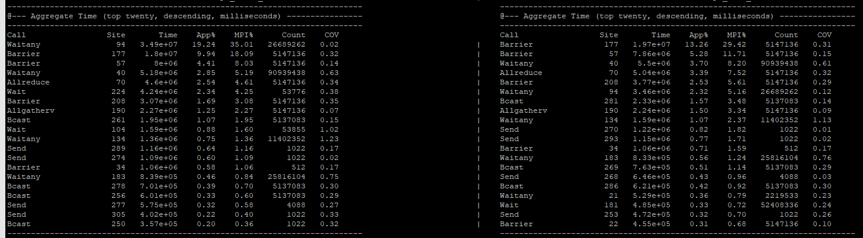
OpenRadioss – Taurus 20m (2ms) Performance
3rd Generation Intel® Xeon® Scalable 8358
32 PPN/OMP=2
OpenMPI 4.1.4 & Libfabric 1.18.0
application profiled with mpiP
https://github.com/LLNL/mpiP/tree/3.5
PSM2
OPX
Source code was modified to call MPI_Barrier immediately before the allreduce
Barrier is now the most expensive collective suggesting rank imbalance in MPI comms, Allreduce performance itself is not the dominant factor
Notes:
psm2: openradioss-taurus2ms-16nodes-32ppn-icx_opa_1rail_ompi_psm2_omp2_32ppn-run14130-job73605-20230516-130259/engine_linux64_gf_ompi.512.643065.1.mpiP
opx: openradioss-taurus2ms-16nodes-32ppn-icx_opa_1rail_ompi_opx_omp2_32ppn-run14130-job73604-20230516-125714/engine_linux64_gf_ompi.512.636686.1.mpiP

Slide 16
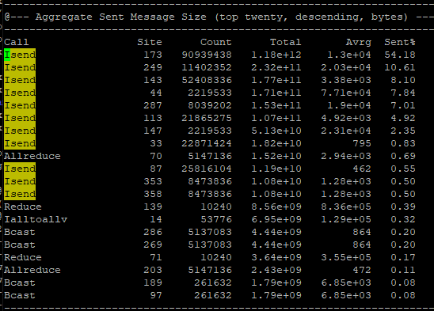
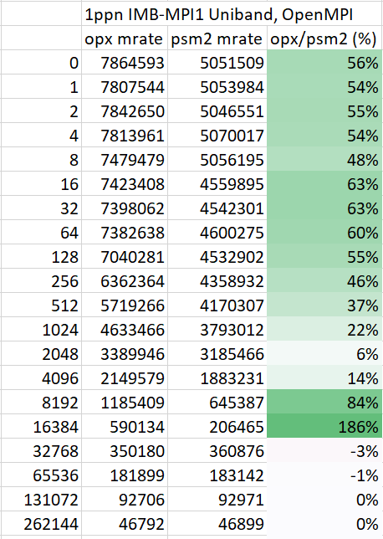
Why is OPX faster with non-blocking pt2pt?
Average msg sizes for non-blocking sends are 13KB, 20KB, 3.3KB, …
This is the OPX "sweet spot" compared to psm2

Slide 17
WRF 3.9.1.1 – CONUS 2.5KM Performance
3rd Generation Intel® Xeon® Scalable 8358
64 PPN
Intel MPI 2021.8 & Libfabric 1.18.0
Non-tuned performance on WRF workload showed reasonable scaling at ~70% @ 16 nodes (1024 cores)
Reducing the FI_OPX_RELIABILITY_SERVICE_USEC_MAX to 100 improved scalability to ~90% @ 16 nodes (1024 cores).
A 27% improvement.

Slide 18
Impact across a range of apps
Reducing FI_OPX_RELIABILITY_SERVICE_USEC_MAX to 100 provides the maximum performance without unnecessarily adding control traffic to the fabric
GROMACS, WRF, and MPAS benefit the most, other apps have a negative impact
Similar trends seen by separately reducing FI_OPX_RELIABILITY_SERVICE_PRE_ACK_RATE
better
default
Notes:
Hypothesis: Varying RELIABILITY_SERVICE parameters alters send-side performance. A lower value retires transactions/buffer usage more frequently which results in higher throughput on the fabric.
Depending on traffic patterns, the inflection point where performance peaks and falls away will be different for different workloads.
Some workloads may even benefit from higher RELIABILITY_SERVICE* values ?

Slide 19
Summary & Future Work
OPX Provider as a direct runtime replacement for the legacy PSM2 library provides a significant improvement in both pingpong latency and small-medium sized message rate
This in turn leads to improvements in MPI collective performance and application performance as demonstrated by significant reductions in time spent in waitany and allreduce operations observed during MPI profiling
OPX provides a high level of control with transaction reliability and completion runtime tuneables - which can lead to measurable performance improvements by adjusting the transaction completion response behaviour on the fabric and driving higher send side performance.
Future Work
Enable callsite address to source translation under mpiP in order to identify exactly which messages are causing high waitany()
Continue to investigate behaviour resulting from varying RELIABILITY_SERVICE* and DELIVERY_COMPLETION runtime parameters

