Slide 1
Modelling Next Generation High Performance Computing Fabrics
Dr Dean Chester - Cornelis Networks
May 2023

Slide 2
Notices and Disclaimers
INFORMATION IN THIS DOCUMENT IS PROVIDED IN CONNECTION WITH CORNELIS NETWORKS PRODUCTS. NO LICENSE, EXPRESS OR IMPLIED, BY ESTOPPEL OR OTHERWISE, TO ANY INTELLECTUAL PROPERTY RIGHTS IS GRANTED BY THIS DOCUMENT. EXCEPT AS PROVIDED IN CORNELIS NETWORKS’S TERMS AND CONDITIONS OF SALE FOR SUCH PRODUCTS, CORNELIS NETWORKS ASSUMES NO LIABILITY WHATSOEVER, AND CORNELIS NETWORKS DISCLAIMS ANY EXPRESS OR IMPLIED WARRANTY, RELATING TO SALE AND/OR USE OF CORNELIS NETWORKS PRODUCTS INCLUDING LIABILITY OR WARRANTIES RELATING TO FITNESS FOR A PARTICULAR PURPOSE, MERCHANTABILITY, OR INFRINGEMENT OF ANY PATENT, COPYRIGHT OR OTHER INTELLECTUAL PROPERTY RIGHT. CORNELIS NETWORKS PRODUCTS ARE NOT INTENDED FOR USE IN MEDICAL, LIFE SAVING, OR LIFE SUSTAINING APPLICATIONS.
Cornelis Networks may make changes to specifications and product descriptions at any time, without notice. Designers must not rely on the absence or characteristics of any features or instructions marked "reserved" or "undefined". Cornelis Networks reserves these for future definition and shall have no responsibility whatsoever for conflicts or incompatibilities arising from future changes to them. The information here is subject to change without notice. Do not finalize a design with this information.
All products, dates, and figures specified are preliminary based on current expectations, and are subject to change without notice. Roadmap not reflective of exact launch granularity and timing. The products described in this document may contain design defects or errors known as errata which may cause the product to deviate from published specifications. Current characterized errata are available on request.
Any code names featured are used internally within Cornelis Networks to identify products that are in development and not yet publicly announced for release. Customers, licensees and other third parties are not authorized by Cornelis Networks to use code names in advertising, promotion or marketing of any product or services and any such use of Cornelis Networks' internal code names is at the sole risk of the user.
All products, computer systems, dates and figures specified are preliminary based on current expectations and are subject to change without notice. Material in this presentation is intended as product positioning and not approved end user messaging.
Performance tests are measured using specific computer systems, components, software, operations, and functions. Any change to any of those factors may cause the results to vary. You should consult other information and performance tests to assist you in fully evaluating your contemplated purchases, including the performance of that product when combined with other products.
Cornelis Networks technologies’ features and benefits depend on system configuration and may require enabled hardware, software, or service activation. Performance varies depending on system configuration.
Cornelis, Cornelis Networks, Omni-Path, Omni-Path Express, and the Cornelis Networks logo belong to Cornelis Networks, Inc. Other names and brands may be claimed as the property of others.
Copyright © 2022, Cornelis Networks, Inc. All rights reserved.

Slide 3
Overview
Simulation Overview
Existing Hardware Validation
Next Generation Features
Simulation Strategy
Conclusions

Slide 4
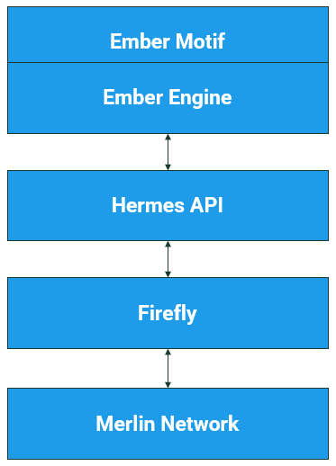

Simulator Overview
Communication Events
generate representative
network traffic
Software/Hardware Interface
drives simulation hardware
Network Interface Controller
injects/consumes network
traffic
Routers and Topologies
route traffic around the
network

Slide 5
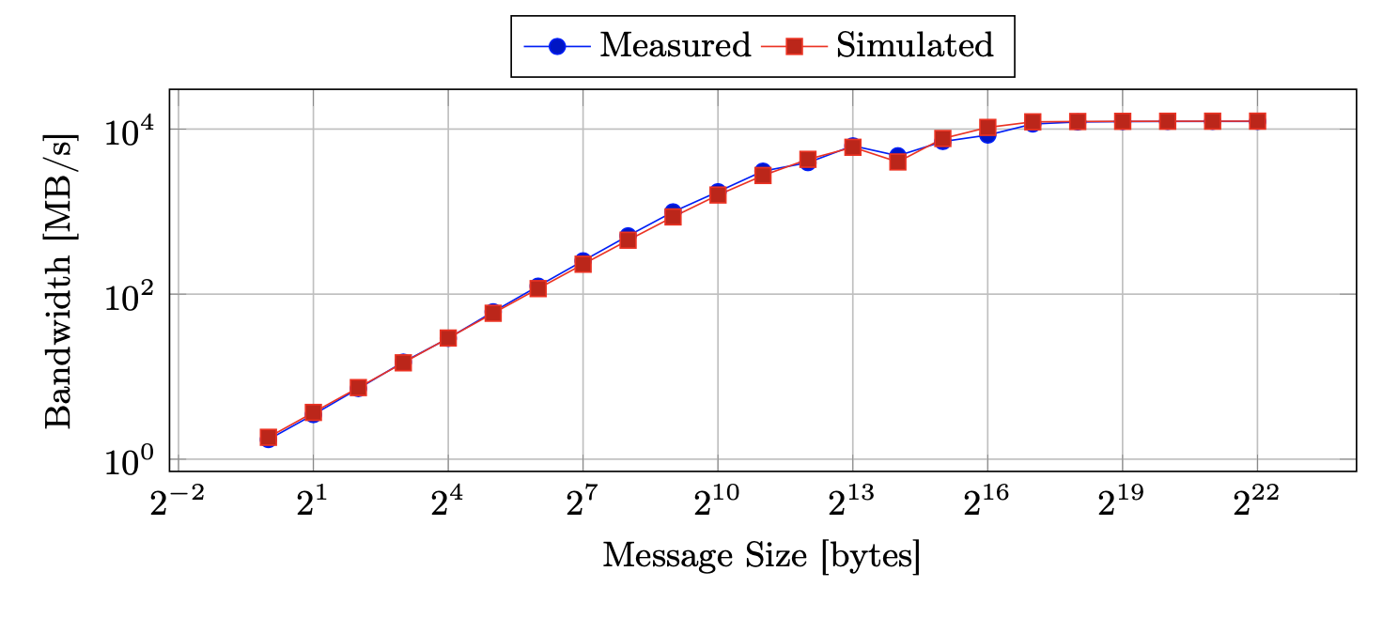
OPA100 Validation using SST
Lenovo NeXtScale nx360 M5 Nodes
  2x Broadwell CPUs
  128GB RAM per node
Omni-Path Fat Tree
  2:1 Tapering
Intel Compiler (v2020.4.304)
  Intel MPI (2019.9.304)
Original models use PSM2
  Predates OPX work

Slide 6
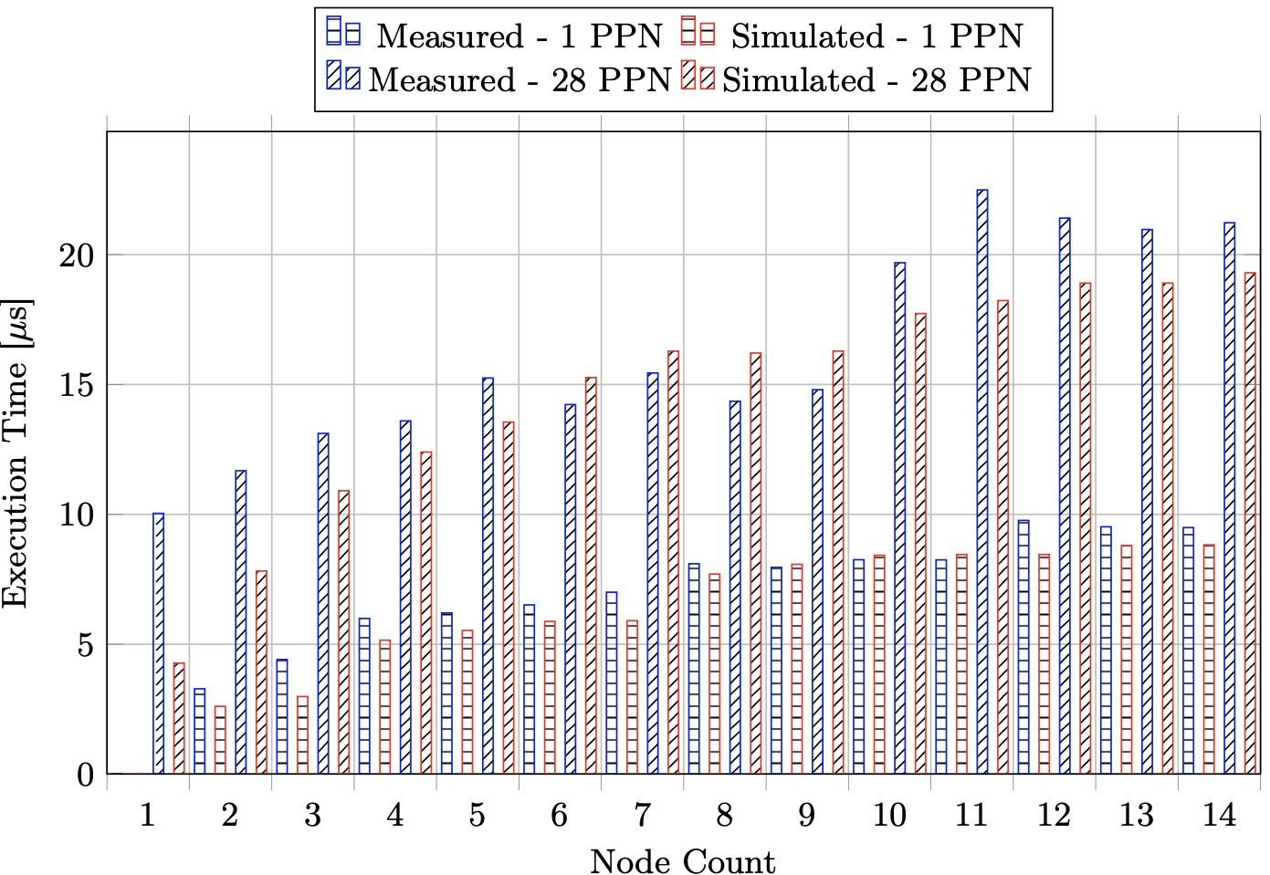
AllReduce
Typical error
  -9.98% for 1PPN
  10.78% for 28PPN
Large difference on single node
  More core-to-core bandwidth than CPU has

Slide 7
Next Generation Features
Switch Design not a straight jump to faster speeds
  New routing functionality
    Telemetry Based Adaptive Routing
  New Topology support
    Dragonfly
    Megafly
  Enhanced Congestion Control and QoS

Slide 8
Merlin
Custom Router Implementation internals implement Cornelis Intellectual Property
Input Queue
Port Control
Output Queue
Crossbar
Crossbar
Cornelis IP
4-Port High Radix Router - Merlin
4-Port CN Router

Slide 9
Simulation and Product Lifecycle
Design
Assess ASIC trade-offs prior to tape-out
Co-design hardware and configuration
Independently validate SST models
using design verification
Bid
Rapidly evaluate proposed solutions
Provide rationale behind favored designs based upon simulated network performance
Design
Support
Bid
Deliver
Support
Analyze real-world performance
  Identify hardware enhancement opportunities to feed into future product generations
Deliver
Provide tuned fabric configuration prior to hardware arriving in the data center
  Deliver optimized routing, congestion control, and QoS settings for desired workloads

Slide 10
Supporting Co-design
Assess designs at full system scale
Prototype supporting software
  Influence software architecture
  Reuse where applicable
Use real data where we can
  Cable Maps to generate the topologies and routing
  Apply same scheduling schemes for job placement
Tabor Communications.

Slide 11
Model Validation
Design Verification (DV) utilizing advances in software to use real-world configurations and data for tests
DV validated designs
  Confidence in new adaptive routing to function as per specification
UVM_INFO <test_path>/route.svh(100) @ 41045500: uvm_test_top.env.m_sb [ROUTE COMPARATOR]
Matches: 1464
Misses: 0

Slide 12
Solutions Exploration
High Fidelity models lend to solutions exploration
  Stress designs to provide optimal solution to customer problems
  Data to back up design choices
Work with customers to make better architectural decisions
 | Dragonfly | Fat Tree | Megafly
Number of Switches | 1152 | 1140 | 1200
Number of Interswitch Links | 20,016 | 27,648 | 21,600
Endpoints | 13,824 | 13,824 | 14,400
Total Cables | 33,840 | 41,472 | 36,000

Slide 13
Conclusions
SST is a great foundation
Integrating simulation and product development is invaluable
Design space for production hardware is massive
  Building on top of SST we can reduce fidelity from Cycle Accurate to less detailed models for studies

Slide 14
Thank You
www.cornelisnetworks.com

