Slide 1
DAOS beyond Persistent Memory
Distributed Asynchronous Object Storage (DAOS)
Michael Hennecke
Principal Engineer, HPC Storage ISC’23 Hamburg, 25-May-2023

Slide 2
Notices and Disclaimers
Performance varies by use, configuration and other factors. Learn more on the Performance Index site.
Performance results are based on testing as of dates shown in configurations and may not reflect all publicly available ​updates. See backup for configuration details. No product or component can be absolutely secure.
Your costs and results may vary.
Intel technologies may require enabled hardware, software or service activation.
Intel's Legal Notices and Disclaimers: Legal Notices and Disclaimers.
© Intel Corporation. Intel, the Intel logo, and other Intel marks are trademarks of Intel Corporation or its subsidiaries. Other names and brands may be claimed as the property of others. ​

Slide 3
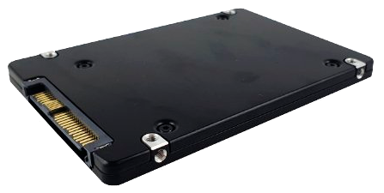
DAOS Software Architecture
Compute Nodes
POSIX apps
MPI -IO
Hadoop Connector
Block
S3
Tensor- Flow IO
HDF5 Datasets
Python apps
Py- Torch
SEGY
FDB
ROOT, DAQ
libdfs (DAOS File System)
PyDAOS
libdaos (native key-value and array interfaces)
HPC Interconnect (TCP or RDMA)
Storage Nodes
DAOS Storage Engine
Storage Class Memory (byte-addressable)
PMem, or DRAM+WAL
NVMe Bulk Storage (through SPDK)
NAND Flash
DDR-T, CXL.mem
PCIe, CXL.io
Write-Ahead Log

Slide 4
DAOS Backend using Persistent Memory
VOS tree (MMAP File)
PMem with PMDK
(or CXL.mem SSD)
NVMe SSD (with SPDK)
Data Blob

Slide 5
DAOS Backend using Volatile Memory
VOS tree (MMAP File)
DRAM/tmpfs (not persistent)
Write-Ahead Log (Synchronous Commit)
NVMe SSD (with SPDK)
Asynchronous Checkpointing
NVMe SSD (with SPDK)
Meta Blob
WAL Blob
Data Blob

Slide 6
New DAOS Backend Stack Layering
VOS
vos_dtx
VEA
VOS = Versioning Object Store
VEA = Versioned Extent Allocation
BIO = Blob I/O
DTX = DAOS Transaction
UMEM = Unified Memory
PMDK = Persistent Memory Dev Kit
SPDK = Storage Performance Dev Kit
WAL = Write Ahead Log
bmem = Blob Memory allocator
BIO
bio_wal
UMEM
WAL
callback
bmem
PMDK
SPDK
DRAM
PMDK
Changes isolated to a few layers

Slide 7
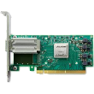
DAOS Server Design Options for 4th Gen Xeon SP
4th Gen Intel Xeon SP
2 * 400 Gbps
4th Gen Intel Xeon SP
4 * 200 Gbps
4th Gen Intel Xeon SP 4 * 400 Gbps
daos_engine_0
daos_engine_1
eng_0
eng_1
eng_2
eng_3
eng_0
eng_1
eng_2
eng_3
400Gb/s (e.g. NDR)
400Gb/s (e.g. NDR)
200Gb/s (e.g. HDR)
200Gb/s (e.g. HDR)
200Gb/s (e.g. HDR)
200Gb/s (e.g. HDR)
400Gb/s (e.g. NDR)
400Gb/s (e.g. NDR)
400Gb/s (e.g. NDR)
400Gb/s (e.g. NDR)
400
400
200
200
200
200
400
400
400
400
16x gen5
16x gen5
16x gen5
16x gen5
16x gen5
16x gen5
16x gen5
16x gen5
SPR (80x PCIe gen5)
SPR (80x PCIe gen5)
SPR (80x PCIe gen5)
SPR (80x PCIe gen5)
SPR (80x PCIe gen5)
SPR (80x PCIe gen5)
UPI
UPI
UPI
8x or 16x DRAM
8x or 16x DRAM
8x or 16x DRAM
8x or 16x DRAM
8x or 16x DRAM
8x or 16x DRAM
16-48x gen5
16-48x gen5
8-24x gen5
8-424 gen5
8-24x gen5
8-424 gen5
16-20x gen5
16-20x gen5
16-20x gen5
16-20x gen5
4-14 * NVMe
4-14 * NVMe
2-7 * NVMe
2-7 * NVMe
2-7 * NVMe
2-7 * NVMe
4-5 * NVMe
4-5 * NVMe
4-5 * NVMe
4-5 * NVMe
Bandwidth: ≤92 GiB/s per server
Bandwidth: ≤92 GiB/s per server
Bandwidth: ≤184 GiB/s per server

Slide 8
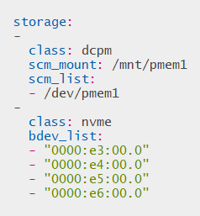
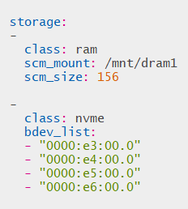
“Traditional” Configuration Options in daos_server.yml
PMem-based DAOS
“Ephemeral” DAOS

Slide 9
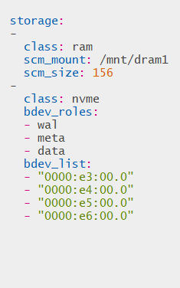
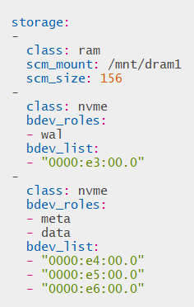
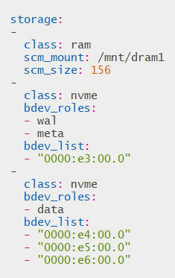
“MD-on-SSD” Configuration Options in daos_server.yml

Slide 10
Metadata Performance ( 1 engine @ 24 targets; HDR IB; 8TB pool; 30sec stonewall )
mdtest-easy (0-Byte files; dir-per-process)
mdtest-hard (3901-Byte files; shared-dir)
mdtest-hard2 (7802-Byte files; shared-dir)

Slide 11
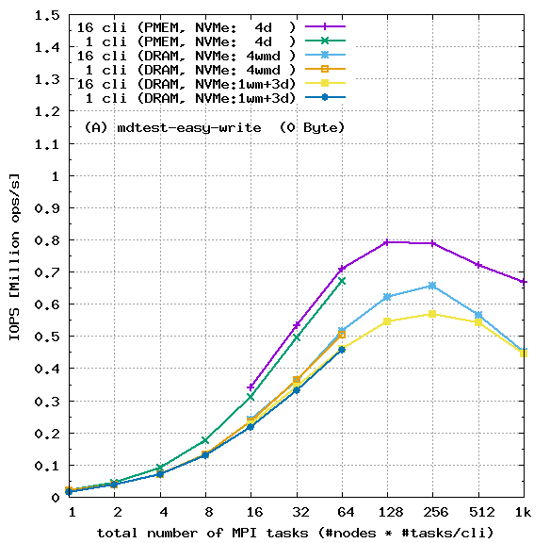
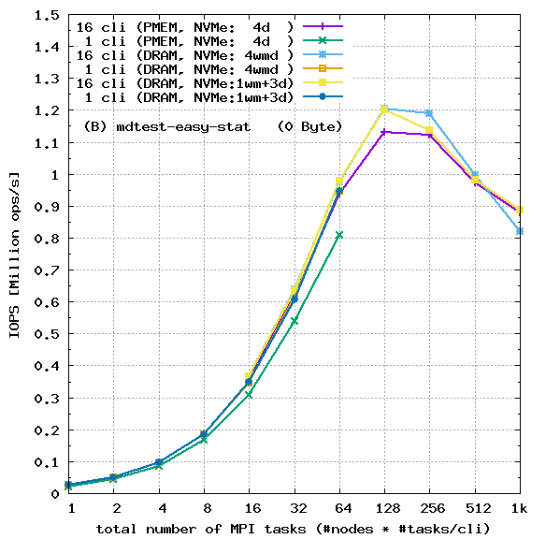
mdtest-easy (0-Byte files): (A) write (B) stat
The information on this page is subject to the use and disclosure restrictions provided on Page 2 of this document. See backup for configuration details.

Slide 12
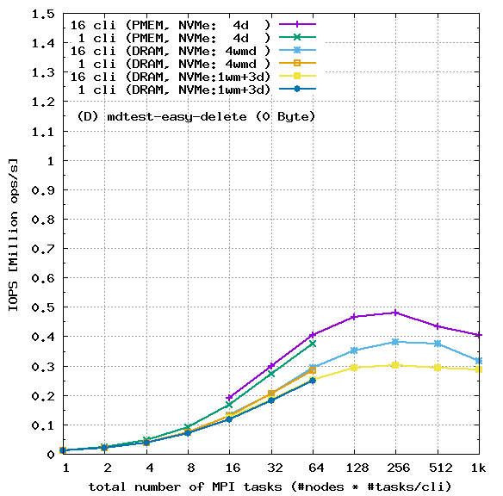
mdtest-easy (0-Byte files): (C) read (D) delete
The information on this page is subject to the use and disclosure restrictions provided on Page 2 of this document. See backup for configuration details.

Slide 13
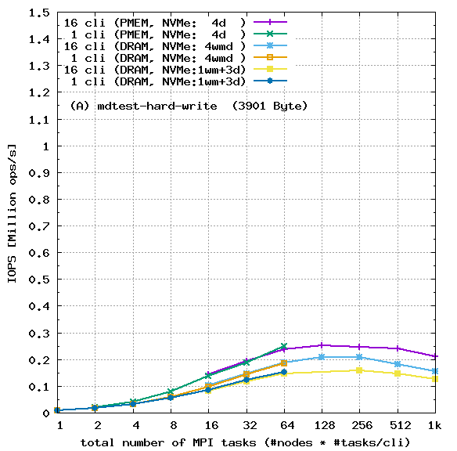
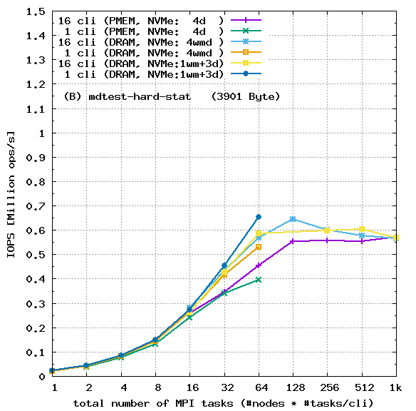
mdtest-hard (3901-Byte files): (A) write (B) stat
The information on this page is subject to the use and disclosure restrictions provided on Page 2 of this document. See backup for configuration details.

Slide 14
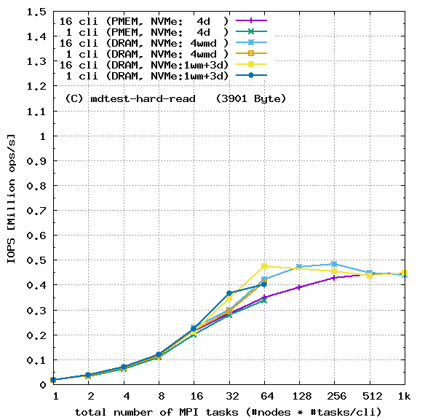
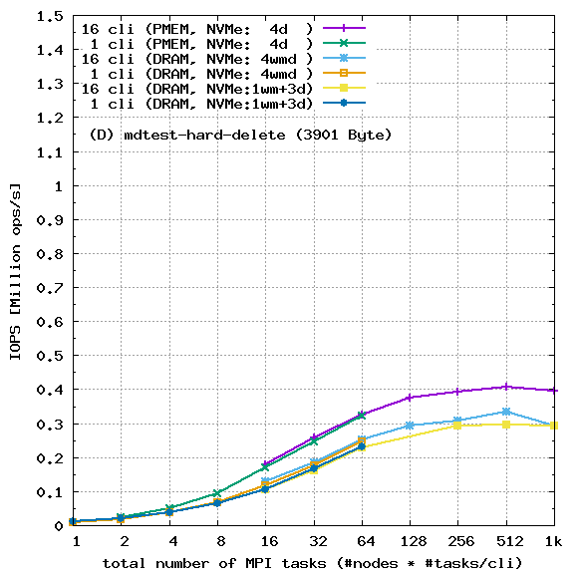
mdtest-hard (3901-Byte files): (C) read (D) delete
The information on this page is subject to the use and disclosure restrictions provided on Page 2 of this document. See backup for configuration details.

Slide 15
Summary and DAOS Resources
DAOS Metadata-on-SSD (Phase 1) is implemented (DAOS 2.4 tech preview)
Comparable performance to DAOS on Optane PMem for mdtest-stat, mdtest-read. Some (up to 20%) degradation for mdtest-write, mdtest-delete (synchronous WAL)
Future Phase 2 of MD-on-SSD: Enable migration of “cold” metadata to data blobs
Will reduce DRAM capacity requirements (as a percentage of NVMe capacity)
DAOS Community Resources:
Github: https://github.com/daos-stack/daos
Online doc: https://docs.daos.io/
Mailing list & slack: https://daos.groups.io/
Recordings from 6th DAOS User Group at SC22: https://dug.daos.io/
Intel landing page for DAOS: https://www.intel.com/content/www/us/en/high-performance-computing/daos.html

Slide 17
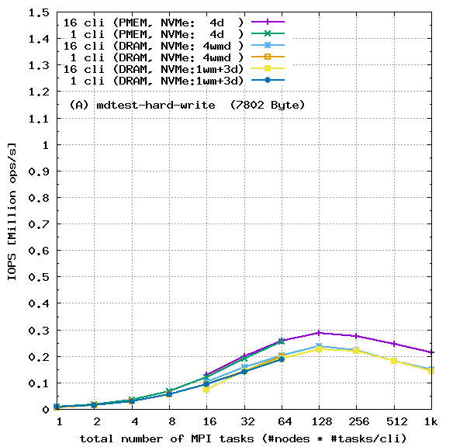
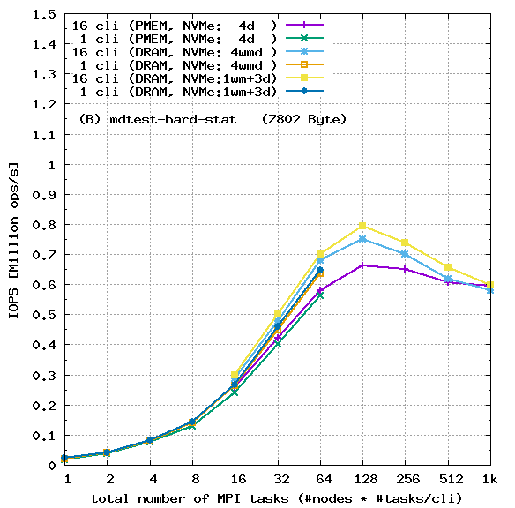
mdtest-hard2 (7802-Byte files): (A) write (B) stat
The information on this page is subject to the use and disclosure restrictions provided on Page 2 of this document. See backup for configuration details.

Slide 18
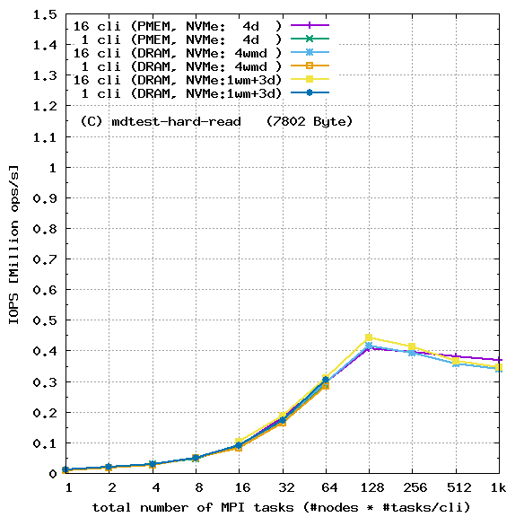
mdtest-hard2 (7802-Byte files): (C) read (D) delete
The information on this page is subject to the use and disclosure restrictions provided on Page 2 of this document. See backup for configuration details.

Slide 19
System Configuration Details (1/3)
1x to 16x ICX
Compute Nodes
2x Xeon® Platinum 8352Y CPU @ 2.20GHz 1x ConnectX-6 Mellanox® HDR 1x to 64x MPI tasks per node (scaling runs with 1-1024 MPI tasks total)
InfiniBand HDR Fabric
DAOS 2.3.106-2 (500GB PMem plus 4 x P5500 NVMe)
DAOS 2.3.106-2 (125GB DRAM plus 4 x P5500 NVMe)
1x DAOS Server, ICX
(1x daos_engine active)
1x DAOS Server, ICX
(1x daos_engine active)
2x Xeon® Platinum 8352Y CPU @ 2.20GHz (1x used) 2x ConnectX-6 Mellanox® HDR (1x used)
16x DRAM 16GB DDR4 16x Optane 200 PMem 128GB DIMMs (8x used for SCM) 8x P5500 3.84TB SSDs (4x used)
2x Xeon® Platinum 8352Y CPU @ 2.20GHz (1x used) 2x ConnectX-6 Mellanox® HDR (1x used)
16x DRAM 16GB DDR4 (156GB used for SCM/tmpfs) 16x Optane 200 PMem 128GB DIMMs (none used) 8x P5500 3.84TB SSDs (4x used)

Slide 20
System Configuration Details (2/3)
Tests by Intel as of 02-May-2023.
DAOS Client Hardware (up to 16x nodes): 2x Xeon® Platinum 8352Y CPU @ 2.20GHz, 16x16GB=256GB DDR4 memory, 1x ConnectX-6 HDR adapter.
DAOS Client Software and Benchmark: Rocky Linux 8.6. MLNX_OFED 5.8-1.0.1. DAOS 2.4 Technology Preview (daos-2.3.106-2.9536.ge3c942ec). Synthetic I/O benchmark “mdtest” (measuring POSIX file create/write, stat, read, delete rates). Scaling tests on 1 and 16 compute nodes, 1 to 64 MPI tasks per node.
DAOS Server Hardware (1x Server): 2x Xeon® Platinum 8352Y CPU @ 2.20GHz,​ 16x16GB=256GB DDR4 memory, 16x Optane 200 Series 128GB PMem, 8x Intel P5510 NVMe SSD, 2x ConnectX-6 HDR adapter. One DAOS engine active (1x CPU, 8x PMem, 4x NVMe, 1x HDR).
DAOS Server Software and DAOS Configuration Variants: Rocky Linux 8.6. MLNX_OFED 5.8-1.0.1. DAOS 2.4 Technology Preview (daos-2.3.106-2.9536.ge3c942ec). Variations in daos_server.yml configuration:
PMem code path (baseline): scm_class=dcpm.
MD-on-SSD code path: scm_class=ram, scm_size=156; bdev_roles=wal,meta,data

Slide 21
System Configuration Details (3/3)
Compute Nodes (all runs)
DAOS Server (all runs and config variations)
Name | ice[2701-2760] | nvm0801
Time | Sun Apr 30 08:13:25 UTC 2023 | Sun Apr 30 09:15:52 UTC 2023
Manufacturer | Lenovo | Lenovo
Product Name | ThinkSystem SD630 V2 | ThinkSystem SR630 V2
BIOS Version | U8E120L-1.40 | AFE120G-1.40
OS | Rocky Linux 8.6 (Green Obsidian) | Rocky Linux 8.6 (Green Obsidian)
Kernel | 4.18.0-372.32.1.el8_6.x86_64 | 4.18.0-372.32.1.el8_6.x86_64
Microcode | 0xd000375 | 0xd000375
IRQ Balance | Enabled | Enabled
CPU Model | Intel(R) Xeon(R) Platinum 8352Y CPU @ 2.20GHz | Intel(R) Xeon(R) Platinum 8352Y CPU @ 2.20GHz
Base Frequency | 2.2GHz | 2.2GHz
Maximum Frequency | 3.4GHz | 3.4GHz
All-core Maximum Frequency | 2.8GHz | 2.8GHz
CPU(s) | 128 | 128
Thread(s) per Core | 2 | 2
Core(s) per Socket | 32 | 32
Socket(s) | 2 | 2
NUMA Node(s) | 4 | 2
Prefetchers | L2 HW, L2 Adj., DCU HW, DCU IP | L2 HW, L2 Adj., DCU HW, DCU IP
Turbo | Enabled | Enabled
PPIN(s) | 518a76d20b127bdf,518d66d26f9e1af5 | 3298abde53e17753,3a9f9fdeaa9f693a
Power & Perf Policy | Performance | Performance
TDP | 205 watts | 205 watts
Frequency Driver | acpi-cpufreq | intel_cpufreq
Frequency Governer | performance | ondemand
Frequency (MHz) | 2200 | 2200
Max C-State | 9 | 9
Installed Memory | 256GB (16x16GB DDR4 3200 MT/s [3200 MT/s]) | 256GB (16x16GB DDR4 3200 MT/s [3200 MT/s]); 2075648MB (16x129728MB Logical non-volatile device 3200 MT/s [3200 MT/s])
Huge Pages Size | 2048 kB | 2048 kB
Transparent Huge Pages | always | always
Automatic NUMA Balancing | Enabled | Enabled
NIC Summary | 1x Mellanox ConnectX-6 HDR (MT28908) | 2x Mellanox ConnectX-6 HDR (MT28908)
Drive Summary | n/a | 2x M.2 (SSSTC CVB-8D128) 8x Intel D7-P5500 NVMe (SSDPF2KX038T9L)

