Slide 1
Closing Remarks IXPUG Workshop Asia 2019
Taisuke Boku
Steering Committee Member of IXPUG
University of Tsukuba

Slide 2
Worldwide organization
Optimization of scientific applications on Intel based HPC systems
Now Intel eXtreme Performance Users Group
Originally Intel Xeon Phi Users Group
Expanding focus to system hardware beyond the processor, software tools & porgraming models, new workloads (e.g. viz, data analytics, ML)
http://www.ixpug.org/

Slide 3
Free exchange of information and ideas
Meetings and activities open to everyone
No cost or barrier to participate
Independent and member run
Strong support from, and interactions with, Intel
http://www.ixpug.org/

Slide 4
Leadership
President: Thomas Steinke, Zuse Institute Berlin
Vice President: Glenn Brook, University of Tennessee
Acting Secretary: Melyssa Fratkin, Texas Advanced Computing Center

Slide 5
Steering Committee

Slide 6
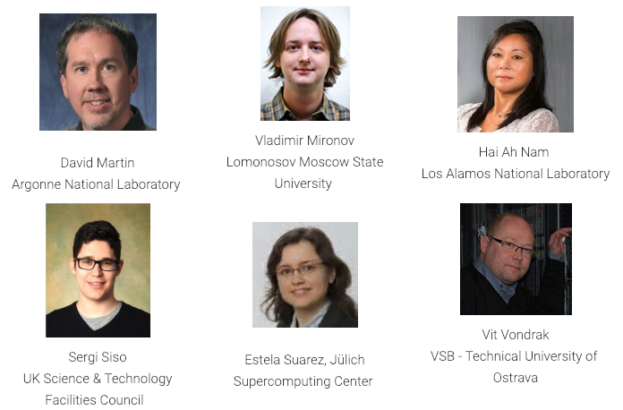
Steering Committee (cont.)

Slide 7
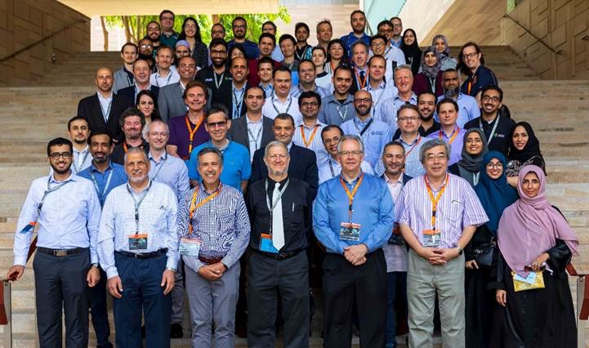
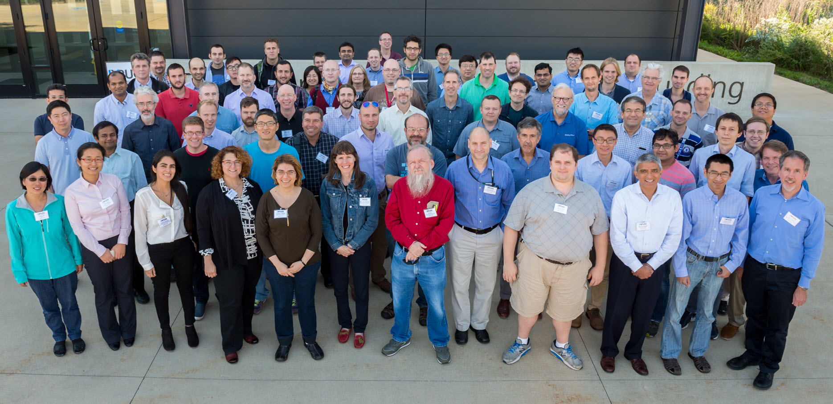
15 major events in 2 years!

Slide 8
Upcoming Events
Workshop at HPC Asia, January 14, 2019 – Guangzhou, China
IXPUG Workshop at ISC19, June 20, 2019 – Frankfurt, Germany
IXPUG Annual Meeting, TBD – Berlin, Germany

Slide 9
ISC19 IXPUG Workshop: “Using FPGAs to Accelerate HPC & Data Analytics on Intel-Based Systems”
The workshop will bring together software developers, scientists, academia, and industry luminaries to share learnings around the integration and use of FPGA devices in HPC, Data Analytics, and Artificial Intelligence (Machine Learning and Deep Learning) workloads in Intel-based HPC systems. The workshop will cover strategies for migrating workloads onto FPGAs, performance comparisons, aspects of productivity, performance portability, and scalability.
Date: June 20, 2019
Location: Messe, Frankfurt, Germany
Registration: The workshop is held in conjunction with the ISC 2019 in Messe Frankfurt. To attend the IXPUG workshop, you must register through the ISC 2019 Conference website specifically for workshops.
Agenda: to be featured on the IXPUG website, upon completion of paper submissions review process
Important Dates:
Call for Papers Open: January 14, 2019
Deadline for Paper Submissions and Uploaded to IXPUG EasyChair: April 14, 2019
Final Paper Acceptance Notifications: May 21, 2019
Final Paper Submission and Uploaded to IXPUG EasyChair: June 19, 2019

Slide 10
How to Get Involved
Join IXPUG (www.ixpug.org)
Connect with us on Twitter @IXPUG1
Contribute to an IXPUG Forum
Participate in an IXPUG Working Group
Attend an IXPUG Event
Volunteer for the Program Committee for an IXPUG Event
Submit Your Work to an IXPUG Event
Host an IXPUG Event
Volunteer for the IXPUG Steering Group

Slide 12
See you at IXPUG Workshop ISC2019 in Frankfurt!! (June 20th, 2019) Paper submission has been opened today (~April 14th) http://www.ixpug.org/

