Slide 1
OpenCL-enabled High Performance Direct Memory Access for GPU-FPGA Cooperative Computation
IXPUG Asia Workshop @ Guangzhou, China
15:40 - 16:00, January 14, 2019
Ryohei Kobayashi^{1,2)}, Norihisa Fujita¹⁾,
Yoshiki Yamaguchi^{2,1)}, Taisuke Boku^{1,2)}
1: Center for Computational Sciences, University of Tsukuba
2: Faculty of Engineering Information and Systems, University of Tsukuba
Notes:
Thank you for your nice introduction and thank you all for coming today.
I’m Ryohei Kobayashi, and an assistant professor of University of Tsukuba.
Today, I would like to talk about OpenCL-enabled High performance DMA for GPU-FPGA Cooperative Computation.
OK, let’s get started.

Slide 2
Accelerators in HPC
The most popular one: GPU
  Strengths
    large scale SIMD (SIMT) fabric in a chip
    high bandwidth memory (GDDR5, HBM)
  GPUs do not work well on applications that employ
    partially poor parallelism
    non-regular computation (warp divergence)
    frequent inter-node communication
FPGAs have been emerging in HPC
  true co-designing with applications (indispensable)
  OpenCL-based FPGA development toolchains are available
  high bandwidth interconnect: ~100 Gbps x 4
Notes:
Today, using accelerators for HPC applications is widely spread, and GPU is the most popular.
you know, GPU are very suitable for parallel applications depending on very wide and regular computation because of the following two reasons.
But, GPU is not suitable for applications that employ “partially poor parallelism”, “non-regular computation”, “frequent inter-node communication”.
So, GPU is not almighty, unfortunately.
To solve these problems, FPGAs have been emerging in HPC.
Here is good points of today‘s FPGA for HPC.
It enables true co-designing with applications.
Its programming effort is reduced compared to the past.
It has high bandwidth interconnect.

Slide 3
Accelerator in Switch (AiS) concept
What’s this?
  using FPGA for not only computation offloading but also communication
  covering GPU non-suited computation by FPGA
  combining computation offloading and ultra-low latency communication among FPGAs
  especially effective on communication-related small/medium computation (such as collective communication)
  OpenCL-enable programming for application users
<- currently we are working on
Notes:
we have a concept called Accelerator in Switch and this figure is what the concept looks like.
In this concept, FPGA is used for not only computation offloading but also communication.
The computation offloading means covering GPU non-suited computation by FPGA.
So, we aims to combine computation offloading and ultra-low latency communication among FPGAs.
Because of low-latency data movement, AiS is especially good at communication-related small/medium computation (such as collective communication).
And finally, this concept has been assuming that application users can use OpenCL programming environment and this is what we’ve been trying to realize

Slide 4
One issue in realizing this concept
How do we (you) make GPUs and FPGAs work together and control that operation?
Purpose of study
  realizing data movement approaches for GPU-FPGA cooperative computation
    allowing the FPGA (OpenCL kernel) to autonomously perform the DMA-based data movement (not through CPU)
    making use of Intel FPGAs and development toolchains
Comp. node
Traditional method
Proposed method
Notes:
One issue for realizing that concept is how to make all devices, particularly GPUs and FPGAs, work together and to control that operation.
In this study, we focus on realizing data movement approaches for GPU-FPGA cooperative computation.

Slide 5
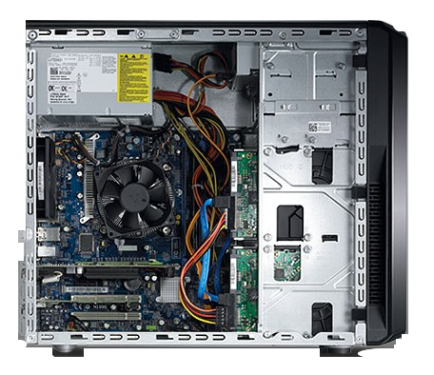
Programming model of
Intel FPGA SDK for OpenCL
OpenCL host code
OpenCL kernel code
Standard
C
Compiler
Intel
Offline
Compiler
Verilog HDL
Files
x86 host PC
exe
aocx
FPGA
accelerator
PCIe
Notes:
We use Intel FPGA SDK for OpenCL, which is OpenCL-based FPGA development toolchain, and here is the programming model.
Similar to CPUs and GPUs, programmers must prepare two kinds of code: OpenCL host and OpenCL kernel.
The host code is compiled using a standard C compiler like GCC to generate a host binary.
The kernel code is compiled using an Intel FPGA OpenCL compiler offered by the toolchain to convert into synthesizable Verilog HDL files, which are then used in Quartus Prime to generate an aocx file that includes FPGA configuration information.
The aocx file is downloaded to the FPGA at runtime of the host application by using APIs, and data required for the kernel execution as well as its resulting data are transferred via the PCIe bus.

Slide 6
Schematic of the Intel FPGA SDK for an OpenCL platform
OpenCL kernel code
FPGA board
Translated by
Intel Offline Compiler
These features like peripheral controllers are provided from Board Support Package (BSP)
Notes:
Here is a schematic of the Intel FPGA SDK for an OpenCL platform.
The host application is implemented using the OpenCL host code and the OpenCL kernel code is compiled into the application-specific pipelined hardware.
These features like PCIe/memory controllers, which are required for realizing OpenCL programming environment, are provided from Board Support Package

Slide 7
BSP: Board Support Package
FPGA board
description specifying FPGA chip and board peripherals configuration and access/control method
  a sort of virtualization to enable same kernel development on an FPGA
  independent for each board with FPGA
What we‘ve done for this study is
  to modify a PCIe controller in a BSP so that an FPGA can access GPU global memory directly through the PCIe bus
  to control such DMA feature from OpenCL kernel code using I/O Channel API
OpenCL kernel
BSP
PCIe
Controller
We’ve modified this component
Notes:
The BSP is a description specifying FPGA chip and board peripherals configuration and how to access and how to control.
In this study, what we have done is to

Slide 8
Overview of performing GPU-FPGA DMA
CPU-side settings (once only)
  ① mapping GPU global memory to PCIe address space
  ② sending PCIe address mapping information of GPU global memory to the FPGA
FPGA-side settings
  ③ generating a descriptor based on the GPU memory address and sending it
  ④ writing the descriptor to the DMA controller
  ⑤ performing GPU-FPGA DMA transfer
  ⑥ receiving the DMA completion notification
  ⑦ getting the completion notification through an I/O channel
Notes:
Here is overview of performing GPU-FPGA DMA we have proposed.
Unfortunately, I have no time to explain all of these parts in detail, so I pick up the important procedures which are marked in red.

Slide 9
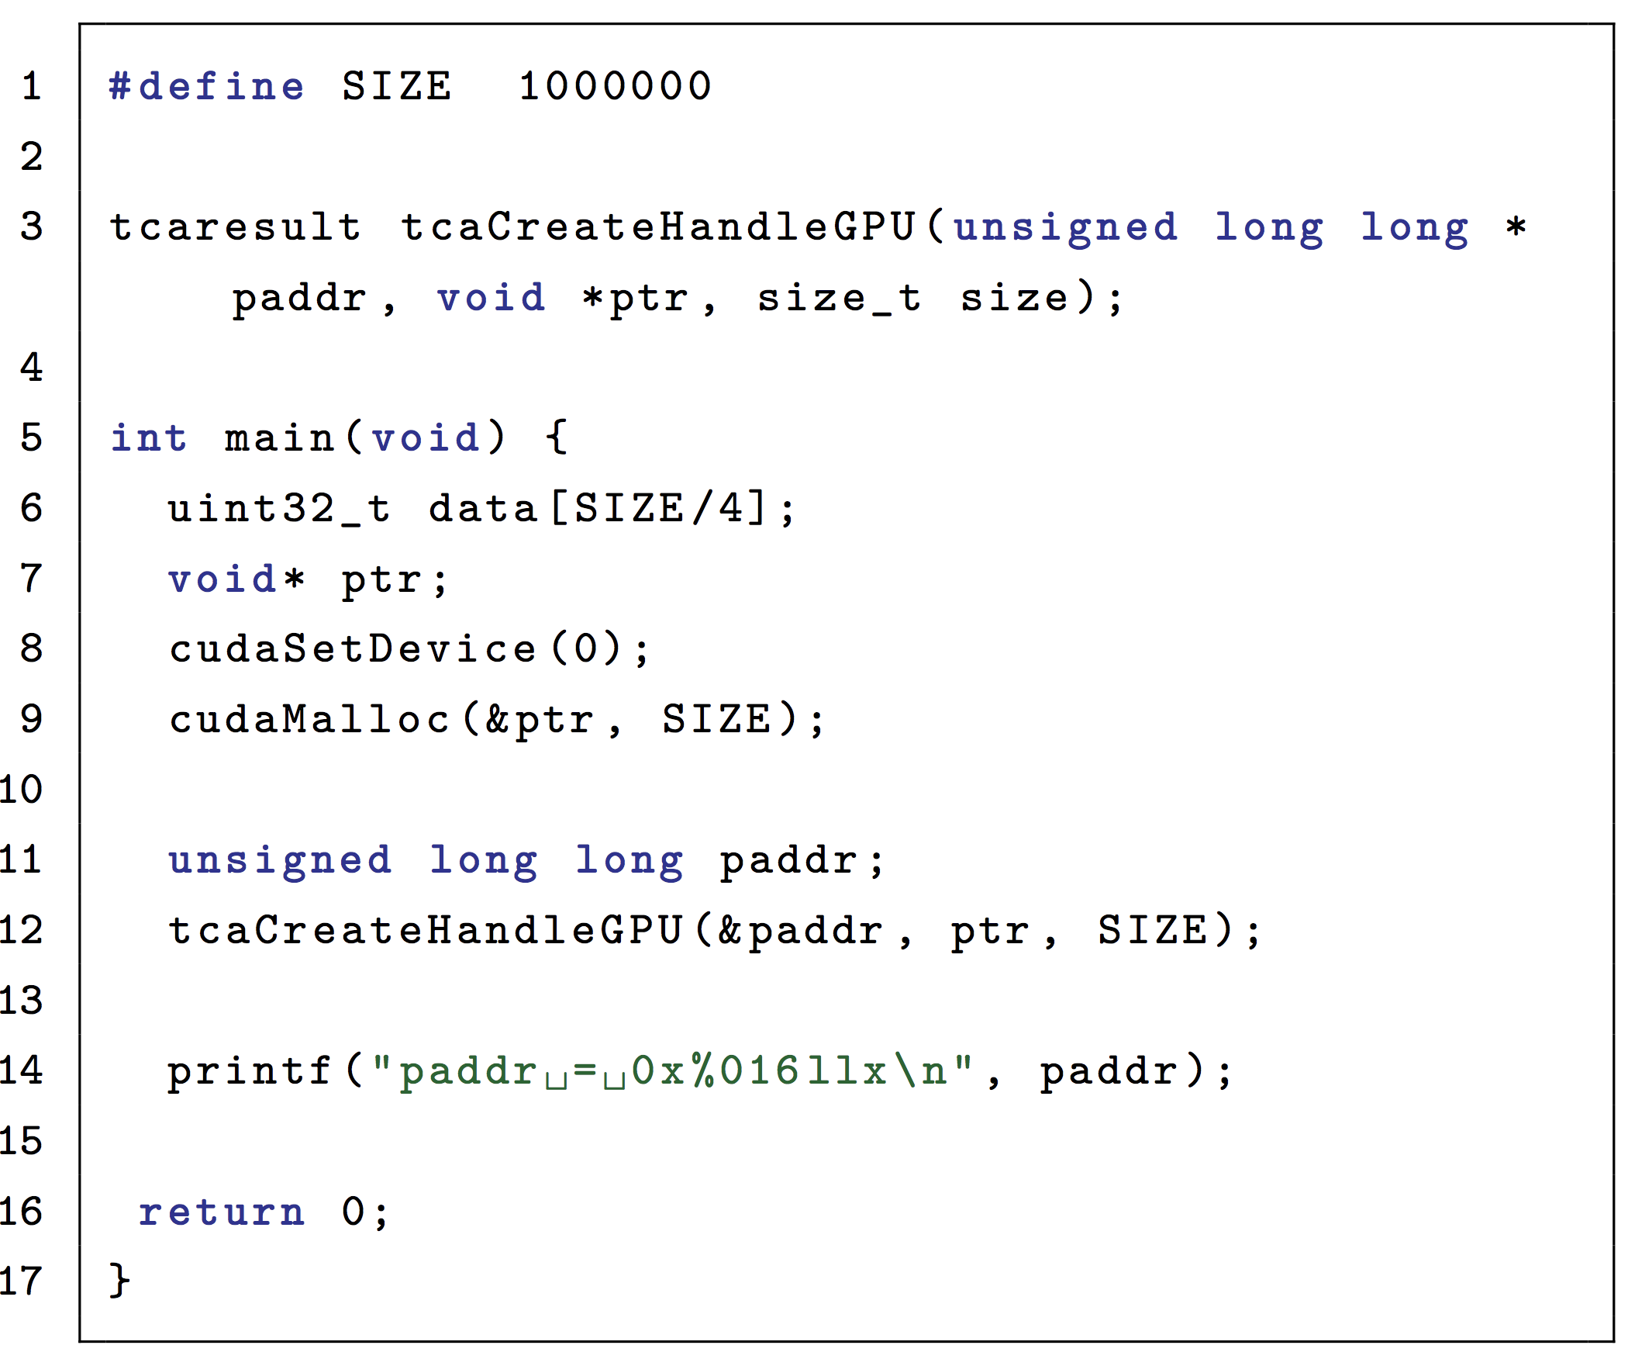
① mapping GPU global memory to PCIe address space
Using PEACH2 API*
  getting the global
  memory address (paddr)
  mapped to PCIe
  address space
  NVIDIA Kernel API is
  working internally
  (GPU Direct for RDMA)
* Hanawa, T et al., Interconnection Network for Tightly Coupled Accelerators,
2013 IEEE 21st Annual Symposium on High-Performance Interconnects, pp 79-82
Notes:
First, what we have to do is to map GPU global memory to PCIe address space and to get the mapped memory address information.
To do that, we use PEACH2 API, and here is corresponding part.
After getting the mapped address information, it is sent to FPGA to generate a descriptor.

Slide 10
③ generating a descriptor and sending
Descriptor: a table for DMA transfer
  src addr, dst addr, data length, ID of a descriptor
    If src addr is paddr and dst addr is FPGA memory address, then FPGA ← GPU comm. is invoked.
Kernel code
Descriptor definition
Setting data
Sending a descriptor to
the Descriptor Controller
Notes:
Descriptor is a table for performing DMA transfer, which is composed of source and destination addresses, data length for transfer, ID of a descriptor.
For example, If src addr is paddr and dst addr is FPGA memory address, then FPGA ← GPU comm. is performed.
Here is kernel code for performing GPU-to-FPGA DMA transfer.

Slide 11
⑦ getting the completion notification through an I/O channel
using read_channel_intel function
  reading the completion notification stored in the Descriptor Controller
  We use elapsed cycles from ③ to ⑦ for comm. evaluation
Kernel code
#pragma OPENCL EXTENSION cl_intel_channels : enable
channel ulong dma_stat
__attribute__((depth(0))) __attribute__((io("chan_dma_stat")));
...
ulong status;
status = read_channel_intel(dma_stat);
Notes:
After DMA transfer completes, getting that completion notification is needed.
To do that, read_channel_intel function is used, which is also I/O channel API.
This reads the completion notification stored in the Descriptor Controller and here is a corresponding kernel code.
We use elapsed cycles from 3 to 7, for evaluation we will talk from the next slide.

Slide 12
Evaluation testbed
Pre-PACS version X (PPX)
  working at Center for Computational Sciences, University of Tsukuba.
Hardware specification
CPU | Intel Xeon E5-2660 v4 x2
Host Memory | DDR4-2400 16GB x4
GPU | NVIDIA Tesla P100 x2 (PCIe Gen3 x16)
FPGA | Intel Arria 10 GX (BittWare A10PL4) (PCIe Gen3 x8)
Software specification
OS | CentOS 7.3
Host Compiler | gcc 4.8.5, g++ 4.8.5
GPU Compiler | CUDA 9.1.85
FPGA Compiler | Intel Quartus Prime Pro Version 17.1.2.304
A computation node of PPX
Notes:
This slide shows our evaluation testbed called Pre-PACS-X, which is working at Center for Computational Sciences, University of Tsukuba.
This is not ‘X’, this is Roman numerals, OK.
A computation node of PPX has two Intel Xeon CPUs, two NVIDIA P100 GPUs, a single FPGA board and InfiniBand Host Channel Adapter.
The OS and software toolchains we used are shown here.

Slide 13
Communication paths for GPU-FPGA data movement
Traditional method
  GPU-FPGA data movement through a CPU
    CPU-FPGA: OpenCL API, CPU-GPU: cudaMemcpy
  This entire communication time is measured with high_resolution_clock function implemented in the C++11 chrono library
Proposed method
  FPGA autonomously performs GPU-FPGA DMA transfer
  Time measurement:
    using an OpenCL helper function to get elapsed cycles for the DMA transfer
  Measurement of elapsed time for FPGA → GPU data comm.
    (time of FPGA → GPU → FPGA comm.) – (time of GPU → FPGA comm.)
Traditional method
Proposed method
Notes:
Here is two patterns of the GPU-FPGA data movement, which is traditional method and proposed method.
In traditional method, GPU-FPGA data movement is performed through a CPU, which means CPU-FPGA comm uses OpenCL API, cudaMemcpy is used for CPU-GPU comm.
In proposed method, FPGA autonomously performs GPU-FPGA DMA transfer and in this evaluation, we use an OpenCL helper function to get elapsed cycles for the DMA transfer.

Slide 14
Communication latency
Data size: 4 Bytes
  the minimum data size that the DMA controller in the PCIe IP core can handle
FPGA ← GPU data comm.
  11.8x improvement
FPGA → GPU data comm.
  33.3x improvement
 | Latency
Traditional | 17 μsec
Proposed | 1.44 μsec
 | Latency
Traditional | 20 μsec
Proposed | 0.60 μsec

Slide 15
Communication bandwidth
Data size: 4 ~ 2G(2³⁰) Bytes
Up to 6.9 GB/s (FPGA → GPU)
The maximum effective bandwidth is achieved at the earlier phase by low latency
Up to 4.1 GB/s (FPGA ← GPU)
Higher is Better
Performance degradation begins
(FPGA ← GPU)
4K
64K
1M
16M
256M

Slide 16
Conclusion
Proposal
  a high-performance OpenCL-enabled GPU-FPGA DMA method for making both devices work together
    allowing the FPGA (OpenCL kernel) to autonomously perform the DMA-based data movement (not through CPU)
Evaluation
  latency:
    our proposed method is better in both cases
    up to 33.3x improvement
  bandwidth:
    FPGA ← GPU: better in the case of less than 4MB
    FPGA → GPU: always better
      up to 6.9 GB/s (2.0x improvement)

Slide 17
Future work
How FPGA knows GPU computation completion?
  A sophisticated synchronization mechanism is needed
We do not want to write multiple code!!
(CUDA, OpenCL, etc)
  needs a comprehensive programming framework
    enabling the programming in a single language
Targeting real applications
    Currently, we are focusing on astrophysics application

Slide 19
Background
Notes:
OK, let’s get into the background

Slide 20
Accelerators in HPC
The most popular one: GPU
  Strengths
    large scale SIMD (SIMT) fabric in a chip
    high bandwidth memory (GDDR5, HBM)
  GPUs do not work well on applications that employ
    partially poor parallelism
    non-regular computation (warp divergence)
    frequent inter-node communication
FPGAs have been emerging in HPC
  Strengths
    true co-designing with applications (indispensable)
    OpenCL-based FPGA development toolchains are available
    high bandwidth interconnect: ~100 Gbps x 4
  Problems
    FPGAs still cannot beat GPU in terms of
      absolute performance (FLOPS)
      memory bandwidth
→ Don’t try what GPU can perform well
Notes:
There are a lot of accelerators such as Clear Speed, Cell Broadband Engine, GRAPE, Xeon Phi, MATRIX-2000, etc.
And among them, the most popular one is GPU, you know? And here is GPU-based HPC clusters.
GPU are very suitable for parallel applications depending on very wide and regular computation because of the following two reasons.
But, GPU is not suitable for applications that employ “partially poor parallelism”, “non-regular computation”, “frequent inter-node communication”.
So, what I’d like to say is GPU is not almighty, unfortunately.

Slide 21
Each device’s pros and cons
 | performance (FLOPS) | external comm. | programming effort
CPU | △ | ○ | ◎
GPU | ◎ | △ | ○
FPGA | ○ | ◎ | × -> △? recently getting better
Each device’s strength and weakness are different
A technology to compensate with each other is needed for more driving HPC forward
  offering large degree of strong scalability
Notes:
According to each device’s characteristics, we summarize each device’s strength and weakness in this table. This row is for CPU’s pros and cons.
Of course, each device’s strength and weakness are different.
What I‘d like to say is a technology to compensate with each other is needed for more driving HPC forward, which can offer good strong scalability.
For realizing such a technology,

Slide 22
Intel FPGA SDK for OpenCL
Notes:
From now on, I’ll talk about Intel FPGA SDK for OpenCL

Slide 23
BSP: Board Support Package
FPGA board
description specifying FPGA chip and board peripherals configuration and access/control method
  a sort of virtualization to enable same kernel development on an FPGA
  independent for each board with FPGA
Basically, only minimum interface is supported
  minimum interface:
  external (DDR) memory and PCIe
OpenCL kernel
BSP
Notes:
The BSP is a description specifying FPGA chip and board peripherals configuration and how to access and how to control.
Basically, only minimum interface to enable OpenCL programming is supported.

Slide 24
What if we (you) want to control other peripherals from OpenCL kernel?
implementing that controller and integrating it into the BSP
  Ryohei Kobayashi et al., OpenCL-ready High Speed FPGA Network for Reconfigurable High Performance Computing, HPC Asia 2018, pp. 192-201
    integrating a network (QSFP+) controller into the BSP
The network controller can be controlled from OpenCL kernel code using an I/O Channel API
  E.g. FPGA-to-FPGA comm. in OpenCL
FPGA board
OpenCL kernel
BSP
additionally implemented
Notes:
So, if programmers want to perform inter-FPGA communication but BSPs do not offer the network controller, programmers must implement the controller and integrate it into the BSP, and that is what we did.
OK, let’s go on to the next slide and I’ll talk about the main content of this presentation.

Slide 25
What we‘ve done for this research
FPGA board
OpenCL kernel
modifying a PCIe controller in a BSP so that an FPGA can access GPU global memory directly through the PCIe bus
controlling the DMA feature from OpenCL kernel code using the I/O Channel API
  similar to the previous study
BSP
PCIe
Controller
We’ve modified this component
Notes:
The BSP is a description specifying FPGA chip and board peripherals configuration and how to access and how to control.
Basically, only minimum interface to enable OpenCL programming is supported.

Slide 26
OpenCL-enabled
GPU-FPGA DMA transfer
Notes:
From now on, I’ll talk about Intel FPGA SDK for OpenCL

Slide 27
④ writing the descriptor to the DMA controller
Descriptor controller
  A hardware manager for writing descriptor
  Our proposed method uses this controller through I/O channel API (OpenCL kernel)
  CPU also uses this module to perform CPU-FPGA DMA
    the exclusive access control is necessary

Slide 28
A descriptor is sent to the DMA controller by
a scheduler implemented in the descriptor controller
Additionally
implemented
Schematic of the hardware logic to control
the DMA transfer from OpenCL kernel

Slide 29
Evaluation

Slide 30
Conclusion and future work
Notes:
Oh, it‘s time to conclude this presentation

Slide 31
② PCIeアドレス空間にマップした
メモリアドレスをFPGAに送信
現在の実装では，OpenCLの初期化時に渡している
  OpenCLカーネルコードの引数にセット
hostコードでの操作
status = clSetKernelArg(kernel, argi++, sizeof(unsigned long long), &paddr);
aocl_utils::checkError(status, "Failed to set argument PADDR");
kernelコード
__kernel void fpga_dma(
__global uint *restrict RECV_DATA,
__global const uint *restrict SEND_DATA,
__global ulong *restrict E_CYCLE,
__global const uint *restrict NUMBYTE,
const ulong PADDR,
const uint DEBUG_MODE
)

Slide 32
GPU-FPGA間DMAデータ転送の実行手順
(SWoPP2018バージョン)
CPU側での設定
  ① GPUのメモリをPCIeアドレス空間にマップさせる
  ② ディスクリプタをホストで作成し，FPGAに書き込む
FPGA側での設定
  ③ ホストから受け取ったディスクリプタを DMA コントローラに書き込む
  ④ 通信が実行される
  ⑤ 完了信号が発行される
ディスクリプタ
DMAデータ転送に必要な情報
(例: 宛先アドレス) を含んだ構造体
FPGA上のPCIe IPコントローラのDMA機構に渡し, データ転送を起動

Slide 33
通信バンド幅の比較 (contʼd)
提案手法
  提案手法によるGPU-FPGA通信では，FPGAデバイスの
  PCIe接続が通信経路上において最も狭帯域であるため理論
  ピークバンド幅は 8 GB/s
    FPGA ← GPU: 最大 4.1 GB/s (51.3 %)
    FPGA → GPU: 最大 6.9 GB/s (86.3 %)
  FPGA ← GPUのバンド幅が低い原因は現在調査中
    おそらく，GPU側のDMAコントローラのメモリアクセス
      FPGA ← GPU の通信は，GPUにリードリクエストを送り，GPUからデータを送ってもらうので2回分の通信がある
    8 MBの通信からバンド幅が落ちる原因も調査中
      1つのディスクリプタで送信出来るデータサイズは最大で1M-4 bytes
      それ以上のデータサイズを転送する場合は，ディスクリプタを作り直し，繰り返しDMA転送を起動する必要がある (そのオーバーヘッドが影響)
従来手法
  通信がストアアンドフォワードで実行されるため
  理論ピークバンド幅が低い (通信レイテンシも大きい)
    FPGA ← GPU, FPGA → GPU 通信の実行効率は
    それぞれ最大 80.7 % と 78.8 %

Slide 34
本日報告する内容
前回の発表最後に今後の課題として申し上げた
“提案手法のOpenCL拡張” を実現しましたので，
それを報告致します

Slide 35
GPU-FPGA複合システムにおけるデバイス間連携機構
小林 諒平, 阿部 昂之, 藤田 典久, 山口 佳樹, 朴 泰祐
研究報告ハイパフォーマンスコンピューティング（HPC）/2018-HPC-165(26)/pp.1-8, 2018-07
GPUデバイスのグローバルメモリ, FPGAデバイスの内蔵メモリを
PCIeアドレス空間にマッピングすることで，
PCIeコントローラIPの持つDMA機構を用いて
双方のメモリ間でデータのコピーを行う
通信レイテンシの評価
通信バンド幅の評価
成果
・通信レイテンシにおいては， FPGA ← GPUは5.5倍，FPGA → GPUは19倍の性能差を確認
・通信バンド幅においては，一部を除き提案手法が優れていたことを確認

Slide 36
CPU
GPU
Global
memory
①
PCIe Controller
⑤
PCIe IP core
②
DMA
controller
④
⑥
Descriptor
Controller
External
memory
(DDR)
③
⑦
OpenCL kernel
FPGA

Slide 37
周波数が異なるので
ディスクリプタの受け渡しには
非同期FIFOが必要
プライオリティエンコーダで
適切に排他制御
OpenCLカーネルクロックドメイン
PCIe クロックドメイン (250 MHz)
readバス
PCIe IPコア
Descriptor Controller
OpenCL
kernel
CPU専用レジスタ
非同期FIFO
Read モジュール
追加した部分
from/to host/GPU
CPU専用レジスタ
非同期FIFO
Write モジュール
writeバス
外部メモリ

