Slide 1
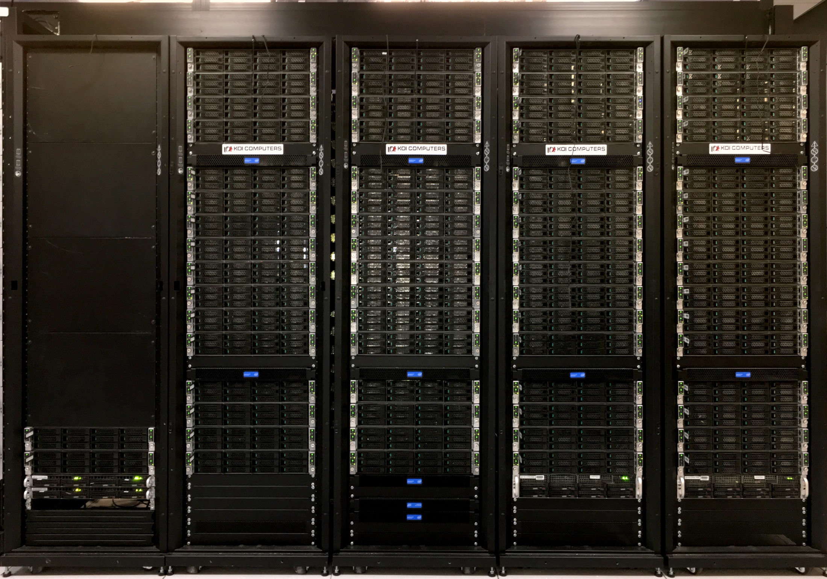
JLab “SciPhi-XVI” KNL Cluster
Thomas Jefferson National Accelerator Facility
Sandy.Philpott@jlab.org
IXPUG @ TACC 09/26/17

Slide 2
Background
The DOE USQCD project’s FY16 procurement was installed at JLab in August 2016
3 racks of 64 7230 KNL nodes, ~ $ 1M
In FY17 (October 3!), exercised the upgrade option in the award, for a 4th rack, ~ $ 0.25M, installed late October
Competitive procurement…
  Intel Xeon Phi / Knights Landing
  NVIDIA Pascal GPU, CUDA
  Intel Broadwell CPU server
Consideration factors
  hardware availability timeline
  high speed network – 100 Gbps price/performance; Omni-Path or Infiniband
  available configurations
  reflective benchmarks of USQCD codes
Strategy: optimize portfolio of machines to get the most science on the portfolio of applications
KNL proposals achieved highest aggregate score on all performance metrics and sub-metrics

Slide 3
Since install
4th rack of 64 nodes installed, for a total of 264 nodes
  and more temp location power circuits
Top500 #397! Green500 #10!
Relocation into new Hot Aisle Containment System last December
MCDRAM flat/cache reboots (sometimes hung?)
  daemon to switch not yet automated…
Multi-node job insight
  Reboot/power cycle between every job?
Early-ship KNL silicon … 26 nodes replaced as we discovered issues
User benchmarks … are sometimes hard to get ...
Testbed configured in June; one rack production in July
  Xppsl 1.5.1, OPA 10.3
  New production BIOS, along with chip screening
    R01.02.0072

Slide 4
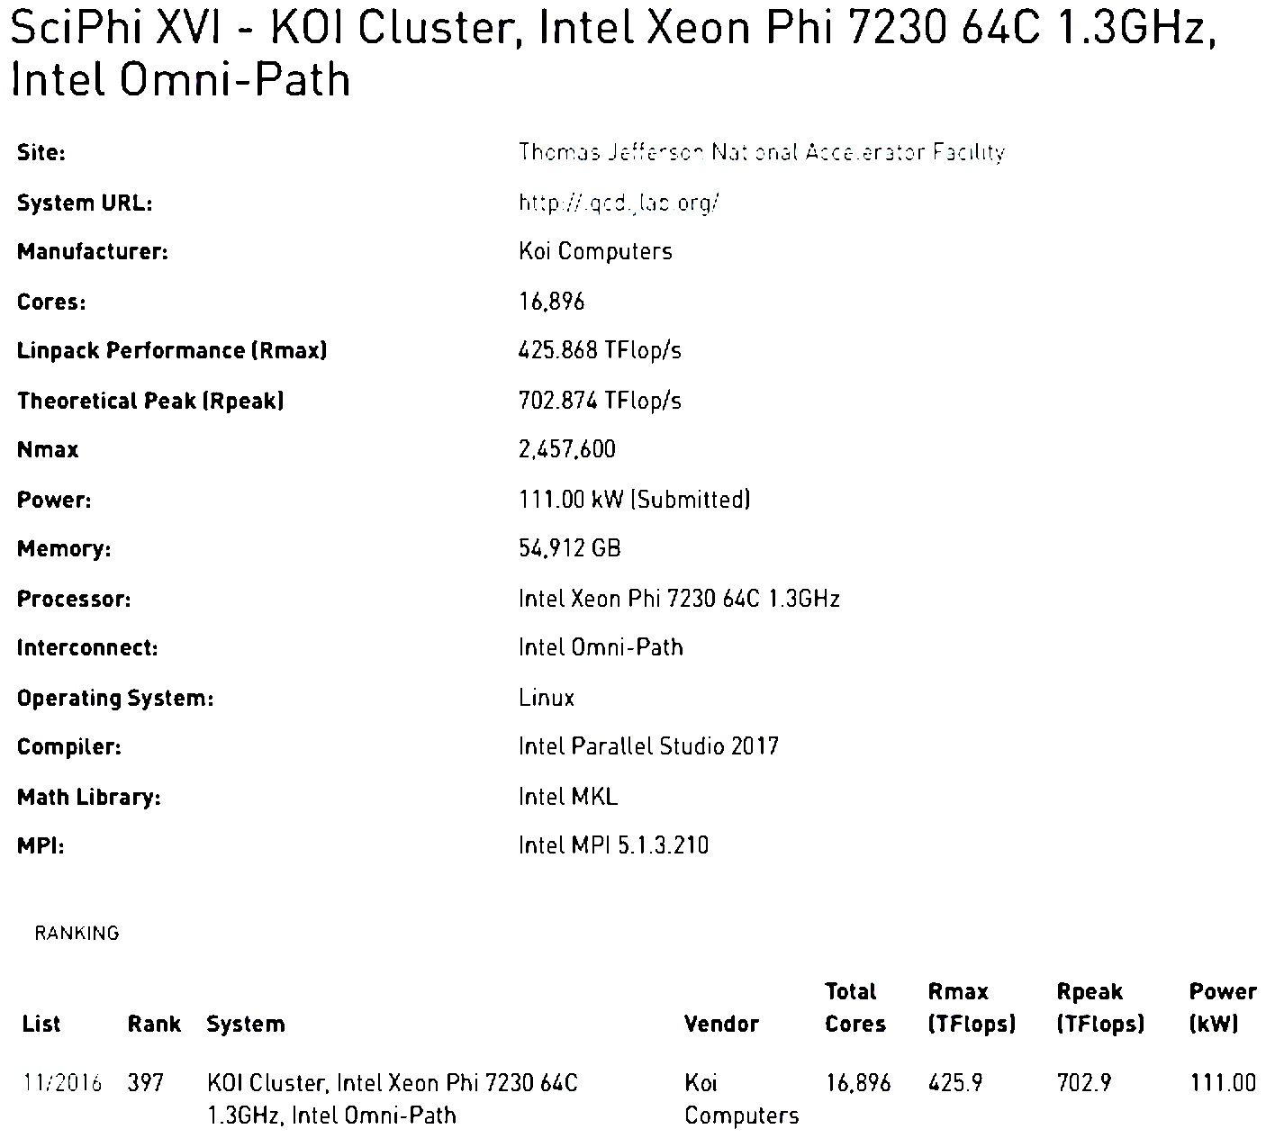
Top500 #397 on Nov ‘16 list

Slide 5
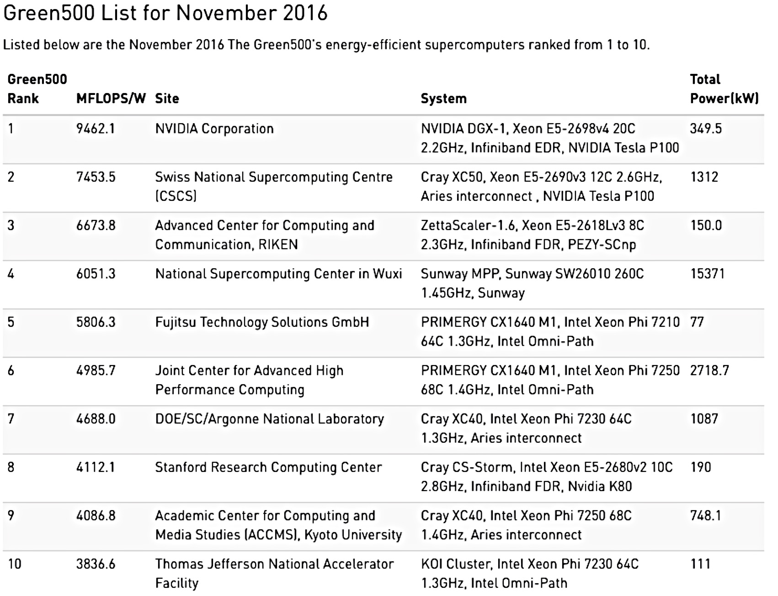
Green500 #10 on Nov ‘16 list

Slide 6
KNL Cluster Hardware
264 Intel Xeon Phi 7230
64 cores, 1.3GHz, 256 threads, 192GB RAM, 16GB MCDRAM
1 TB Seagate disk
Intel Omni-Path 100gbps
Total: 16,896 cores, >50 TB memory
Server Board:
Intel S7200AP
BIOS: S72C610.86B.01.01.0190.080520162104 (08/05/2016)

Slide 7
KNL Cluster Software
CentOS 7.2:
3.10.0-327.22.2.el7.xppsl_1.4.1.3272.x86_64
openMPI:
  openmpi-1.10.0-10.el7.x86_64
  openmpi_intel_hfi-1.10.2-8.x86_64
  openmpi_gcc-1.10.2-8.x86_64
  openmpi_gcc_hfi-1.10.2-8.x86_64
  openmpi_pgi_hfi-1.10.2-8.x86_64
Mvapich2
  mvapich2_gcc_hfi-2.1-4.x86_64
  mvapich2_pgi_hfi-2.1-4.x86_64
  mvapich2_intel_hfi-2.1-4.x86_64
  mvapich2_gcc-2.1-4.x86_64
Intel Parallel Studio
  parallel_studio_xe_2016.3.067
  parallel_studio_xe_2017

Slide 8
Memory options
Changing nodes with reboot to update BIOS to set MCDRAM to Flat or Cache mode per user job tag…
latest version of syscfg
(hwloc_dump_hwdata showed different settings?!)
Works … but nodes would often randomly hang during the process, remaining down until a required a power cycle ...
Turns out, Intel requires a CPU reset (IPMI “power cycle”) power cycle anyway to guarantee the memory setting
New solution in the works ...
Update the BIOS, check the chip set; if “old” – update ...
But this takes several hours of manual intervention on each node! Final arrangements await ...

Slide 9
Omni-Path
Spine : 4 64 port switches; Leaf switch uplinks in bundles of 6,6,4
for 256 nodes, 2 core switches consumed, 3rd support s 4 links to the file system plus 8 additional nodes with a little room to spare
32 nodes connect to a 48 port leaf switch
- nominally 2:1 oversubscribed, but effectively full bandwidth per node
Need more than a single core to drive OPA to full bandwidth
/dev/hfi1 driver – use the correct one, or
  hfi_userinit: PSM2 and driver version mismatch
  Driver initialization failure on /dev/hfi1 (err=23)
  [3] MPI startup(): tmi fabric is not available and fallback fabric is not enabled
Managed OPA switch subnet manager stopped running several times; recommended for <100 nodes
so, installed subnet manager on 2 hosts

Slide 10
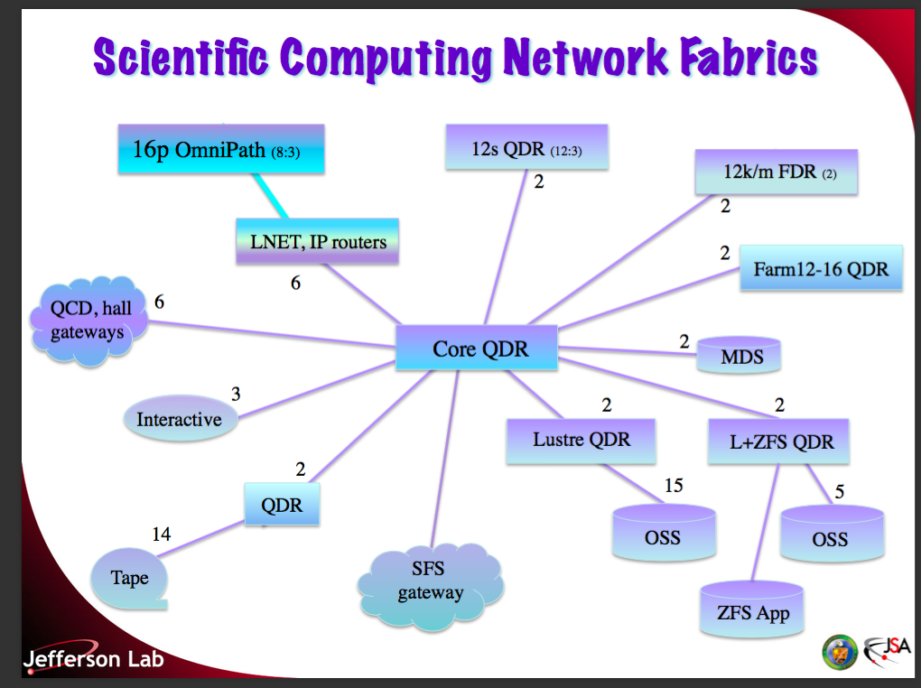
Adding OPA to the Fabric

Slide 11
OPA to IB File Systems
Omni-Path 16p nodes need to reach Lustre and NFS file services on the Infiniband QDR fabric…
Lustre: /cache (on tape), /volatile (scratch)
Use 4 LNet routers between OPA and IB
NFS : /home, /dist, /work
Use 2 JLab hosts with IB and OPA connections, with IP routing

Slide 12
Observations
Double check the power
  Our first HPL run tripped the single power panel
  PDU reached >100 KW, can run at 135KW, 90% of rating, when nodes distributed across 2 panels
5 nodes of 200 initially had hardware errors
  3 MCDRAM
  1 bad DIMM slot
  1 won’t POST
Transparent khugepaged problematic
  – turned off; watching …

Slide 13
Updates to PBS/Torque
prologue
sync; echo 3 > /proc/sys/vm/drop_caches
But, still problematic … must do it on every node in the job!
prologue.parallel
config
  Increase alarm timeout to execute the job prologue to 5 minutes
  our setting of 1 minute was leaving many jobs orphaned, nodes “busy”, required manual intervention
  $ prologalarm 300

Slide 14
Still To Do…
Benchmark users’ USQCD codes relative to conventional cores
  Currently assuming 3 Jpsi core hour, the reference for USQCD
Bin nodes into fast/medium/slow, with 80% in medium, so jobs land on consistently performant nodes (we’ve seen >10% spread) ?
Automate cache/flat memory reboots based on job demands
  PBS/Torque/Maui
Chip screening, BIOS updates for 3 more racks
  More spares on hand by vendor, to keep downtime < 0.5%
Investigate Zonesort kernel module, Intel Cluster Checker tool
More sharing experiences with other KNL sites

Slide 15
We want to share expertise!
  Fall16 HEPiX HPC BOF
  Procurements
  Allocations
  Benchmarks
  Software
  Porting
  Lessons learned
  NLCIO group brown bag lunches?
  IXPUG

