Slide 1
Early Results of Deep Learning on the Stampede2 Supercomputer
Zhao Zhang, Weijia Xu, Niall Gaffney, Daniel Stanzione
Texas Advanced Computing Center
zzhang@tacc.utexas.edu
Sep 26th, 2017

Slide 2
Outline
Overview
Technical Approach
Performance
Summary and Future Work

Slide 3
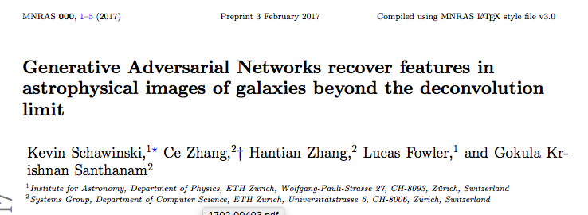

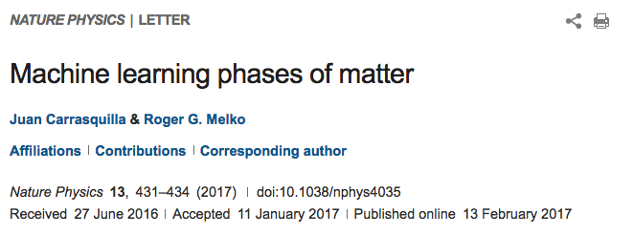
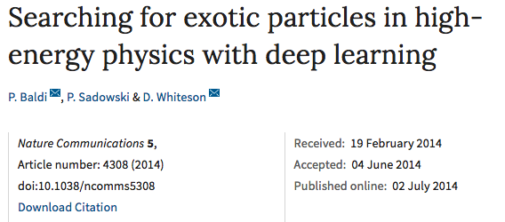
Deep Learning as a Methodology
Many scientists are exploring and adopting deep learning as the data science methodology to tackle their domain research challenge
  Astronomy
  Drug discovery
  Disease diagnosis
  Molecular dynamics
  Neurology
  Particle physics
  Social science

Slide 4
Deep Learning on HPC
Neural network is a good fit for HPC architecture
HPC can reduce the training turnaround time
  Minutes, Hours
    — Interactive research! Instant gratification!
  1-4 days
    Tolerable
    Interactivity replaced by running many experiments in parallel
  1-4 weeks
    High value experiments only
    Progress stalls
  >1 month
    Don’t even try
      — Jonathan Hseu, Google Brain Team

Slide 5
TACC’s Mission
To enable discoveries that advance science and society through the application of advanced computing technologies
TACC is embracing this new type of application and the programming paradigm changes it may bring

Slide 6
Technical Approach
Support a number of popular deep learning frameworks
  Caffe, MXNet, and TensorFlow at the moment
Support multiple modern architectures
  Intel KNL, Intel Xeon CPU, Nvidia GPU
Profile and present the performance of a suite of well-known deep learning applications
  ConvNet on the Cifar10 dataset, AlexNet, CaffeNet, GoogeNet on the ImageNet dataset

Slide 7
Status
We measured Caffe, MXNet, and TensorFlow performance on the Stampede2 supercomputer and our GPU-based Maverick cluster
Intel Caffe is available as a module on the Stampede2 supercomputer with the user guide in preparation

Slide 8
Outline
Overview
Approach
Performance
Summary and Future Work

Slide 9
Stampede2
Phase 1 of Stampede2 has 4,200 KNLs
96 GB DDR4 and 16 GB MCDRAM
100 Gb/s Intel Omni-Path interconnect
A Lustre deployment with ~40 PB storage

Slide 10
Software Stack
Intel Caffe (self_contained_MKLGOLD_u2)
Machine Learning Scaling Library -- MLSL (v2017-Preview)
MKLML (2017.0.2.20170110)
Intel MPI 17.0.4
MXNet (v0.10.0-79-g790328f)
TensorFlow (v1.3.0-rc2)

Slide 11
Single-node Performance — Caffe
Goal:
  Find out the OMP_NUM_THREADS configuration for best performance on a KNL
  Compare the MKL2017 kernel and the default kernel
Methodology:
  Fix the workload of ConvNet with Cifar10 dataset and CaffeNet with ImageNet-100 dataset
  Run the workloads with {32, 64, 128} OpenMP threads

Slide 12
Single-Node Performance - Caffe
MKL2017 has a 1.4-3.7x speedup compared to the default kernel
64 OpenMP threads deliver the best performance

Slide 13
Single-node Performance — Architecture Comparison
Goal:
  Understand the performance difference between KNL and Nvidia’s K40 and P100
Methodology:
  Fix the workloads
  Run ConvNet, CaffeNet, AlexNet, and GoogleNet on one KNL, one K40, and one P100

Slide 14
Single-node Performance — Architecture Comparison
One KNL is 2x faster than one K40
One KNL is 40-80% slower than one P100

Slide 15
Single-node Performance — MXNet and TensorFLow
Slowdown summary of MXNet and TensorFlow on KNL
 | MXNet | TensorFlow
K40 | 1.2-3.7x | 5.0-22.3x
P100 | 5.3-14.1x | 18.9-59.0x

Slide 16
Multi-node Performance - Strong Scaling Caffe
Goal:
  Understand the strong scaling pattern of Caffe
Methodology:
  Fix the mini-batch size of each model
  Fix the number of epochs
  Run ConvNet, CaffeNet, AlexNet, and GoogleNet on {1, 2, 4, 8} KNLs
mini-batch size {
Number of Epochs
Guaranteed Generalization!
mini-batch size {
Number of Epochs

Slide 17
Multi-Node Performance — Strong Scaling Caffe
~50% strong scaling efficiency

Slide 18
Multi-Node Performance — Strong Scaling Caffe
2 KNLs deliver similar performance to one P100 for CaffeNet, AlexNet, and GoogleNet

Slide 19
Multi-node Performance — Weak Scaling Caffe
Goal: to understand the weak scaling pattern of Caffe
Methodology:
  Increase the mini-batch size proportionally to node count
  Fix the number of epochs
  Run ConvNet, CaffeNet, AlexNet, and GoogleNet on {128, 256, 512, 1024} KNLs with
mini-batch size {
Number of Epochs
mini-batch size {
Guaranteed Generalization?
Number of Epochs

Slide 20
Multi-Node Performance — Weak Scaling Caffe
MLSL stops working
Pure MPI mode
Known largest working scale: 768

Slide 21
Summary
TACC has three popular deep learning frameworks, Caffe, MXNet, and TensorFlow running on the Stampede2 supercomputer
A single KNL performance with Caffe is ~2x faster than a K40 and ~40%-80% slower than a P100
Strong scaling Caffe with the same mini-batch size has ~50% efficiency on 4 KNLs
Weak scaling Caffe with large mini-batch size has ~80% efficiency on 512 KNLs

Slide 22
Ongoing and Future Work
Improving the Caffe scalability with Intel
Deploying the Layer-wise Adaptive Rate Scaling (LARS) algorithm to enable large mini-batch size training with less time
Possibly optimize MXNet and TensorFlow performance with Intel

Slide 23
THANKS
Q&A

