Slide 1
A Comparative Evaluation of Xeon Phi Platforms Based on a Hodgkin-Huxley Neuron Simulator
George Chatzikonstantis, Diego Jiménez, Esteban Meneses, Christos Strydis, Harry Sidiropoulos, Dimitrios Soudris
-
Microprocessors and Digital Systems Lab, National Technical University of Athens
Advanced Computing Laboratory, Costa Rica National High Technology Center
School of Computing, Costa Rica Institute of Technology
Neuroscience Department, Erasmus Medical Center Rotterdam
Notes:
Good Morning
Join effort between….
Part of the Erasmus Brain Project led by the Erasmus Medical Center: neural simulations on heterogeneous environments
Familiar for those who attended the IXPUG workshop at ISC 17
First approach to the KNL platform with our application, a neuron simulator.
Goal
Intel’s goal for KNL: don’t start optimization from a point of significant performance deficit….
Application realize at least “at-par performance” for unoptimized code….
This work is….. a first approach….
in which we wanted to see where we where standing…
as we tested an “Out-of-the box” porting from KNC to KNL….
Measuring not only performance but also energy consumption

Slide 2
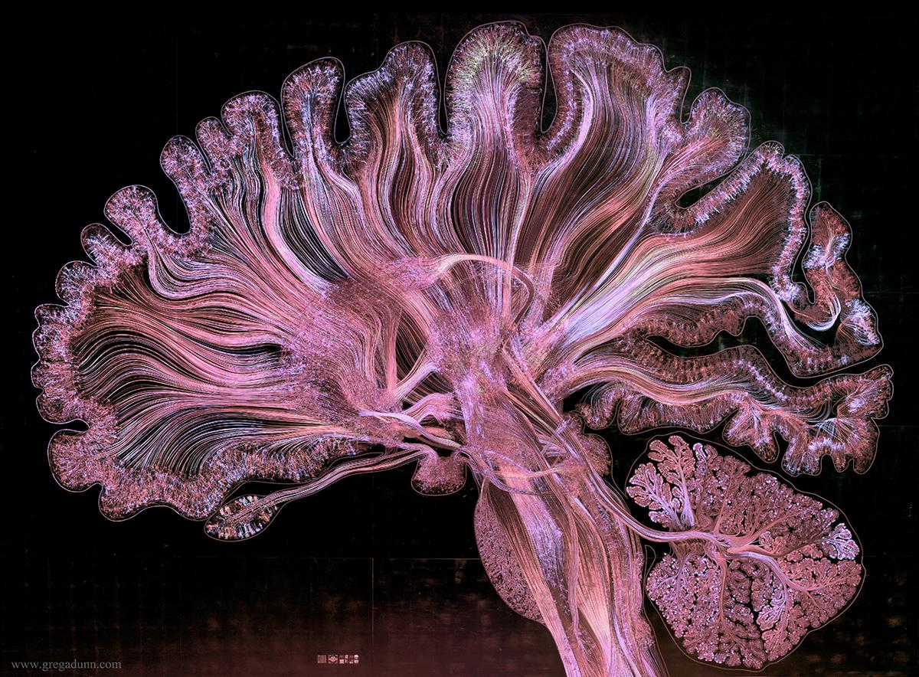
Notes:
Long term goal or holy grail:
Brain functionality understanding
restoration
To achieve this… details of neuron operation
Biophysically meaningful neural models
which in hand with the need...
This work is part of the Erasmus Brain Project led by the Erasmus….
The main focus of the project is on neural modelling and simulation on heterogeneous computing platforms.
Other initiatives:
Human Brain Project (Europe)
BRAIN Initiative (USA)
BRAIN/MINDS (JAPAN)

Slide 3
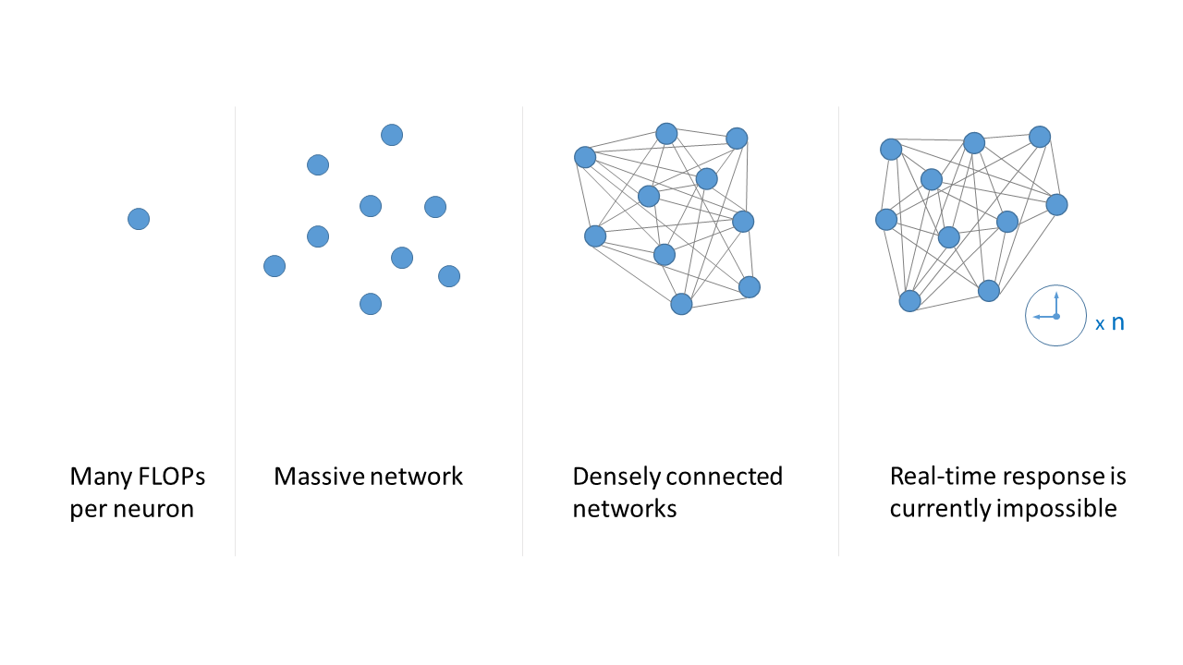
Problem Complexity
Notes:
First level: single neuron: detailed models require many FLOPs per neuron. (thousands per neuron per step)
Second level: we need to simulate massive networks (many neurons per network)
Third level: our brain is a highly dense interconnection system and to simulate it we need large volumes of data exchange.
Fourth level: we need to run long experiments which lead to many simulation steps per experiment.
real-time response is currently impossible in large-scale, detailed simulations.

Slide 4
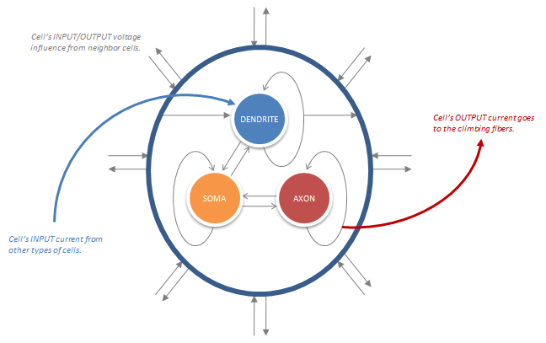
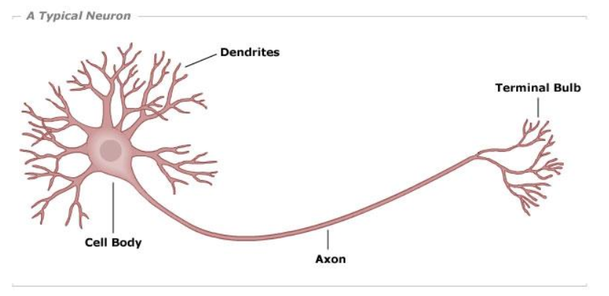
Infoli Simulator - Description
Tri-compartmental model:
    Dendrite: communication
    Soma (body): computation
    Axon: output
Gap Junction mechanic
The communication between dendrites in the network
Performance Bottleneck!
Notes:
Feature a biophysically accurate neuron representation of the human Inferior Olivary Nucleus (hence InfOli) based on a Hodgkin-Huxley model.
Each neuron comprised of 3 compartments:
Dendritic compartment: charge of communicating with the rest of the network. (electrical synapses named Gap Junctions)
somatic compartment is where most calculations take place
axonal compartment acts as the output port

Slide 5
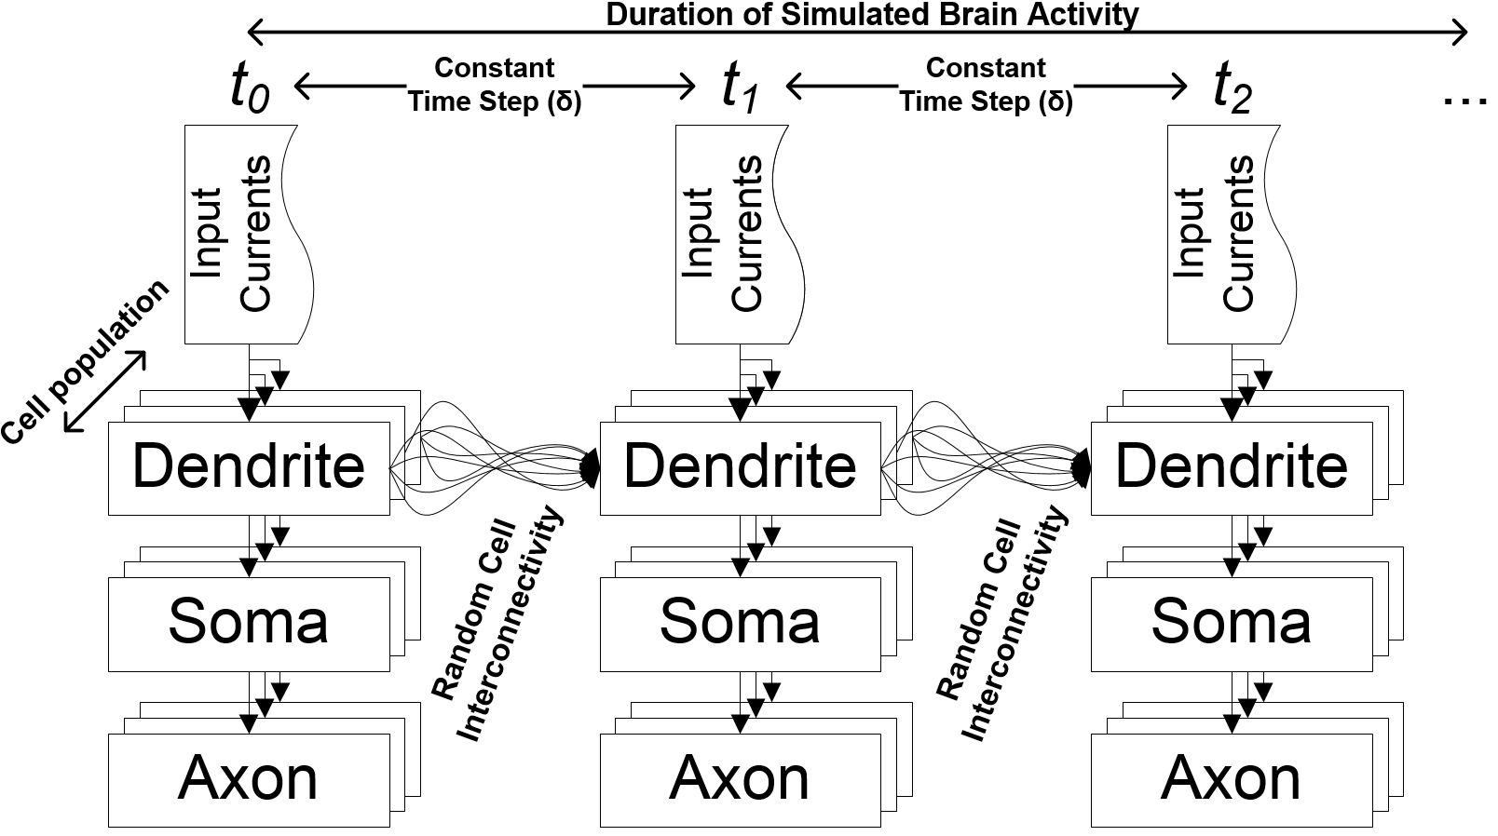
Infoli Simulator - Description
Notes:
transient simulator in which brain activity is calculated in simulation steps
Ordinary Differential Equations governing the model via the Euler forward Method.
We have random cell interconnectivity based on probabilities.
excellent candidate for parallelization
realistic worst case scenario in terms of model complexity
benchmark for neuron modeling workloads.

Slide 6
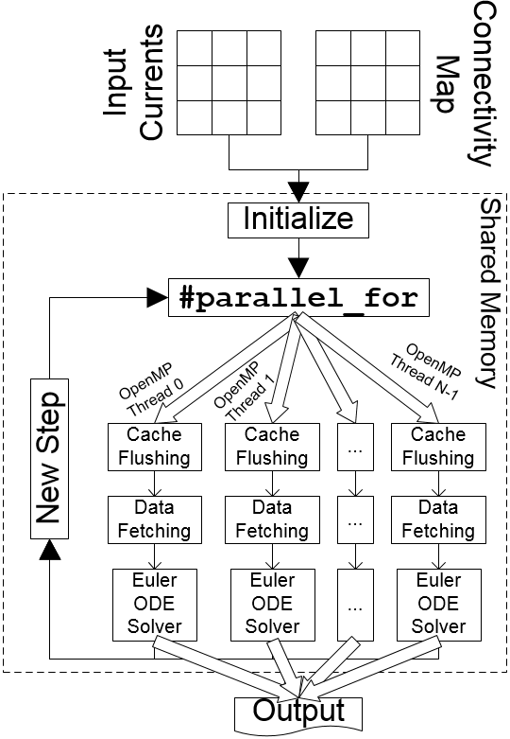
Infoli Simulator - Parallelization
OpenMP threads, up to 240 on the KNC and 256 on the KNL
Data Partitioning:
    Each thread handles a subnetwork
    Network is divided as evenly as possible
Need for data exchange between threads
Neurons are calculated independently:
    Threads operate in parallel
    Each thread vectorizes calculation for more parallel neuron processing
Notes:
OpenMP has been employed to parallelize the application
data partitioning scheme
KNC optimizations:
Data transformations like struct to arrays
aligning data to cache lines
loop transformations

Slide 7
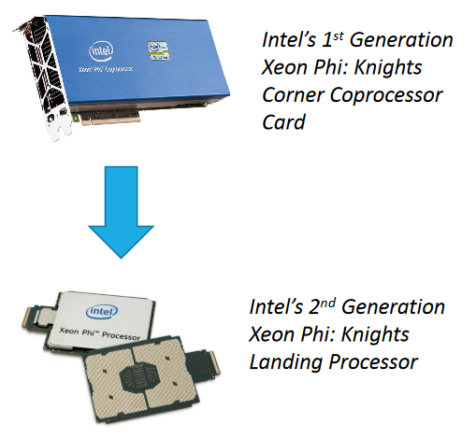
From Knights Corner to Knights Landing
Out-the-box measurements from the KNC on the KNL.
Ease of transferring: only recompilation needed
KNL vs KNC?
    Better single-threaded performance (3x TFPs)
    More VPUs, better vectorization support
    High Bandwidth MCDRAM (set to cache mode)
    Increased amount of cores, maximum amount of threads
Experimental evaluation
    Small (1000) to large (10k) neuron networks
    Connectivity densities: from 0 up to 1 k GJs per neuron.
    Exploration of simulation speed, energy used and thread efficiency.
Model: 3120p
Model: 7210
Xeon Baseline model: E5-2609-v2 (4 cores, Ivy Bridge)

Slide 8
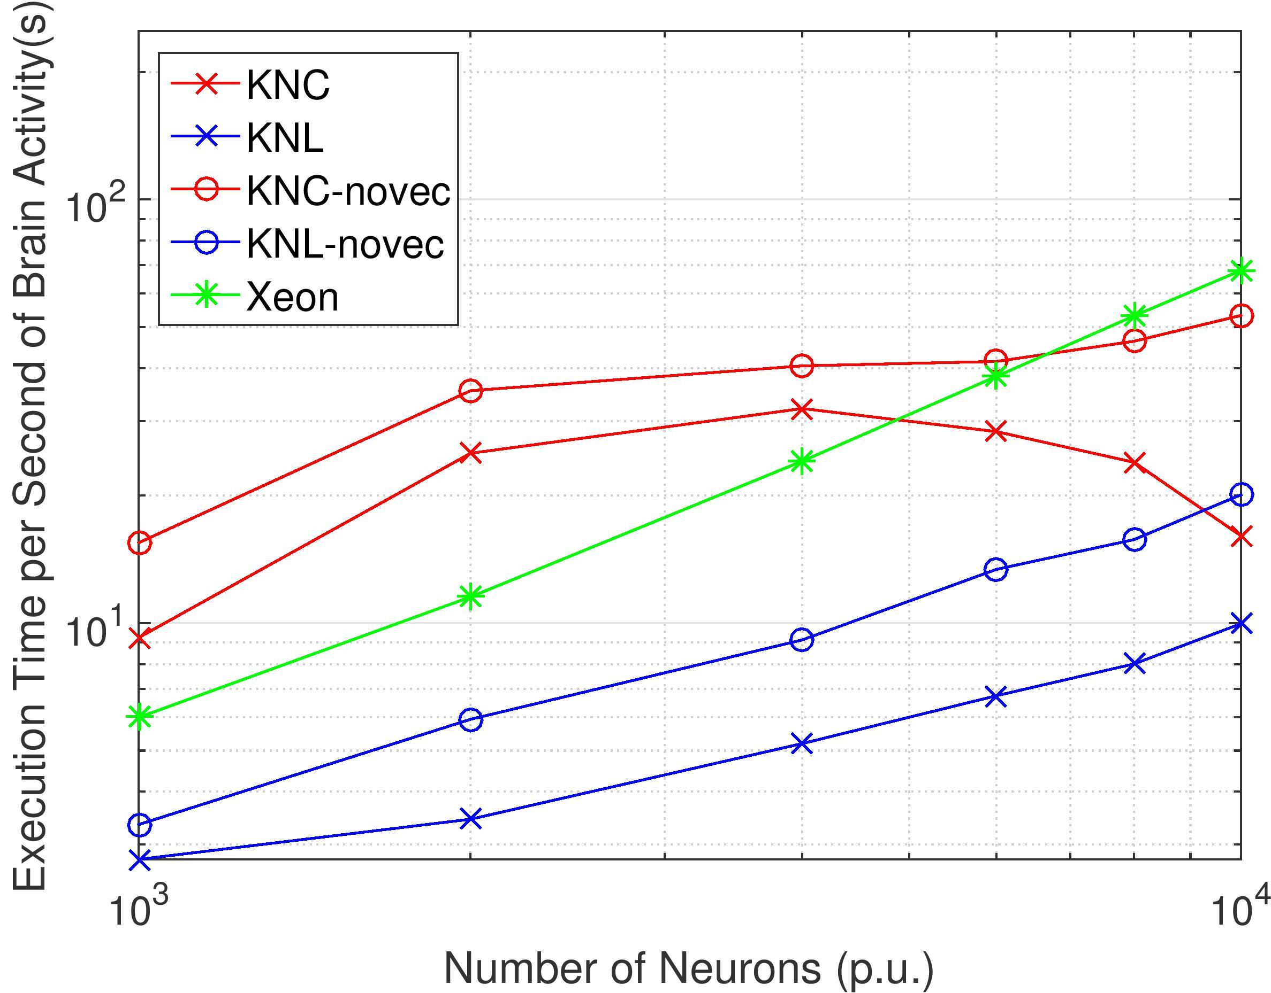
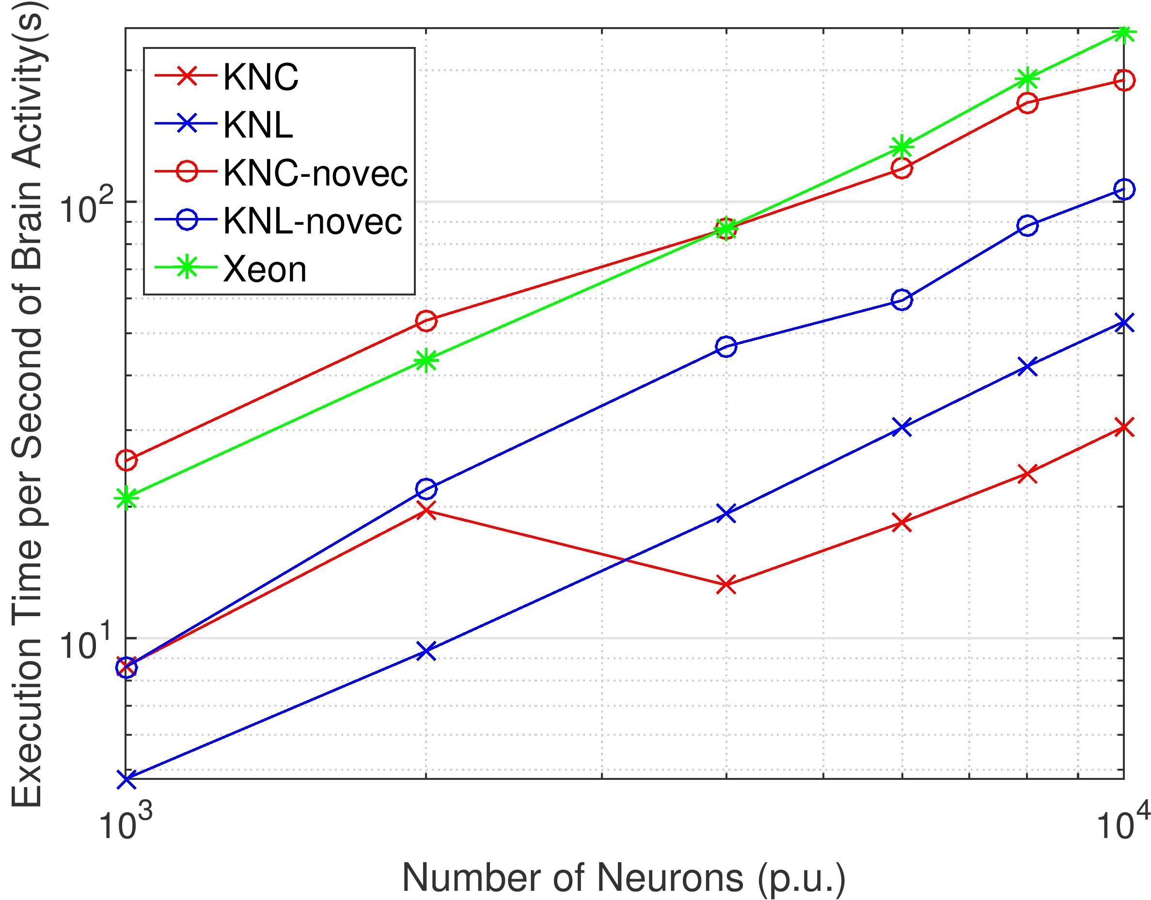
Results - Execution time
Low-density networks
High-density networks
Notes:
Low density: KNL overtakes the KNC by a fair margin.
When there are few GJs, vectorization fails to boost performance.
Faster handling of serial code by both the Xeon and KNL in comparison to KNC.
High density: as computational workload increases, KNC performs significantly better.
Gap lesses as KNC can use its assets with more efficiency.
Better VPU usage.
On both cases, KNL exhibits better performance predictability.

Slide 9
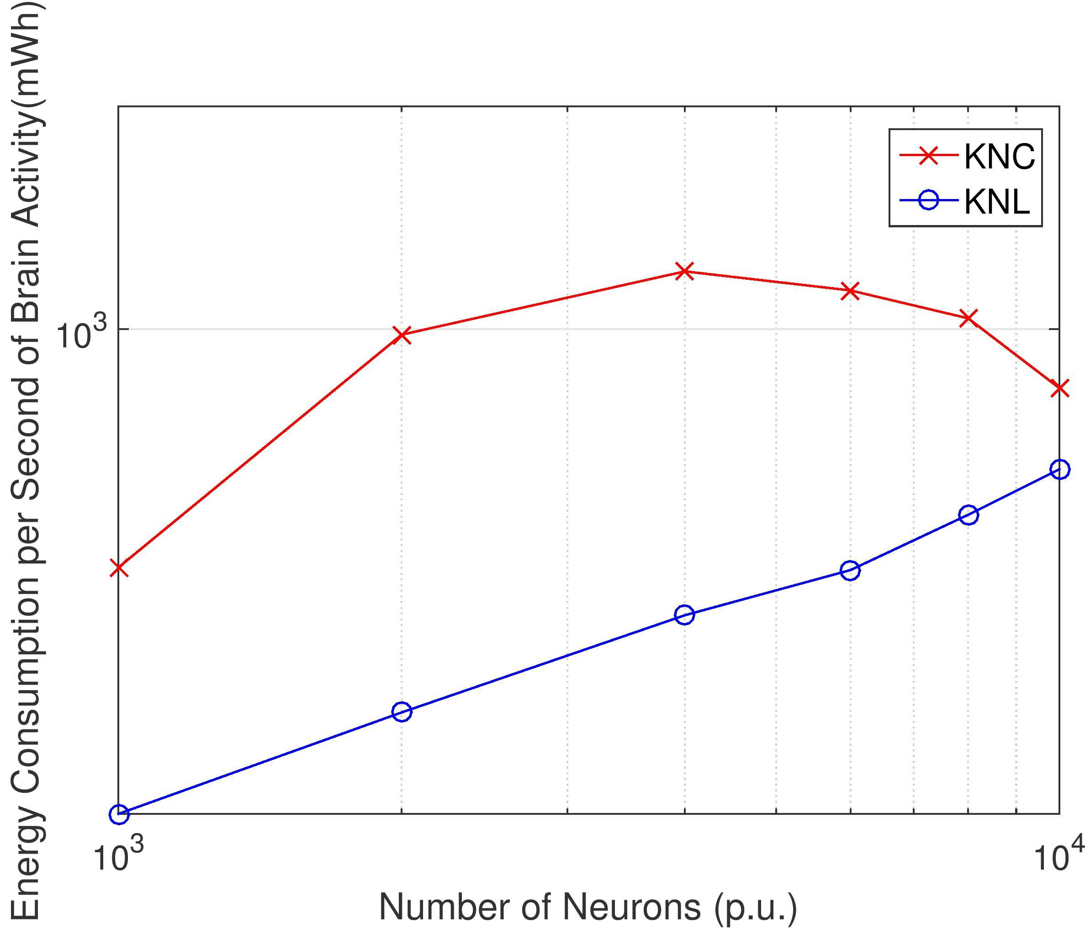
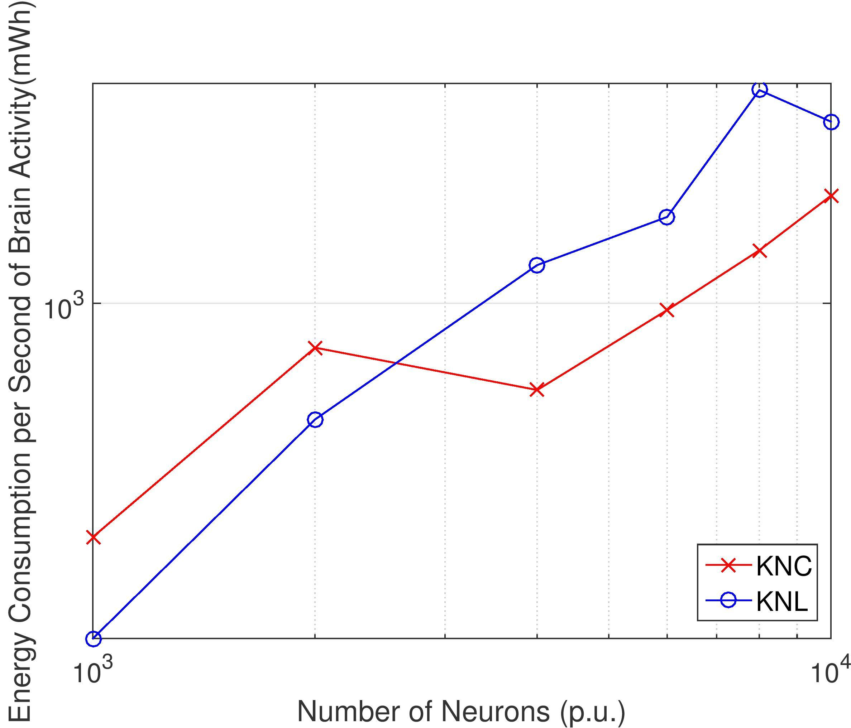
Results - Energy Consumption
Low-density networks
High-density networks
Notes:
we measured consumption in mWh.
energy consumption depends on execution time, we can observe similar patterns
On average KNL more efficient than KNC mostly because of its lower TDP.
For larger networks, KNCs smaller execution times result in less overall consumption.

Slide 10
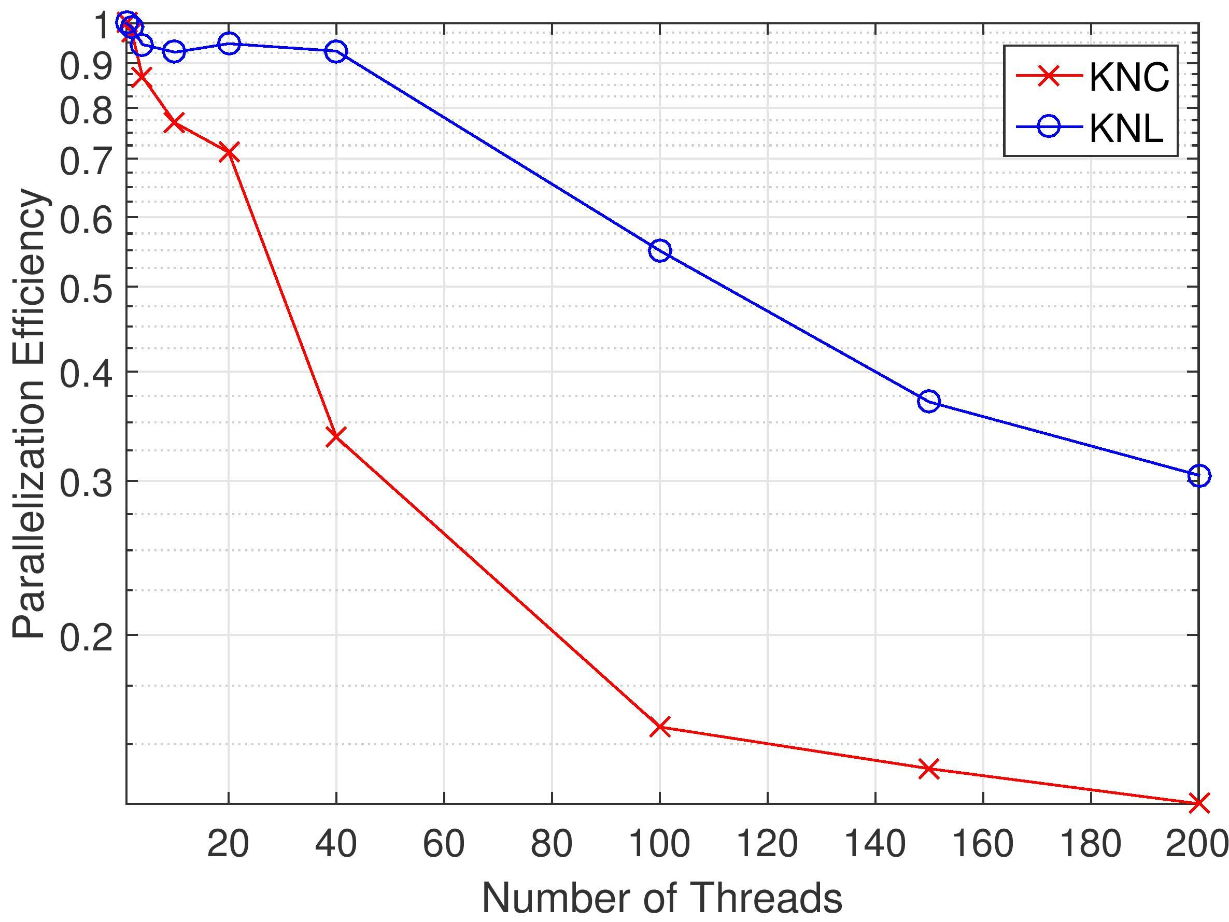
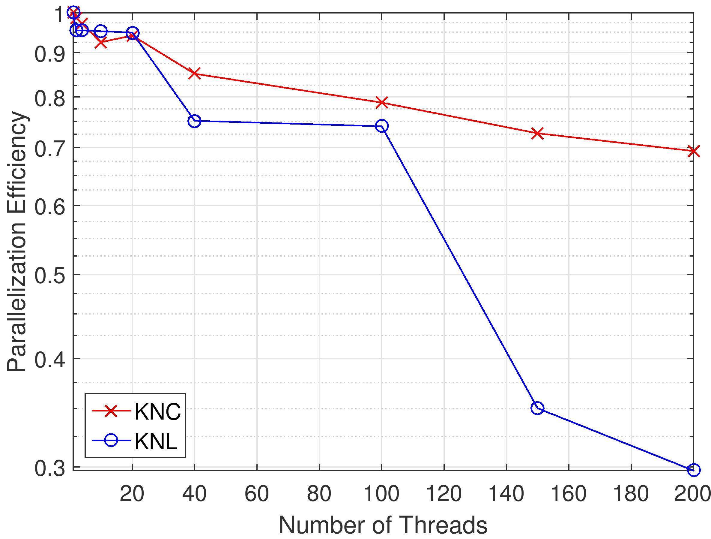
Results - Efficiency
High-density network of 1000 neurons
High-density network of 10k neurons
Notes:
KNL: the efficiency of utilizing approximately 50 threads remains at satisfactory levels.
Each core spawns either one or two threads.
KNL reliable efficiency for low degrees of threading regardless of simulated network.
KNC: larger networks ---> better opportunities to utilize the computational assets.
Efficiency over 70% for 200 threads.

Slide 11
Results - Analysis
Sparse networks are more serial in nature, so they operate well on KNL (superior single-threaded performance).
Denser networks heavily favor vectorization-enabled implementations:
    Vectorization on the KNC is significantly better after a certain point.
    KNL performance is worse for some of the heaviest workloads.
KNL´s lower TDP leads to significant energy gains.
    Gap lessens with higher workload.
    On heavier workloads, KNL´s lower TDP offset by increased simulation times.
KNL very efficient for 1 thread per core, however efficiency takes a significant hit past 100 threads.
KNC retains acceptable efficiency for 200 threads.

Slide 12
Conclusions and Insights
On average, 2.4x speedup, comparable to expected single thread performance upgrade of KNL over KNC (3x).
Lower TDP leads to overall energy savings (~50%) on KNL. Up to 75% saving on low density networks!
Thread efficiency suffers on the KNL possibly because of lack of fine-tuning of the application to the architectural details of the platform.
    Best practice suggests ~2 threads per KNL core.
KNL displays greater predictability in performance.

Slide 13
Future Work
Fine tuning for the KNL:
    VPU optimal usage
    Thread efficiency
Exploration of MCDRAM modes and clustering modes
Hybrid MPI + OpenMP for multinode systems
    Usage of Intel’s Omnipath technology

Slide 14
Thank you!

