Slide 1
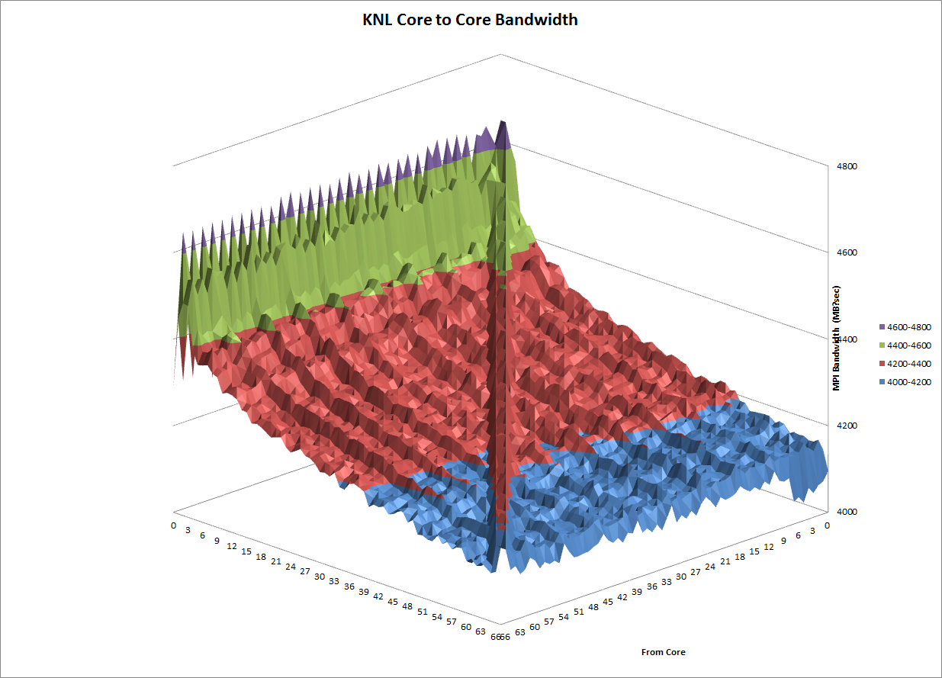
KNL Disabled Tiles and Performance Variability
IXPUG Annual Fall Conference 2017
Phil Romero
Los Alamos National Laboratory
LA-UR-17-27273
September 28, 2017

Slide 2
Background
KNL nodes have 68 logical cores
KNL nodes have either 68, 72, 74 or 76 physical cores
From 0 to 8 cores have been disabled
There are 2 cores per tile
Consequently, either 0, 1, 2, 3 or 4 tiles have been disabled
How does this affect performance?
KNL Nodes have variation in disabled tiles

Slide 3
Inferring Which Tiles are Disabled
Find bandwidth between mpi transfers on all core pairs.
Very different pattern than Haswell (shown later)
Can now use lstopo to find information to determine disabled tiles, didn’t work back in February/March 2017 as far as I know…
Bandwidths between tiles are used to calculate distances between tiles.
Multidimensional Scaling is used to produce an estimate of tile locations that can be shown on a two dimensional graph
Warning, sometimes the graph is flipped top to bottom, left to right, or both…
Some samples from the 1952 unique nodes tested are show on subsequent slides.
Can now find disabled tiles with lstopo

Slide 4
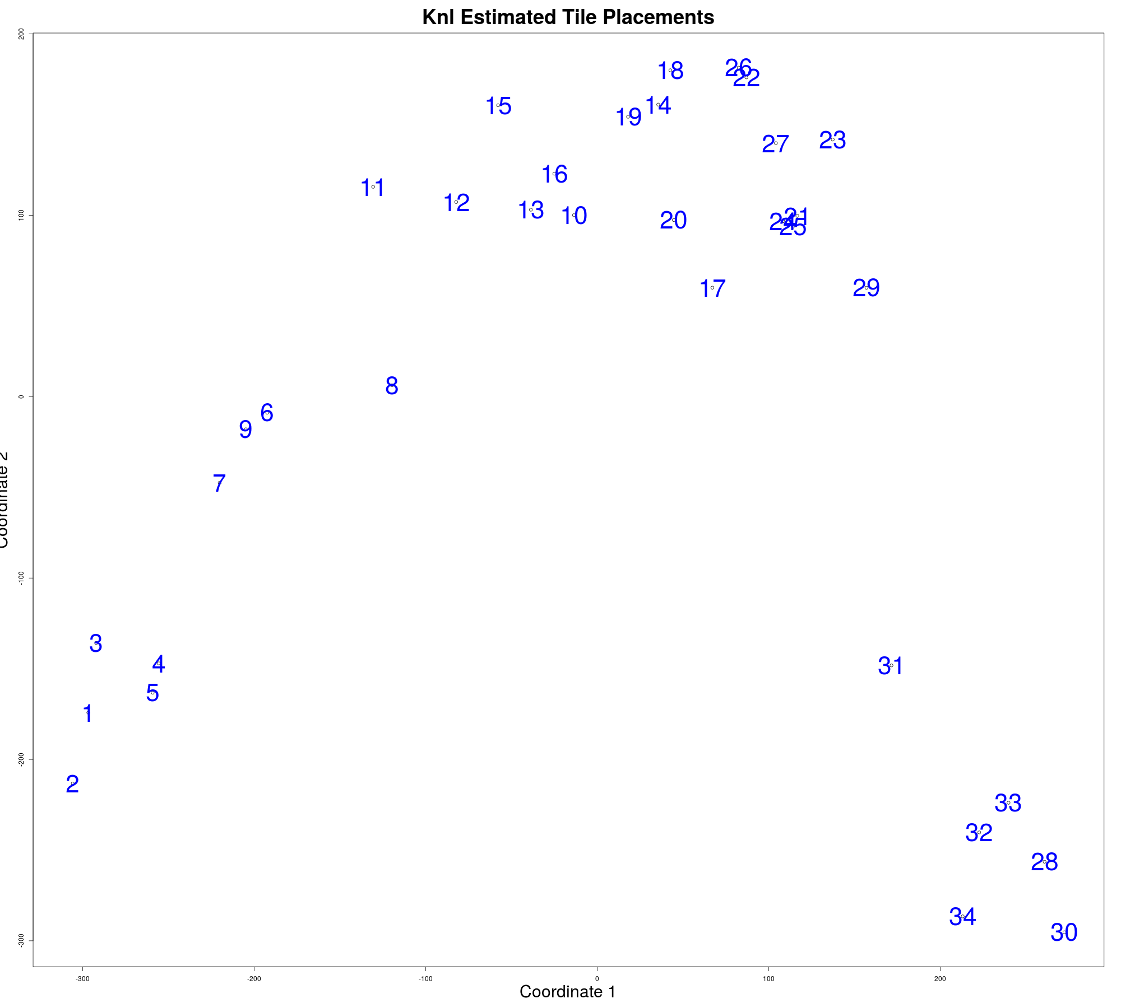
Sample Tile Placement 1
Most common pattern found

Slide 5
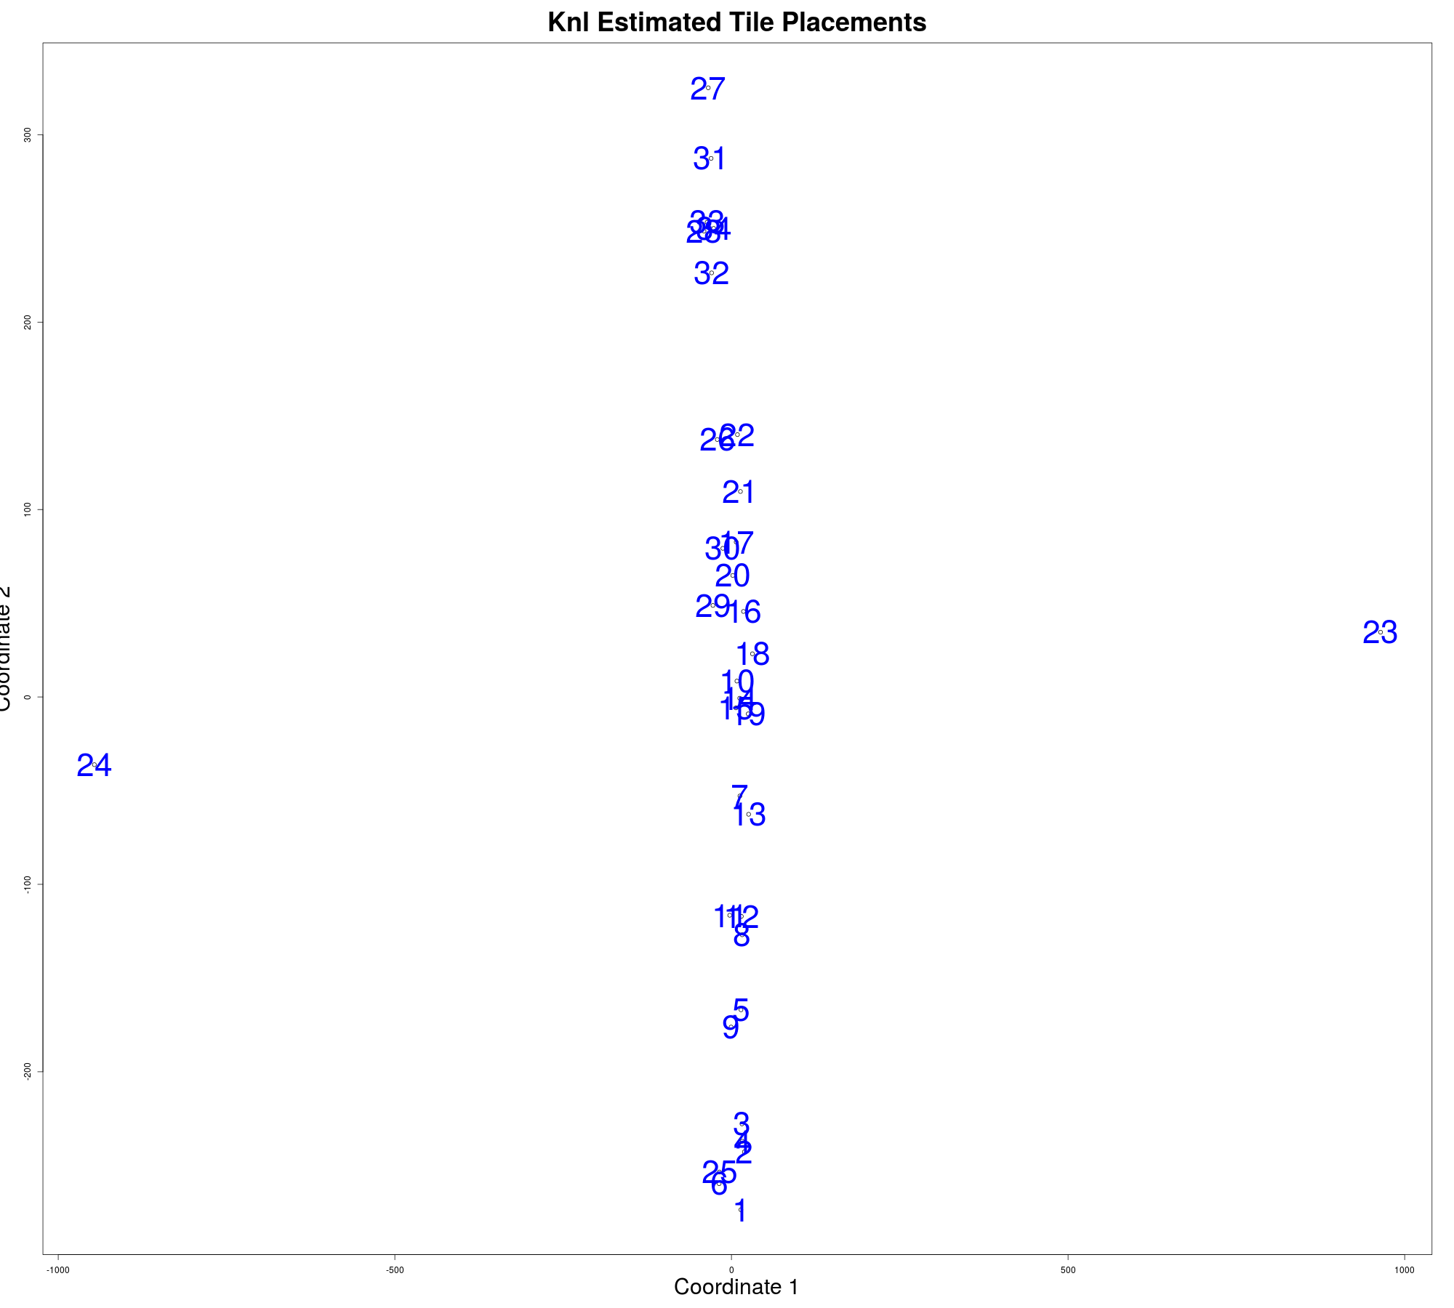
Sample Tile Placement 2
Many look different from the most common pattern

Slide 6
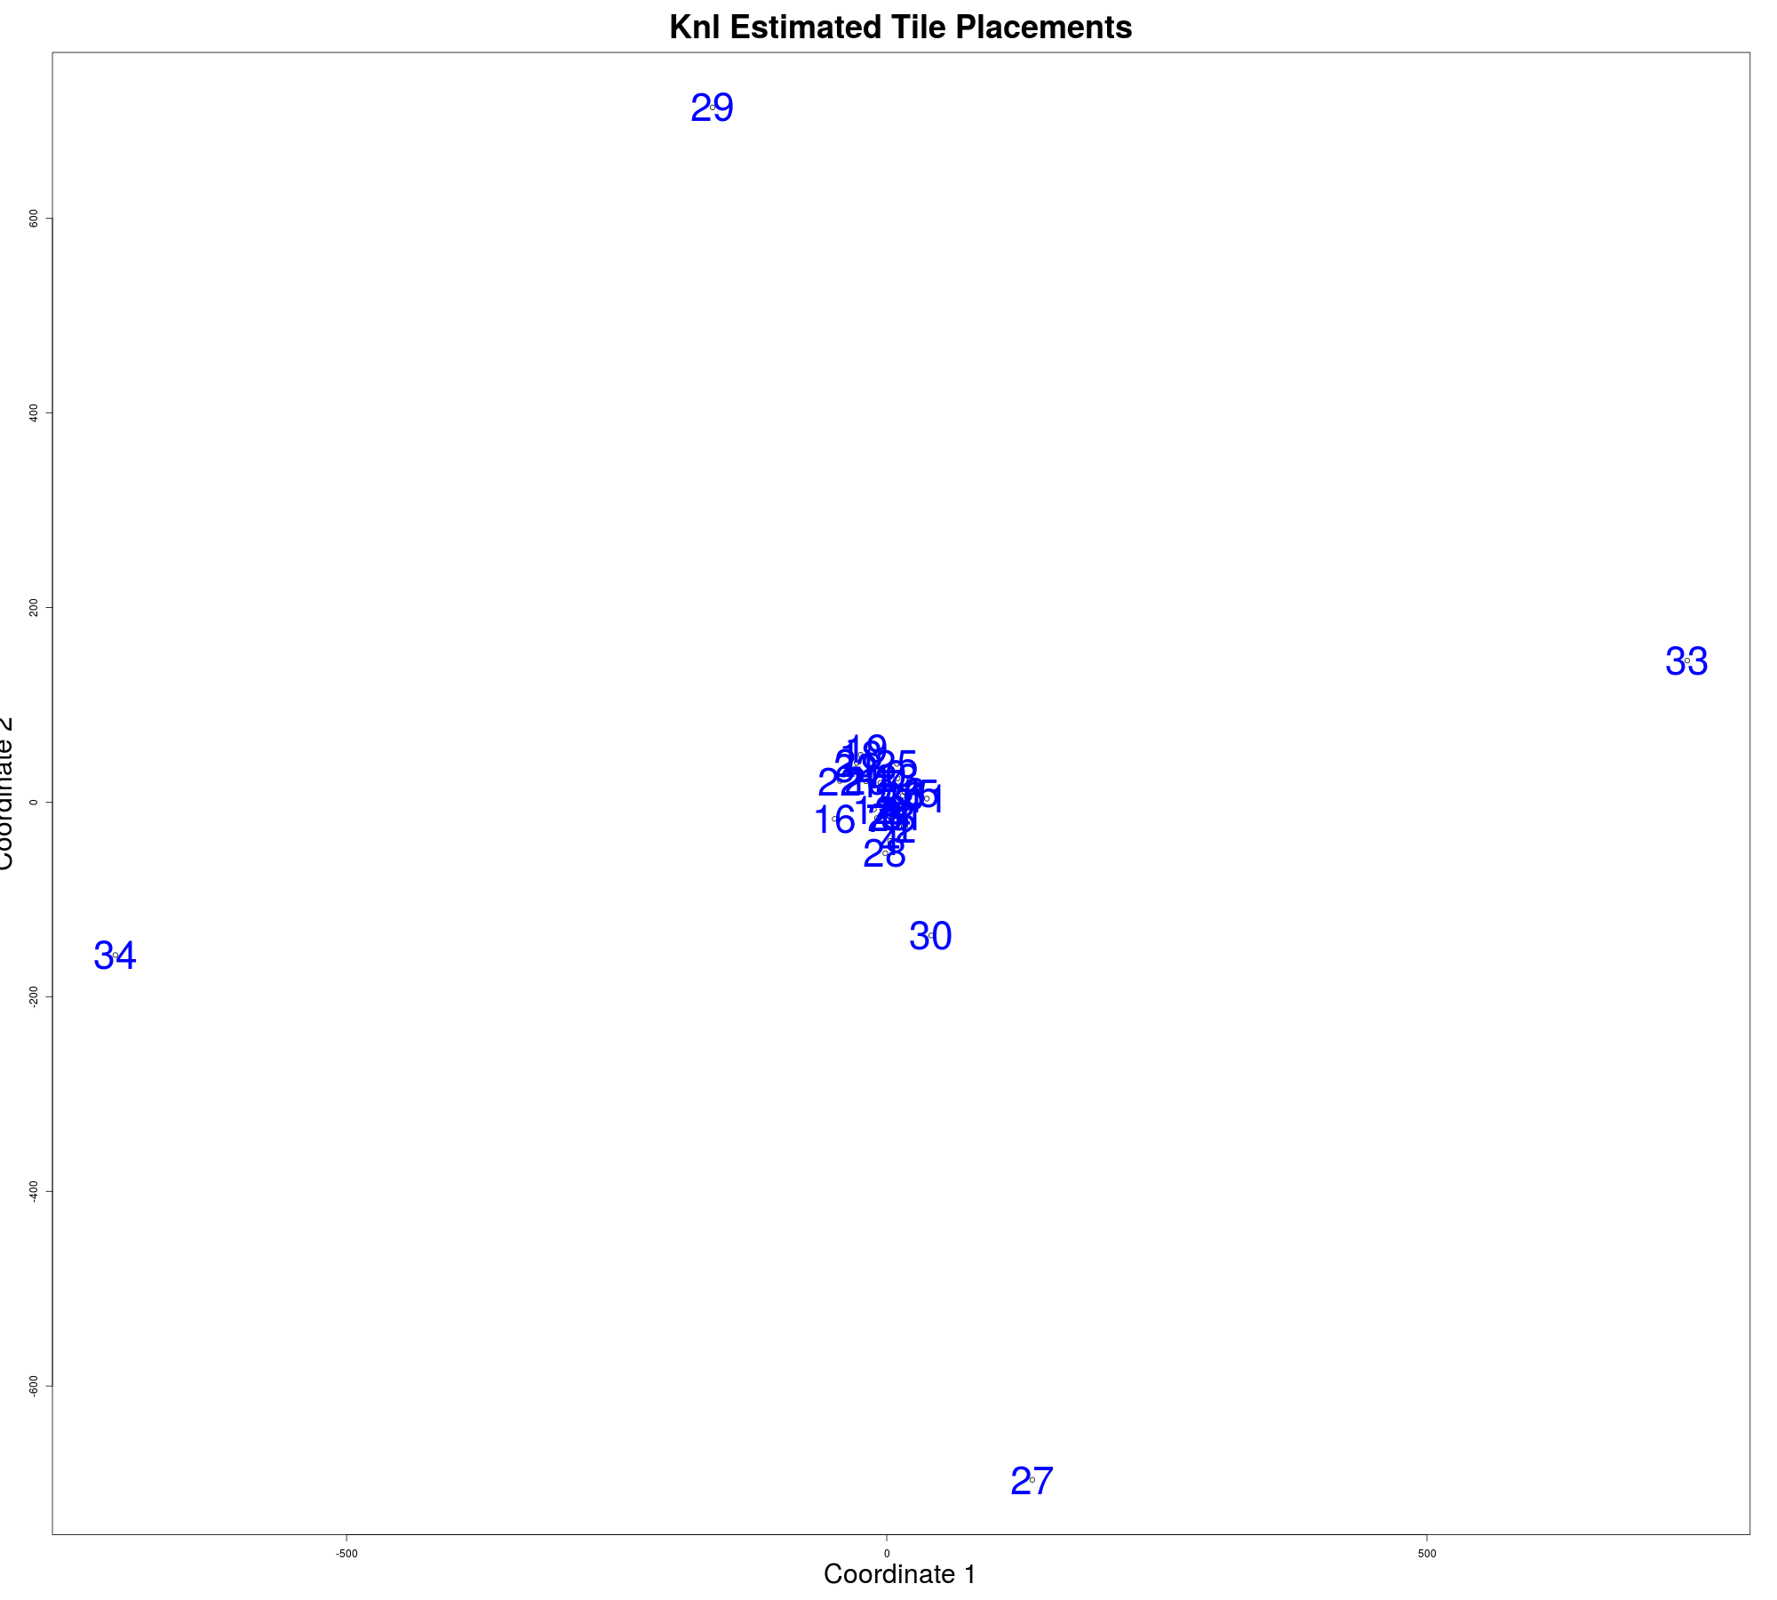
Sample Tile Placement 3
Another pattern different from the most common pattern

Slide 7
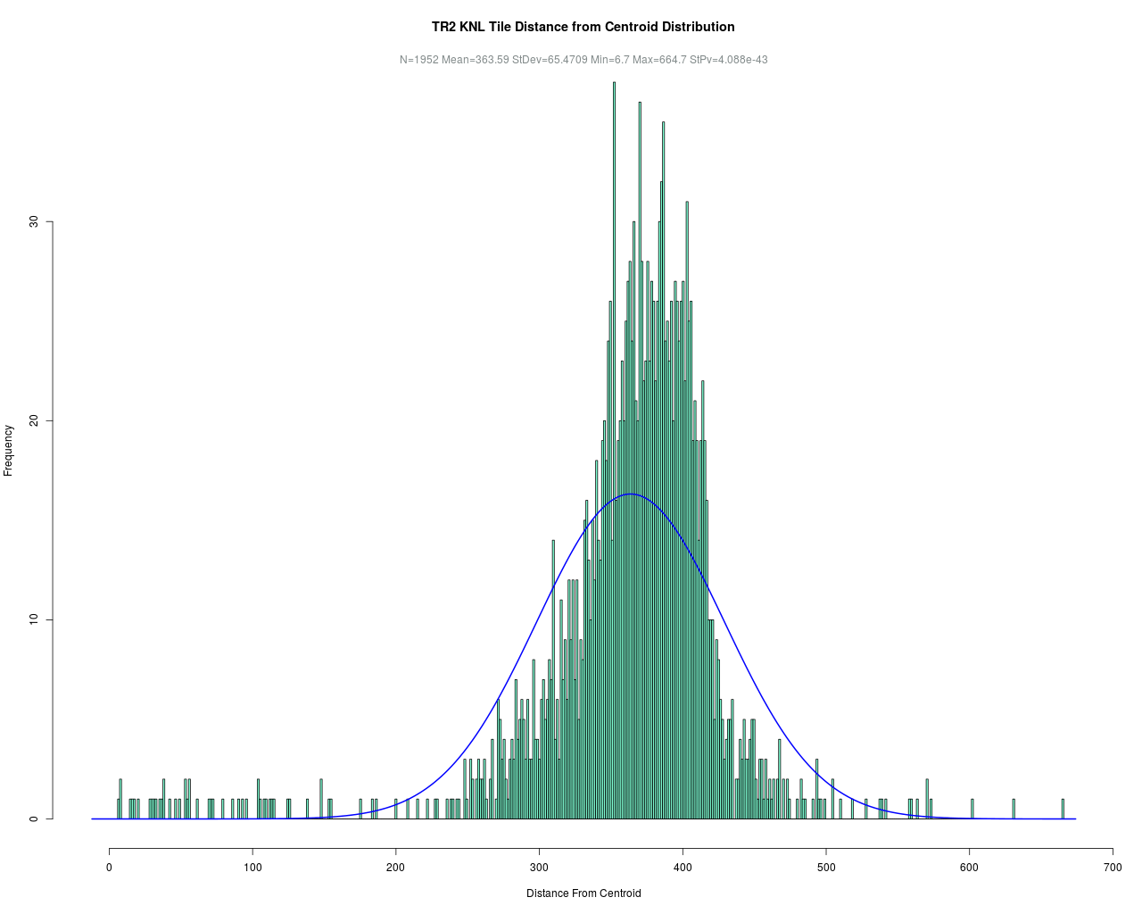
Histogram Showing Distances From Centroid Sample 1
Tile 1 distribution of distances from the centroid

Slide 8
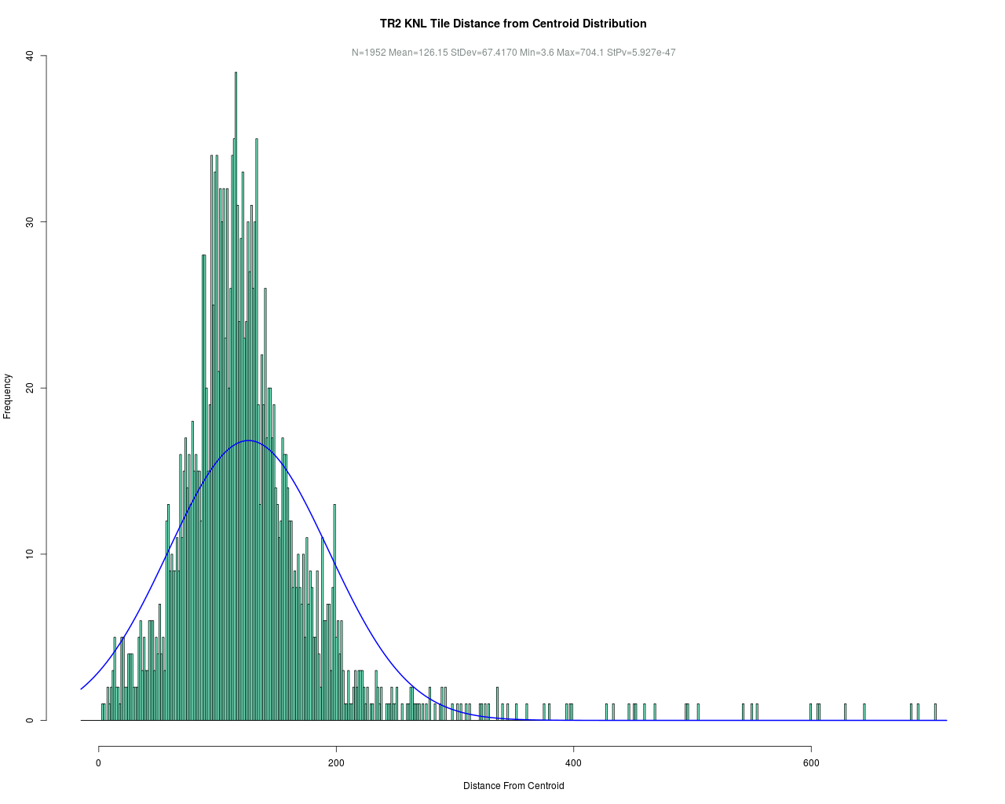
Histogram Showing Distances From Centroid Sample 2
Tile 10 distribution of distances from the centroid

Slide 9
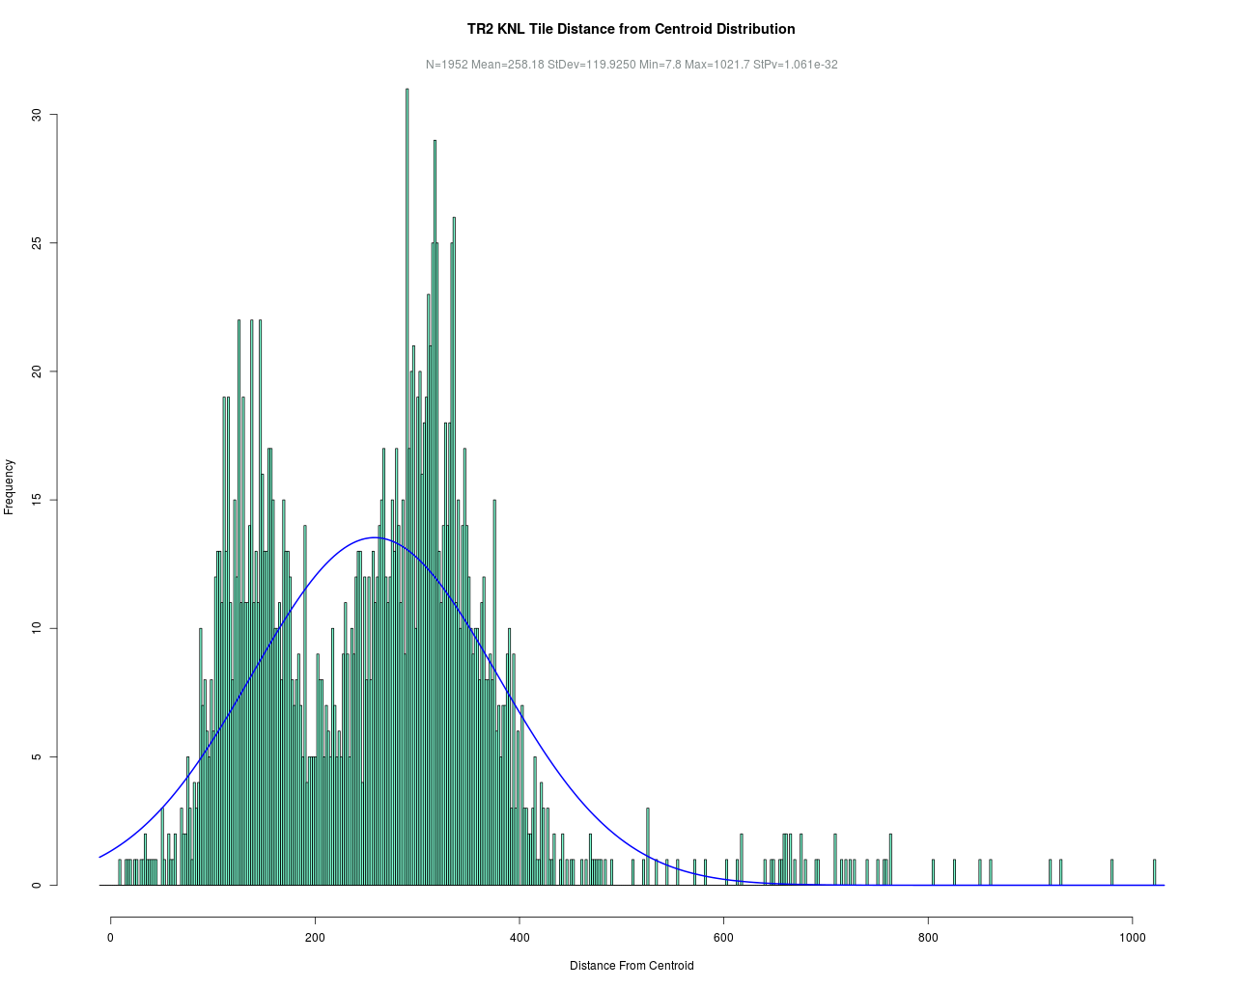
Histogram Showing Distances From Centroid Sample 3
Tile 27 distribution of distances from the centroid

Slide 10
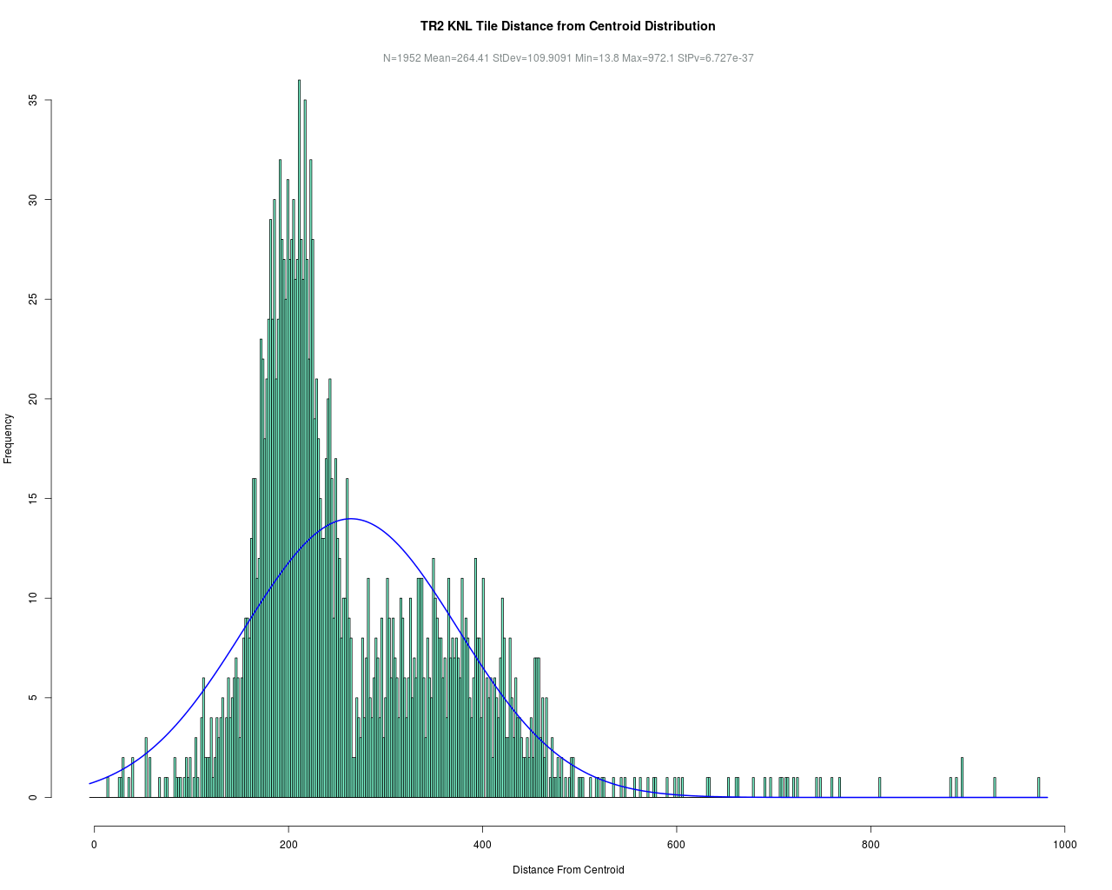
Histogram Showing Distances From Centroid Sample 4
Tile 28 distribution of distances from the centroid

Slide 11
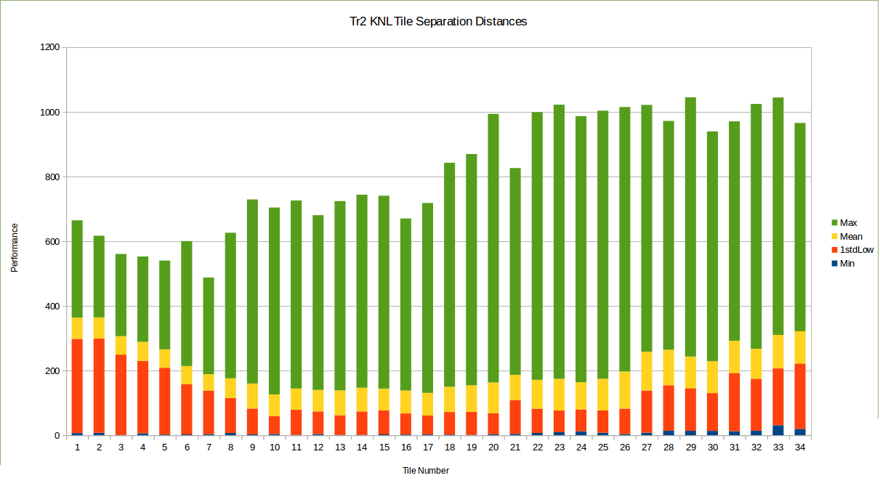
Combined Histograms Showing Distances From Centroid
Higher mean distances to centroid at lowest and highest numbered tiles

Slide 12
Performance
Distinct delay in reaching the first few and last few tiles
HPL needs to be run in powers of two (non OpenMP version)
What happens if we select which cores to run on since we have 4 to spare
Five choices were selected including:
Without the option at all, probably what most applications are using now (Nocc)
Using the outer two cores on the first two tiles (cores 0,3) and last two tiles (cores 64,67) labeled CC03
Using the inner two cores on the first two tiles (cores 1,2) and the last two tiles (cores 65,66) labeled CC12
Placing rank 0 at the middle core 33 and working out toward the ends and using only (cores 0,3, 64, 67 as above of the 0,1,2,3 and 63,64,65,67 set of cores) the outermost cores of the tiles at each end. Labeled CC3303
Same as above only using the innermost cores at the ends that is labeled CC3312. These last two were meant to determine if using the cores closest to the most other cores could speed up the application since rank 0 is heavily used for coordination
Experiment to evaluate which 64 of 68 cores to use

Slide 13
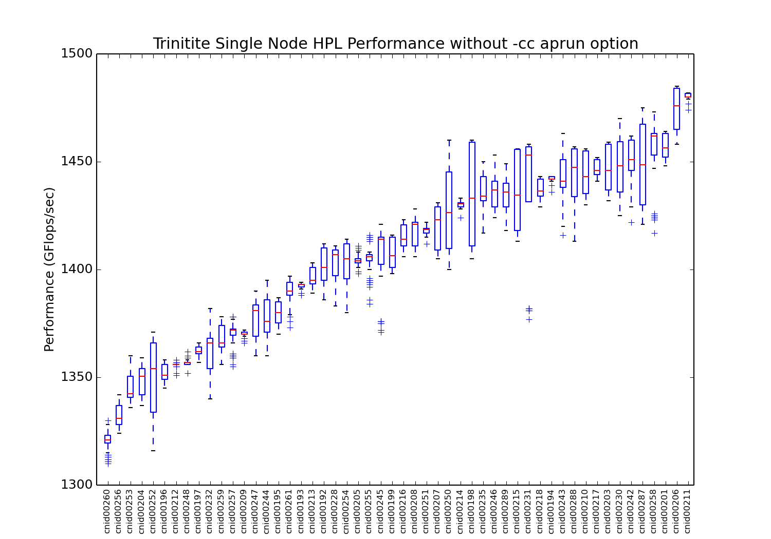
Performance Boxplot with Nocc Placement Option
Wide Performance variation is more prevalent in nodes

Slide 14
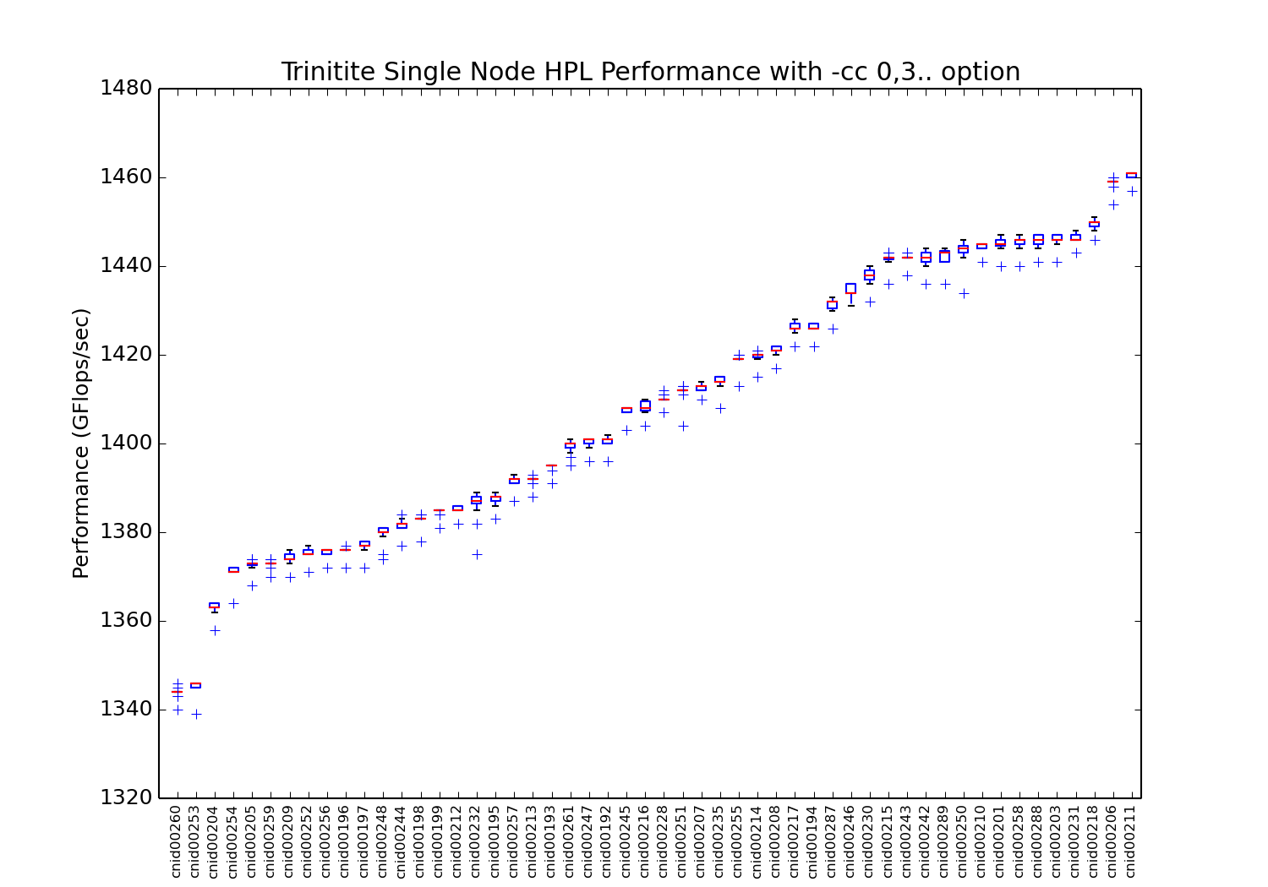
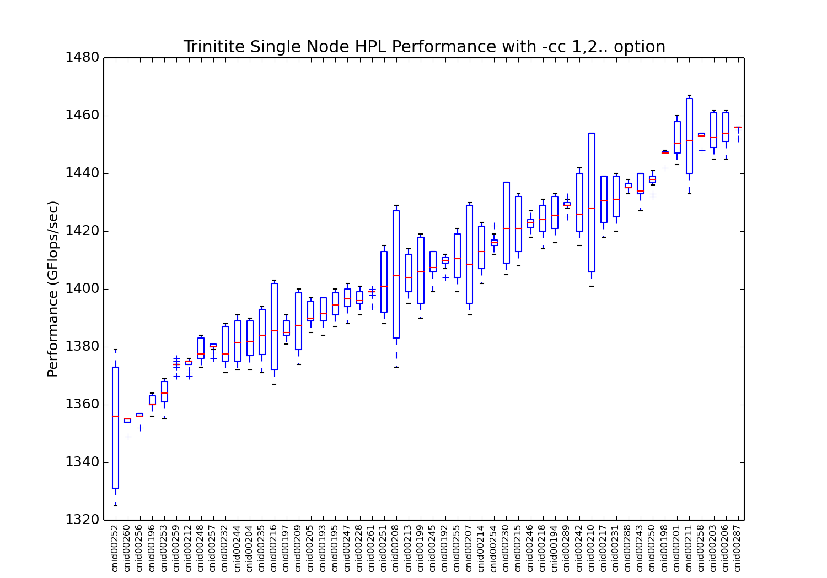
Performance Boxplot with CC03 and CC12 Options
Wide Performance variation is more prevalent in CC12 than CC03

Slide 15
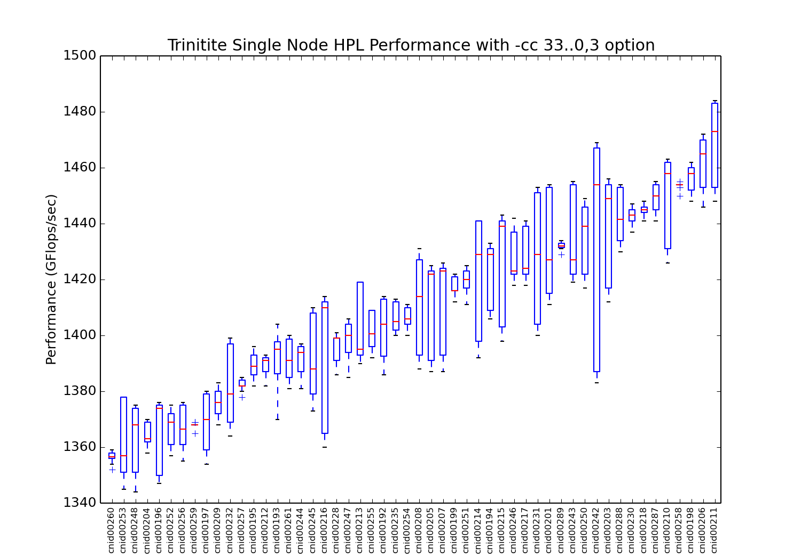
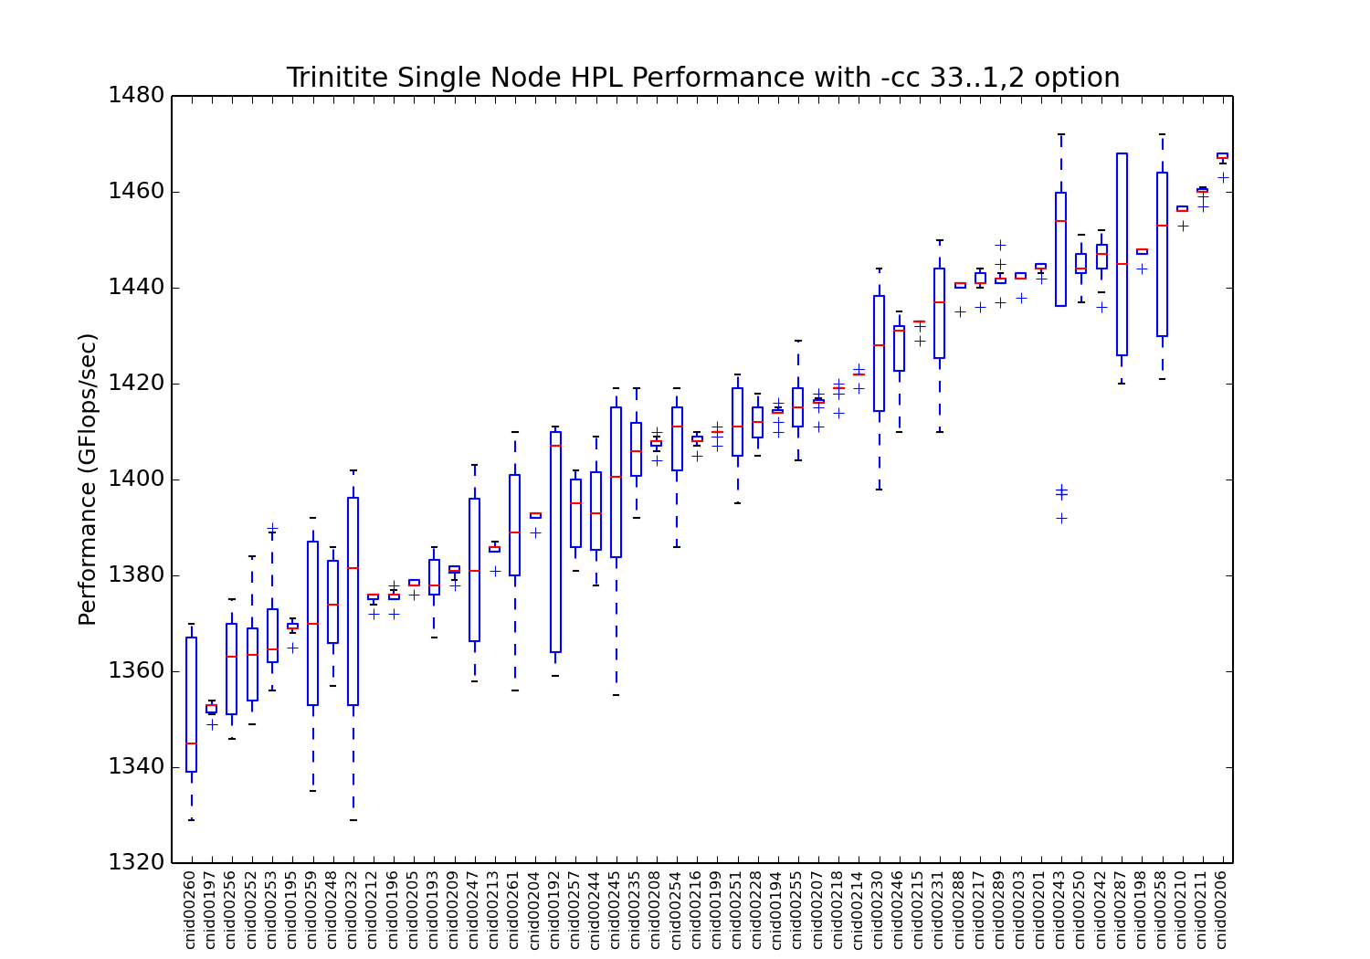
Performance Boxplot with CC3303 and CC3312 Options
Wide Performance variation is more prevalent in CC3303 than CC312

Slide 16
Reduction in Performance Variability
The table above shows there is an 84% reduction in the mean of the standard deviations (runtime/performance variability) obtained across all nodes tested when the CC03 option is utilized from when the –cc option is not utilized. This can be seen from the series of boxplots that are attached where the CC03 option has the smallest boxes of any of the plots.
Note: The first result from each run was discarded as it typically runs about 25 GFlops slower than all others and leaving it in would bias the results when a node had more runs of a given type than other types.
Reduction in performance variability is possible with core placement

Slide 17
Study done in MOAB
This study was conducted with the MOAB scheduler, we have since switched to Slurm.
Initially the –cpu_bind:map_cpu=0x01,0x03… option did not work.
Study has not been repeated under slurm.
However, there is reason to believe that map_cpu does work now, at least with OpenMP.
Reduction in performance variability is possible with core placement

Slide 18
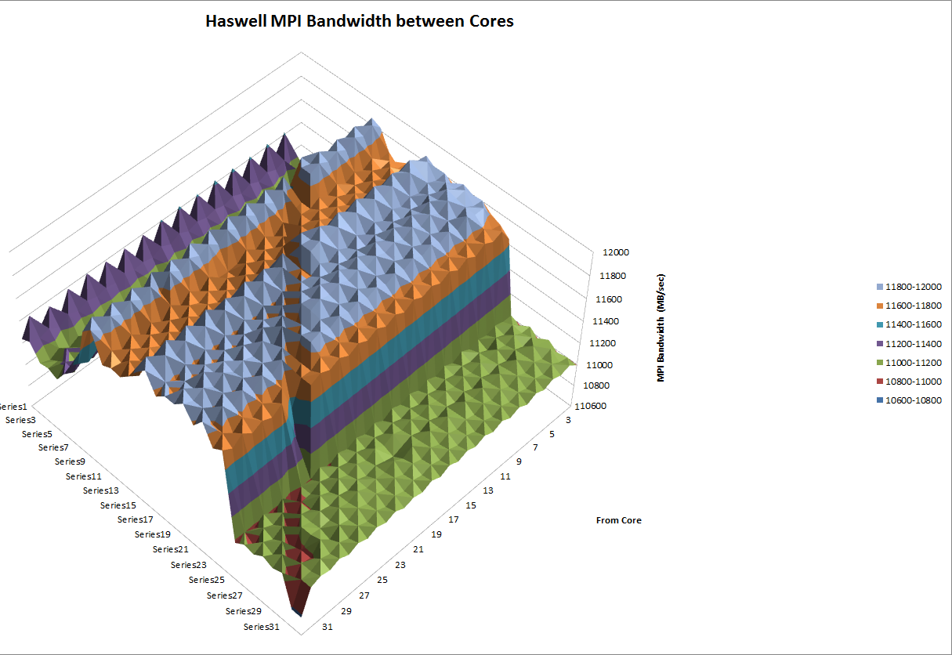
KNL and Haswell Bandwidth Distributions
KNL and Haswell Have very different bandwidth distributions between cores

Slide 19
Conclusions and Insights
Utilizing the –cc aprun option can reduce performance variation up to ~85%
Testing was with the HPL, your results may vary.
Disabled tile prevalence makes the CC03 option best to use
Disabled tile concentration in quadrants may force work across numa boundaries
Could resort to finding best –cc option for each node but…. Switched to slurm
Haswell MPI Distribution versus KNL Bandwidth Distribution are very different.
KNL and Haswell Have very different bandwidth distributions between cores

