Slide 1


Efficient MPI/OpenMP parallelization of the Hartree-Fock method on KNL
Vladimir Mironov¹, Yuri Alexeev²,
Kristopher Keipert³, Michael D’Mello⁴,
Alexandr Moskovsky², Mark Gordon³
¹Moscow State University, ²Argonne National Laboratory,
³Iowa State University, ⁴Intel Corporation

Slide 2
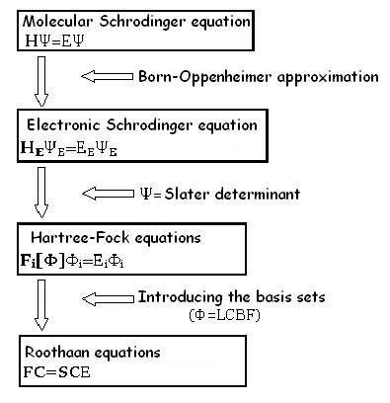
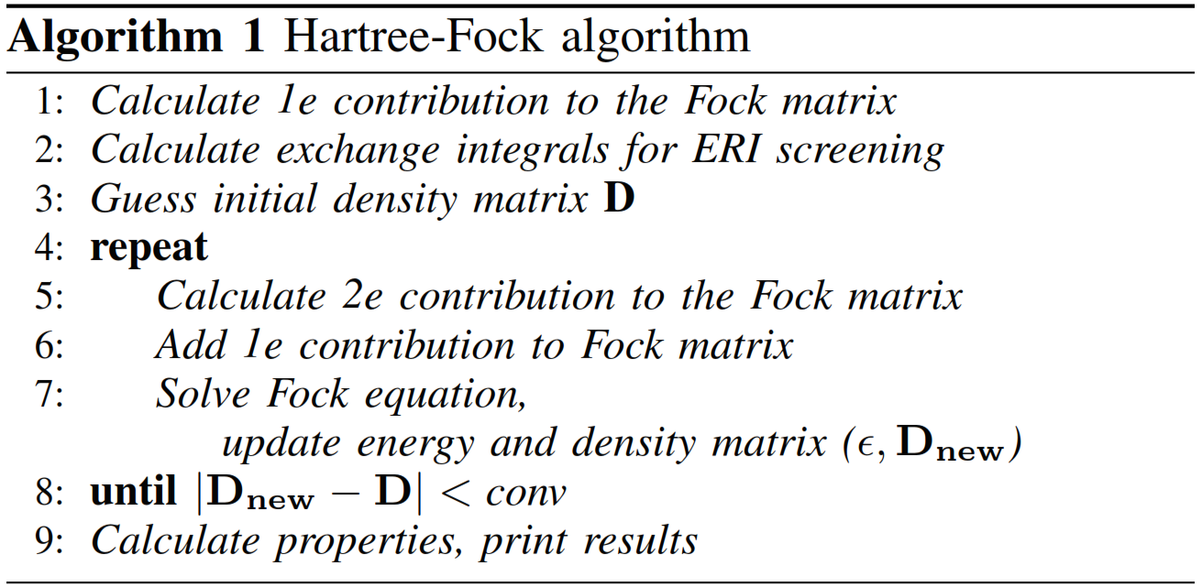
Hartree-Fock Introduction
Acronyms:
GAMESS = General Atomic and Molecular Electronic Structure System
ERI = two electron Electron Repulsion Integrals
F = Fock matrix
D = density matrix
Notes:
Approximations made in Hartree-Fock-Roothaan-Hall theory, Fock depends on wavefunction, thus iterative solution – SCF, F dimensions are in basis functions

Slide 3

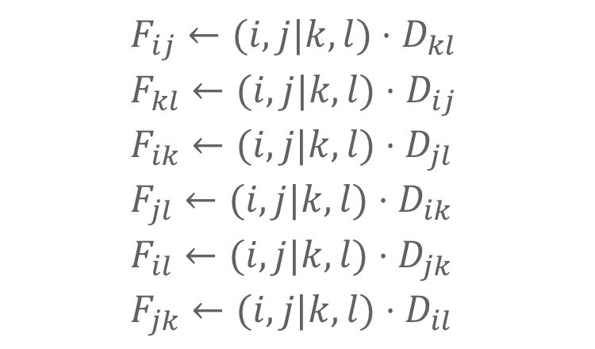
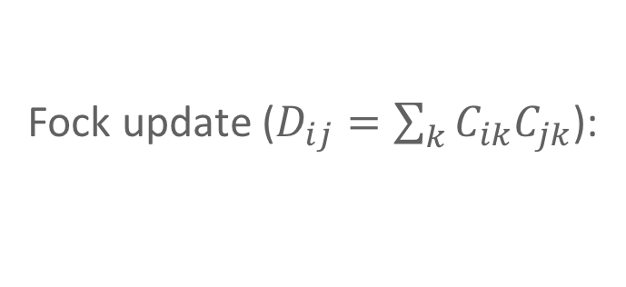
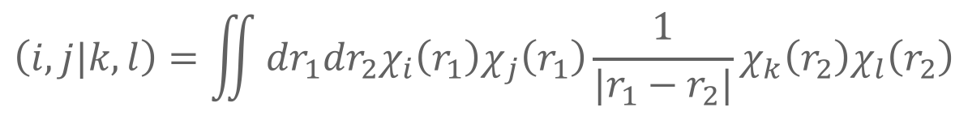
Hartree-Fock Introduction
Coulomb’s Law:
F$=\frac{Q1∗Q2}{d2}$
2-e Electron Repulsion Integrals (ERIs) scale as N⁴:
$$\left(i,j|k,l\right)=\iint{{dr}_{1}{dr}_{2}χ_{i}\left(r_{1}\right)χ_{j}\left(r_{1}\right)\frac{1}{|r_{1}−r_{2}|}χ_{k}\left(r_{2}\right)χ_{l}\left(r_{2}\right)}$$
Fock update ($D_{ij}=\sum_{k}{C_{ik}C_{jk}}$):
$F_{ij}←(i,j|k,l)⋅D_{kl}$ $F_{kl}←(i,j|k,l)⋅D_{ij}$ $F_{ik}←(i,j|k,l)⋅D_{jl}$ $F_{jl}←(i,j|k,l)⋅D_{ik}$ $F_{il}←(i,j|k,l)⋅D_{jk}$ $F_{jk}←(i,j|k,l)⋅D_{il}$
Notes:
Computation scales as N^4, memory requirements scale as 2*N^2 if integrals are recomputed

Slide 4
Challenges and Solutions
  Challenges
    Monolithic code (~2 million lines) written over many decades in Fortran 77
    Optimized for old CPU architectures (cache unfriendly)
    Global data structures (COMMON blocks) are used throughout the code
    Use of obsolete constructs (IF computed GOTO, EQUIVALENCE etc.)
    Custom dynamic array allocator (hard to debug)
    High memory and compute demand of quantum chemistry algorithms
  Why we care
    Over 150,000 users world wide (50+ active code developers,
    GAMESS-UK, Firefly (former PC-GAMESS))
    One of the most popular comprehensive quantum chemistry packages
    Supported by INCITEs (1.2 billion core hours), ALCCs, ESPs, ECP, 3 IPCCs
  Solutions
    Rewrite critical subroutines in Fortran 95
    Remove global data structures
    OpenMP parallelization and vectorization
Notes:
General Atomic and Molecular Electronic Structure System

Slide 5
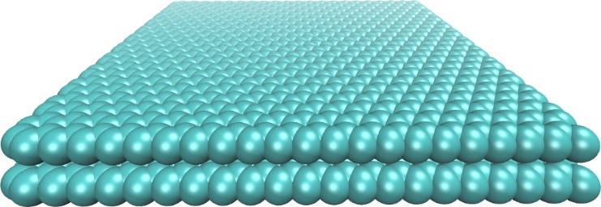
Hardware and Chemical Systems
Model system of a C₂₀₁₆ graphene bilayer. In the text, we refer to this system as 5 nm. There are two layers with size 5 nm by 5 nm. Each graphene layer consists of 1,008 carbon atoms.

Slide 6
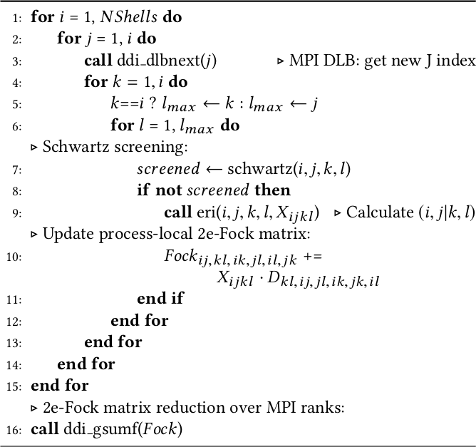
Hartree-Fock original MPI code
Notes:
Three major blocks: SCF driver, 2-e integrals computation, Fock construction

Slide 7
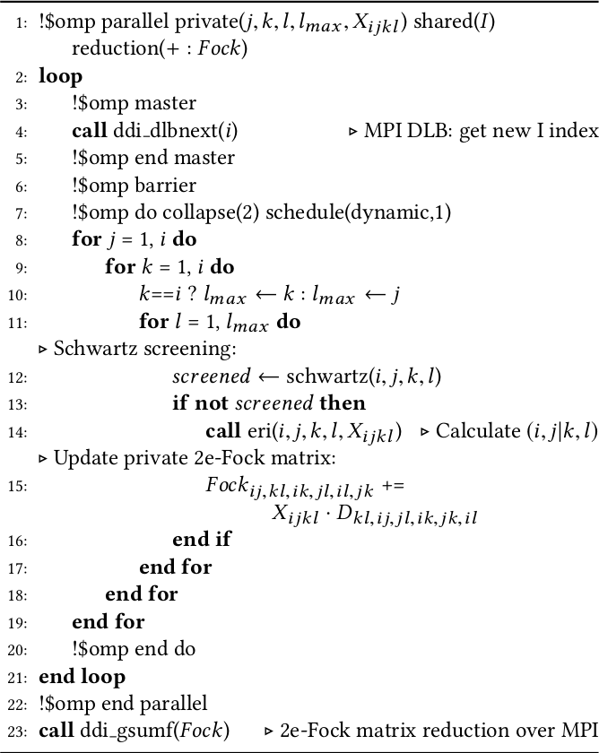
Notes:
Private Fock

Slide 8
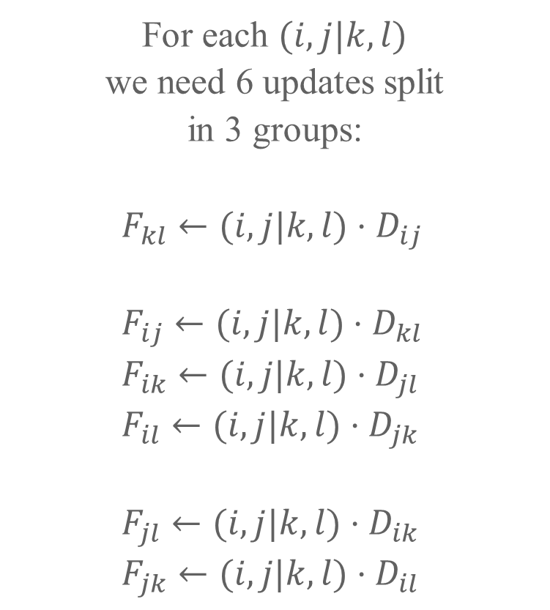
For each $(i,j|k,l)$
we need 6 updates split
in 3 groups:
$F_{kl}←(i,j|k,l)⋅D_{ij}$
$F_{ij}←(i,j|k,l)⋅D_{kl}$ $F_{ik}←(i,j|k,l)⋅D_{jl}$
$F_{il}←(i,j|k,l)⋅D_{jk}$
$F_{jl}←(i,j|k,l)⋅D_{ik}$ $F_{jk}←(i,j|k,l)⋅D_{il}$

Slide 9
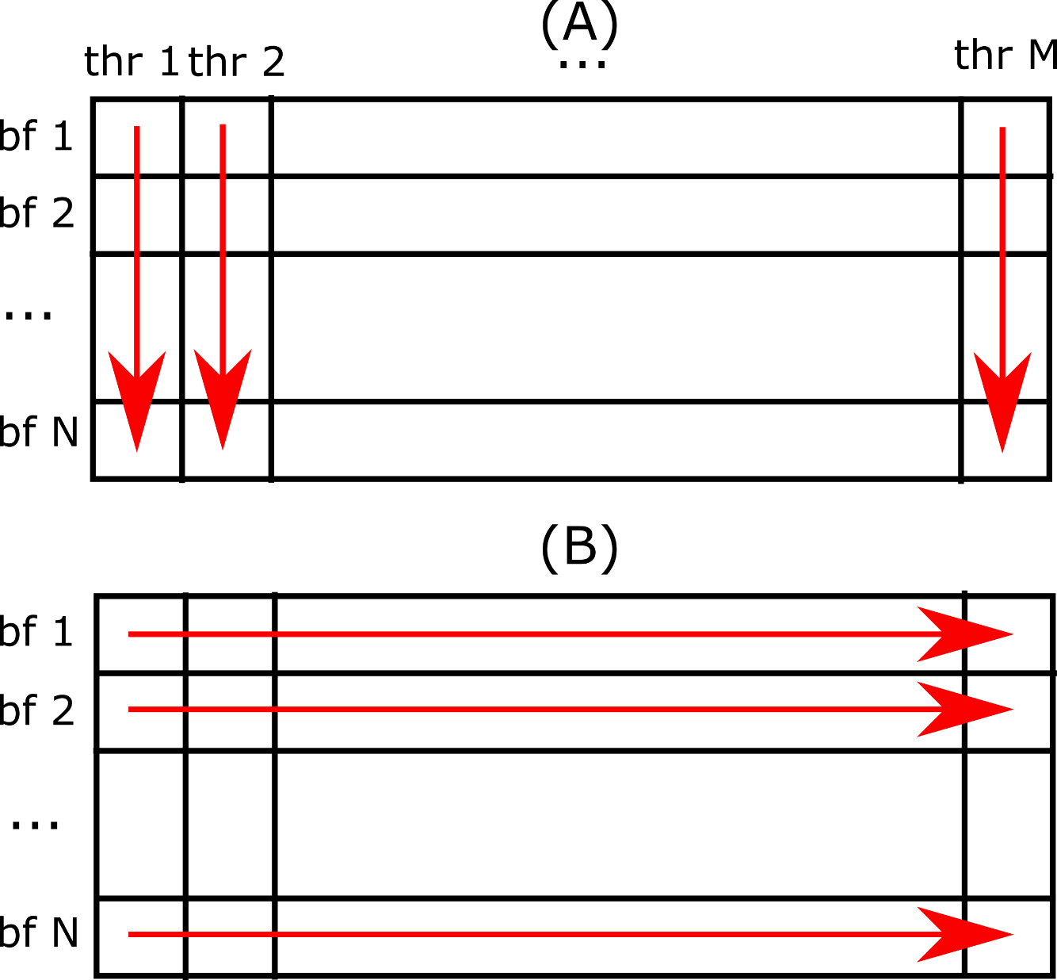
I and J vectors Update
Notes:
I and J Fock vectors update (A) and summing up all Fock elements for each Fock element in the vectors (B). ``bf'' means basis function and ``thr'' means thread.

Slide 10
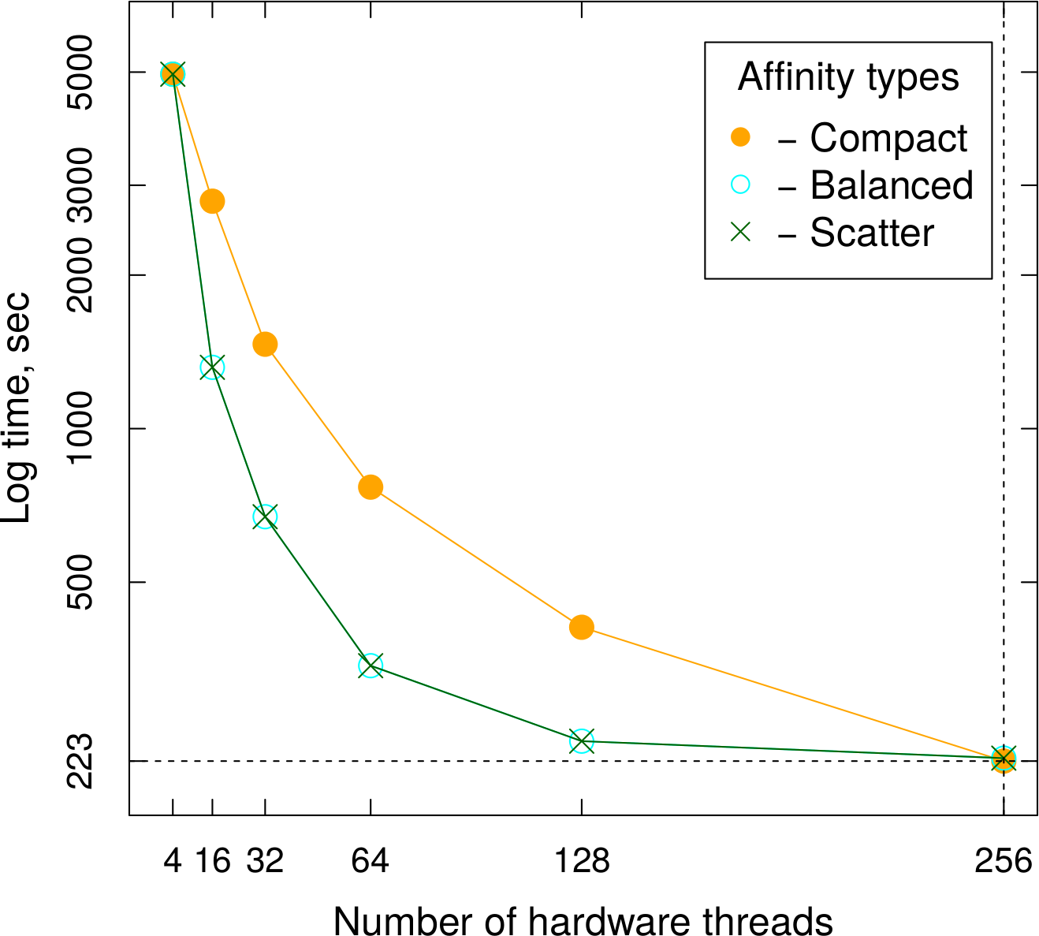
OpenMP scaling on the single Xeon Phi
Thread affinity impact:
Graphene bilayer benchmark
120 carbon atoms (1,800 basis functions), 6-31G basis set
OpenMP code scaling up to 256 threads
Thread affinity does not matter at thread limit
It is better to distribute threads over cores otherwise
All calculations are performed for Quad-Cache mode (fixed number of MPI ranks to 4 and varied OMP threads from 1 to 64)

Slide 11
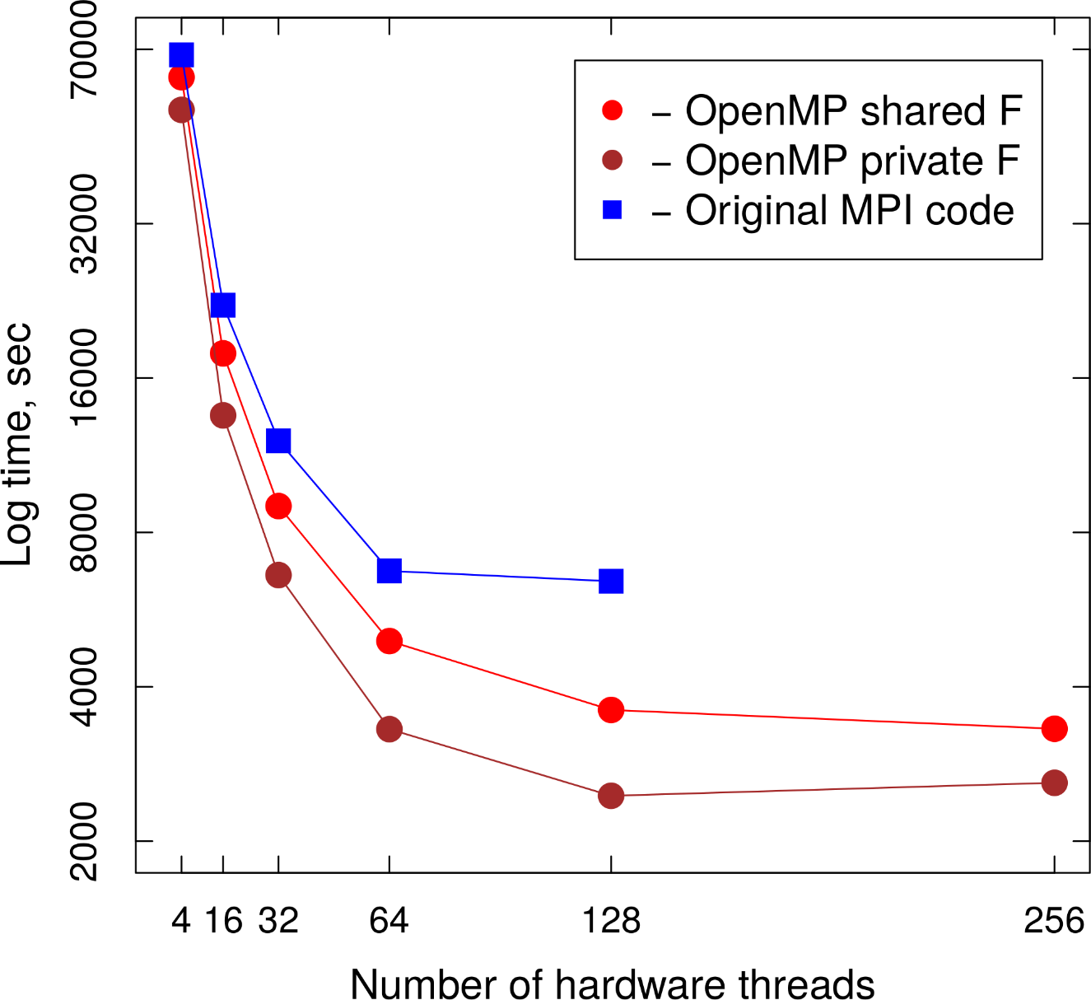
OpenMP and MPI scaling on the single Xeon Phi
Scalability with respect to the number of hardware threads of the original MPI code and two OpenMP versions on a single Xeon Phi processor using the 1.0 nm benchmark.
For the hybrid versions of GAMESS, the number of ranks times the number of threads per rank is the number of hardware threads targeted. The larger memory requirements of the original MPI-only code restrict the computations to, at most, 128 hardware threads. In contrast, the two hybrid versions can easily utilize all 256 hardware threads available.

Slide 12
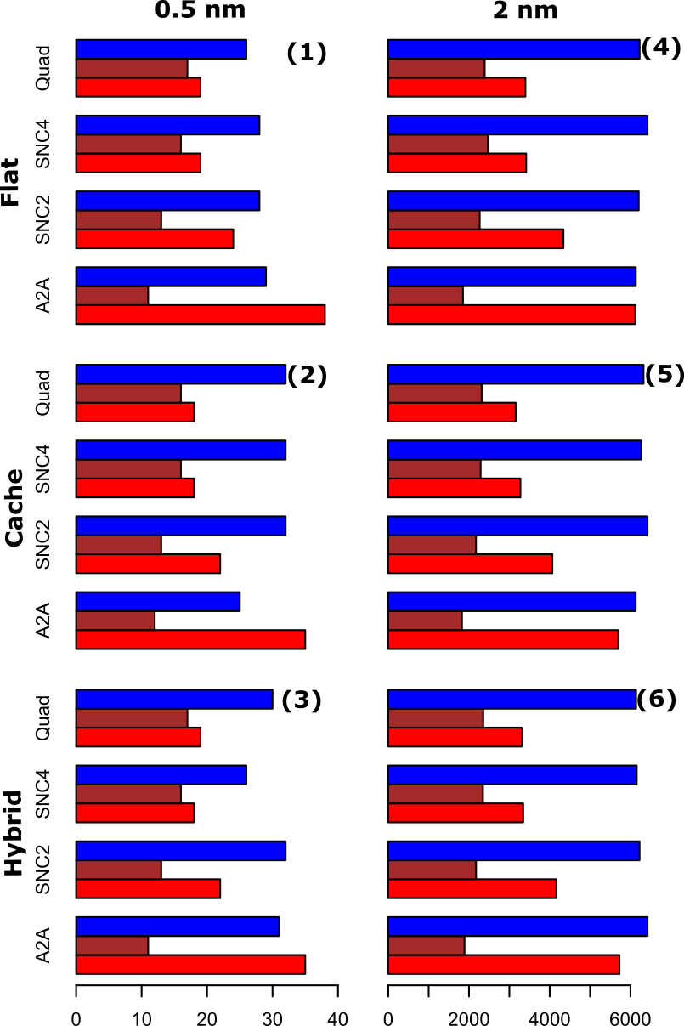
Memory and Clustering Modes
Blue – MPI-only code
Brown – OpenMP Private Fock code
Red – OpenMP Shared Fock code
Time to solution (x axis, time in seconds) for different clustering and memory modes. Left column displays the small chemical system - 0.5 nm bilayer graphene and right column displays one of the largest molecules bilayer graphene - 2.0 nm.
For 2 nm system no difference between different modes.
For 0.5 nm Flat-Quad MPI code is faster than Cache-Quad OpenMP code

Slide 13
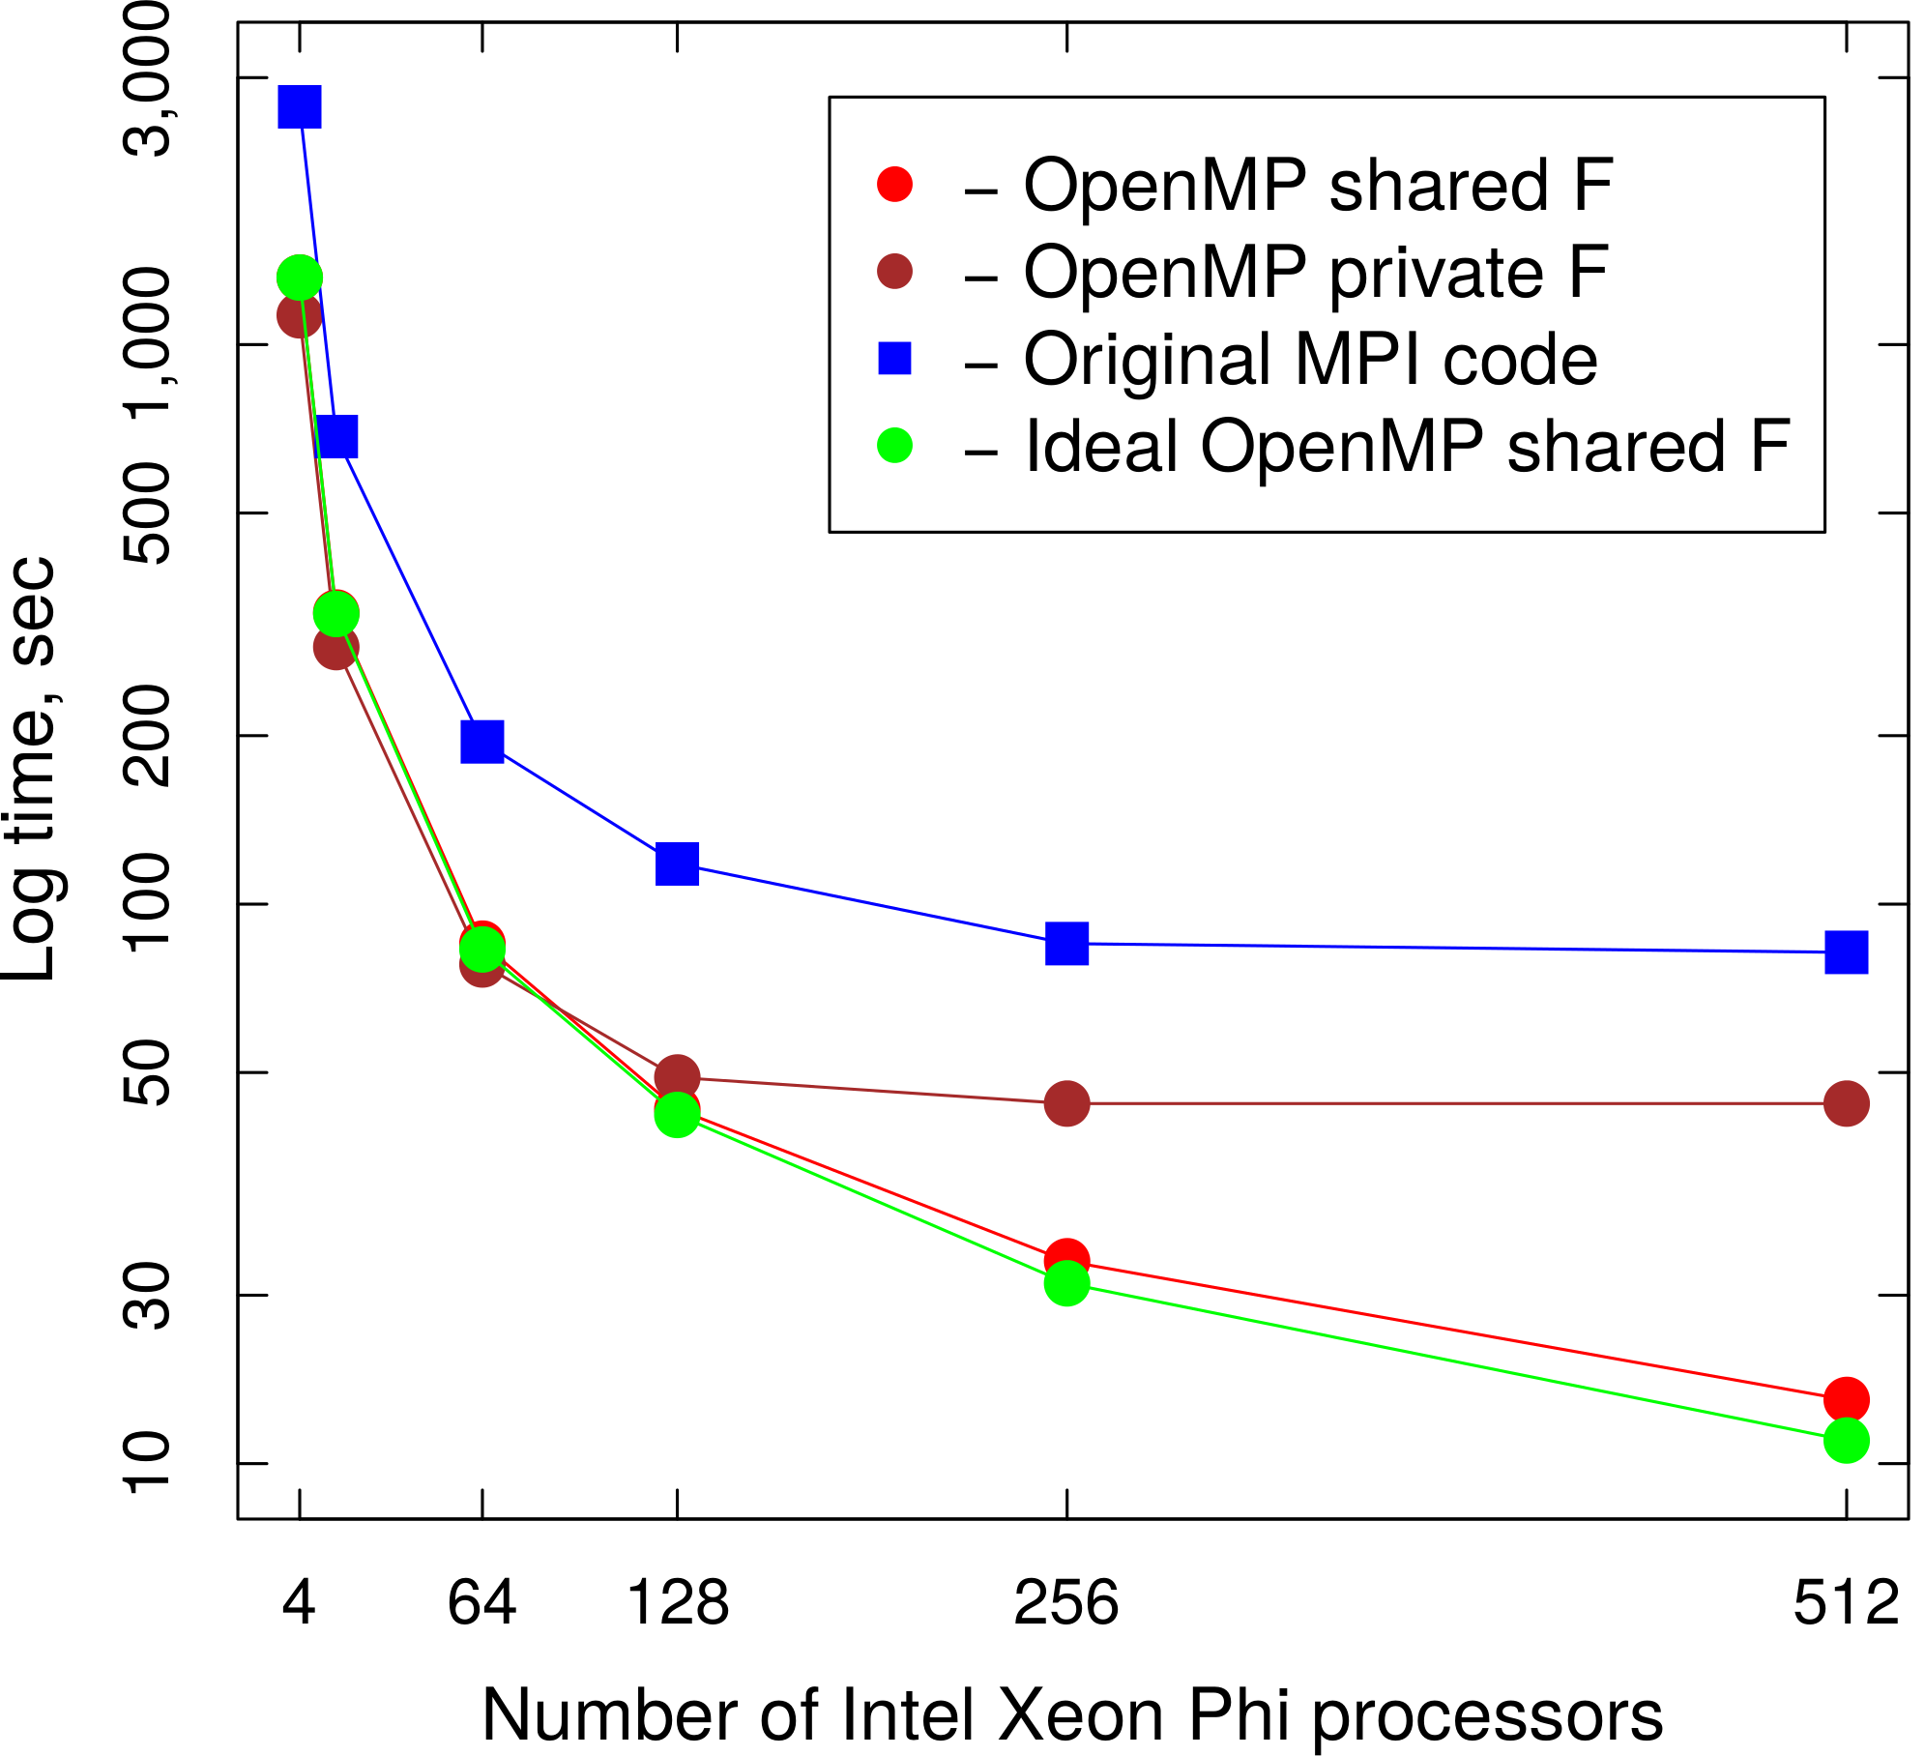
OpenMP and MPI scaling on many Xeon Phi
Multi-node scalability of the Private Fock and the Shared Fock hybrid MPI-OpenMP and the MPI-only stock GAMESS codes on the Theta machine with the 2.0 nm dataset. The Quad-Cache cluster-memory mode was used for all data points.

Slide 14
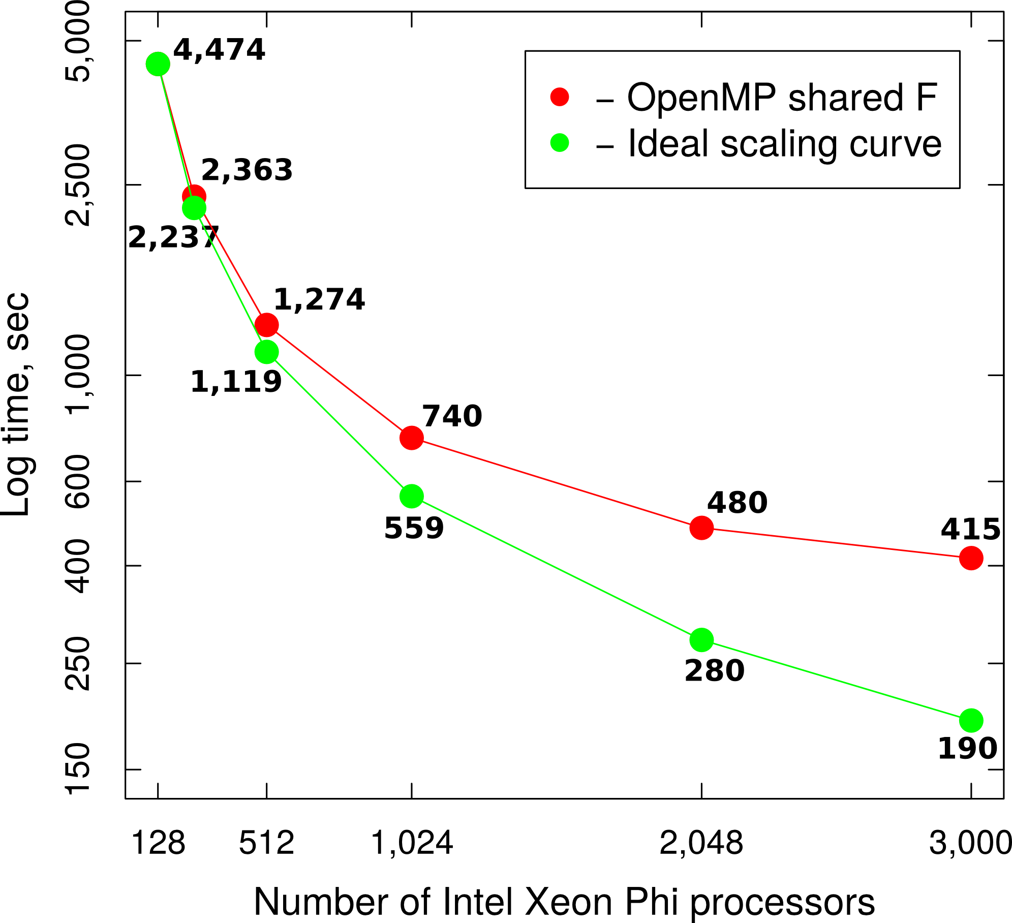
OpenMP and MPI scaling on many Xeon Phi
Scalability of the Shared Fock hybrid MPI-OpenMP version of GAMESS on the Theta machine for the 5.0 nm (i.e. large) dataset in quadrant cache mode on 3,000 KNL processors. The results here are for 4 MPI ranks per node with 64 threads per rank, giving full saturation (in terms of hardware threads) on every KNL node.

Slide 15
Memory Footprint

Slide 16
Results
  Sped up code up to 6 times
  Significantly reduced memory footprint by up to 200 times
  ERI code is now thread-safe (Rotated axis and Rys ERI)
  Implemented OpenMP parallelization in SCF driver
  Threaded energy code for RHF, UHF, ROHF, and HF-exchange part in hybrid DFT
  Threaded gradient code for RHF, UHF, ROHF, and HF-exchange part in hybrid DFT
  Results are published in
  1. SC17 technical paper: “An efficient MPI/OpenMP parallelization of the Hartree-Fock method for the second generation of Intel Xeon Phi processor”
  2. Paper in The International Journal of High Performance Computing Applications: An efficient MPI/OpenMP parallelization of the Hartree-Fock-Roothan method for the first generation of Intel Xeon Phi processor achitecture”

Slide 17
Acknowledgments
This research used resources of the Argonne Leadership Computing Facility, which is a DOE Ofﬁce of Science User Facility supported under Contract DE-AC02-06CH11357
We gratefully acknowledge the computing resources provided and operated by the Joint Laboratory for System Evaluation (JLSE) at Argonne National Laboratory
Vladimir Mironov thanks Intel® Parallel Compute Center program for funding
The authors would like to thank the RSC Technologies staff for discussion and help related to the paper and for providing Intel Xeon Phi development platform

