Slide 1



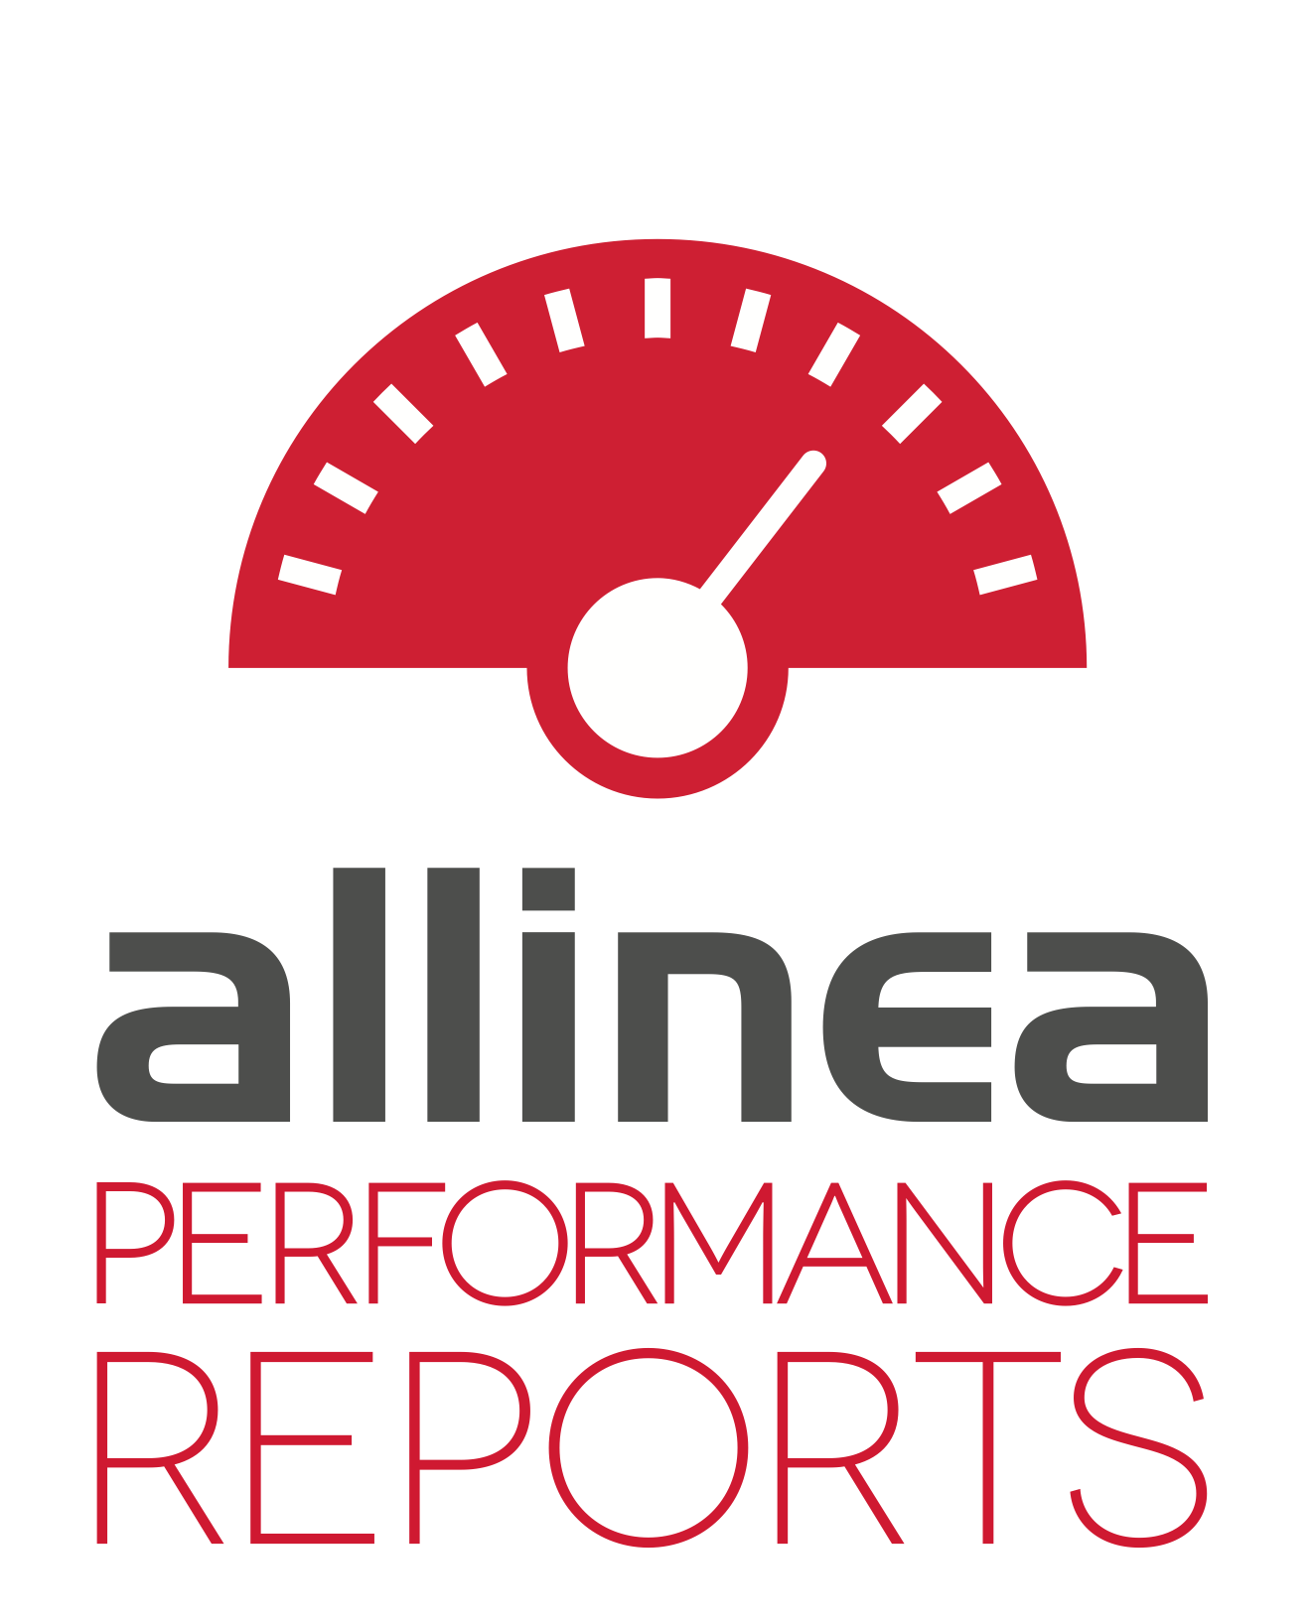


Show don’t tell: improving vectorization awareness in HPC
Mark O’Connor
VP Product Management
Notes:
Introduce the company:
Almost 15 years in HPC
Dedicated to science – to accelerating the pace of scientific progress
Contributing to this goal by making the best tools for science
Introduce the products:
Forge – a development tool for debugging and profiling parallel codes
Performance Reports –analysis and tuning of applications for system administrators and owners

Slide 2


An Uncomfortable Truth About HPC Codes
caption

Slide 3

This is a problem when CPU architectures change…
Image © Guido da Rozze CC-BY
Notes:
Previously this has been referred to as the elephant in the room, and it’s been something of a pet elephant because increasing per-core performance has kept it from really hurting anyone.
Now with the move to many-core architectures and their dependence on extremely wide vector units for high performance this isn’t really a tame elephant any more…

Slide 4

This is a problem when CPU architectures change…
The Dragon of Hell © Baltasar Vischi CC-BY-ND
Notes:
… this problem is more… urgent. We need to deal with it to keep on growing as a community.

Slide 5
How do we help scientific users get the most out of our machines?
Brave Hero:
1 code 10x faster
Wise Ruler:
100 codes 10% faster
Images © Frank Kovalchek CC-BY
Notes:
Historically there have been a couple of different ways of dealing with dragons. Many of the presentations here are heroic in nature – conquering difficult codes one at a time and improving their performance by orders of magnitude. This is essential work. But there are too many codes and too many scientists developing new ones to only tackle one at a time. We need a complimentary approach – helping educate developers and researchers in how to structure and profile their codes from the start.

Slide 6
Two very different ways to improve the situation
Notes:
This is something we believe we can help with!

Slide 7

Can we help scientific developers scalably?
You can teach a man to fish
But first he must realize he is hungry
Image © Kanani CC-BY
Notes:
Outreach to scientific developers within HPC is an ongoing task for all of us, and the biggest barrier is awareness. Many either do not know how much performance is being left on the table or simply do not care – they have other problems on their minds and are happy as soon as their results are correct.

Slide 8

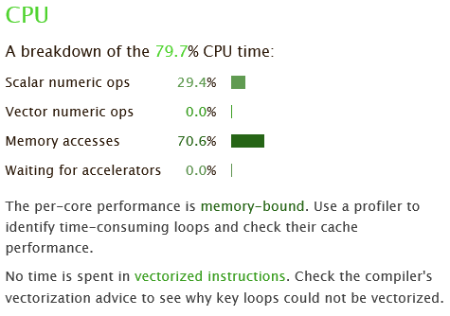
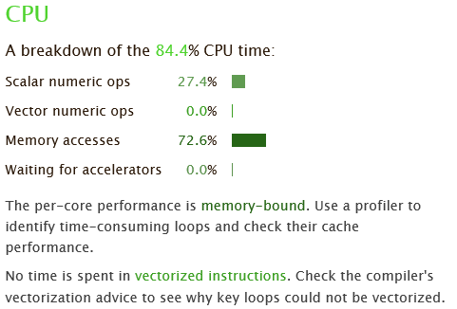
Communicating the benefits of optimization
caption
This is your brain on drugs…
… this is your code on –O0
Notes:
We’ve adopted the process of SHOW, don’t TELL. The design of Performance Reports is to let any non-technical user pull up a 1-page HTML report of their code that is simple to understand. You can also run this on a user’s code without their help, e.g. transparently on their unmodified binaries. Then you can take this report and say “Hey, this is your code on –O0”
“I don’t compile with –O0”
“Actually it turns out you’ve been running in production with –O0. But in any case, this is what it looks like with –O3”
“Oh, huh, why is that 0.0%? Is that good?”
“Not really – let me tell you about that…”

Slide 9
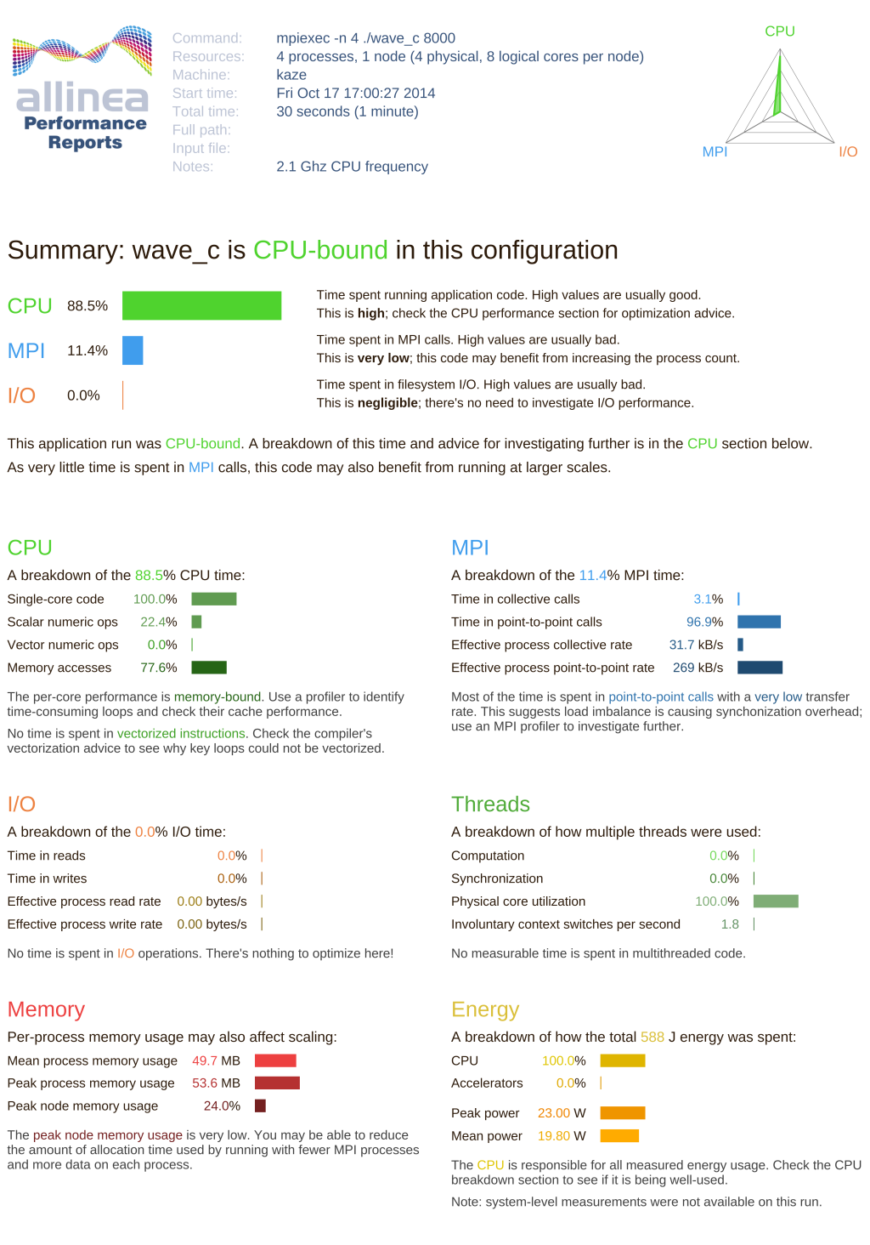
Show the user with a performance model they understand
caption
“Vectorization, how does it work?”
Notes:
Most users have a fairly simplistic mental model of how a CPU works. Instruction in, instruction out. Something with cache as well. If we can communicate at that level, THEY ask US to teach them more, instead of having to have the information force-fed in sessions they don’t really want to attend.

Slide 10
Communicating at the user’s abstraction level
Out-of-order
Pipelined
Time per retired instruction
caption
Notes:
The complexity of a modern superscalar, out-of-order, deeply pipelined core frankly terrifies the uninitiated. So to communicate with them we have to try to back away from all of that – which means sacrificing a significant number of useful performance counters – and give them feedback at the only level they understand – retired instructions. Although they just call them “instructions”, so we do too.

Slide 11
Explaining performance in terms of the program counter
Statistical wallclock time estimate of:
Scalar numeric operations
AVX/AVX2 operations
Memory accesses (what about indirect accesses?)
Other (branch, logic, …)
caption
+ simple, actionable advice
Notes:
So what do we actually show here? You can come and ask us for more details outside the talk, but as a quick overview we present a statistical wallclock estimate of the amount of time spent in various classes of instructions. This isn’t a measurement in the sense of the performance counters we’re used to dealing with, but it turns out for the purposes of communication and education we don’t actually need exact measurements. The aim is to be able to point an otherwise unsophisticated user in the right direction to get more help.

Slide 12
Not just for vectorization, but for MPI, I/O, memory and energy usage too
caption
Notes:
Can call out specific sections of a report to describe it

Slide 13
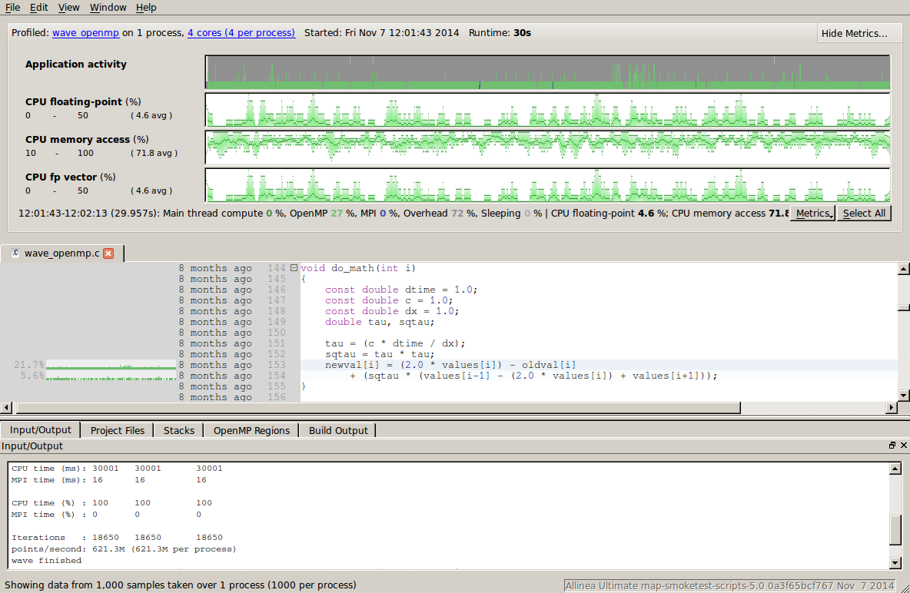
Diving deeper with Allinea Forge – where can I improve?
Slow lines of code
Unvectorized loops
Performance over time
…and much more!
MPI Bottlenecks
OpenMP bottlenecks
caption
Notes:
We’ve been working with a wide variety of teams in the IPCC and can strongly recommend getting involved with the program. There are free licences, support and training for all participants and we’ve had very good feedback from teams so far.

Slide 14
Intel® Xeon Phi™ Knights Landing Support
Debug
First-class Intel® Xeon Phi™ support
Memory debugging enhancements for HBM
Profile
First-class Intel® Xeon Phi™ support
Investigating additional Intel® Xeon Phi™ metrics – watch this space!
Tune and Analyze
First-class Intel® Xeon Phi™ support
Investigating additional Intel® Xeon Phi™ metrics – watch this space!

Slide 15
Thank you! Any questions?
Mark O’Connor
VP Product Management
Notes:
Thank-you!

