Slide 1


TAU Performance System®
TAU is a profiling and tracing toolkit that supports programs written in C, C++, Fortran, Java, Python, UPC on HPC platforms
TAU v2.25 and PDT v3.21 released at SC’15
HPCLinux LiveDVD/OVA [http://www.hpclinux.org] includes TAU
New features:
  OpenMP instrumentation support using latest OMPT package
  New binary rewriters (DyninstAPI, MAQAO, PEBIL)
  PDT parsers use EDG v4.10.1 for support of C99 and C++ 14
  PDT supports a GNU gfortran-4.8.5 based parser
  Support for Intel KNC, Xeons
  Memory footprint tracking
  Access to hardware performance counters to compute vectorization intensity

Slide 2
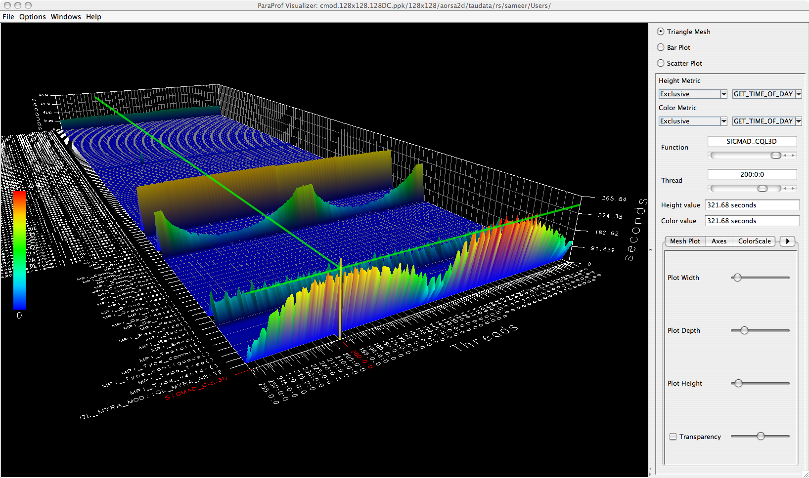
TAU’s ParaProf 3D Profile Browser

Slide 3
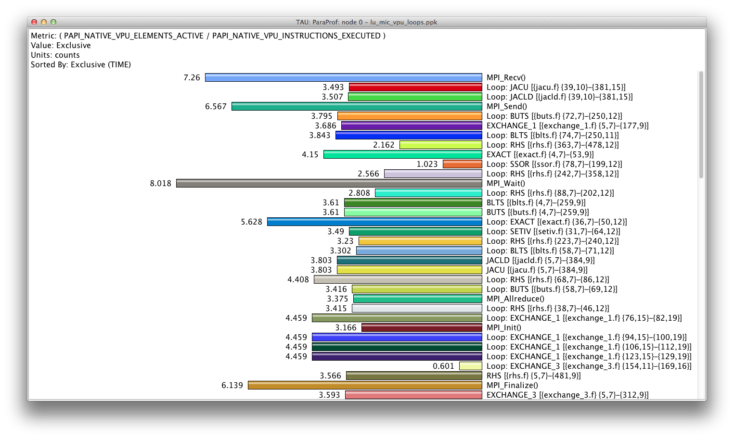
ParaProf’s Derived Metric Window: MIC
% export TAU_MAKEFILE=$TAUROOT/mic_linux/lib/Makefile.tau-papi-mpi-pdt; make CC=tau_cc.sh
% export TAU_METRICS=TIME,
PAPI_NATIVE_VPU_ELEMENTS_ACTIVE,PAPI_NATIVE_VPU_INSTRUCTIONS_EXECUTED

