Slide 1
www.ixpug.org
@IXPUG1

Slide 2
Worldwide organization
Optimization of scientific applications on Intel based HPC systems
Now Intel eXtreme Performance Users Group
Free exchange of information and ideas
Meetings and activities open to everyone
Strong support from, and interactions with, Intel
Independent and member run
http://www.ixpug.org/

Slide 3
Why did the name change?
We are moving from “Intel Xeon Phi User Group” to “Intel eXtreme Performance Users Group” (still abbreviated IXPUG).
This name change reflects an expanding focus, to include: system hardware beyond the processor (e.g. memory, interconnect); software tools and programming models; and new workloads (e.g. visualization, data analytics, machine learning).

Slide 4
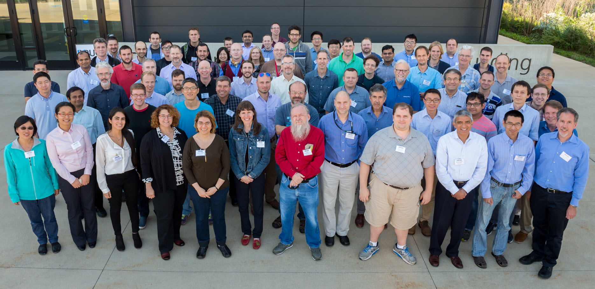
16 major events in ~2 years!

Slide 5
Past IXPUG Meetings
IXPUG Annual Meeting, September 12-22, 2016 – Argonne National Laboratory, Argonne, USA
IXPUG at Intel HPC Developer Conference, November 12-13, 2016 – Salt Lake City, USA
BoF: “Optimizing Performance on Intel® Xeon Phi and Beyond: Unleashing the Power of Many-Core Processors”, November 16, 2016 – SC16, Salt Lake City, USA
IXPUG Annual Spring Meeting, April 10-13, 2017, University of Cambridge, Cambridge, UK
IXPUG Software-Defined Visualization Workshop, May 22-25, 2017 – TACC, Austin, USA
IXPUG Russia Annual Meeting, June 1-2, 2017 – Russian Academy of Sciences, Moscow, Russia
BoF: “Achieving Performance on Large-Scale Intel Xeon Phi Knights Landing Systems”, June 19, 2017 – ISC’17, Frankfurt am Main, Germany
Workshop: "Experiences on Intel Knights Landing at the One Year Mark”, June 22, 2017 – ISC’17, Frankfurt am Main, Germany
IXPUG at Intel HPC Developer Conference, November 11-12, 2017 – Denver, USA
IXPUG BoF, November 14, 2017 – SC17, Denver, US
Asia HPC IXPUG Workshop, January 28-31, 2018
All technical presentations and recordings are posted on www.ixpug.org

Slide 6
Upcoming IXPUG Meetings
Date | Location | Event | Description
March 8, 2018 | Virtual | Working Group | “Compiler Prefetching for Knights Landing” (Rakesh Krishnaiyer, Intel): We will cover some of the recent changes in the compiler-based prefetching (for Knights Landing and Skylake) and provide tips on how to tune for performance using compiler prefetching options, pragmas and prefetch intrinsics.
April 22-25, 2018 | Thuwal, Saudi Arabia | IXPUG Workshop at KAUST | This meeting is hosted by King Abdullah University of Science and Technology (KAUST) the IXPUG Conference will focus on the areas of energy, climate simulations and analytics based on PDE’s or analytics based on geospacial statistics are limited to memory, processing or both. This is the first IXPUG meeting in the Middle East.
May 10, 2018 | Virtual | Working Group | “High Productivity Languages” (Rollin Thomas, NERSC and Sergey Maidanov, Intel): The challenges of numerical analysis and simulations at scale use tools such as Python which are often used for prototyping are not designed to scale to large problems. Therefore, new approaches are required for address scalability and productivity aspects of applied science that combines two distinct worlds, the best of HPC and database worlds.
June 28, 2018 | Frankfurt, Germany | IXPUG ISC18 Workshop | "Many-core Computing on Intel Processors: Applications, Performance and Best-Practice Solutions" This one full-day IXPUG workshop will bring together software developers and technology experts to share challenges, experiences and best-practice methods ,for the optimization of HPC, Machine Learning (ML) and Data Analytics (DA) workloads on Intel Xeon Scalable Processors and Intel Xeon Phi Processors.
September 25-28, 2018 | Hillsboro, Oregon | IXPUG Annual Fall Conference | This meeting is hosted by Hosted by Sandia National Lab (SNL) and Los Alamos National Lab (LANL), but held at the Intel Corporation (Hillsboro, Oregon) facility. This conference will be focused on Application characterization on emerging technologies (HBM, NVM, Quantum, Xeon, Xeon Phi, FPGAs, etc.), implications of workload behavior on system design at extreme scale (power, reliability, scalability, performance, processor design, memory systems, I/O, etc.), software environments and tools for computing at extreme scale (instrumentation, debugging/correctness, thread and process management, libraries and language development, etc.), experiences using extreme scale systems (usability, In-Situ visualization, programming challenges, algorithms and methods, etc.) and covering key topics that touch HPC, AI, Data Analytics, Systems and Cloud.

Slide 7
IXPUG KAUST Conference 2018
April 22 – 25, 2018
Thuwal, Mecca Province, Saudi Arabia
Focused on all aspects of employing, adopting many-core processing technologies and techniques for optimal application execution.
Including the areas of energy and environmental, climate simulations and analytics with convergence of large-scale simulation, big data
analytics, co-design for Exascale (i.e. architecture, algorithms, applications) from bulk-synchronous to dynamic task-based algorithm design.
This is the first IXPUG meeting in the Middle East.
Date: April 22, 2018: Welcome Reception
April 23-25, 2018: Keynote, Workshops, Lightning Talks, Tutorials [Open to public]
Location: King Abdullah University of Science and Technology (KAUST), Thuwal 23955, Saudi Arabia
Registration: https://www.ixpug.org/kaust-spring-meeting-2018
Agenda: https://www.ixpug.org/ixpug-kaust-spring-conference-2018, more details will be posted upon abstract selection.
Cost: Free and open to the public open to the public meeting and all are welcome to join
Call for Abstracts: https://easychair.org/conferences/?conf=ixpugspring2017 (submit NOW!)
Important dates:
Abstract submissions open: January 1, 2018
Abstracts due: February 16, 2018 (AoE)
Presenters notified: February 23, 2018 (AoE)
Final presentations: April 19, 2018

Slide 8
ISC18 IXPUG Workshop: "Many-core Computing on Intel Processors: Applications, Performance and Best-Practice Solutions“
This one full-day IXPUG workshop will bring together software developers and technology experts to share challenges, experiences and best-practice methods ,for the optimization of HPC, Machine Learning (ML) and Data Analytics (DA) workloads on Intel Xeon Scalable Processors and Intel Xeon Phi Processors.
Date: June 28, 2018
Location: Messe, Frankfurt, Germany
Registration: he workshop is held in conjunction with the ISC 2018 in Frankfurt (Main). To attend the IXPUG workshop, you have to register for ISC Workshops. More information is on the ISC 2018 Conference website.
Agenda: to be featured on the website, upon completion of abstract submission process
Call for Abstracts: coming soon
Important dates:
Abstract submissions open: March 14, 2018
Abstracts due: April 15, 2018 (AoE)
Presenters notified: May 13, 2018 (AoE)
Final presentations: June 27, 2018

Slide 9
IXPUG Annual Fall Conference 2018
September 25 – 28, 2018
Hillsboro, Oregon
Focused on all aspects of employing, adopting many-core processing technologies and techniques for optimal application execution.
Including topics that cover system hardware beyond the processor (memory, interconnect, etc.), software tools, programming
models, new workloads (visualization, data analytics, machine learning, etc.) and more.
Date: September 25-28, 2018
Location: Intel Corporation (Jones Farm Conference Center, JFCC Building, 2111 NE 25th Avenue Hillsboro, Oregon 97124)
Registration: coming soon
Agenda: to be featured on the website, upon completion of abstract submission process
Cost: Free and open to the public meeting and all are welcome to join
Call for Abstracts: coming soon
Important dates:
Abstract submissions open: March 14, 2018
Abstracts due: July 13, 2018 (AoE)
Presenters notified: July 25, 2018 (AoE)
Final presentations: September 24, 2018

Slide 10
IXPUG Working Groups
Focused on fostering collaborations of cross sharing open standard techniques, best practices, etc.
Timeline: ~monthly virtual conferences meetings
Attendance: combination of Intel experts and industry luminaries
Cost: this is a FREE, open to the public meeting and all are welcome to join
Registration: https://www.ixpug.org/working-groups for more information
Material Location: all technical presentations and recordings are posted on the website mentioned above
Date | Location | Description
January 11, 2018 | Virtual | "Vectorization of Inclusive/Exclusive Scan in Compiler 19.0" (Nikolay Panchenko, Intel): We propose a new OpenMP syntax to support inclusive and exclusive scan patterns. In computer science, this pattern is also known as a prefix or cumulative sum. The proposal defines several new constructs to support inclusive and exclusive scans through OpenMP, defines semantics for these constructs and possible combination of parallelization and vectorization. In 18.0 Compiler 3 new OMP SIMD experimental features were added: vectorization of loops with breaks, syntax for compress/expand patterns and syntax for histogram pattern.
February 8. 2018 | Virtual | Threading Building Blocks (TBB) Flow Graph (Pablo Reble, Intel) Expressing and Analyzing Dependencies in Your C++ Application. This session focuses on Flow Graph, an extension to the Threading Building Blocks (TBB) interface that can be used as a coordination layer for heterogeneity that retains optimization opportunities and composes with existing models. This extension assists in expressing complex synchronization and communication patterns and in balancing load between CPUs, GPUs, and FPGAs.
March 8, 2018 | Virtual | “Compiler Prefetching for Knights Landing” (Rakesh Krishnaiyer, Intel): We will cover some of the recent changes in the compiler-based prefetching (for Knights Landing and Skylake) and provide tips on how to tune for performance using compiler prefetching options, pragmas and prefetch intrinsics.
May 10, 2018 | Virtual | “High Productivity Languages” (Rollin Thomas, NERSC and Sergey Maidanov, Intel): The challenges of numerical analysis and simulations at scale use tools such as Python which are often used for prototyping are not designed to scale to large problems. Therefore, new approaches are required for address scalability and productivity aspects of applied science that combines two distinct worlds, the best of HPC and database worlds.

Slide 11
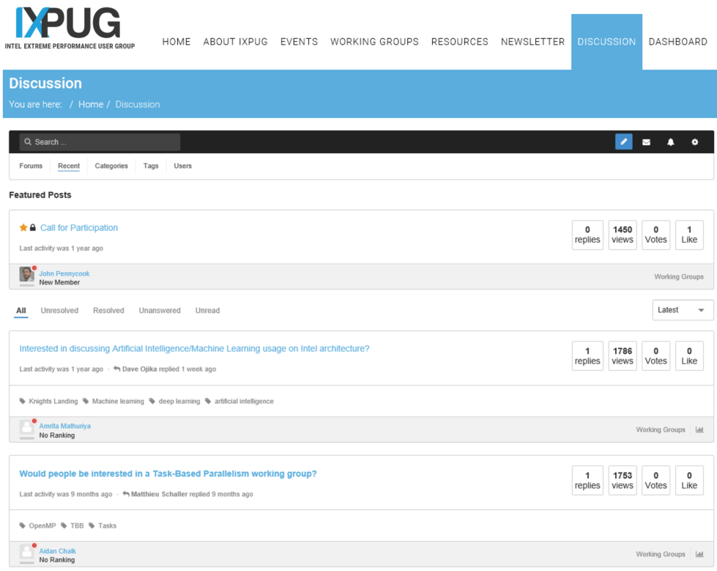
IXPUG Discussion Forums
Focused on building a community that supports open discussions that address questions, technique suggestions, etc. on general purpose Intel architecture using open standards
Start a discussion thread
Share your learnings and experiences
Encourage others to join
Visit https://www.ixpug.org/discussion

Slide 12
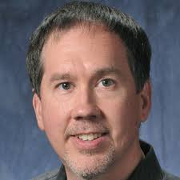
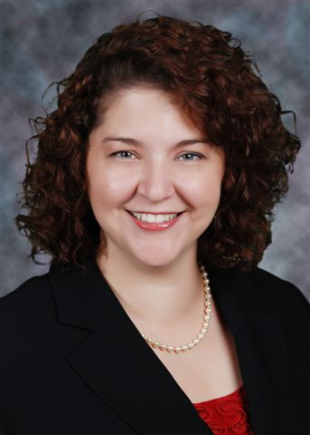
IXPUG Leadership Board
President: David Martin, Argonne National Laboratory
Vice President: Estela, Jülich Supercomputing Centre
Secretary: Melyssa Fratkin, Texas Advanced Computing Center

Slide 13
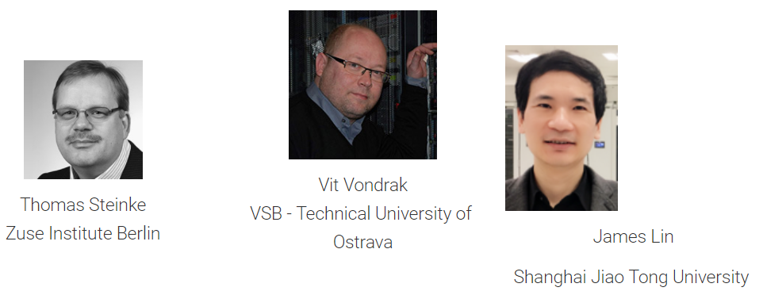
IXPUG Steering Committee

Slide 14
How to Get Involved
Become a member by registering at www.ixpug.org
Contribute by sharing your learnings and experiences in using Intel architecture
Attend an IXPUG Conferences, Workshops, Birds-of-Feather, etc. meeting
Volunteer to be a Reviewer for any upcoming “call for abstracts”, by sending an email to info@ixpug.org
Participate in the ~monthly Working Groups as a speaker and/or attendee
Post a question, share a technique, best practices, etc. on the “Discussion” board at https://www.ixpug.org/discussion
Join the IXPUG Steering Group and/or host an IXPUG Meeting
Connect with us on Twitter @IXPUG1
Encourage others to join the IXPUG community, by sharing it with your network

