Slide 1
ALCF Site Update
David E. Martin
Argonne Leadership Computing Facility
with thanks to Scott Parker
Notes:
Good afternoon
My name is Scott Parker
I am from Argonne National Lab where we are working on the deployment and bring up of the Aurora Exascale supercomputer
This talk will provide:
an update of on status of the Aurora supercomputer
an overview of the architecture
and some early applications results

Slide 2
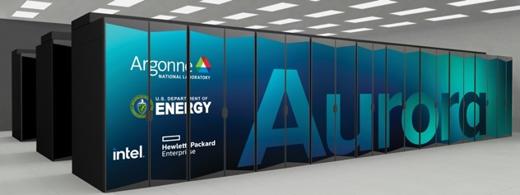
Aurora
Leadership Computing Facility Exascale Supercomputer
Peak Performance
≧ 2 Exaflops DP
Intel GPU
Intel® Data Center GPU Max Series
Intel Xeon Processor
4th Gen Intel XEON Max Series CPU with High Bandwidth Memory
Platform
HPE Cray-Ex
Compute Node
Two 4th Gen Intel XEON Max Series CPUs Six Intel® Data Center GPU Max Series Node Unified Memory Architecture Eight fabric endpoints
GPU Architecture
Intel® Data Center GPU Max Series architecture
High Bandwidth Memory Stacks
Node Performance
>130 TF
System Size
>10,000 nodes
Aggregate System Memory
>10 PB aggregate System Memory
System Interconnect
HPE Slingshot 11
Dragonfly topology with adaptive routing
Network Switch
25.6 Tb/s per switch (64 200 Gb/s ports)
Links with 25 GB/s per direction
High-Performance Storage
220 PB ≧25 TB/s DAOS bandwidth
Software Environment
C/C++
Fortran
SYCL/DPC++
OpenMP offload
Kokkos
RAJA
Intel Performance Tools
Notes:
Aurora will be an Exascale system that is currently in the process of being deployed at Argonne
It will have greater than 2 EF of double precision peak performance
And over 10 thousand nodes each of which will have over 130 TF of peak performance
Each of nodes will have two 4th Gen Intel XEON Max Series CPUs with HBM (aka Sapphire Rapids)
And Six Intel Data Center GPU Max Series per node (aka PVC)
In addition it will have 8 slingshot NIC pers node
which are connected via dragonfly topology
Overall the system will have greater than 10 PB of memory split between DDR and HBM (both on GPU and CPU)
New file system based on Intel DAOS architecture with 220 PB of storage and over 25 TB/s of bandwidth

Slide 3
Notes:
Aurora is in the process of being installed in the Argonne data center
This slide shows some pictures of the hardware that is on the floor
Today we have all the hardware except for the full set of compute blade
Which are arriving and being installed daily
And we are working to make the system available to applications teams in Q3 of this year

Slide 4
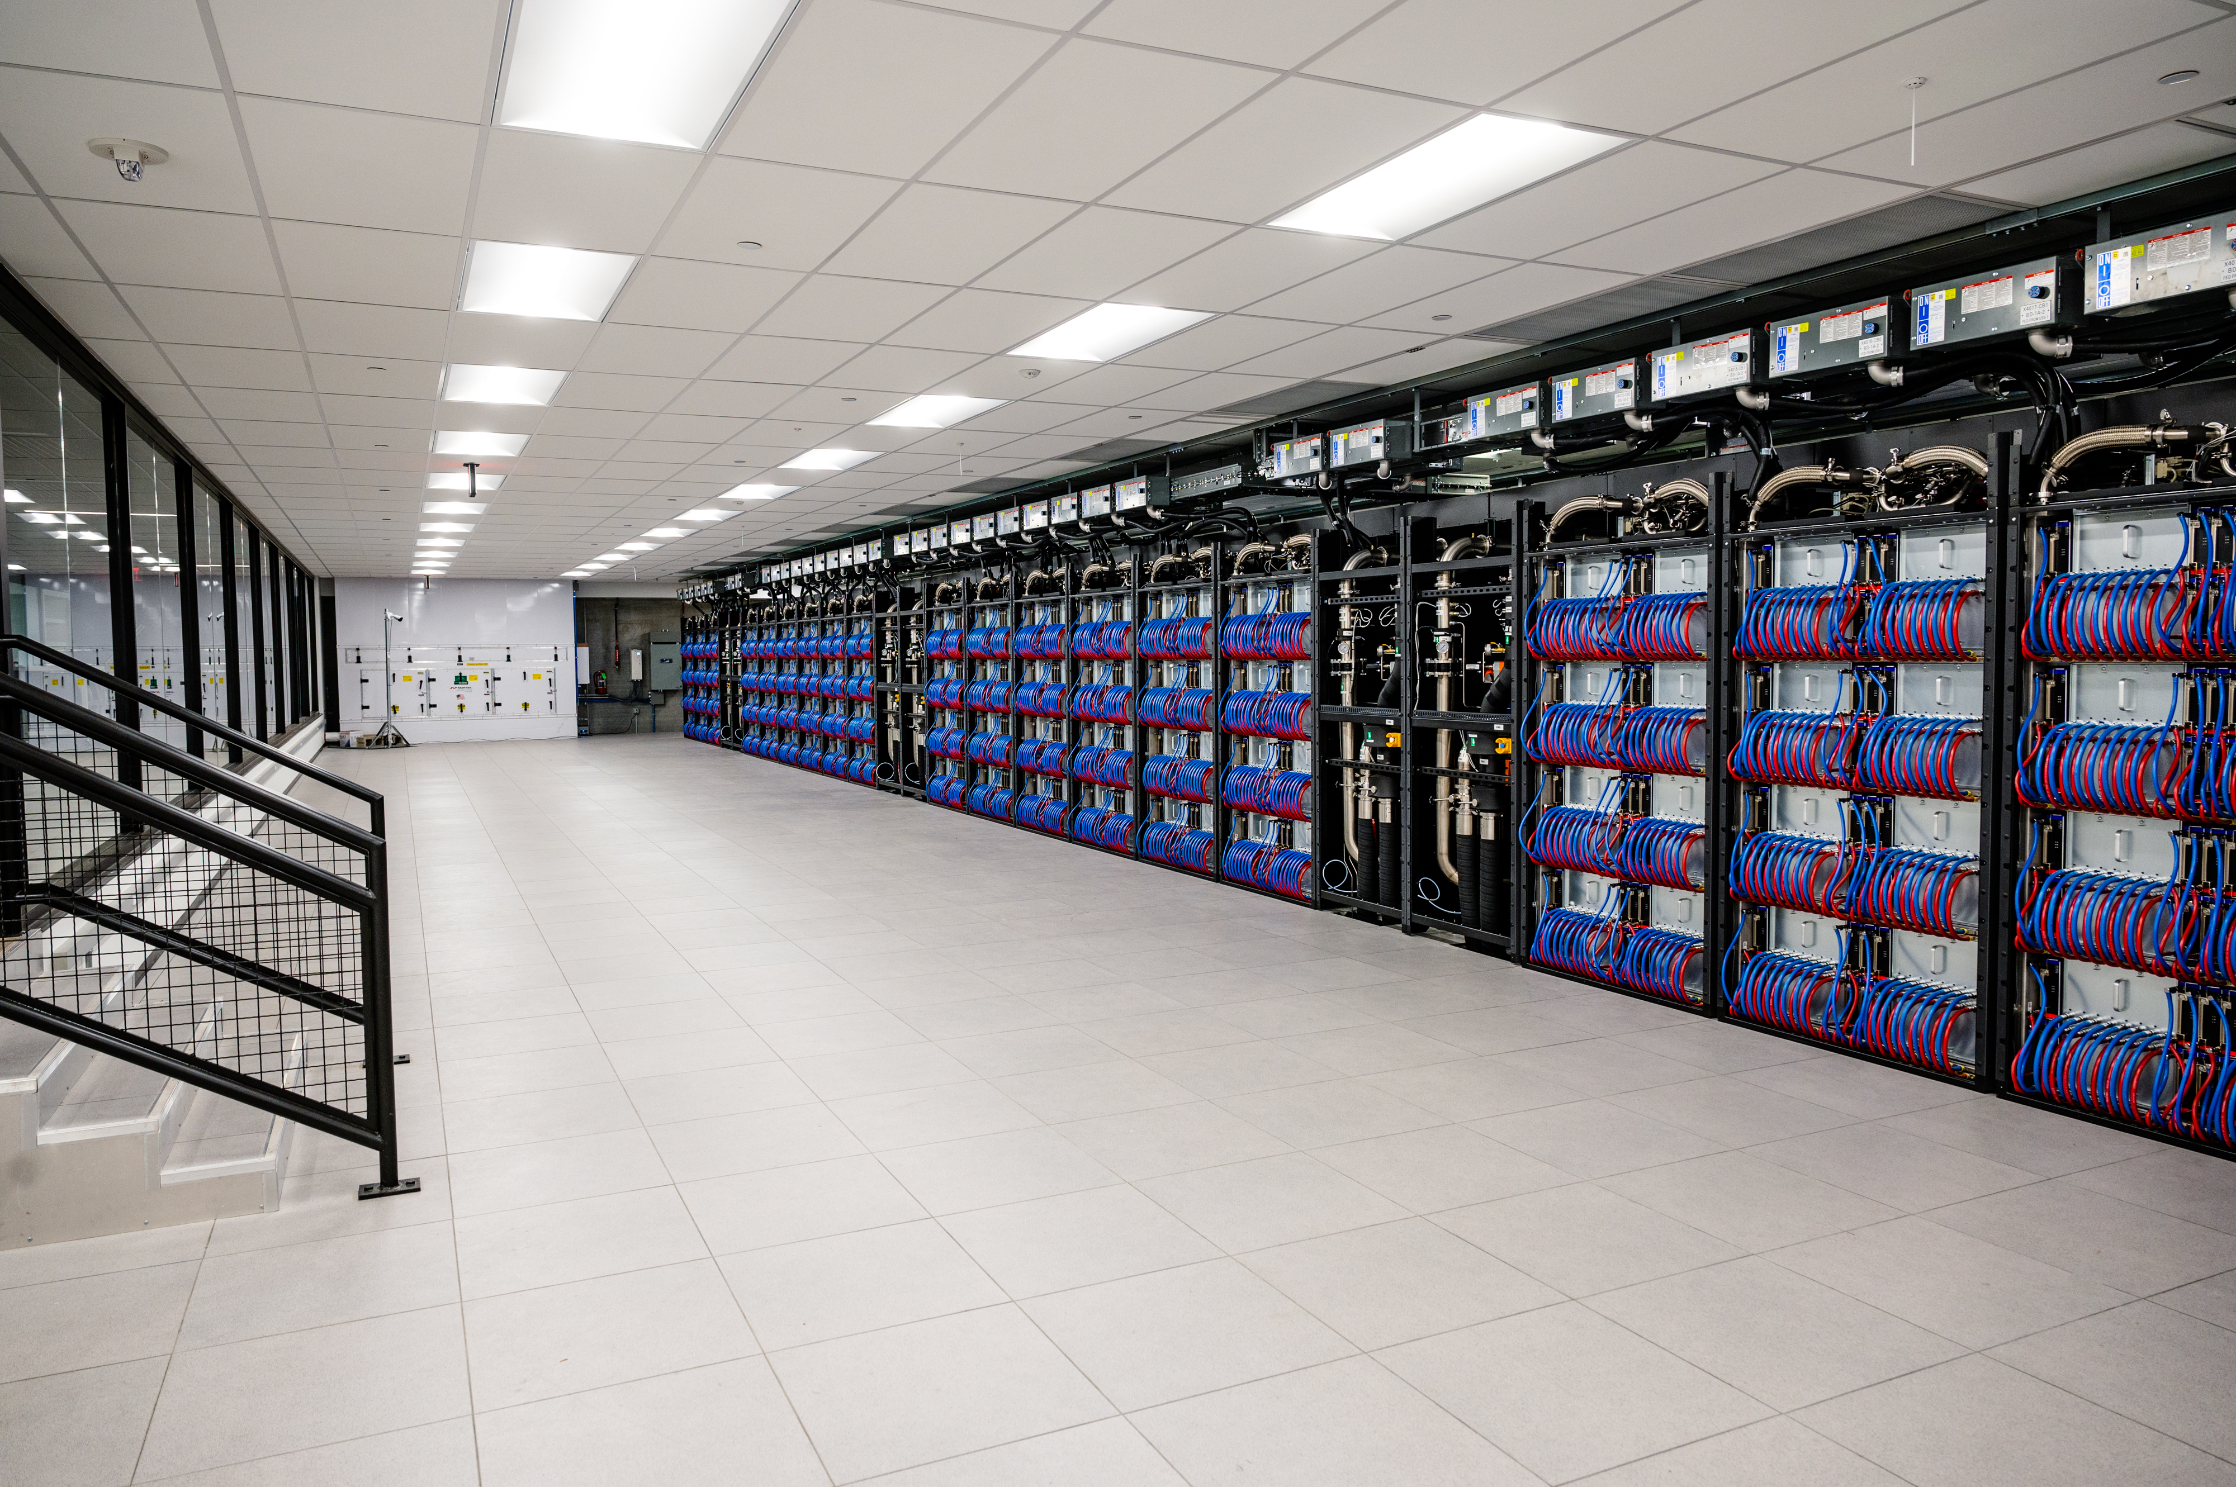
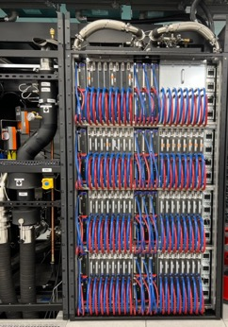
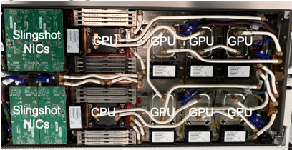
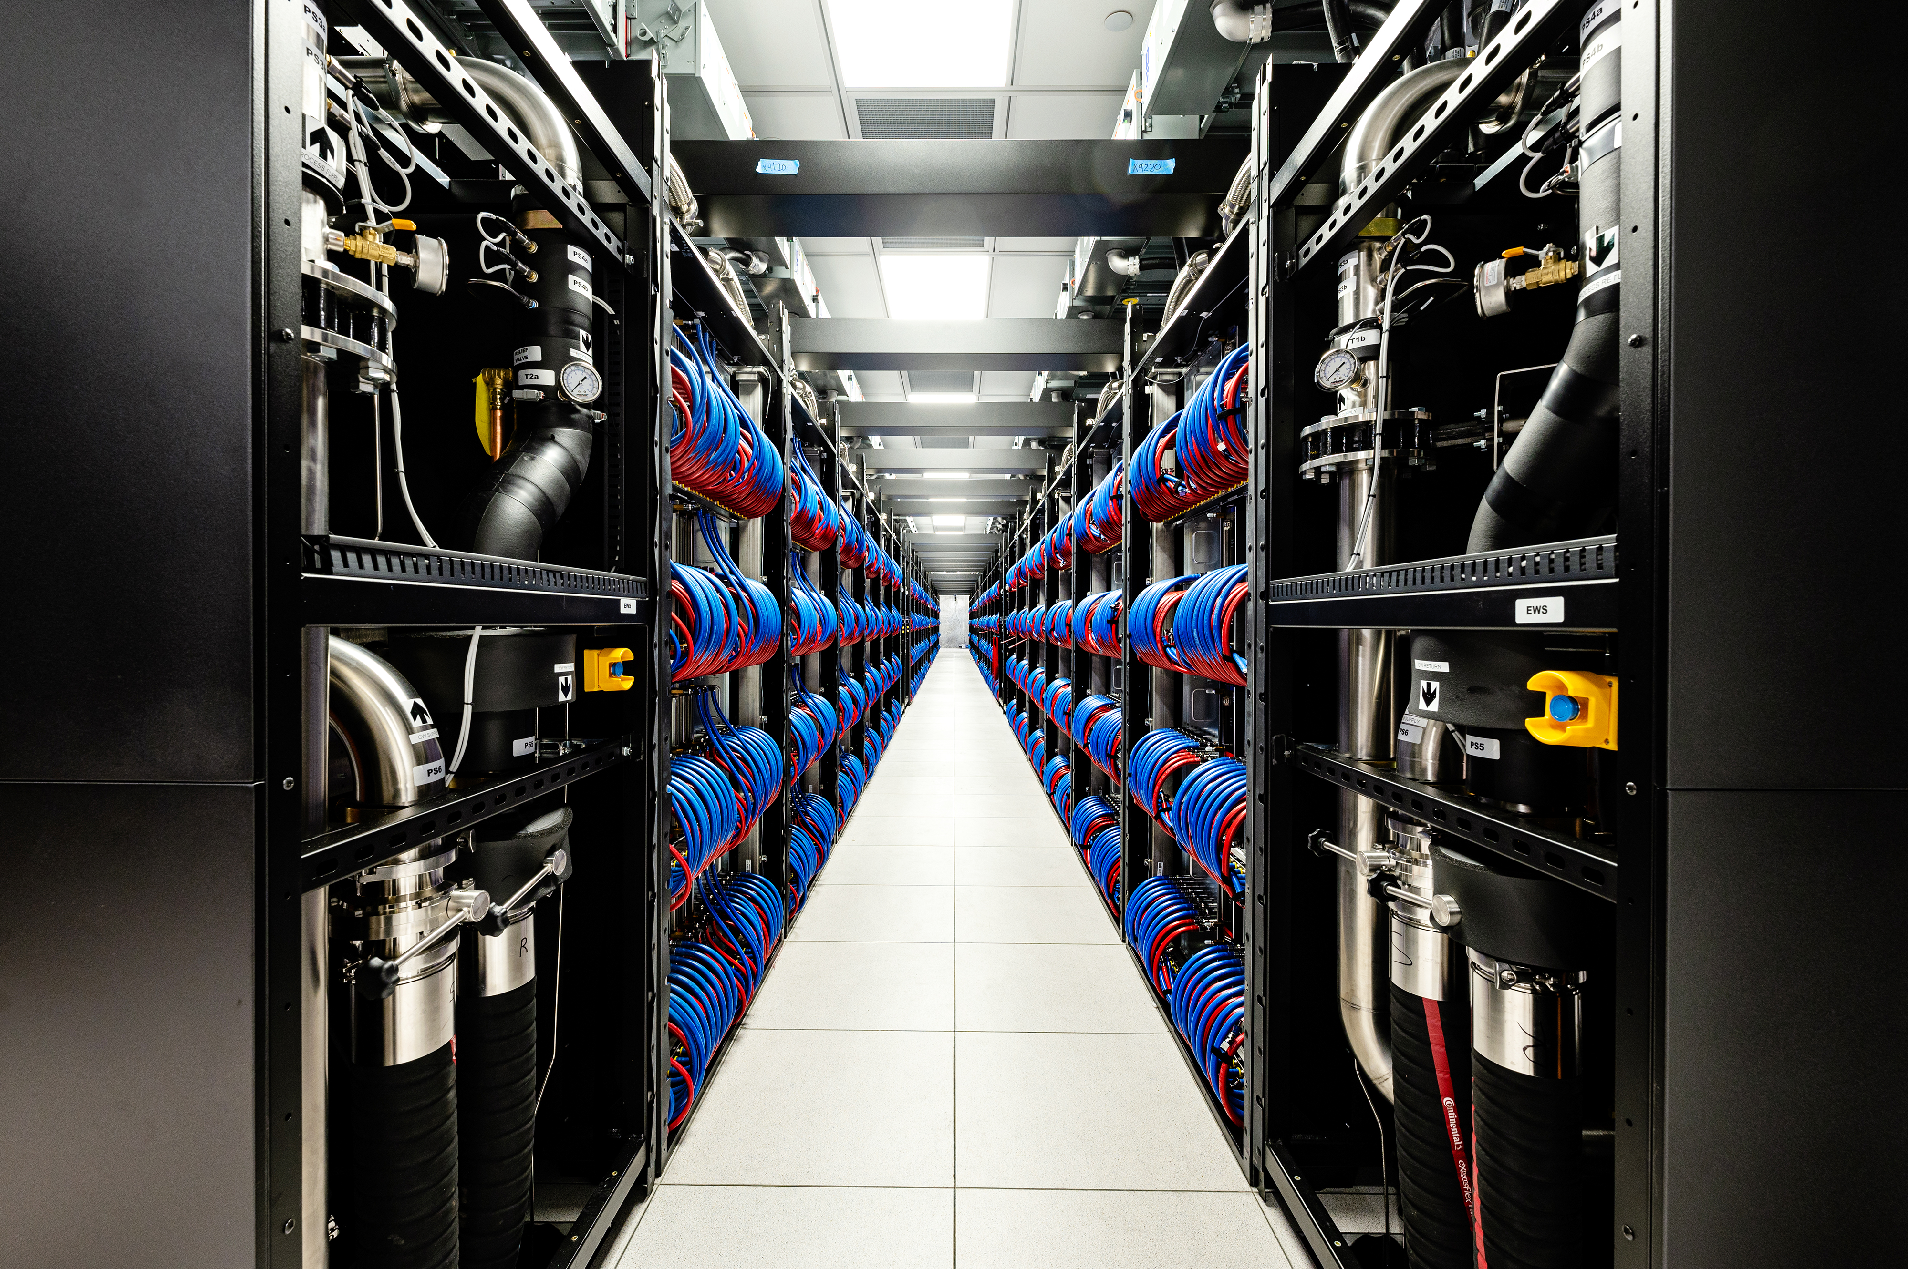
The Status of Aurora
Aurora deployment is underway
All of the Aurora system is installed at ANL
Except - the installation of compute blades which is nearly complete
Targeting early user in Q3 2023
Notes:
Aurora is in the process of being installed in the Argonne data center
This slide shows some pictures of the hardware that is on the floor
Today we have all the hardware except for the full set of compute blade
Which are arriving and being installed daily
And we are working to make the system available to applications teams in Q3 of this year

Slide 5
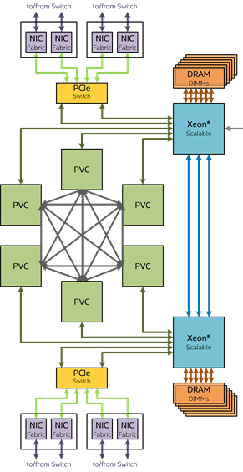
Aurora Testbeds: The Path to the Aurora Hardware
2019 - Iris
2020 - Yarrow - XeLP/DG1 (Decommissioned)
2020 - Arcticus XeHP GPU
2021 - Arcticus XeHP GPUs v2
2022 - Florentia Intel® Data Center GPU Max Series
2022 - Sunspot Aurora TDS
2023 Aurora
Iris node
Dual Discrete GPU Development Node
Arcticus node
Quad GPU Early Silicon PVC Node
Florentia node
Sunspot node
Aurora node
Initial Software Development Node
128GB DDR4
128GB DDR4
512GB DDR5
512GB DDR5
64GB DDR4
Intel® Data Center GPU Max Series
Intel® Data Center GPU Max Series
EDR
100 GBE
Intel® Xeon®
UPI
Intel® Xeon®
Intel® Xeon®
UPI
Intel® Xeon®
Intel® Xeon® Skylake 4C
Intel® Data Center GPU Max Series
Intel® Data Center GPU Max Series
4th Gen Intel XEON Max Series CPU
Iris Pro Graphics P580
XeHP GPU
XeHP GPU
Intel® Data Center GPU Max Series
SPR+HBM
EDR
2x Port X
100 GBE
EDR
2x Port X
100 GBE
Intel® Data Center GPU Max Series
Intel® Data Center GPU Max Series
Intel® Data Center GPU Max Series
Intel® Data Center GPU Max Series
Intel® Data Center GPU Max Series
Aurora Testbeds for Applications Development and Software Testing
4th Gen Intel XEON Max Series CPU
SPR+HBM
Sunspot is a two rack test and development system
Sunspot nodes and cabinets have the same hardware as Aurora
Sunspot is fully built and available for application developer use
Notes:
The Intel GPU that powers Aurora is new piece of hardware which presented challenges to getting the software ready
Prior to the arrival of the full Aurora system we have deployed a number of the Aurora testbed systems shown on this slide
these have been extremely useful for applications development and testing with the Intel software development environment
Started with Iris in 2019 and progressed through two generations of early Intel discrete GPUs (Arcticus with Intel XeHP GPUs)
First access to Intel PVC GPUs on our Florentia testbeds in 2022 which had four early silicon GPUs per node
More recently we’ve been using the Sunspot system:
Sunspot has the same hardware as Aurora
essentially just two racks of the Aurora system

Slide 6
Aurora Compute Node
Six Intel® Data Center GPU Max Series
All to all connection
Two 4th Gen Intel XEON Max Series CPUs with:
HBM memory
DDR memory
Unified Memory Architecture across CPUs and GPUs
8 Slingshot Fabric endpoints
4th Gen Intel XEON Max Series CPU
SPR+HBM
Intel® Data Center GPU Max Series
Intel® Data Center GPU Max Series
Intel® Data Center GPU Max Series
Intel® Data Center GPU Max Series
Intel® Data Center GPU Max Series
Intel® Data Center GPU Max Series
4th Gen Intel XEON Max Series CPU
SPR+HBM
Notes:
Aurora will be the first large scale system to use the new Intel Data Center GPU Max Series
But the node architecture will look fairly familiar to anyone who has looked at GPU based HPC systems
As mentioned earlier, each node will contain 6 PVC GPUs connected in an all-to-all fashion on the node
Along with two 4th Gen Intel XEON Max Series CPUs which contain HBM memory and are also connected to larger DDR memory
And 8 Slingshot Fabric end points which can access data directly on the GPU (not saying more about the network because it’s the same Slingshot)

Slide 7
Available Aurora Programming Models
Aurora applications may use:
DPC++/SYCL
OpenMP
Kokkos
Raja
OpenCL
Experimental
HIP – running GAMESS, CP2K, libCEED
Not available on Aurora:
CUDA
OpenACC
HIP
Notes:
On Aurora, we will support a number of GPU programming models
Including the ones that come with Intel oneAPI software which are SYCL, OpenMP, and OpenCL
In addition Aurora will provide Kokkos and RAJA
Aurora won’t however provide CUDA, as CUDA is proprietary
However an alternative to CUDA is HIP which was initially developed for AMD GPUs
For Aurora we initiated an effort to make HIP available
Early results is that we’ve been able to get several applications (GAMESS, CP2K) and libraries (libCEED) running on Intel GPUs using HIP

Slide 8
Aurora Applications Overview
Early applications for Aurora come from two programs:
The Argonne Early Science Program (ESP) : 19 projects
9 Simulation projects
5 Learning projects
5 Data projects
The DOE Exascale Computing Project (ECP) : 15 projects
Some projects contain multiple codes
44 codes are targeted for Aurora as part of ESP or ECP projects
3 codes are intended for use on the CPU only
Involves effort from over 60 Argonne and Intel staff and over one hundred outside collaborators
Almost all projects involve teams from outside Argonne
Notes:
For Aurora we’ve been working with a number of applications teams to have their codes ready to run on Aurora
Applications come from two programs:
Argonne organized early science program which has 19 projects – 9 sim, 5 learning, 5 data
DOE Exascale computing project where we are partnered with 15 of their applications projects
Several projects contain multiple codes so in all we are working with teams to prepare 44 codes for Aurora (and others outside these programs)
Handful of codes are intended to run on only the CPU so these were far less challenging and won’t be included in the applications focused on in this talk
Many people are involved in this effort, at least sixty people at ANL & ANL, and more than 100 people outside of that at various labs and universities

Slide 9
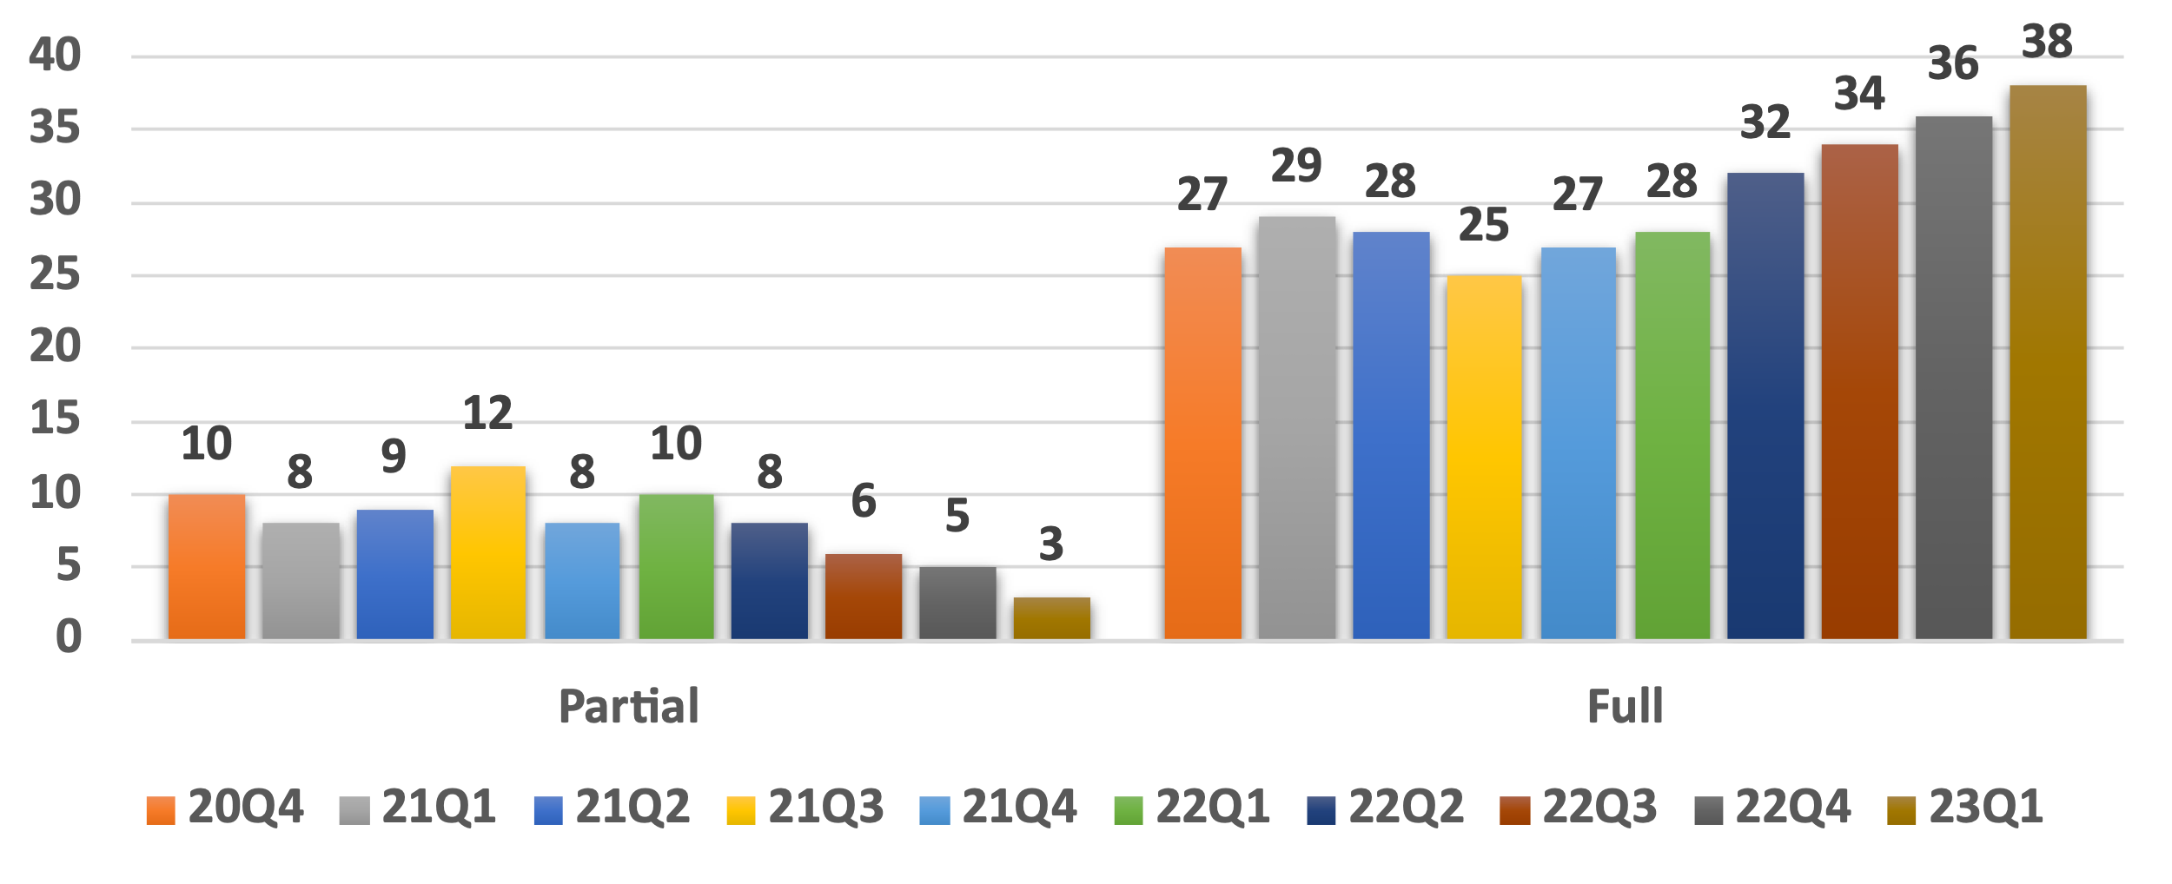
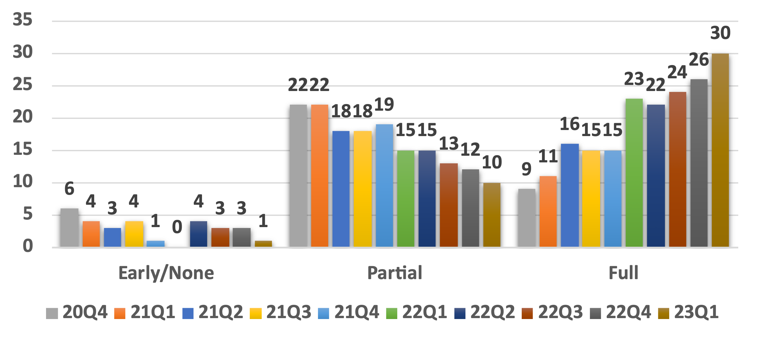
Aurora Applications Development
Steps in application preparation
Implementation of science and algorithms
Porting to Aurora programming models
Testing with Aurora software on the Aurora testbeds
Tuning for performance on Aurora testbeds
Scaling across the Aurora system
Application Science Implementation
Port to Aurora Programming Models
Notes:
Applications have generally gone through a number of steps to be ready for Aurora which include
Implementation of science and algorithms
Porting to Aurora programming models
Testing with Aurora software on Aurora testbeds
Tuning for performance on Aurora testbeds
Scaling across the Aurora system
The charts at the bottom of the slide show the progress applications have made in the first two areas
in-terms of science implementation seen a steady increase of the codes report a full implementation, with ~6 codes continuing work in this area
For porting we’ve seen a steady increase the number of codes ported to Aurora
And at this point about 2/3 of our applications report being fully ported to an Aurora programming model

Slide 10
Questions?

