Slide 1
Building a Productive, Open, Accelerated Programming Model for Now and the Future
Joe Curley, Intel VP, GM Software Products & Ecosystem
Software Advanced Technology Group, Intel

Slide 2

Open Accelerated Computing with oneAPI
Open
Choice
Trust
Programmability to enable productivity on high-performance open platforms
Interoperability across hardware and software platforms and ecosystems
Build with confidence and protect your investment with a secure, open, cross-architecture standard programming model
oneAPI empowers developers to accelerate performance
across diverse hardware vendors

Slide 3
Software is a competitive advantage for Intel
Uniquely able to build on Foundational Software
Solutions, Services and Platforms
Pull-Through Platform Value
Delivers Unique, High-Value Solutions
MARKET
MAKING
Languages, Frameworks, Tools, and Libraries
Broadly Optimize
& Differentiate
Productively Extracts Value in Hardware
MARKET DIFFERENTIATING
Client/Edge/Cloud/Data Center
Foundational Software
Accelerate Leading HW Capabilities
Enables Industry
Platform Success
MARKET
ENABLING
Developer value delivery changes by layer of the stack

Slide 4














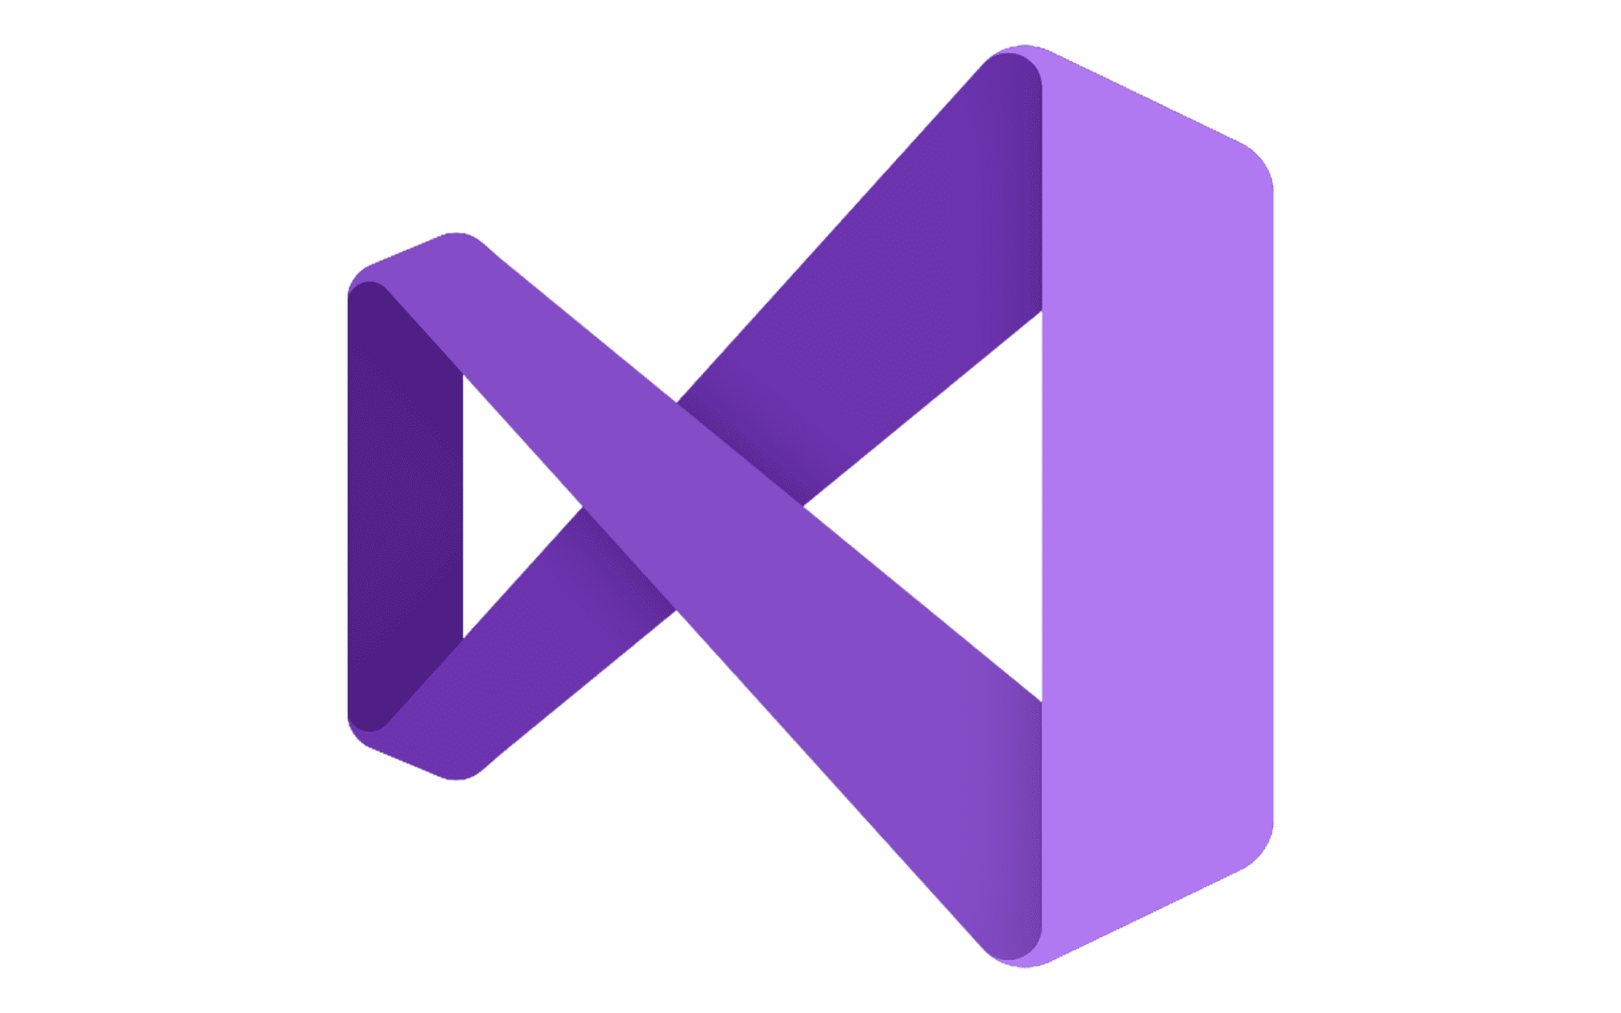








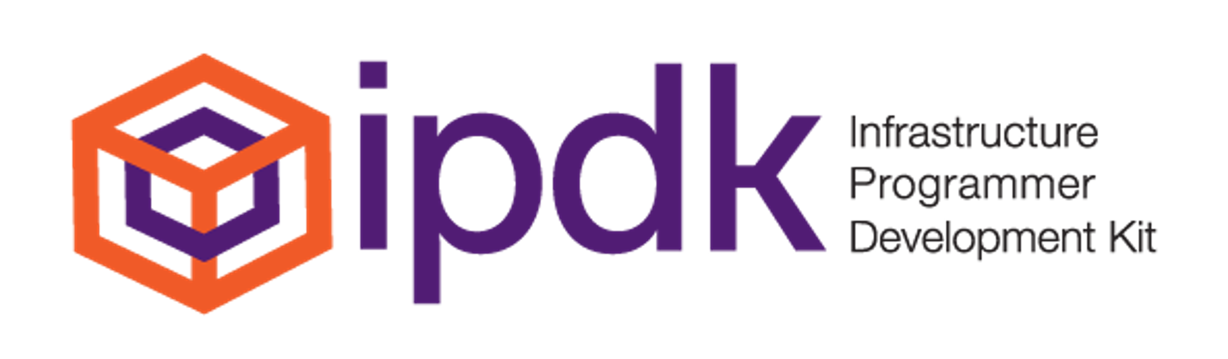


Market Differentiating
Software Development Tools, Languages, Libraries & Domain Frameworks
Intel® Graphics Command Center
Xe GTAO
Intel® oneCCL
Intel® Bridge Technology
Intel® Integrated Performance
Primitives (IPP)
Intel® oneVPL
Intel® XTU
System Debug/
Trace
SynapseAI
Intel® oneDAL
LibC
Intel XeSS SDK
Intel® oneDPL
DML
Intel® VTune Profiler
Intel® Quartus® Prime Software Suite
QPL
Intel® DPC++ Compiler
Intel® oneDNN
Intel® Distribution for Python
Intel® oneMKL
Languages, Frameworks, Tools, and Libraries
Software for developers that unleash the potential of their hardware to applications and services
MARKET DIFFERENTIATING
We want the software we develop to be your competitive advantage
We want the software we develop to be your competitive advantage

Slide 5
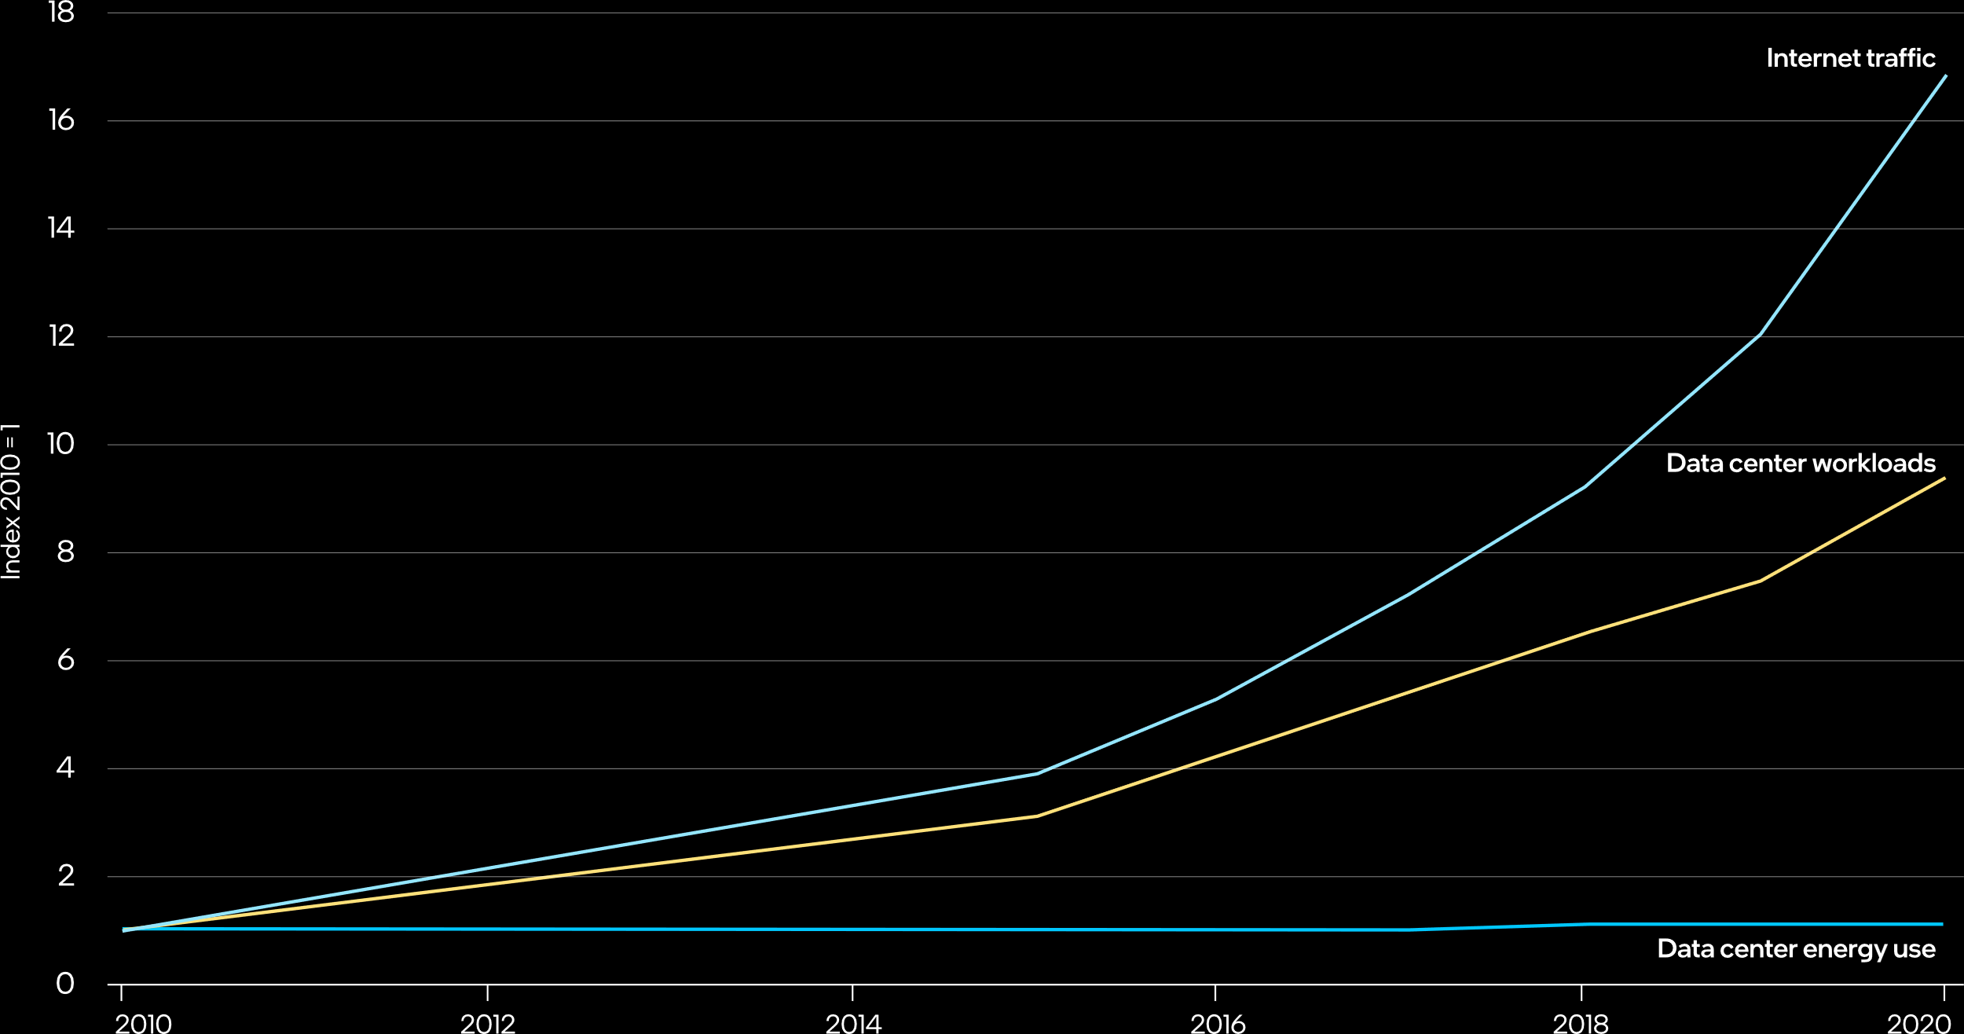
Datacenter/Network Demand and Power
“Strong growth in demand for data center services continues to be mostly offset by ongoing efficiency improvements…”
Acceleration and Data Center Compute Demand
Global trends in internet traffic, data center workloads, and data center energy use, 2010-2020
Source: International Energy Agency, November 2021. Data Centers and Data Transmission Networks,
Lead Author George Kamiya. https://www.iea.org/reports/data-centres-and-data-transmission-networks

Slide 6
A lot can happen in a year…
Explosive AI Growth
Transformers
1e+09
Megatron – Turing NLG 530B
GPT - 3
1e+08
Microsoft T- NLG
GPT - 2
1e+07
Megatron
Non- Transformer
XLNet
Wav2Vec 2.0
1e+06
Xception
MOCO
ResNet 50
Training Compute (PFLOPs)
1e+05
BERT Large
GPT - 1
Transformer
1e+04
ResNeXt
DenseNet201
ELMo
1e+03
1e+02
2016
2017
2018
2019
2020
2021
2022
2023
Source: Moore, S. (2022), “Nvidia’s Next GPU Shows That Transformers Are Transforming AI“, IEEE Spectrum.
Notes:
Net: There has been an incredible explosion in AI growth, …and models are growing in sizes & variety
Transformer data (purple line) - 275x / 2yrs
Non-transformer data (blue line) - 8x / 2yrs
Great time to be alive in this thriving technical computing ecosystem
Experiencing one of most transformative eras
All familiar with compute demand from traditional HPC – faster results, more sustainable outcomes
Rate of change is accelerating

Slide 7
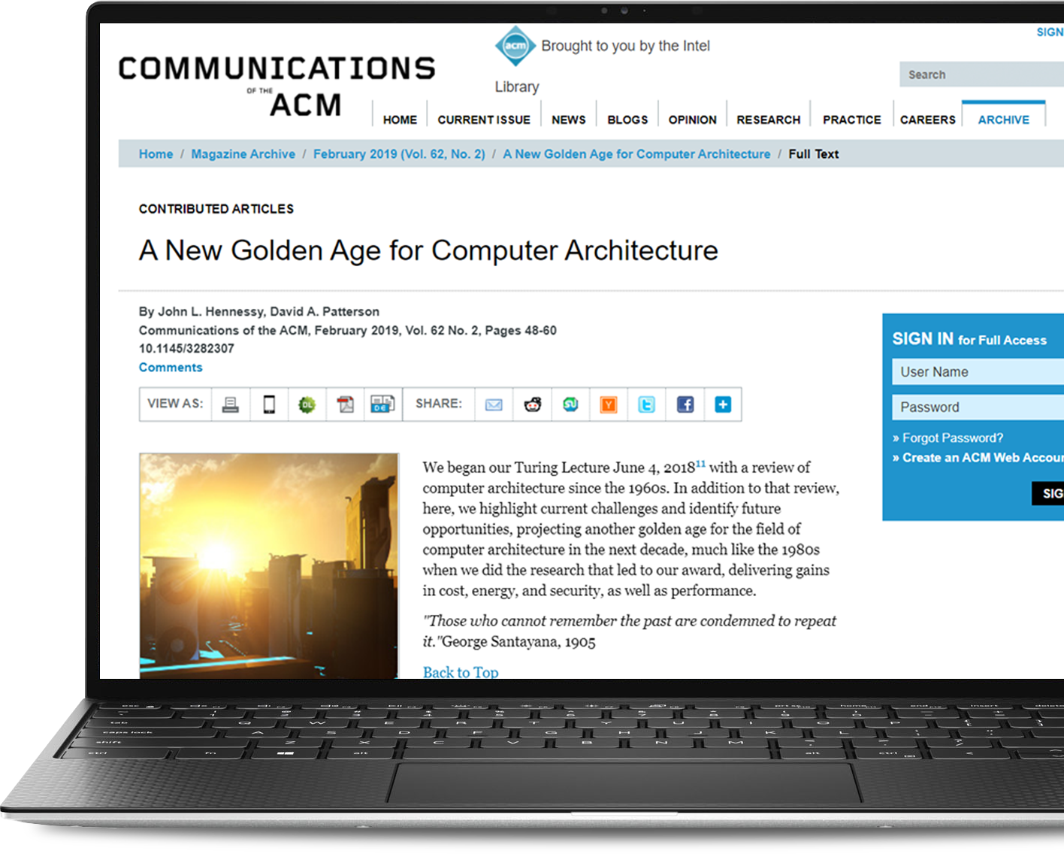
Cambrian Explosion of Compute Architecture
High-level, domain-specific languages and architectures, freeing architects from the chains of proprietary instruction sets, along with demand from the public for improved security, will usher in a new golden age for computer architecture.
Source: John L. Hennessy, David A. Patterson, Communications of the ACM
https://cacm.acm.org/magazines/2019/2/234352-a-new-golden-age-for-computer-architecture/fulltext
Diverse and evolving workloads enable hardware innovation

Slide 8
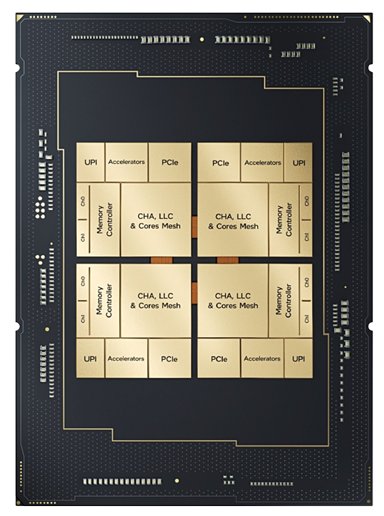
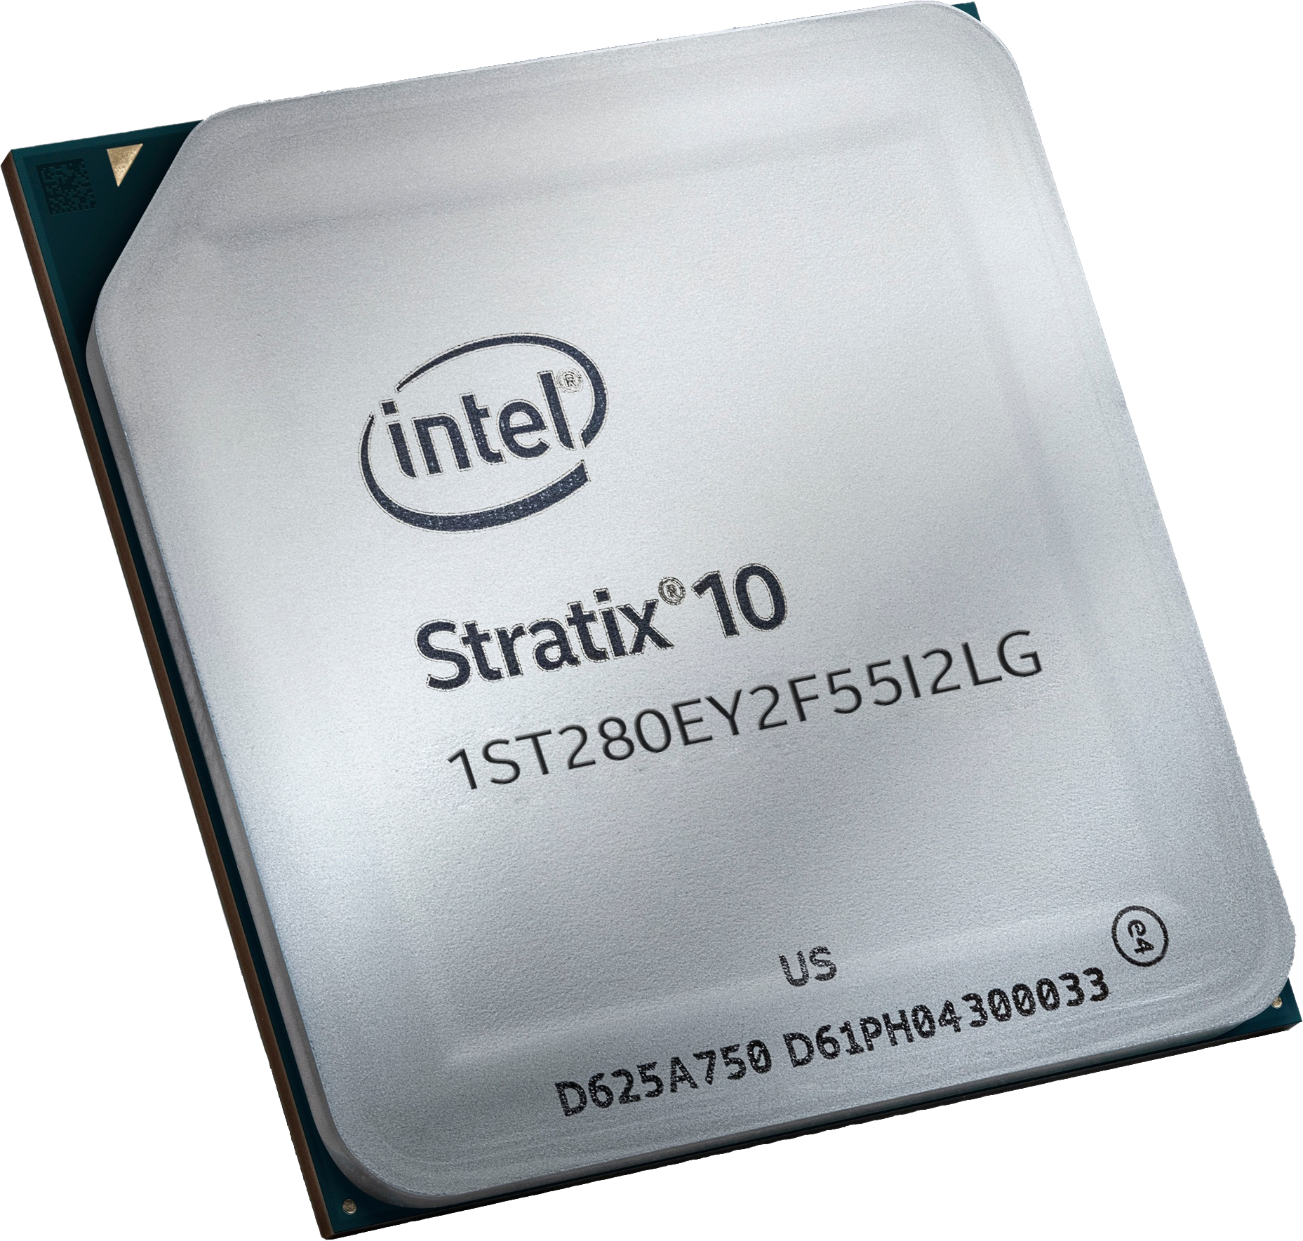
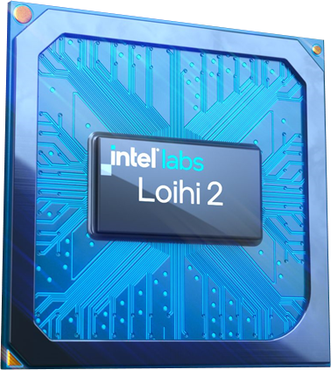
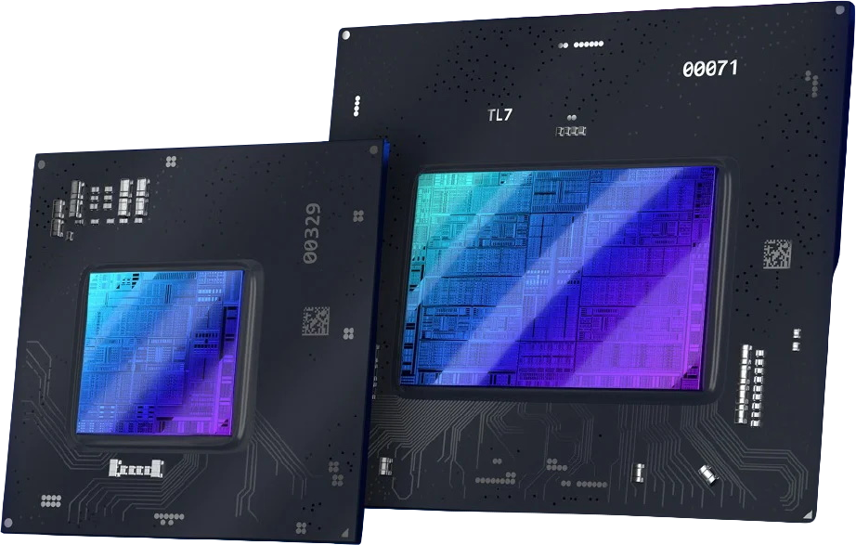
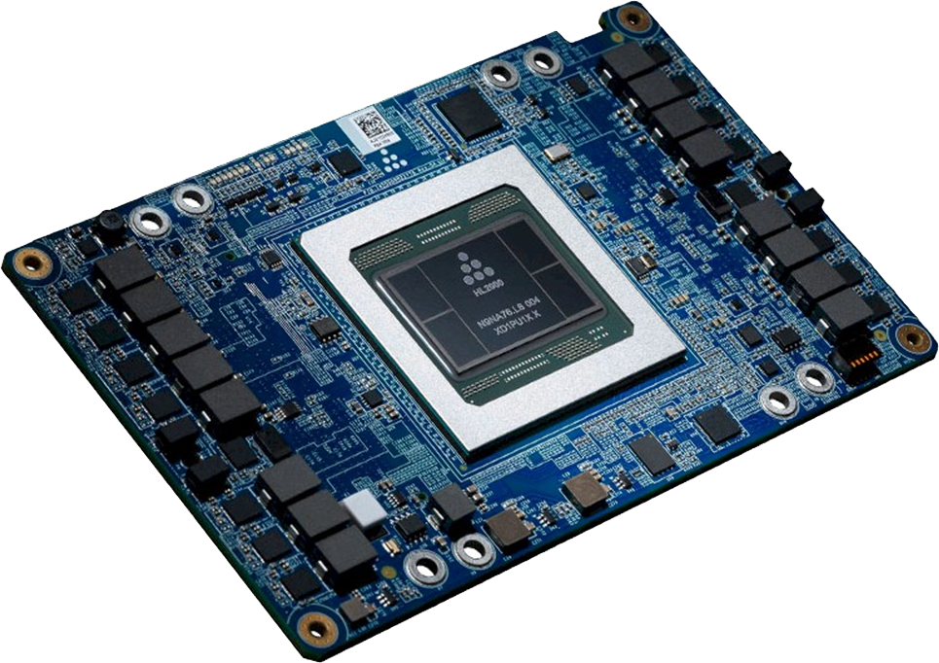
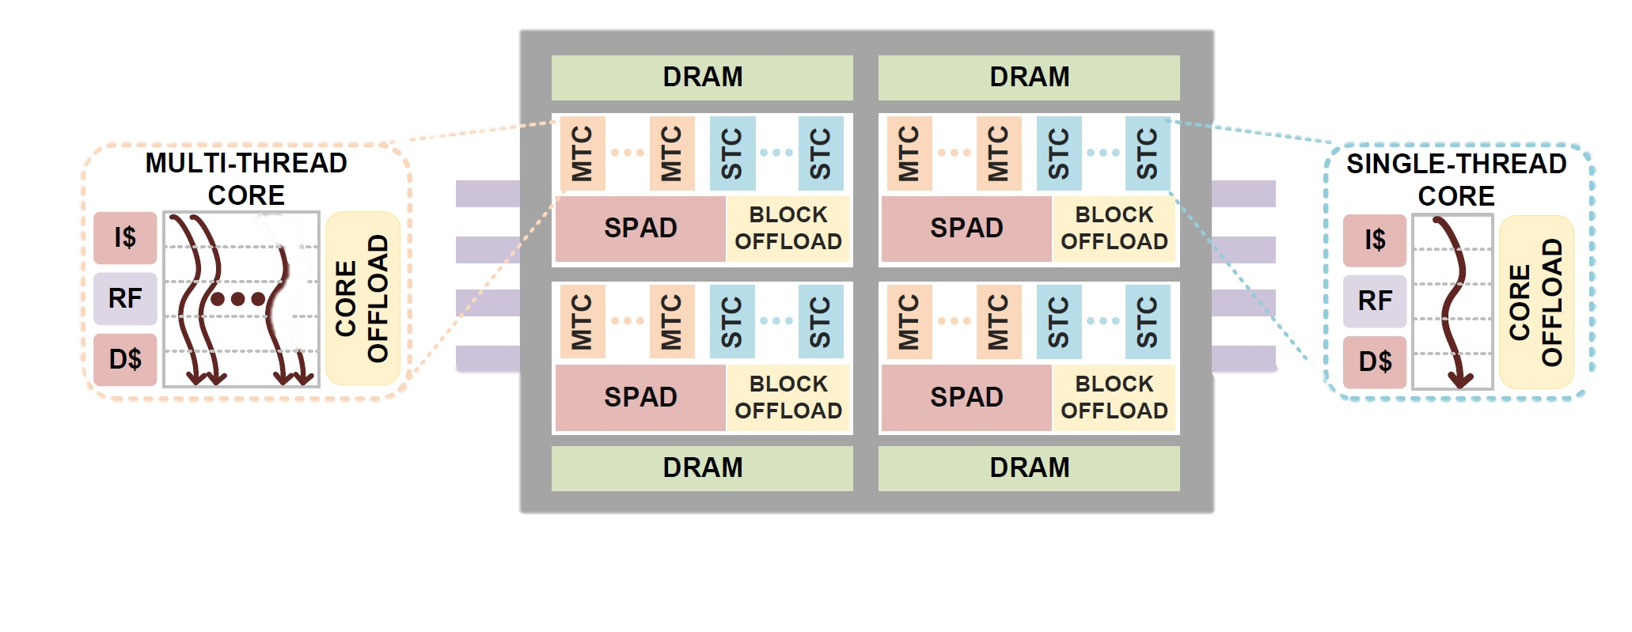
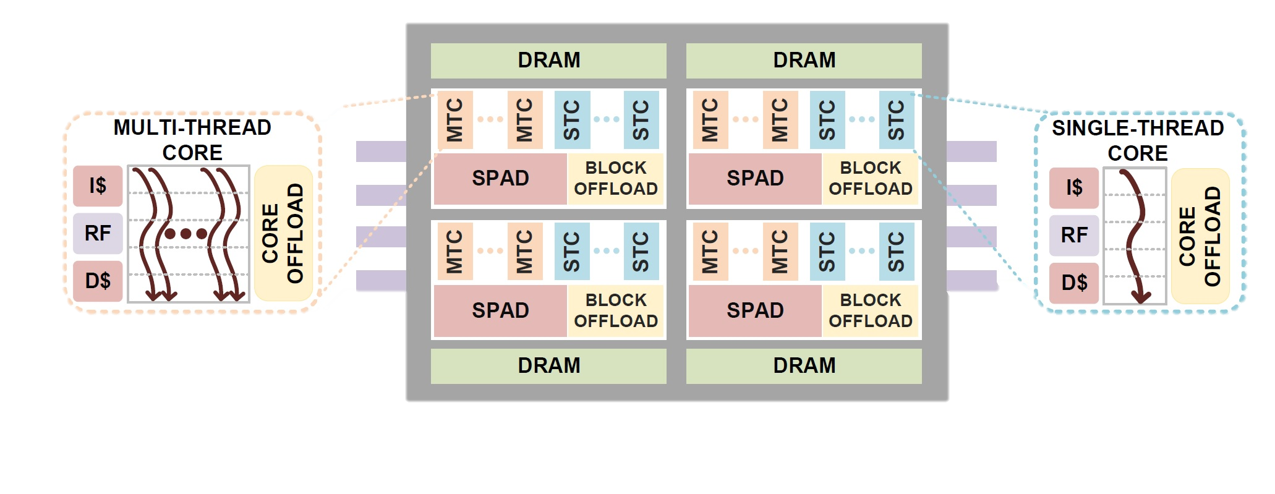
A New Golden Age for Computer Architecture
Products
Research
Novel On-Die
Accelerators
GPU/Data Parallel
Spatial/
Dataflow
Deep Learning
Optimized
Neuromorphic
Graph Analytics
“Strong growth in demand for data center services continues to be mostly offset by ongoing efficiency improvements…”
Source: International Energy Agency, November 2021. Data Centers and Data Transmission Networks, Lead Author George Kamiya. https://www.iea.org/reports/data-centres-and-data-transmission-networks

Slide 9
How Do You Get to Market?
SERVICES AND SOLUTIONS
APPLICATIONS
DEVELOPER TOOLS
MIDDLEWARE FRAMEWORKS AND RUNTIMES
DEVELOPER TOOLS
MIDDLEWARE FRAMEWORKS AND RUNTIMES
DEVELOPER TOOLS
MIDDLEWARE FRAMEWORKS AND RUNTIMES
DEVELOPER TOOLS
MIDDLEWARE FRAMEWORKS AND RUNTIMES
LOW-LEVEL LIBRARIES
LOW-LEVEL LIBRARIES
LOW-LEVEL LIBRARIES
LOW-LEVEL LIBRARIES
DIRECT LANGUAGE
COMPILERS
DIRECT LANGUAGE
COMPILERS
DIRECT LANGUAGE
COMPILERS
DIRECT LANGUAGE
COMPILERS
VIRTUALIZATION/ORCHESTRATION
VIRTUALIZATION/ORCHESTRATION
VIRTUALIZATION/ORCHESTRATION
VIRTUALIZATION/ORCHESTRATION
OS
OS
OS
OS
FW IP AND BIOS
FW IP AND BIOS
FW IP AND BIOS
FW IP AND BIOS
DRIVERS
DRIVERS
DRIVERS
DRIVERS
CPU
GPU
AI
FPGA
Each device’s software stack adds complexity, making IHV and SW
incur in higher developing costs, and longer time to market

Slide 10
Standards Drive Scale for Accelerated Computing
SERVICES AND SOLUTIONS
Powered
by oneAPI
APPLICATIONS
oneAPI-POWERED MIDDLEWARE FRAMEWORKS AND RUNTIMES
oneAPI LOW-LEVEL LIBRARIES
oneAPI
specification
oneAPI DIRECT LANGUAGE COMPILERS
DEVELOPER TOOLS
VIRTUALIZATION/
ORCHESTRATION
DEVELOPER TOOLS
VIRTUALIZATION/
ORCHESTRATION
DEVELOPER TOOLS
VIRTUALIZATION/
ORCHESTRATION
DEVELOPER TOOLS
VIRTUALIZATION/
ORCHESTRATION
OS
OS
OS
OS
FW IP AND BIOS
FW IP AND BIOS
FW IP AND BIOS
FW IP AND BIOS
DRIVERS
DRIVERS
DRIVERS
DRIVERS
CPU
GPU
AI
FPGA
A common source for diverse accelerators

Slide 11
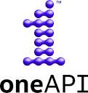
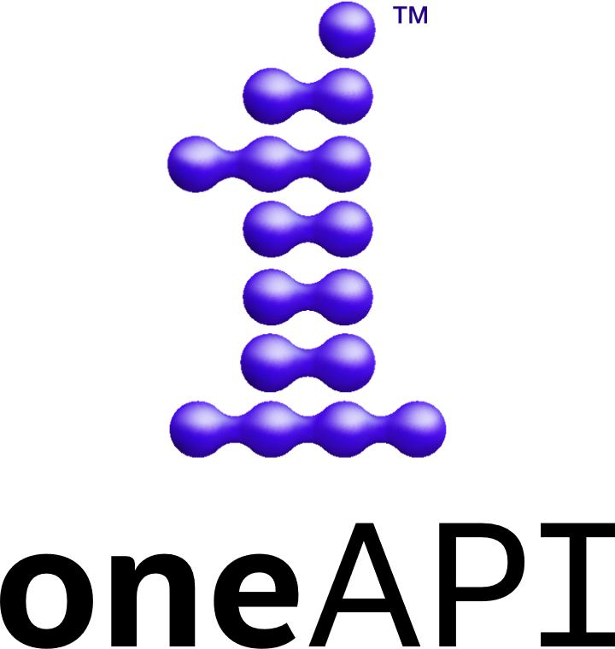
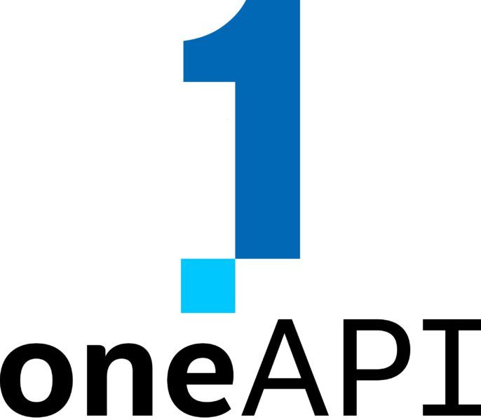
oneAPI: One Name, Two Distinct Objectives
Open industry specification
Open-source repo and development
Community driven
Supports multi-vendor implementation
oneAPI Industry Specification
Direct Programming
API-Based Programming
SYCL
Libraries
Math
Threading
Parallel STL
Ray Tracing
Data Parallel C++
Analytics/
ML
DNN
ML Comm
Volumetric
Rendering
Video Processing
Signal
Processing
Image Processing
Image
Denoise
Low-Level Hardware Interface (Level Zero)
Intel’s implementation
Toolkits optimized for Intel HW
Available for free download
Open, standard language: Khronos SYCL
Standardized interfaces for common libraries
Standardized hardware interface

Slide 12
Intel Developer Software
Contributions to Open source
Optimized Distributions
Optimized Compilers
Directives
Libraries
Accelerator Programming
HW Specific Tools
OpenJDK Python
PyTorch TensorFlow
Intel Distribution of Python
Intel PyTorch and Tensorflow
Intel DPC++/C++ Compiler
Intel Fortran Compiler
OpenMP 5.x
OpenMP Parallel
OpenMP SIMD
OpenMP Target
oneMKL
oneDNN
oneCCL
oneDPL
Intel IPP
Intel MPI
SYCL
OpenCL
Intrinsics
eSIMD
Developer Productivity
Performance Implicit
Developer Control
Performance Explicit
Comprehensive offering of Intel provided and optimized open-source
developer tools including oneAPI products

Slide 13
Why SYCL?
sycl::queue q(cpu_selector{});
auto A = sycl::malloc_shared<float>(n, q);
auto B = sycl::malloc_shared<float>(n, q);
q.parallel_for( sycl::range<1>{n},
[=] (sycl::id<1> i) {
B[i] += A[i] * A[i];
}
).wait();
sycl::queue q(gpu_selector{});
auto A = sycl::malloc_shared<float>(n, q);
auto B = sycl::malloc_shared<float>(n, q);
q.parallel_for( sycl::range<1>{n},
[=] (sycl::id<1> i) {
B[i] += A[i] * A[i];
}
).wait();
. . .
`
Standard C++17
aids time to developer productivity
Syntax for accelerators (device selection, offload, memory transfer)
Stack based on standards and open specifications (CLANG, LLVM, SPIR-V, Level Zero)
Single source code
(host and device code)
Multi-Architecture (CPU, GPU, FPGA, AI accelerators, and other targets)
Unified shared memory
*Example uses static targets in bold, but can be programmed to be dynamic as well

Slide 14





CUDA to SYCL Migration Made Easy
Open Source SYCLomatic Tool Reduces Code Migration Time
NVIDIA CUDA
Migrate
C++ with SYCL
Build
Deploy
CUDA Source Code
SYCLomatictool
HumanReadable
C++ with SYCL Single Source Code with inline comments
Compilers, Libraries, Analyzers, Debuggers
Run on Multiple Devices
(Architecture/Vendor Agnostics)
CPU
#include
<cuda_runtime.h>
{
GPU
FPGA
90-95%¹ Code Transformed
Format & Structure Preserved
Tune per Desired
Architecture Performance
Other
Accel.
Github.com/oneapi-src/SYCLomatic
Assists developers migrating code written in CUDA to C++ with SYCL, generating human readable code wherever possible
~90-95% of code typically migrates automatically¹
Inline comments are provided to help developers
finish porting the application
Intel® DPC++/C++ Compatibility Tool is Intel’s
implementation, available in the Base Toolkit
¹Intel estimates as of September 2021. Based on measurements on a set of 70 HPC benchmarks and samples, with examples like Rodinia, SHOC, PENNANT. Results may vary.
Notes:
Thank you for joining me at our first QGS of 2023
We have many things to be proud of in 2022. We put some points on the board.
But clearly, we have work to do – and that's especially true in Q1.
Want to take this time with you today to reinforce the steps we are taking – and need to take – to change our current trajectory.
We’re in one of the toughest macro environments we’ve ever seen, which factored heavily into Q4 results we shared last week, and also the tough Q1 guide we gave to the street.
We guided to a loss in Q1 for the first time in 30 years.
Wrong direction.
In fact, we recognized the changing market conditions were becoming challenging, which is why we began our austerity measures last year -- One of the reasons for CPM actions.

Slide 15
On NVIDIA GPU – SYCL Provides Comparable
Performance to CUDA
^ CudaSift: higher SYCL perf. - efficient parallel computations
^ DL-Mnist: lower SYCL perf. - not yet fully optimized
Testing Date: Performance results are based on testing by Intel as of April 15, 2023 and may not reflect all publicly available updates.
Configuration Details and Workload Setup: Intel® Xeon® Platinum 8360Y CPU @ 2.4GHz, 2 socket, Hyper Thread On, Turbo On, 256GB Hynix DDR4-3200, ucode 0xd000363. GPU: Nvidia A100 PCIe 80GB GPU memory. Software: SYCL open source/CLANG 17.0.0, CUDA SDK 12.0 with NVIDIA-NVCC 12.0.76, cuMath 12.0, cuDNN 12.0, Ubuntu 22.04.1. SYCL open source/CLANG compiler switches: -fscycl-targets=nvptx64-nvidia-cuda, NVIDIA NVCC compiler switches: -O3 –gencode arch=compute_80, code=sm_80. Represented workloads with Intel optimizations.
Performance results are based on testing as of dates shown in configurations and may not reflect all publicly available updates. See configuration disclosure for details. No product or component can be absolutely secure.
Performance varies by use, configuration, and other factors. Learn more at www.Intel.com/PerformanceIndex. Your costs and results may vary.

Slide 16
On AMD GPU – SYCL Provides Comparable
Performance to HIP
^ Quicksilver: lower SYCL perf. - not yet fully optimized
^ CudaSift: higher SYCL perf. - efficient parallel computations
Testing Date: Performance results are based on testing by Intel as of April 15, 2023 and may not reflect all publicly available updates.
Configuration Details and Workload Setup: AMD EPYC 7313 CPU @ 3.0GHz, 2 socket, AMD Simultaneous Multi-Threading Off, AMD Precision Boost Enabled, 512GB DDR4, ucode 0xa001144. GPU: AMD Instinct MI250 OAM, 128GB GPU memory. Software: SYCL open source/CLANG 17.0.0, AMD RoCm 5.3.0 with roc-5.3.0 22362, hipSolver 5.3.0, rocBLAS 5.3.0, Ubuntu 20.04.4. SYCL open source/CLANG compiler switches: -O3 -fsycl -fsycl-targets=amdgcn-amd-amdhsa -Xsycl-target-backend --offload-arch=gfx90a, AMD-ROCm compiler switches: -O3. Represented workloads with Intel optimizations.
Performance results are based on testing as of dates shown in configurations and may not reflect all publicly available updates. See configuration disclosure for details. No product or component can be absolutely secure.
Performance varies by use, configuration, and other factors. Learn more at www.Intel.com/PerformanceIndex. Your costs and results may vary.

Slide 17
Ecosystem Driven Innovation
Intel Product
Multi-Architecture
Community Driven
Multi-Vendor
Multi-Vendor
Multi-Architecture
Multi-Language
Multi-Architecture
Community Driven
Multi-Language
SYCL
SYCL
(DP C++)
SYCL
(DP C++)
SYCL
(DP C++)
Julia / Tornado JVM
HIP LZ
Front End
Intel oneAPI
Codeplay
HIPSYCL
Huawei CCE
Intel oneAPI
oneAPI
Level Zero
Intel GPU
NVIDIA GPU
AMD GPU (β)
AMD GPU
NVIDIA GPU
Huawei
Ascend
Intel GPU, CPU
Intel GPU
Intel Provided
Ecosystem Content
  Standards-based architecture allows others to freely develop new language front ends and support new hardware targets.

Slide 18
oneAPI Open Ecosystem Progress
Open, Broad, Multiarchitecture / Multivendor Implementation
2020
2021
2022
2023
Specification updates
oneAPI SYCL implementation
Intel CPU, GPU, FPGA support
SYCL for Nvidia GPU
Fugaku deploys oneDNN for Arm
Univ. of Heidelberg deploys HIPSYCL for AMD CPUs & GPUs
NERSC, Argonne deploy SYCL for NVIDIA GPU
Argonne, Oakridge Nat’l Labs deploy SYCL for AMD GPU
Hardware implementations: NVIDIA GPUs, AMD CPUs/GPUs,
Arm CPUs
GROMACS SYCL code on Intel CPUs/GPUs, NVIDIA & AMD GPUs
Huawei CCE & Ascend uses oneAPI
oneAPI community forum & open governance established
oneAPI plug-ins for NVIDIA & AMD
Julia interface to oneAPI
TensorFlow accelerates models via oneDNN
SYCL performance matches NVIDIA/AMD native system languages
Initiative &
Technology Advancements
Adoption is Growing − Showcased in DevSummits, IWOCL, ISC, SC, AI Conferences…
Notes:
oneAPI is still in its infancy > yet we’re seeing strong growth & milestones across different vendors’ architectures – & that’s a tall mountain
5 years ago – it was an Idea, a vision, – really just a pipedream
In 2020 – the oneAPI 1.0 specification was delivered supporting Intel HW - & a SYCL compiler was created for Nvidia GPUs
In 2021 – we saw Early Adopters working to prove the vision is worthwhile
Last year to today – we’re seeing more technical advances, stronger multivendor & multiarchitecture pick-up – Implementations: NVIDIA GPUs, AMD CPUs and GPUs, and Arm CPUs
& many more customers coming online
GE Healthcare anticipates saving millions of dollars through oneAPI….
GROMACS: workload executed on AMD & Nvidia GPUS, as well as Intel GPU & CPU from a single binary executable
Tensor Flow uses oneDNN to accelerate models, with significant performance improvement
Nat’l Energy Research Scientific Computing Center (NERSC) at Lawrence Berkeley Nat’l Lab (Berkeley Lab), in collaboration with Argonne, signed a contract with Codeplay to enhance the LLVM SYCL™ GPU compiler for NVIDIA® A100 GPUs
– and more to come with Argonne’s Aurora launching this year, & more Intel GPUs hitting the market
In a short time – we’ve moved from a Shared Vision to Reality
SELF SUSTAINING ECOSYSTEM: Conferences, Hackathons, Papers, Standards Body; Gain Market Segment Share

Slide 19
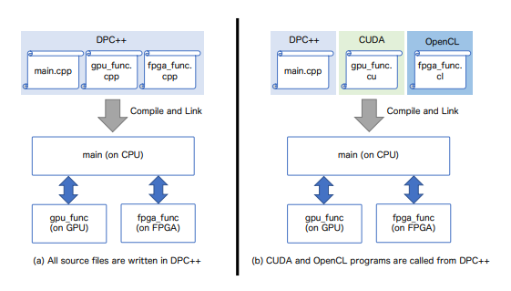
Device Selector Programming in a Multi-Accelerator System
Tsukuba University Multi-Hetero Simulation with oneAPI Simulation¹
R,Kashino, R. Kobayashi, N. Fujita, T. Boku - HPC Asia January 12-14 2022
Team findings:
Two Approaches to Realizing CHARM application on SYCL
Cross-architecture: “Found that current oneAPI framework is effective for DPC++ and traditionally developed apps coded in CUDA and OpenCL to support multiple types of accelerators.” ¹
Performance: “Found that code implemented with oneAPI is comparable to the performance code implemented with CUDA+OpenCL.” ¹
Productivity: “Under oneAPI, it is possible to synchronize and mediate between devices, thus maintaining the high maintainability and availability of the application code.” ¹
Source: Figure comes from Multi-Hetero Acceleration Simulation study by Tsukuba University. Two approaches to realizing CHARM (Heterogeneous Acceleration by Reconfigurable Multidevices) with oneAPI¹
1- Ryuta Kashino, Ryohei Kobayashi, Norihisa Fujita, and Taisuke Boku. 2022. Multi-hetero Acceleration by GPU and FPGA for Astrophysics Simulation on oneAPI Environment | International Conference on High Performance Computing in Asia-Pacific Region (acm.org)

Slide 20
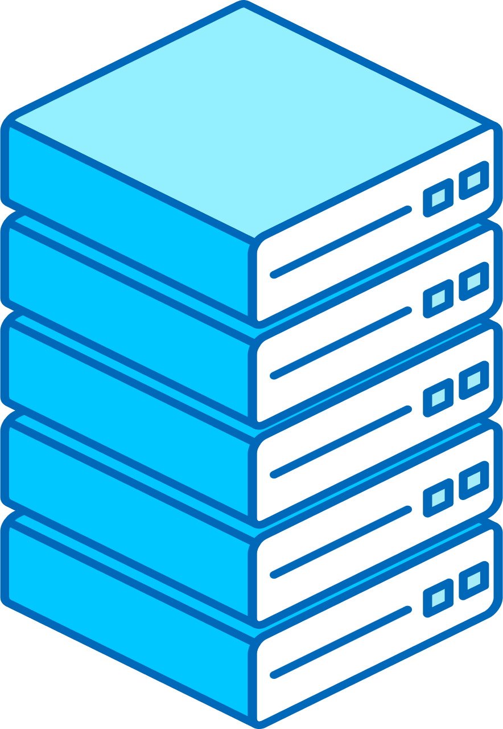
Evolving Heterogeneity
CPU Only Rack
CPU Rack + CPU/GPU Rack
CPU Rack + CPU Rack+ Pools of:
GPU
CPU
GPU 2
AI Accel
FPGA
Other Accel
GPU
GPU
Time
A traditional general-purpose AI/HPC rack or cluster system
Accelerated, but
Fixed ratio of CPU & GPU
Accelerated resource may be constrained by
datacenter design
Dynamically access pools of optimal accelerator that can include CPU, GPU, AI Accelerator, FPGA, and Other Specialty Accelerators
Soon developers will program to choose
the right device to execute in a multi accelerator system

Slide 21
What If: Heterogeneous/Distributed Future
My vision for how we bring oneAPI into a future dominated by power-optimized heterogenous chips organized into distributed systems:
Research
Machine Programming
Radical portability across distributed systems
The key to making this work? The programmer is in control and chooses the level of abstraction based on the programming task.
Distributed Data Structures
Collection of distributed data containers for common core structures
Partitioned Global Address Space
OpenSHMEM or MPI 3 one-sided communication
Runtime Improvements
Execute on any XPU, intelligent scheduling
Foundation of
solid oneAPI engineering
oneAPI Languages
SYCL, OpenMP, TBB + common high-level APIs

Slide 22






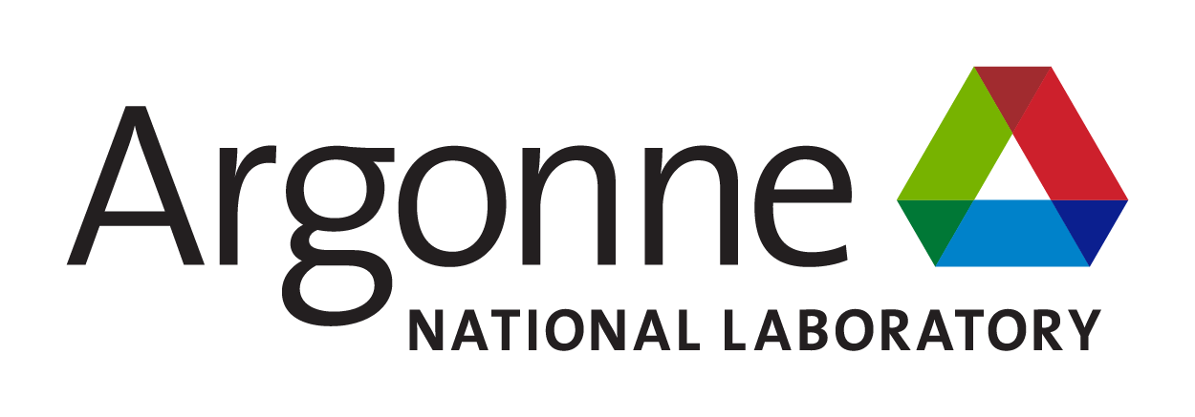


























































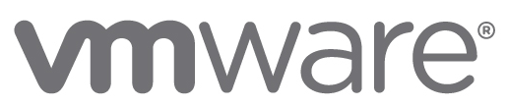






















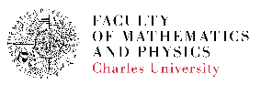
























It Takes A Community Communities
End Users
National Labs
GeoEast
Oak Ridge National Laboratory
WeBank
Verizon
ISVs & OSVs
OEMs & SIs
Universities & Research Institutes
CSPs & Frameworks
Indian Institutes
of Technology
Delhi / Kharagpur / Roorkee
University
College
London
Indian Institute of Science Bangalore
Indian Institute of Science Education & Research Pune
These organizations support the oneAPI initiative for a single, unified programming model for cross-architecture development.
It does not indicate any agreement to purchase or use of Intel’s products. *Other names and brands may be claimed as the property of others.

Slide 23
In Closing
Standard programming – brings the golden age of architecture to developers
oneAPI: multi-vendor, multi-architecture programming for heterogenous hardware
Demand open accelerated computing
Available today in both open-source GitHub and as finished Intel product
… and this is only the beginning
  Visit oneapi.io for specifications, source repository
  Please join the community, provide input
  Intel platforms – download
  for free at software.intel.com

Slide 24
Notices and Disclaimers
Forward-Looking Statements. Statements in this presentation that refer to business outlook, plans, and expectations are forward-looking statements that involve risks and uncertainties. Words such as "anticipate," "expect," "intend," "goal," "plans," "believe," "seek," "estimate," "continue,“ “committed,” “on-track,” ”positioned,” “ramp,” “momentum,” “roadmap,” “path,” “pipeline,” “progress,” “schedule,” “forecast,” “likely,” “guide,” “potential,” “next gen,” “future,” "may," "will," “would,” "should," “could,” and variations of such words and similar expressions are intended to identify such forward-looking statements. Statements that refer to or are based on estimates, forecasts, projections, uncertain events or assumptions, including statements relating to Intel’s strategy and its anticipated benefits; business plans; financial projections and expectations; total addressable market (TAM) and market opportunity; manufacturing expansion and investment plans; future manufacturing capacity; future products, technology, and services, and the expected availability and benefits of such products, technology, and services, including product and manufacturing plans, goals, timelines, ramps, progress, and future product and process leadership and performance; future economic conditions; future impacts of the COVID-19 pandemic; plans and goals related to Intel’s foundry business; future legislation; future capital offsets; pending or future transactions; the proposed Mobileye IPO; supply expectations including regarding industry shortages; future external foundry usage; future use of EUV and other manufacturing technologies; expectations regarding customers, including designs, wins, orders, and partnerships; projections regarding competitors; ESG goals; and anticipated trends in our businesses or the markets relevant to them, including future demand, market share, industry growth, and technology trends, also identify forward-looking statements. Such statements involve many risks and uncertainties that could cause actual results to differ materially from those expressed or implied in these forward-looking statements. Important factors that could cause actual results to differ materially are set forth in Intel's earnings release dated April 27, 2023, which is included as an exhibit to Intel’s Form 8-K furnished to the SEC on such date, and in Intel's SEC filings, including the company's most recent reports on Forms 10-K and 10-Q. Copies of Intel’s SEC filings may be obtained by visiting our Investor Relations website at www.intc.com or the SEC's website at www.sec.gov. All information in this presentation reflects management’s views as of May 25, 2023, unless an earlier date is indicated. Intel does not undertake, and expressly disclaims any duty, to update any statement made in this presentation, whether as a result of new information, new developments or otherwise, except to the extent that disclosure may be required by law.
Intel technologies may require enabled hardware, software or service activation. No product or component can be absolutely secure. Your costs and results may vary. Product and process performance varies by use, configuration and other factors. Learn more at www.Intel.com/PerformanceIndex and www.Intel.com/ProcessInnovation. Future product and process performance and other metrics are projections and are inherently uncertain.
Intel does not control or audit third-party data. You should consult other sources to evaluate accuracy.
© Intel Corporation. Intel, the Intel logo, and other Intel marks are trademarks of Intel Corporation or its subsidiaries. Other names and brands may be claimed as the property of others.

Slide 25


Slide 26
oneAPI Open-Source Projects Evolution
oneAPI
Announcement
oneAPI
Spec 1.0
SYCL 2020 Spec
oneAPI
Spec 1.2
2018
2019
2020
2021
2022
2023
Embree
OSPRay
oneDNN
DPC++
Level Zero
oneDPL
OpenImage Denoise
Open
VKL
oneCCL
oneMKL
oneTBB
SYCLomatic
oneDAL
Codeplay NVIDIA SYCL backend + oneMKL/oneDNN
Codeplay AMD SYCL backend
Amazing progress in 5 years… amazing progress to come

Slide 27
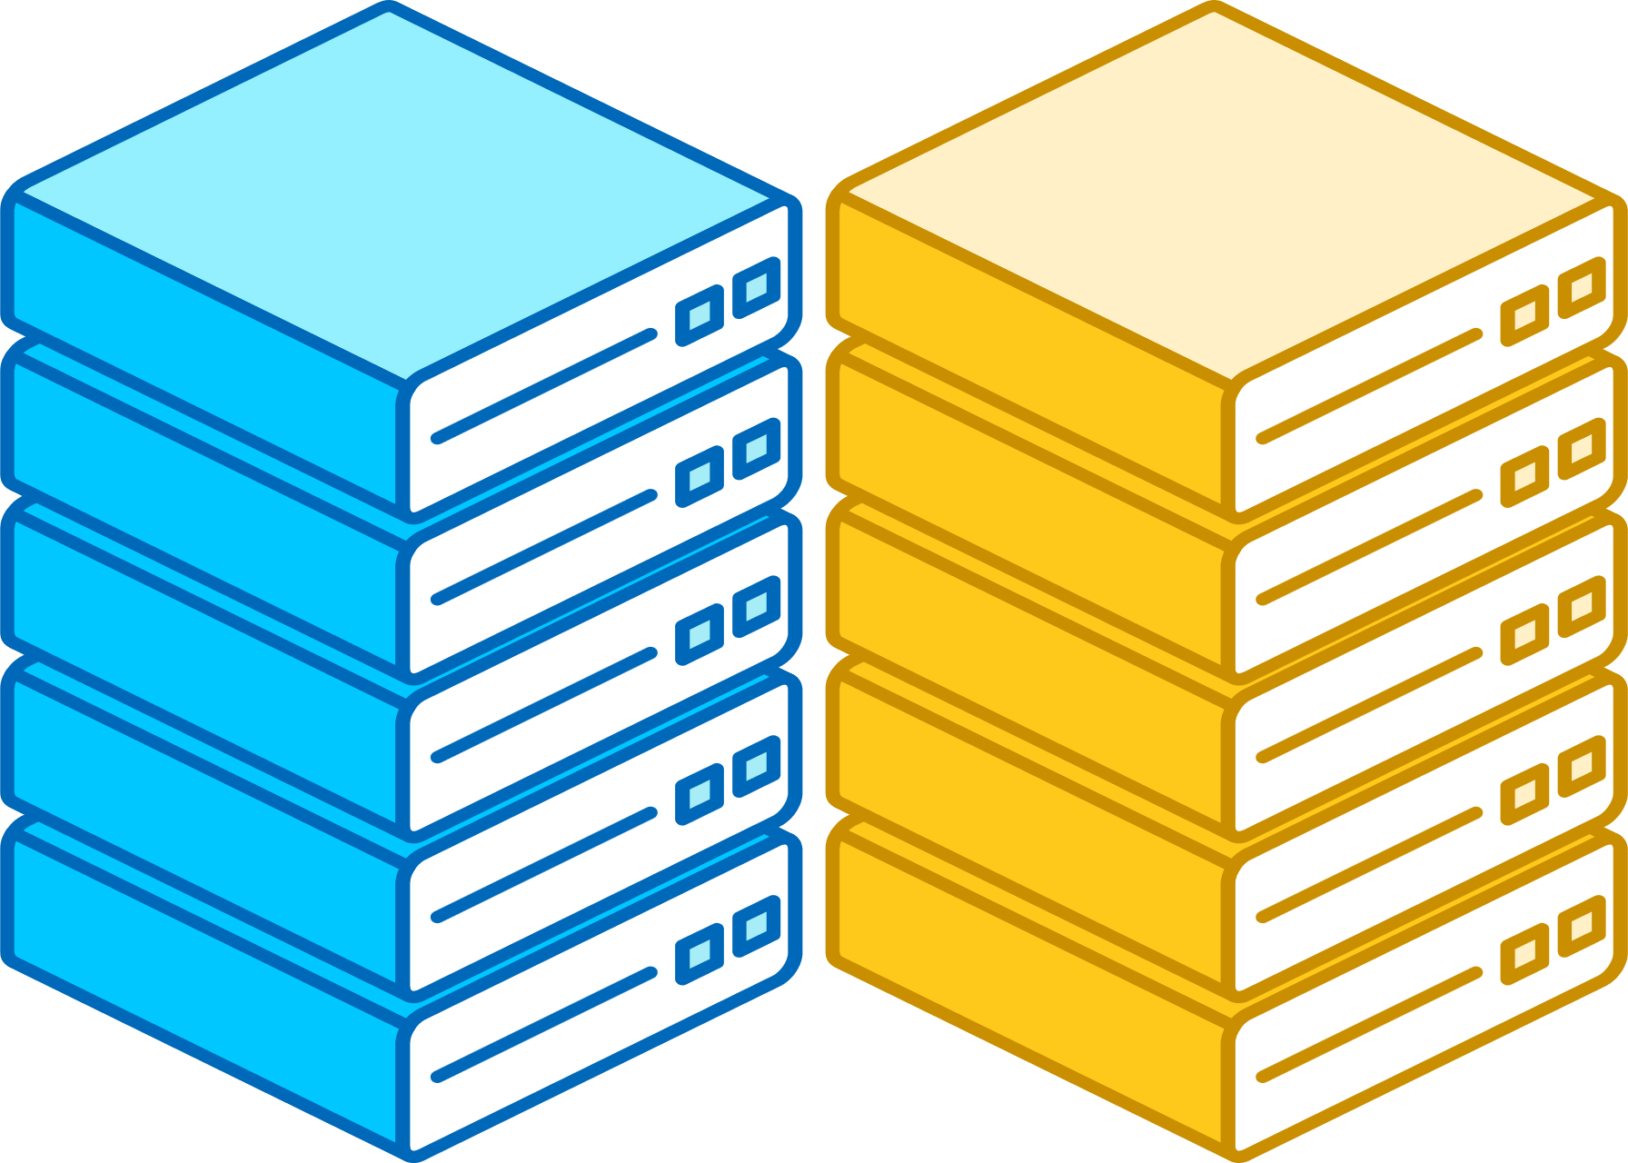
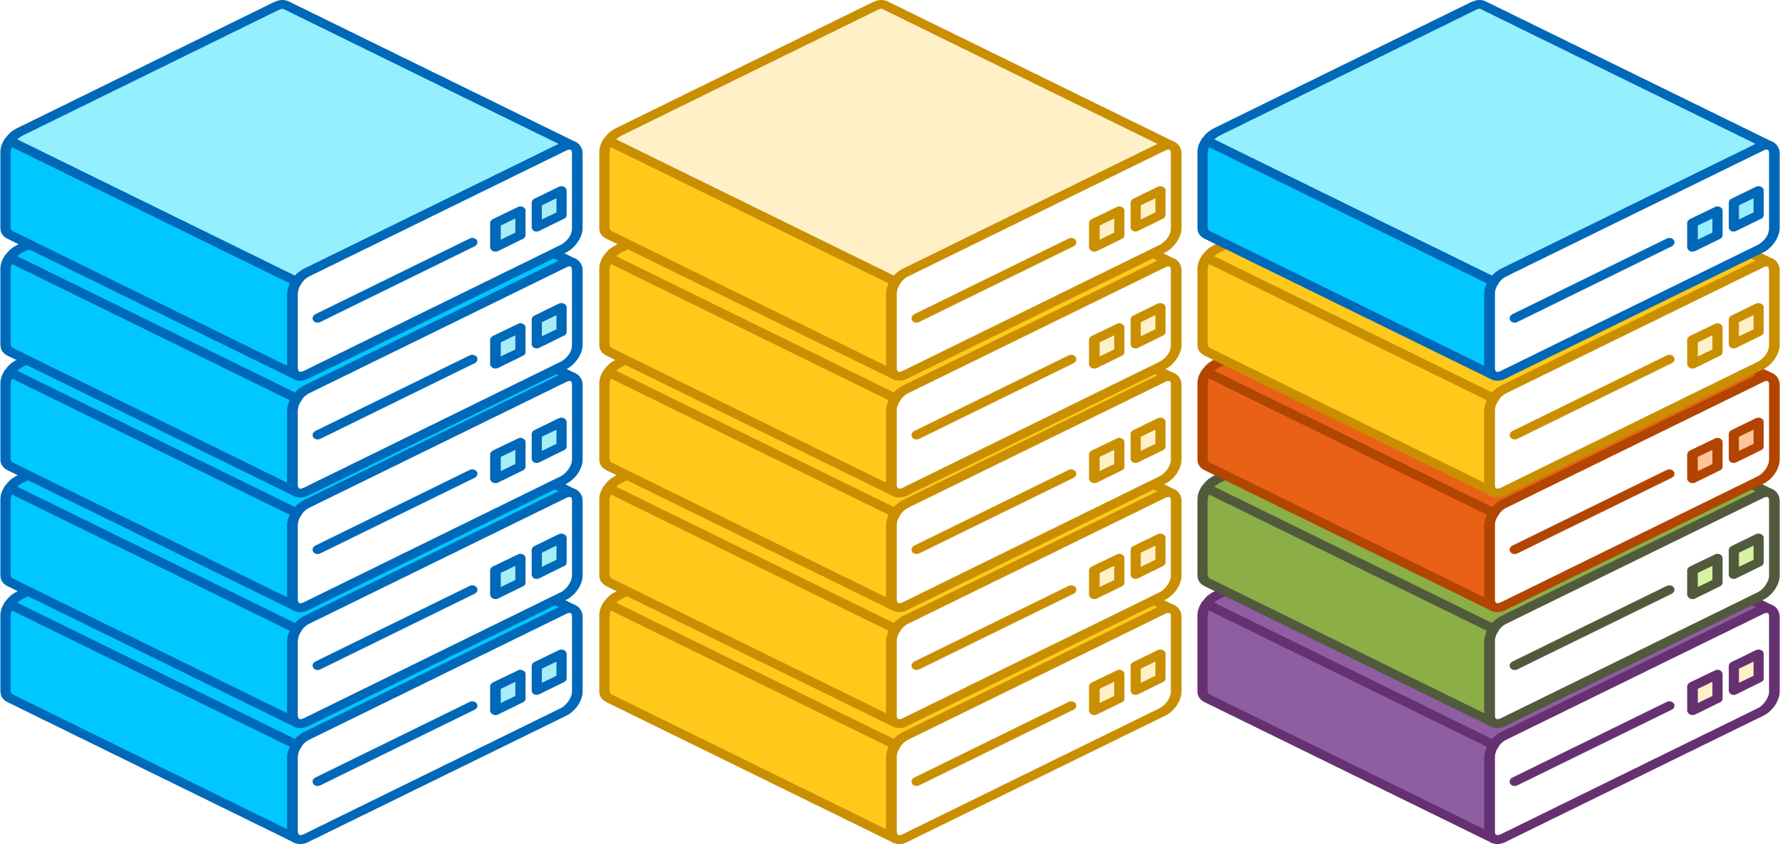
Evolving Heterogeneity
Make this Blue
Make this GPU2 and a different color
CPU Rack
CPU Rack + CPU/GPU Rack
CPU Rack + GPU Rack + Pools of:
CPU
GPU
AI Accel
FPGA
ASIC
A traditional general-purpose AI/HPC rack or cluster system
Accelerated, but
Fixed ratio of CPU & GPU
Accelerated resource may be constrained by
datacenter design
Dynamically access pools of optimal accelerator that can include CPU, GPU, AI Accelerator, FPGA, and Other Specialty Accelerators
Soon developers will have to program to choose
the right device to execute in a multi accelerator system

Slide 28







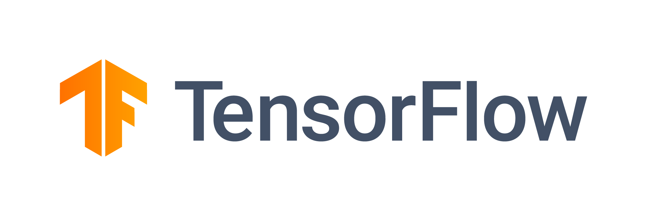







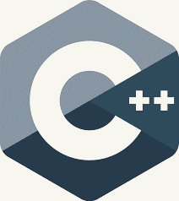



Domain-Specific Software Portfolio
Finance
Industrial and Energy
Generative Content
Automotive
Telecom
Computational Science
Healthcare
Media
MLOps
Cnvrg.io
Reference Implementations
Intel® Developer Catalog
Developer Sandbox
Intel® Developer Cloud
Cloud Services
>
Accenture
AI
HPC
Rendering
Data Analytics at Scale
Distributed Computing
High Fidelity Graphics
DL Inference and Training
Analysis Tools
Visualization/
Visual Compute
Intel®
Neural Compressor
Classical ML
MPI/Fortran
Ray Tracing
Powered by oneAPI
Performance Libraries
oneMKL
oneDNN
oneDAL
oneCCL
oneTBB
oneDPL
oneVPL
Tools
Direct Programming
Hardware Interface
DPC++
We want the software we develop to be your competitive advantage
CPU
GPU
FPGA
ACC
Developer Productivity, Application Performance, and Hardware Value

