Slide 1
TACC Center UPDATE
IXPUG17
Dan Stanzione
Executive Director
Austin, TX
dan@tacc.utexas.edu

Slide 2
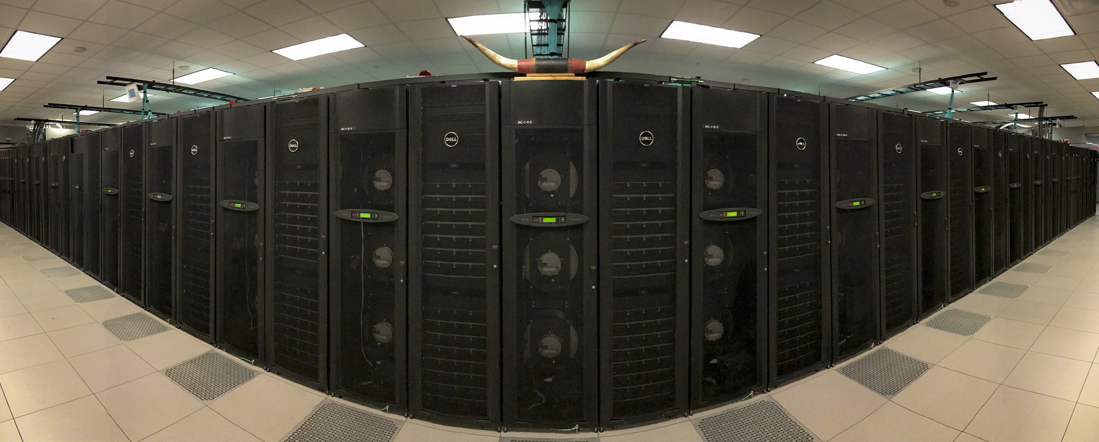
Stampede 2
Funded by NSF as a renewal of the original Stampede project.
The largest XSEDE resource (and largest university-based system).
Follow the legacy of success of the first machine as a supercomputer for a *broad* range of workloads, large and small.
Install without ever having a break in service – in the same footprint.

Slide 3
Stampede 2 -- Components
Phase 1
4,204 Intel Xeon Phi ”Knights Landing” (KNL) Processors (Intel and Dell)
~20PB (usable) Lustre Filesystem (Seagate), 310GB/s to scratch.
Intel Omnipath Fabric – Fat Tree.
Ethernet fabric and (some) management infrastructure.
Phase 2
1,736 Intel Xeon (Sky Lake) Processors
(Associated networking, but core in phase 1).
Balance of management hardware.
Phase 3
3D Crosspoint DIMMS as an experimental component in a small subset of the system.

Slide 4
Stampede “1.5”
Beginning in May 2016, we added 508 complete KNL compute nodes to the existing system.
Same SKU that eventually went into Stampede 2.
Also used OPA fabric
Intel “reference boxes”, no Dell products in that timeframe.
First public KNL system (ranked #116 on Top 500).
By deployment time, Stampede 2 was committed.

Slide 5
Stampede “1.5” (cont.)
Once S-2 was publicly announced, “1.5” became the “development platform” for S-2.
Allow us to prepare and tune a working system software stack (though a fast-moving target).
Build expertise in-house in building, tuning, and supporting KNL applications.
Give the user community some actual time to prepare for Stampede-2 on the correct platform!!!
With Stampede-1, start of production was first access to KNC for almost all users.
Adapt to new memory modes – a large challenge (more on this later!).
And we also got some more capacity during the “swing” phase.
1.5 was available for users from August (2016) through May, when the nodes were moved, re-cabled, and integrated into Stampede-2.

Slide 6
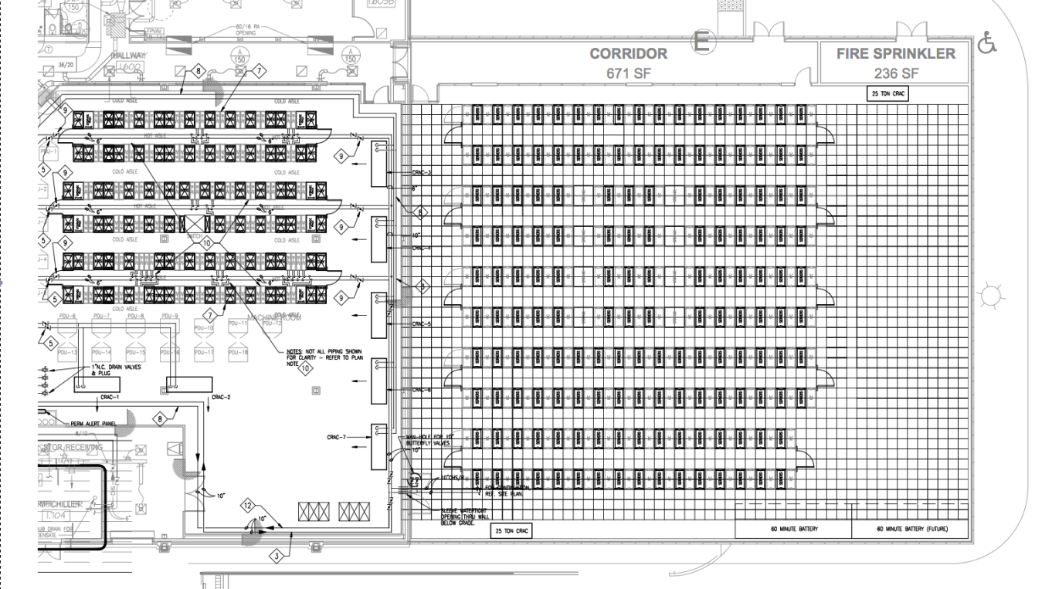
Stampede Footprint
Ranger
Stampede
8000 ft²
~10PF
6.5 MW
3000 ft2
0.6 PF
3 MW
Machine Room Expansion
Added 6.5MW of additional power
Notes:
Mention hot aisle containment

Slide 7
Stampede Footprint
Ranger
Stampede
Stampede-2 Phase 1
8000 ft²
~10PF
6.5 MW
3000 ft2
0.6 PF
3 MW
Machine Room Expansion
Added 6.5MW of additional power
Notes:
Mention hot aisle containment

Slide 8
Hardware Overview
Stampede 2 Phase 1 compute nodes
924 Dell C6320P chassis, 4 nodes per chassis
3,696 total compute nodes
Intel Xeon Phi 7250 CPU, 68 cores, 1.4GHz
96 GB (6x16GB) 2400MHz DDR4
200 GB SSD
Redundant 1600W power supplies
126 Intel PCSD chassis, 4 nodes per chassis
508 total compute nodes
Intel Xeon Phi 7250 CPU, 68 cores, 1.4GHz
96 GB (6x16GB) 2400MHz DDR4
120 GB SSD

Slide 9
Early results
Yifeng Cui at SDSC has sped up SCEC’s primary code to get a 5x performance improvement over Haswell (competitive for a P100).
Martin Berzins’ team at Utah has scaling the UINTAH combustion code, outperforming Titan on the original version, and showing algorithmic improvements that can yield even more.
Rommie Amaro at SDSC is using KNL to investigate the structure, function, and dynamics of complex biological systems.
Omar Ghattas and team have recently ported in the Gordon Bell winning code from 2015 and a finalist from 2013, with good results.
George Biros has a fast solver that achieves 1.4TF per node – and scales!
Dan Bodony at Illinois is doing a massive study of for Prediction and Control of of Compressible Turbulent Flows (request equivalent to all KNL nodes for 3 months).
Real Time severe storm prediction with Ming Xue at Oklahoma has migrated to Stampede-2
New R benchmarks have been published by IU Colleagues– with KNL reference data.
Our software defined visualization stack supported six teams in a workshop in the early science phase coupling visualization to simulation – including Stephen Hawking’s team at Cambridge.

Slide 10
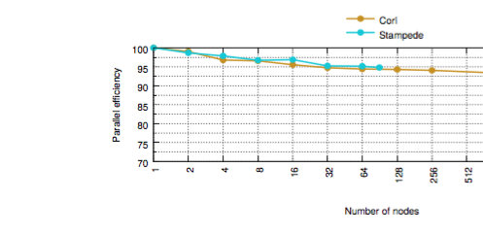
Omnipath Scaling
Seems just fine
comparison to KNL-Cray at NERSC, just to 128 nodes (on a seismic code).
From an ISC paper by Yifeng Cui, didn’t have higher node counts up in time to publish

Slide 11
Early Results --Generalizations
Everything runs, but. . .
Carefully tuned codes are doing pretty well, but with work.
“Traditional” MPI codes, especially with OpenMP in it do relatively well, but not great.
Some codes, particularly, not very parallel ones, are pretty slow, and probably best run on Xeon.
Mileage varies widely – but raw performance isn’t the whole story.

Slide 12
Our Experience with Xeon Phi
Xeon Phi looks to be the most cost and power efficient way to deliver performance to highly parallel codes.
In many cases, it will not be the fastest. For things that only scale to a few threads, it is *definitely* not the fastest.
But what is under-discussed:
As far as I can tell, a Dual-socket Xeon node costs 1.6x what a KNL node costs, even after discounts.
A dual-socket, dual GPU nodes is probably >3x a Xeon Phi node.
A KNL node uses about 100 less watts per node than a dual-socket Xeon node.

Slide 13
Power from Top 500
List unveiled in June at ISC17 in Frankfurt
Stampede-2 uses half the power of a roughly equivalent performance system (see 11 vs 12)

Slide 14
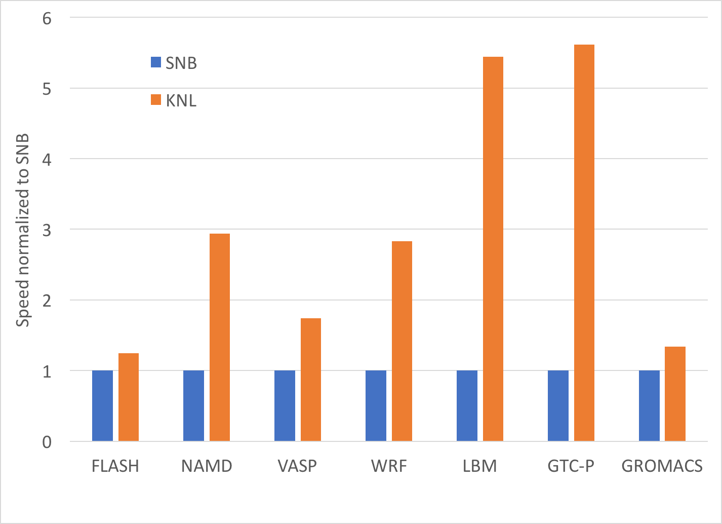
Reference Application Graph
Measured Performance between Stampede and Stampede-2 nodes.
Codes are unmodified versions, as checked out from the source repository, to accurately reflect the “average user” experience.
(There is nothing less fair than comparing optimized codes on one platform to un-optimized codes on a different platform )

Slide 15
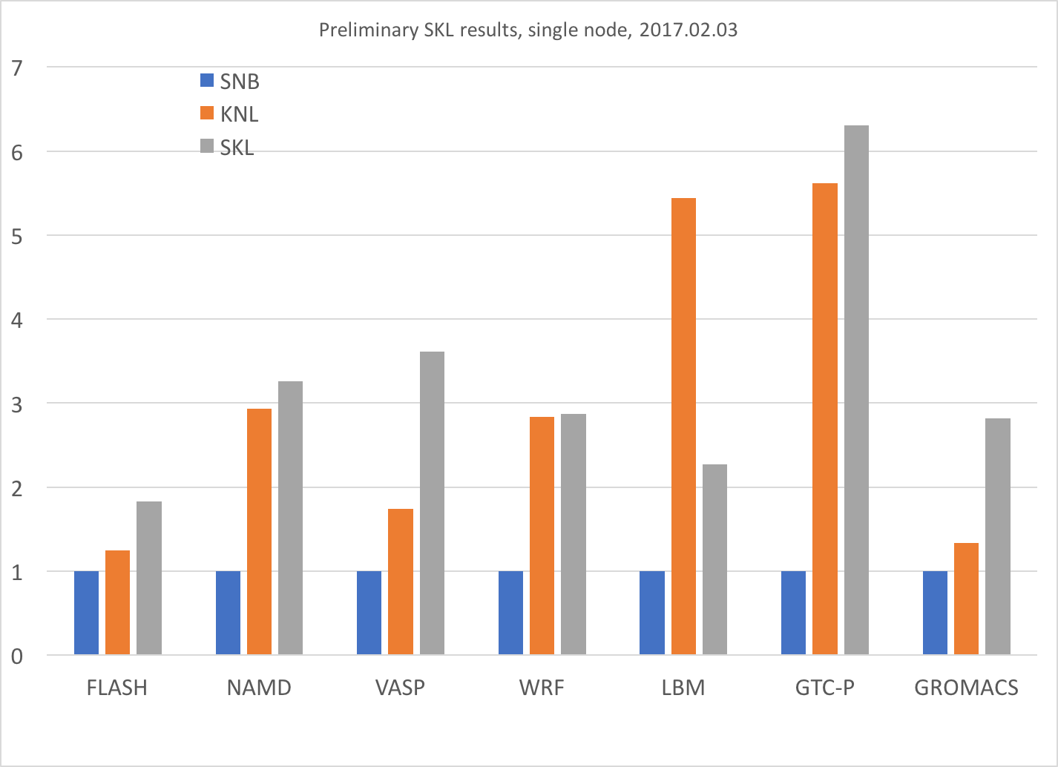
Reference Application Graph

Slide 16
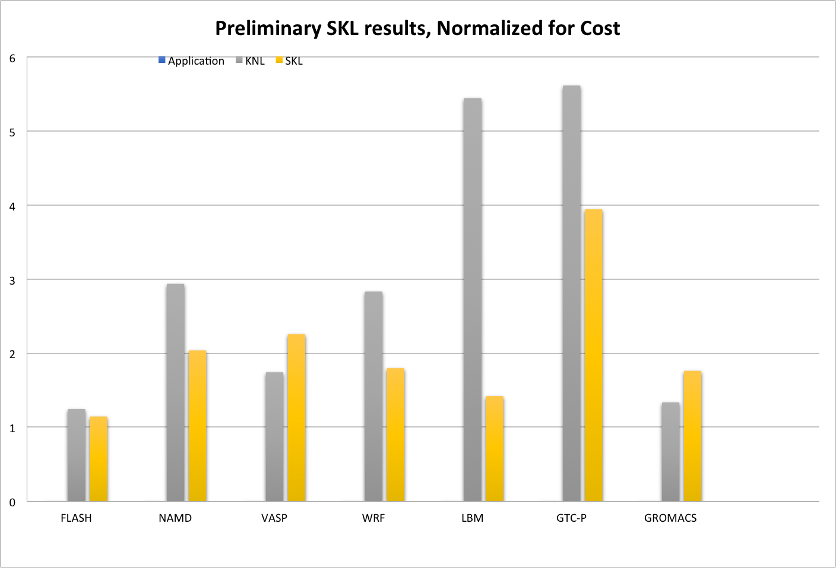
Reference Application Graph –Normalized for Cost
This compares Xeon Phi Performance on major parallel applications to our projections for “Sky Lake”, the next generation Xeon, in a dual-socket configuration with top bin parts.
The KNL wins on price-performance in many applications with *no* optimization (but not always in absolute performance!).

Slide 17
Our Experience with Xeon Phi
Xeon Phi looks to be the most cost and power efficient way to deliver performance to highly parallel codes.
Is “fastest” our only metric? Are we maximizing for an individual user, or most Science &Engineering computing output for the amount of investment?
In straight Xeon, we would have had at least a thousand less nodes.

Slide 18
TEAM
Literally, everyone at TACC!!! – and a lot of folks at Dell, Intel, and Seagate – and our academic partners.
Co-Pis : Tommy Minyard, Bill Barth, Niall Gaffney, Kelly Gaither.
Deployment, Ops, Security:
Laura Branch, Dennis Byrne, Sean Hempel, Nathaniel Mendoza, Patrick Storm, Freddy Rojas, David Carver, Nick Thorne, Dave Cooper, Frank Duomo, Je’aime Powell, Peter Lubbs, Sergio Leal, Jacob Getz, Lucas Nopoulos, Garland Whiteside, Matthew Edeker, Dave Littrell, Remy Scott
HPC, Data, Vis, and Life Sciences App support
John Cazes, Cyrus Proctor, Robert McLay, Ritu Arora, Todd Evans, Si Liu, Hang Liu, Lars Koersterke, Victor Eikhout, Lei Huang, Kevin Chen, Doug James, Antonio Gomes, Kent Milfeld, Jerome Vienne, Virginia Tueheart, Antia Limas-Lanares, John McCalpinWeijia Xu, Chris Jordan, David Walling, Siva Kula, Amit Gupta, Maria Esteva, John Gentle, Suzanne Pierce, Ruizhu Huang, Tomislav Urban, Zhao Zhang, Paul, Navratil, Anne Bowen, Greg Foss, Greg Abram, Jaoa Barbosa, Luis Revilla, Craig Jansen, Brian McCann, Ayat Mohammed, Dave Semararo, Andrew Solis, Jo Wozniak, Joe Allen, Erik Ferlanti, Brian Beck, James Carson, John Fonner, Ari Kahn, Jawon Song, Matt Vaughn, Greg Zynda,
Education, Outreach, Training
Rosie Gomez, Joon-Yee Chuah, Dawn Hunter, Luke Wilson, Jason Allison, Charlie Dey
Web Services
Maytal Dahan, Steve Mock, Rion Dooley, Josue Coronel, Alex Rocha, Carrie Arnold, David Montoya, Mike Packard, Cody Hammock, Mike Keller, Joe Stubbs, Tracy Brown, Rich Cardone, Steve Terry, Andrew Magill, Joe Meiring, Marjo Poindexter, Juan Ramirez, Harika Gurram
User Support, PM, Admin
Chris Hempel, Natalie Henriques, Tim Cockerill, Bryan Snead, Janet Mccord, Dean Nobles, Susan Lindsay, Akhil Seth, Bob Garza, Marques Bland, Karla Gendler, Valori Archuleta, Suzanne Bailey, Paula Baker, Janie Bushn, Katie Cohen, Sean Cunningham, Aaron Dubrow, Dawn Hunter, Shein Kim, Hedda Prochska, Jorge Salazar, Matt Stemalszak, Faith Singer, Arleen Umbay, Valerie Wise, Ashley Bucholz, Melyssa Fratkin, Manu John, John West

Slide 19
Thanks! Dan Stanzione dan@tacc.utexas.edU

